Slide 1
IμBEAM
The Interagency Modeling and Analysis Working Group on
Integrated Multiscale Biomaterials Experiment and Modeling
2017 Annual Report
Markus Buehler, MIT Guy Genin, Washington University
https://www.imagwiki.nibib.nih.gov/content/integrated-multiscale-biomaterials-experiment-and-modeling-group-imubeam
Notes:
Add agency logos

Slide 2
Markus Buehler (MIT), working group co-lead
Guy Genin (WUSTL), working group co-lead
Mark Alber (Notre Dame)
Mark Bathe (MIT)
David Breslauer (Refractored Materials)
Ioannis Chasiotis (UIUC)
Changqing Chen (Tsinghua)
Horacio Espinosa (Northwestern)
Jeff Holmes (Virginia)
Iwona Jasiuk (UIUC)
Songbai Ji (Dartmouth)
David Kaplan (Tufts)
Roland Kaunas (Texas A&M)
Spencer Lake (WUSTL)
Bob Latour (Clemson)
CT Lim (National University of Singapore)
Reza Mirzaeifar (Virginia Tech)
Vicky Nguyen (Johns Hopkins)
Pedro Ponte Castañeda (UPenn)
Paolo Provenzano (Minnesota)
Vivek Shenoy (University of Pennsylvania)
Stavros Thomopoulos (Columbia)
Mark Van Dyke (Wake Forest)
Jeff Weiss (Utah)
Tony Weiss (U. Sydney)
Joyce Wong (BU)
Feng Xu (Xi'an Jiaotong)
Michael Yu (Johns Hopkins)
Sulin Zhang (Penn State)
Goals and Objectives:
This WG aims to provide an active forum to foster, report and assess interactions between experimental and computational groups engaged in the design, synthesis and testing of hierarchical biomaterials. Key issues to be explored are to identify common approaches, tested methods and validation steps, and to develop ways to make maximum impact in the medical community. We also anticipate sharing activities such as the organization of conferences and workshops, and tutorials. Our vision is that the discussions lead to a set of tools, data, software, training and related products for the broader community. The membership of this WG is diverse and brings together a group of people who do not regularly interact.
We work on joint workshops, symposia, organize webinars, and promote the close integration of biomaterials experiment and modeling in diverse scientific communities.
The IμBEAM working group (WG) was founded to identify and develop guiding principles for designing multi-scale experiments and simulations that simultaneously inform and guide each other. The WG employs an integrated case study approach and inductive inference.

Slide 3
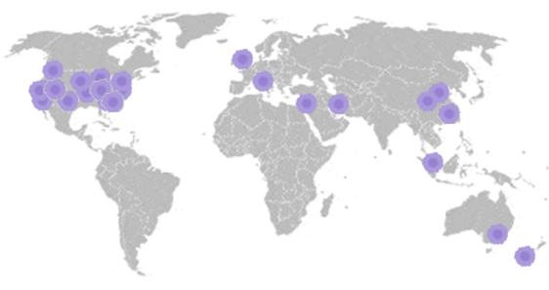
IμBEAM Membership

Slide 4
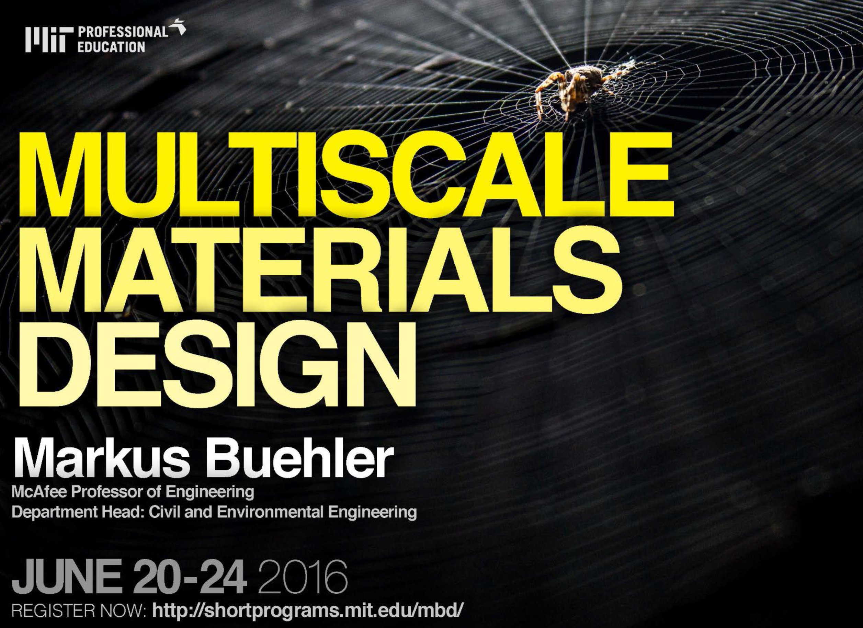

Slide 5
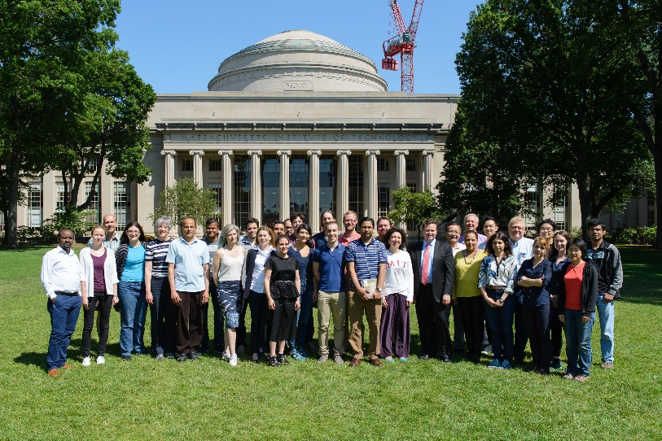
Multiscale Materials Design
MIT Short Course
One-week bootcamp on multiscale modeling, design, manufacturing of biomaterials
As the demand for high-performance materials with superior properties, flexibility and resilience grows, a new design paradigm from the molecular scale upwards has revolutionized our ability to create novel materials. This course covers the science, technology, and state-of-the-art in atomistic, molecular, and multiscale modeling, synthesis, and characterization.
Through lectures and hands-on labs, participants will learn how superior material properties in nature and biology can be mimicked in bioinspired materials for applications in new technology. Bridging vast hierarchies of length- and time-scales, this course trains participants in applications to polymers, metals, biomaterials, and ceramics as well as composites and sustainable construction materials.

Slide 6



IμBEAM Special Issues

Slide 7


IμBEAM Symposia

Slide 8

IμBEAM workshop

Slide 9

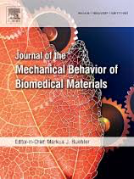
Upcoming…
Theme: Hidden Time and Length-scales

Slide 10



Upcoming…

Slide 11
Focus areas for IμBEAM
More defined scientific focus, 2017-18: Hidden Time and Length-scales
Outreach:
  Targets: K-12, undergraduates, professionals, general public, policymakers
  Vehicles: Social media, apps/javascripts, video/images, protocols papers, codes and standards (ASME)

Slide 12

2017 Short Course

Slide 13
IμBEAM
Watch this space for…
NEMB 2018
ASME IMECE 2018
(Materials Division)
The Interagency Modeling and Analysis Working Group on
Integrated Multiscale Biomaterials Experiment and Modeling
Markus Buehler, MIT Guy Genin, Washington University

