Slide 1
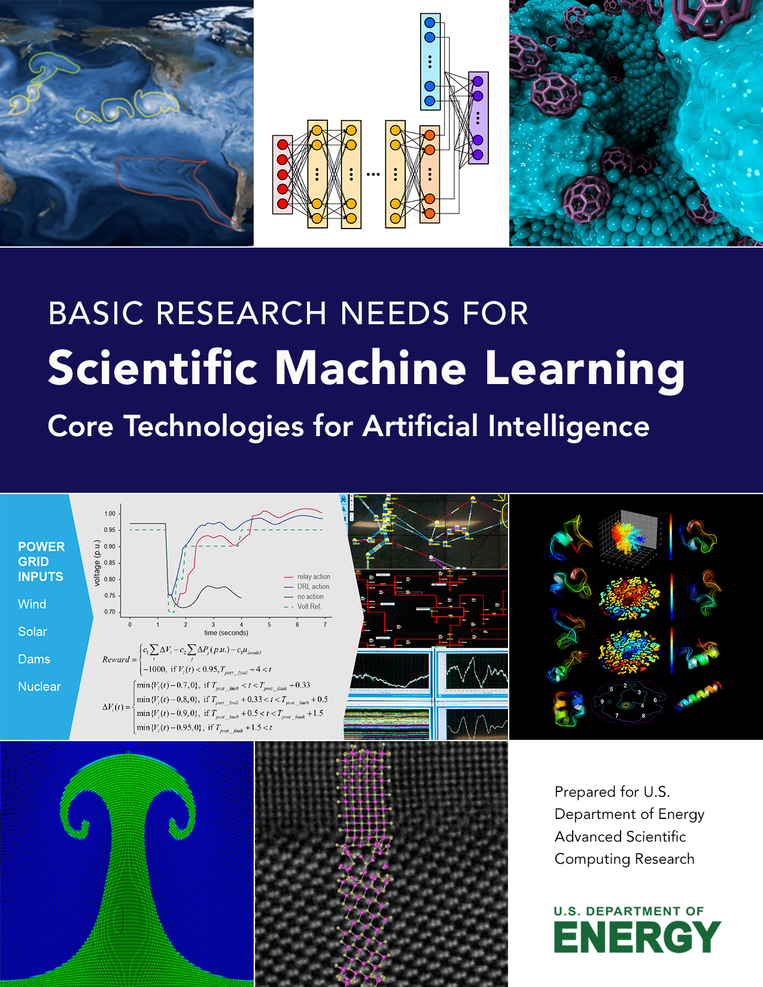
Overview of the ASCR Scientific Machine Learning Basic Research Needs Workshop
Nathan Baker
NIH IMAG Meeting
Report: https://www.osti.gov/biblio/1478744
Brochure: https://www.osti.gov/biblio/1484362

Slide 2
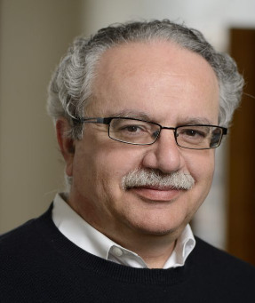
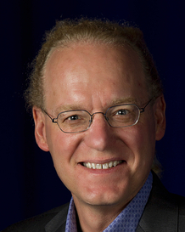
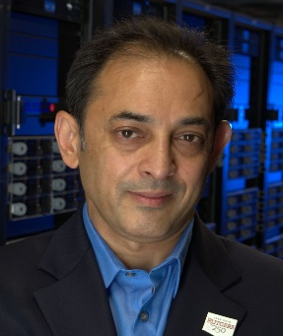
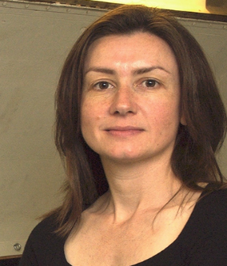
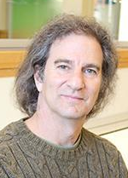
Scientific Machine Learning workshop overview
Workshop held Jan 30 – Feb 1, 2018:
https://www.orau.gov/ScientificML2018/
Program Manager: Steven Lee (DOE ASCR)
Workshop charge:
Consider the status, recent trends, & broad use of machine learning for scientific computing
Examine the opportunities, barriers, & potential for high scientific impact through fundamental advances in underlying research foundations
ASCR grand challenges & resulting priority research directions should span several major machine learning categories & modeling & algorithms research
Identify the basic research needs & opportunities that can enable machine learning-based approaches to transform the future of science and energy research.
2

Slide 3
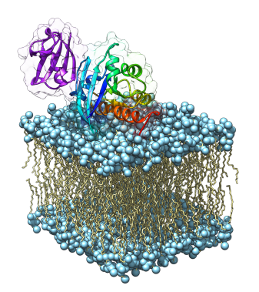
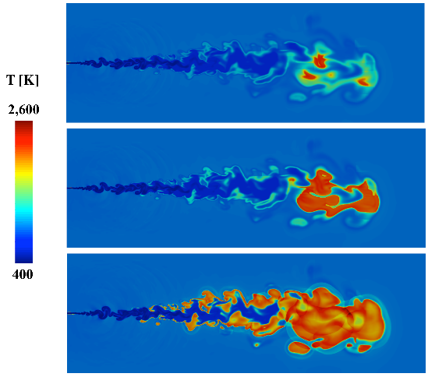
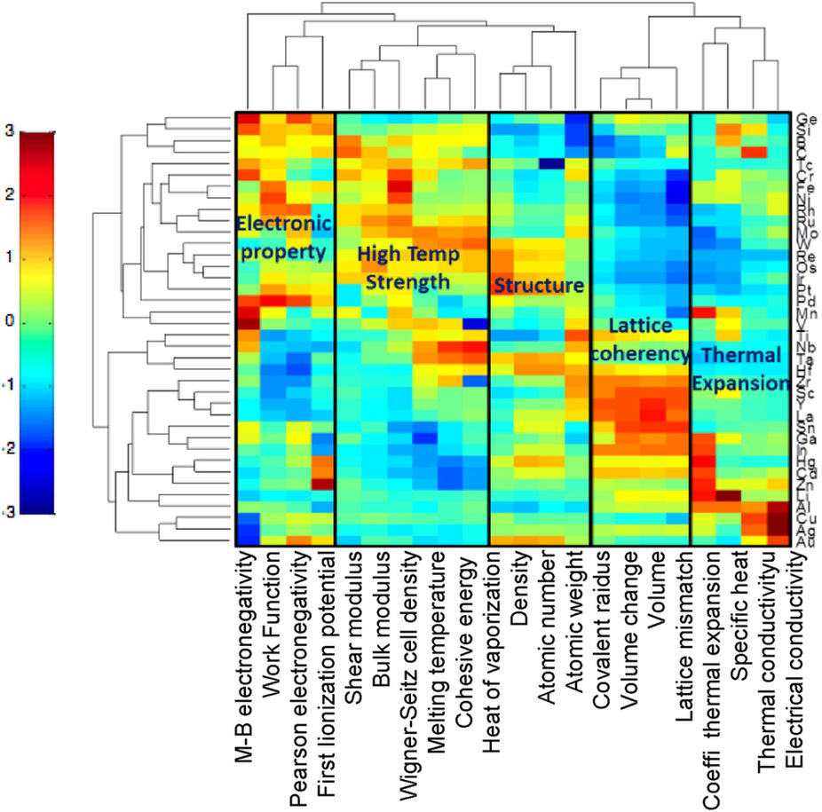
Goal: Define research challenges and directions for scientific machine learning
Machine learning use is on the rise throughout science domains
However, many popular ML methods lack mathematical approaches to understand robustness, reliability, etc.
ASCR Applied Mathematics has a long track record for building mathematical foundations to critical computational tools
Workshop to help ASCR define the grand challenges and priority research directions for scientific machine learning
Timo Bremer, LLNL
CRF, SNL
Krishna Rajan, U Buffalo

Slide 4
BRN process and outcomes
A BES Basic Research Needs-inspired process
Pre-workshop report
Factual status document describing the Scientific Machine Learning (SciML) landscape as it relates to ASCR
Workshop deliverables
Articulation and refinement of grand challenges for SciML
Priority research directions for SciML
Brochure (executive summary)
DOI: 10.2172/1484362
Post-workshop report
Incorporate updated factual status document
Incorporate workshop deliverables
Plenary talks
Highlight status of machine learning, challenges, open questions
Panel discussions
Summarize pre-workshop report
Provide perspectives across DOE ASCR facilities, ECP, and other organizations
Breakout sessions
Organized around ~140 submitted Position Papers presented as flash talks
The “work” in workshop: Crucible for new Priority Research Directions

Slide 5
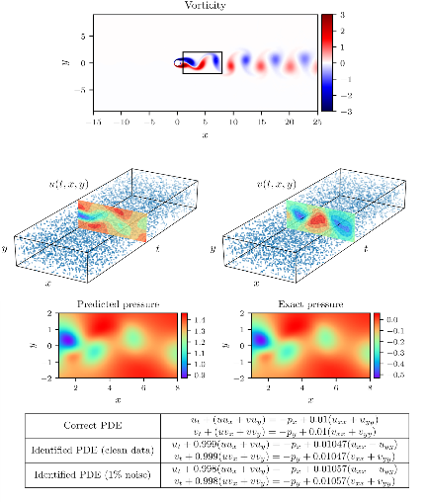
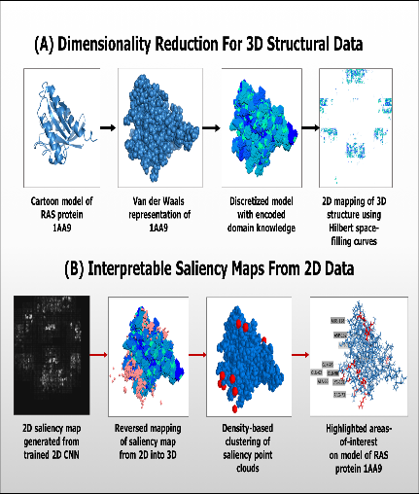
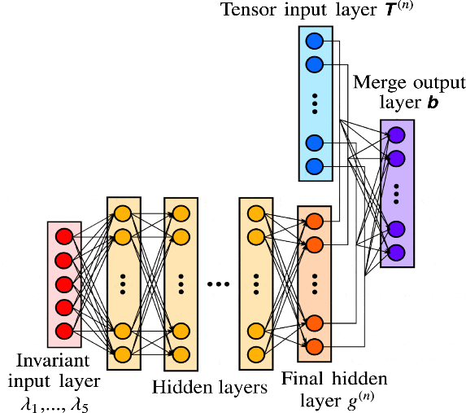
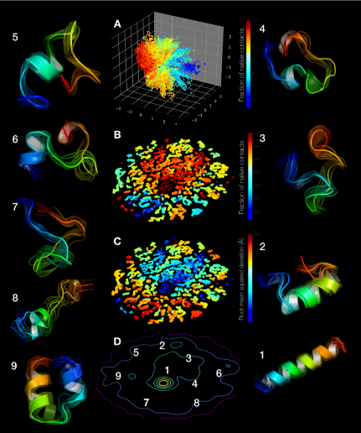
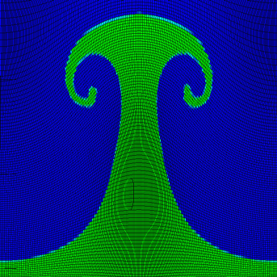
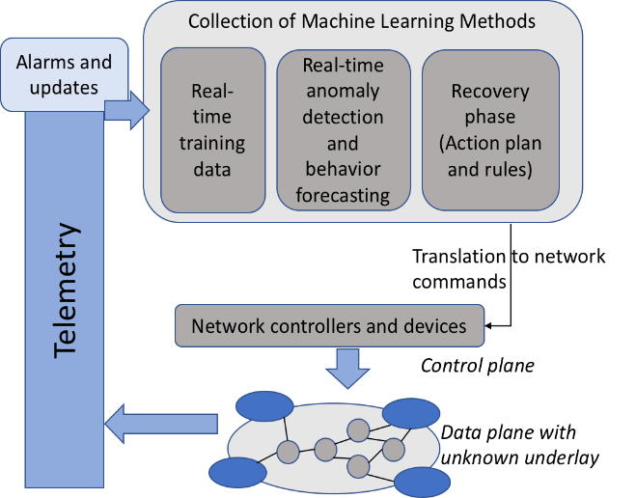
Priority research directions
Foundational themes | Capabilities research
Domain-aware SciML Leveraging scientific domain knowledge | Data-intensive SciML Automated scientific inference & data analysis
Interpretable SciML Explainable & understandable results | Machine learning-enhanced modeling & simulation Models & algorithms enhanced with ML for predictive scientific computing
Robust SciML Stable, well-posed, & efficient formulations | Intelligent automation & decision support Optimization, resilience, and control of complex systems

Slide 6
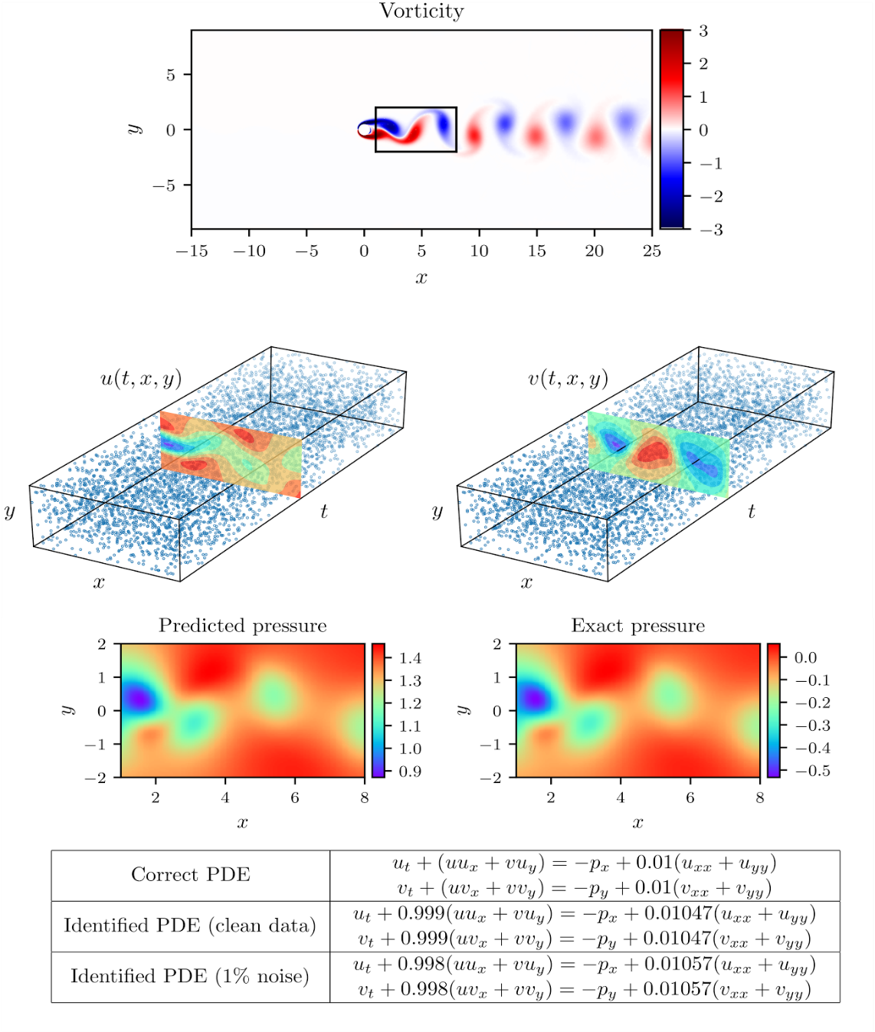
Domain-aware scientific machine learning for leveraging scientific domain knowledge
How can domain knowledge be effectively incorporated into scientific machine learning methods?
Incorporating domain knowledge may dramatically reduce data requirements, accelerate training and prediction, and improve the accuracy and defensibility of scientific machine learning models.
Progress will require new mathematical methods that can account for physical principles, symmetries, uncertainties, and constraints.
This example illustrates the capabilities obtained by incorporating domain knowledge into a deep neural network. Given scattered and noisy data components of an incompressible fluid flow in the wake of a cylinder, we can employ a physics-informed neural network that is constrained by the Navier-Stokes equation in order to identify unknown parameters, reconstruct a velocity field that is guaranteed to be incompressible and satisfy any boundary conditions, as well as recover the entire pressure field. Figure from: Raissi et al.

Slide 7
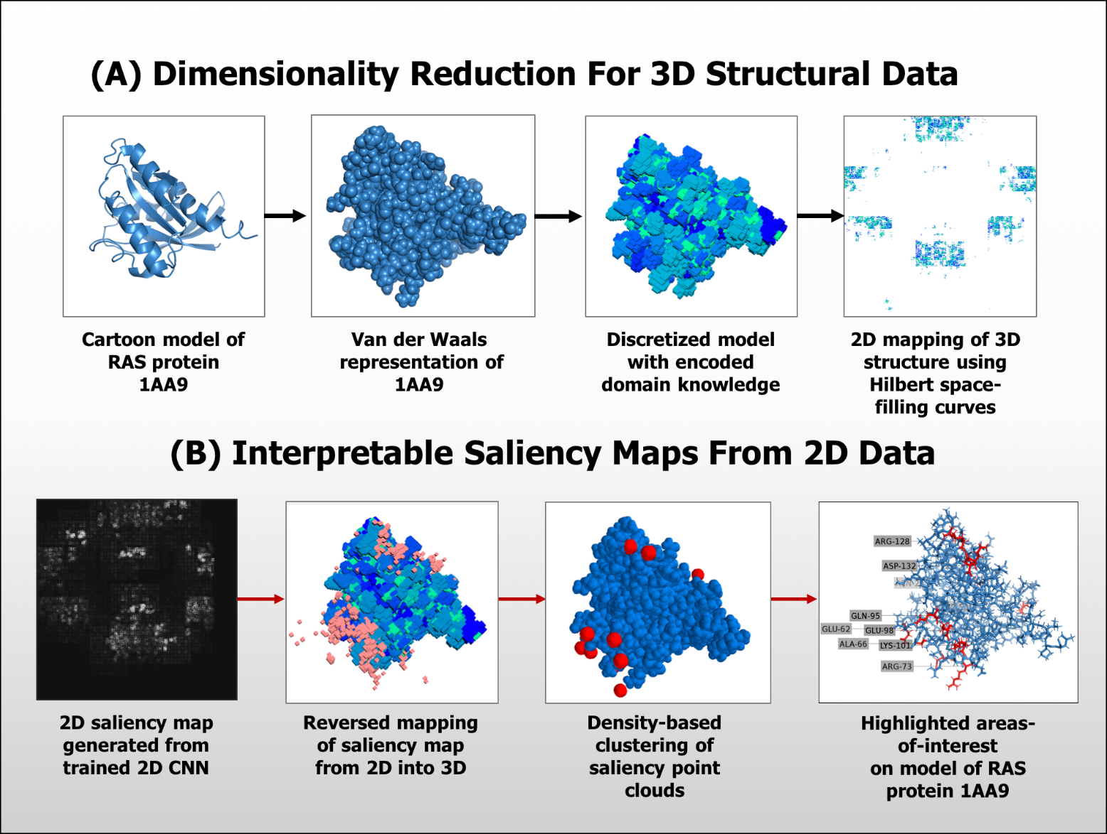
Interpretable scientific machine learning for explainable and understandable results
What is the right balance between the use of increasingly complex machine learning models versus the need for users to understand the results and derive new insights?
Increased integration of domain knowledge into scientific machine learning methods may improve the interpretability of these methods.
Advances will require developing new exploration and visualization approaches to interpret and debug complex models using domain knowledge.
High-level data pipeline overview for dimensionality reduction of 3D protein structures (A) and interpretation of saliency maps from trained CNN model (B). Saliency maps generated from CNN models can then be clustered to identify areas along the 3D structure that are regions that highly influence the output of the CNN model. From these salient regions, specific residues can be identified that fall in close proximity to the salient regions. Image credit: Rafael Zamora-Resendiz and Silvia Crivelli, LBNL.

Slide 8
Robust scientific machine learning for stable, well-posed, and efficient methods
How can efficient scientific machine learning methods be developed and implemented to ensure the results are not unduly sensitive to perturbations in training data and model selection?
Scientific machine learning models are subject to uncertainty in their general form, internal structure, and associated parameters.
To be considered reliable, new approaches must reach the same level of rigor expected of mainstream scientific computing algorithms.
Research will focus on scientific machine learning methods and implementations that are stable, well-posed, and efficient.
In the context of Reynolds averaged incompressible turbulence modeling, a neural network has been used in an eddy viscosity turbulence closure model. From physical arguments, the model needs to satisfy rotational invariance, ensuring that the physics of the
flow is independent of the orientation of the coordinate frame of the observer. A special network architecture, a tensor basis neural network (TBNN), embeds rotational invariance by construction. Without this guarantee, the NN model evaluated on identical flows with the axes defined in different directions could yield different predictions. Image credit: SNL.

Slide 9
Data-intensive scientific machine learning for automated scientific inference and data analysis
What novel approaches can be developed for reliably finding signals, patterns, or structure within high-dimensional, noisy, or uncertain input data?
Scientific machine learning has the potential to reveal valuable information hidden in massive amounts of scientific data from experiments, observations, simulations, and other sources.
ML techniques reveal Fs-peptide folding events from long time-scale molecular dynamics simulations. A low dimensional embedding of the simulation events reveal transitions from fully unfolded states (blue) to fully folded states (red). A two dimensional embedding using t-test stochastic neighborhood embedding shows the presence of near native states (labeled state 1) versus partially unfolded (2-7) and fully unfolded states (8-9) in the picture. Image Credit: Arvind Ramanathan, ORNL.

Slide 10
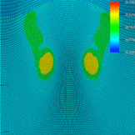
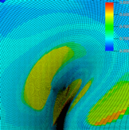
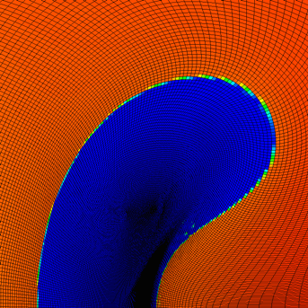
Machine learning-enhanced modeling and simulation for predictive scientific computing
What are the barriers and potential advantages to using scientific machine learning in developing predictive computational models and adaptive algorithms?
Scientific machine learning has the potential to improve the fidelity of reduced-order or sub-grid physics models, automate computational steering, and optimize parameter tuning within multiscale scientific simulations.
The arbitrary Lagrangian-Eulerian (ALE) method is used in a variety of engineering and scientific applications for enabling multi-physics simulations. Unfortunately, the ALE method
can suffer from simulation failures, such as mesh tangling, that require users to adjust parameters throughout a simulation just to reach completion. A supervised ML framework for predicting conditions leading to ALE simulation failures was developed and integrated into a production ALE code for modeling high energy density physics. Image credit: M. Jiang, LLNL.

Slide 11
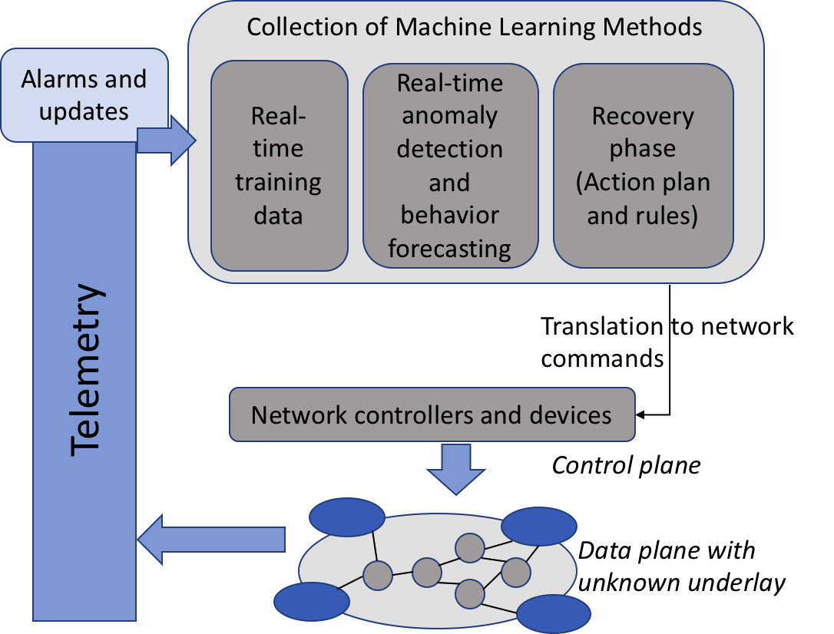
Intelligent automation and decision-support for the management and control of complex systems
What are the challenges in developing scientific machine learning for decision-support and automation of complex systems and processes?
Scientific machine learning has widespread use in improving the operational capabilities of scientific user facilities, communication networks, power grids, or other sensor-equipped infrastructures and complex processes.
Exascale applications are exponentially raising demands from underlying DOE networks such as traffic management, operation scale and reliability constraints. Networks are the backbone to complex science workflows ensuring data is delivered securely and on-time for important compute to happen. In order to intelligently manage multiple network paths, various tasks such as pre-computation and prediction are needed to be done in near-real-time. ML provides a collection of algorithms that can add autonomy and assist in decision making to support key facility goals, without increased device costs and inefficiency. In particular, ML can be used to predict potential anomalies in current traffic patterns and raise alerts before network faults develop. Image credit: Prabhat, LBNL.

Slide 12
Summary and outlook
Machine Learning is a powerful scientific enabling technology
More than Data. Also for Modeling, Complex Systems, Science
Basic research in scientific computing & mathematical foundations is essential
Fast moving area → Need roadmap, blueprint, strategy
Compelling: Re-visit ML, Re-think scientific computing uses
Pump is Primed for DOE leadership
Roots from previous decade(s) of Applied Math basic research
Ready: Researchers & expertise, Professional communities, etc
Future of Science & Energy Research
Advanced technologies: More complex, more heterogeneous
Greater Automation & Adaptivity for research breakthroughs
Scientific Machine Learning Priority Research Directions are a basis for a cross-cutting research initiative toward this future
Notes:
For example, since 2005, the Applied Mathematics program has issued Funding Opportunity Announcements (FOAs) for university and DOE national lab projects that correspond to the following SciML capability research themes:
Data-intensive SciML Mathematics for Analysis of Petascale Data (2009 - 2012) Resilient Extreme-Scale Solvers (2010 - 2013) DOE Data-Centric Science at Scale (2013 - 2016)
Machine learning-enhanced modeling and simulation Multiscale Mathematics Research and Education (2005 - 2008) Multiscale Mathematics for Complex Systems (2008 - 2012) Uncertainty Quantification for Extreme-Scale Science (2013 - 2016)
Intelligent automation and decision support Mathematics for Complex, Distributed, Interconnected Systems (2009 - 2012) Uncertainty Quantification for Complex Systems (2010 - 2013) Mathematical Multifaceted Integrated Capability Centers (2012 - 2017; 2017 - 2022)
The SciML foundational research themes (domain-awareness, interpretability, robustness) also build on other leading-edge research areas sustained in the Applied Mathematics base program e.g., optimization, linear algebra, partial differential equations, multilevel methods, numerical analysis, and so on. The projects and advances supported by the above funding ensures that the “pump is primed” for engaging a broad community of researchers with the expertise needed to develop transformative SciML capabilities.

Slide 13
Next steps
We would like your input:
What community activities should we be pursuing to explore these priority research directions?
What additional research topics are associated with these priority research directions?
Other questions or items we should be discussing regarding SciML?
Report: https://www.osti.gov/biblio/1478744
Brochure: https://www.osti.gov/biblio/1484362

