Slide 1
Promoting Credible Practice of Modeling & Simulation in Healthcare
https://simtk.org/home/cpms
Lealem Mulugeta, Ahmet Erdermir and Joy Ku
On Behalf of the Committee
2017 IMAG Multiscale Modeling Consortium Meeting
HAPPY 10th anniversary!!!
Friday March 24, 2017

Slide 2
Overview of the Committee
2010-12: The IMAG/MSM community expressed a need for methods and processes that can help gain the confidence of end-users (e.g. clinicians) in computational methods for healthcare research and application
2013: Committee on Credible Practice of Modeling & Simulation in Healthcare was established under the IMAG/MSM to address this need
The Committee’s Charge
Develop Guidelines & Procedures for Credible Practice
Demonstrate Workflows of Credible Practice
Establish Consistent Terminology
Promote Good Practice
End Products
“Guidelines for Credible Practice of M&S in Healthcare”
Proposed model certification process
Identify new areas of research to advance I & II

Slide 3
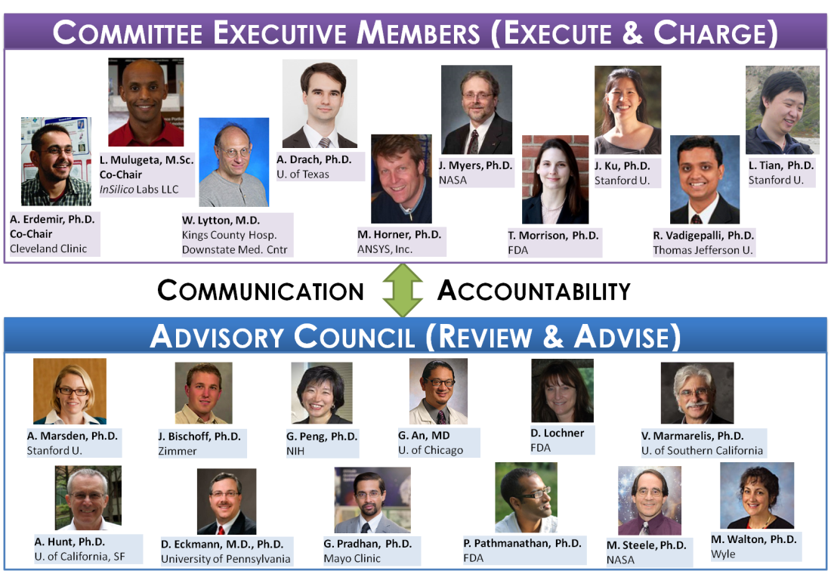
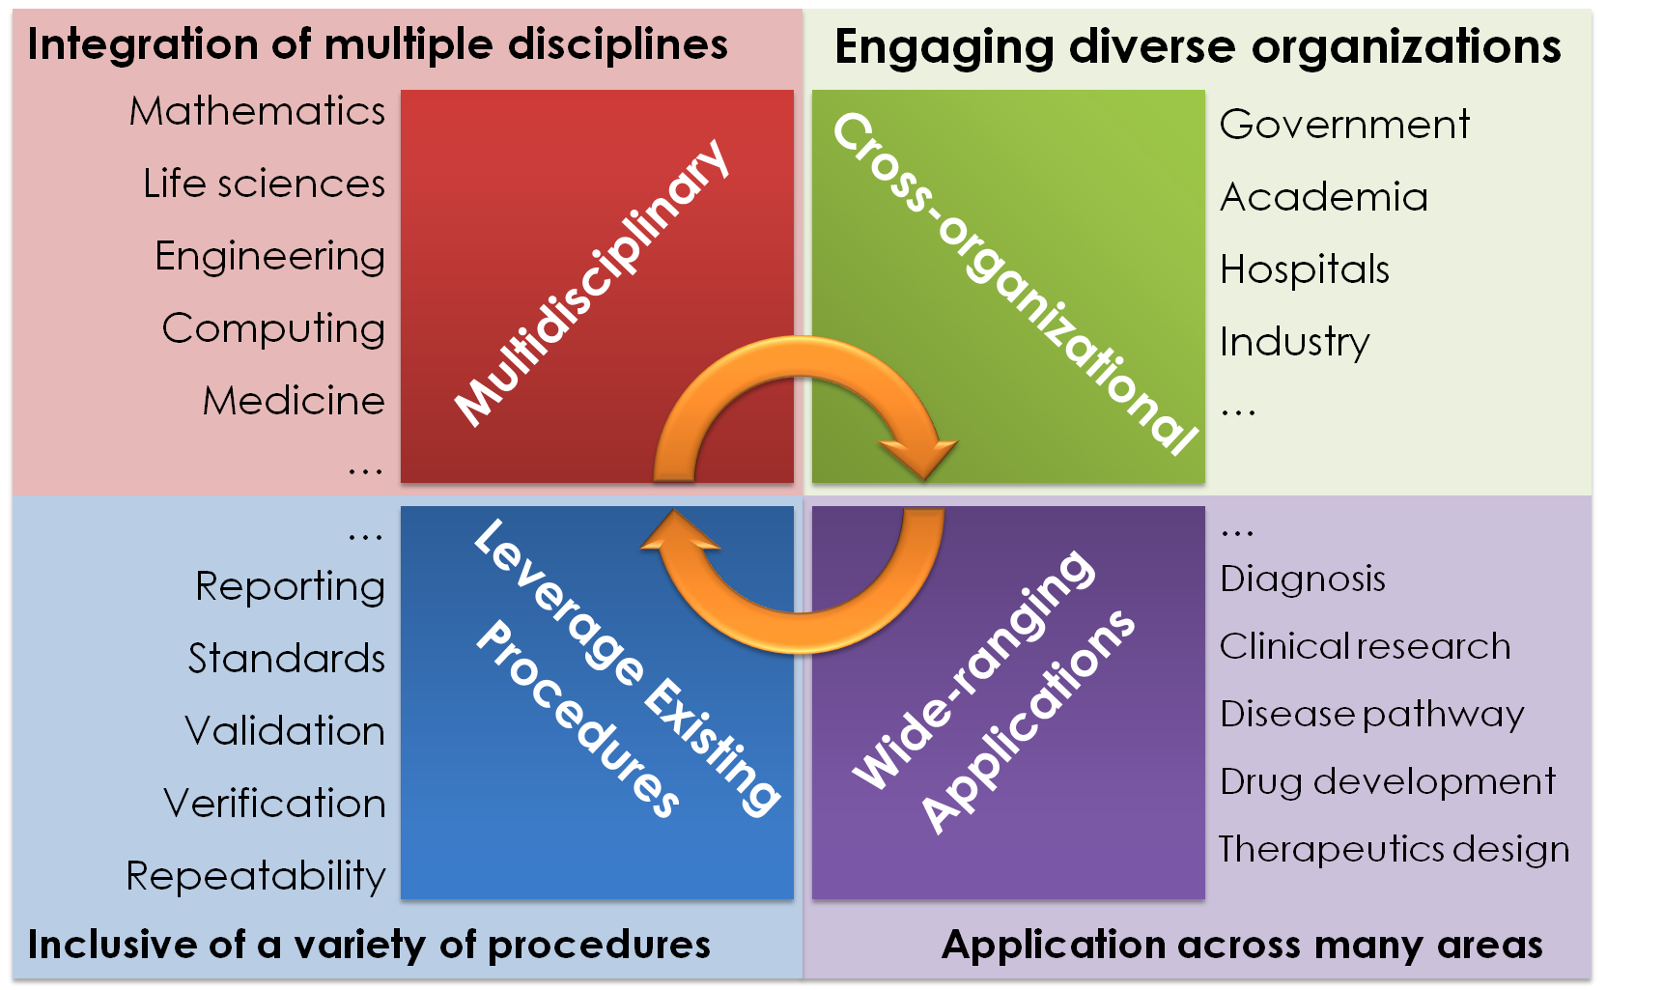
Execution Strategy and Current Progress
The Committee’s “Ten Simple Rules of Credible Practice of M&S in Healthcare”.
Rule 1 | Define context clearly | Rule 6 | Document adequately
Rule 2 | Use appropriate data | Rule 7 | Disseminate broadly
Rule 3 | Evaluate within context | Rule 8 | Get independent reviews
Rule 4 | List limitations explicitly | Rule 9 | Test competing implementations
Rule 5 | Use version control | Rule 10 | Conform to standards
See Poster #1 for more details
Guidelines for Credible Practice of Modeling and Simulation in Healthcare

