Slide 1
Population level models for behavioral and social sciences
PI Leads: David Basanta, PhD, Bruce Y. Lee, MD MBA, Ching-Long Lin, PhD
IMAG POCs: Liz Ginexi, PhD, Greg Bloss, MA, MPP, Regina Bures, PhD

Slide 2
Challenges 11-17
What has been accomplished in these Challenges?
What exactly are the methodologies that were developed?
Describe the newly developed methodologies for:
bridging scales
addressing sparse data
simulating across scales
addressing uncertainty quantification
How have these methodologies impacted each field?
Have they changed the questions or approaches in the field?
Have new theories resulted from this work to improve the understanding of the problems in the field?
What still needs to be done for these challenges?
Are there methods from other fields that should be applied to your field?
What further connections need to be made to address unmet needs?
What questions do you want to pose to the MSM Consortium related to these challenges?
IMAG

Slide 3
A Reminder of Challenges 11-17
11. Mechanistic multiscale models that bridge to the population level to capture more clinical and biological realism for the population
12. Models that generate testable hypotheses regarding the biological underpinnings of behavioral and social phenomena and processes at the individual and population level
13. Models that describe mechanisms through which “outside-the-skin” factors, such as behavioral stressors, social bonding, parenting behavior, etc., can lead to “inside-the-skin” changes, such as in gene expression, the microbiome, or other factors that affect health or behavior
14. Models that provide innovative characterizations of interactions between individual-level behaviors, cognition, or affective processes and group-, market-, or population-level outcomes
15. Models to explore underlying mechanisms of individual-, community-, or population-level preventive or therapeutic interventions
16. Novel computational modeling approaches for big data that account for simultaneous sources of data on multiple scales; from biological and physiological measures, to social and psychological variables, and to environmental or contextual or societal level factors
17. Multiscale models that characterize the implications of individual-level risks for collective outcomes, or the implications of systemic risks for individual behaviors and outcomes

Slide 4
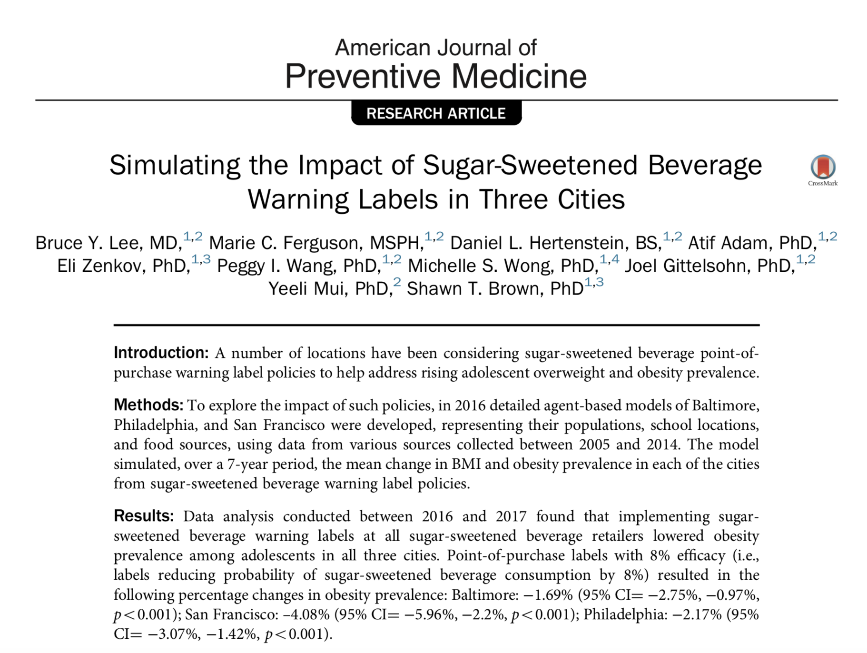
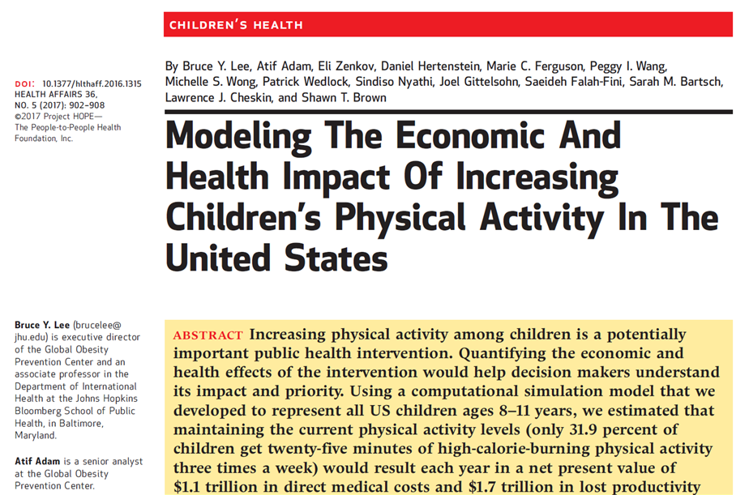
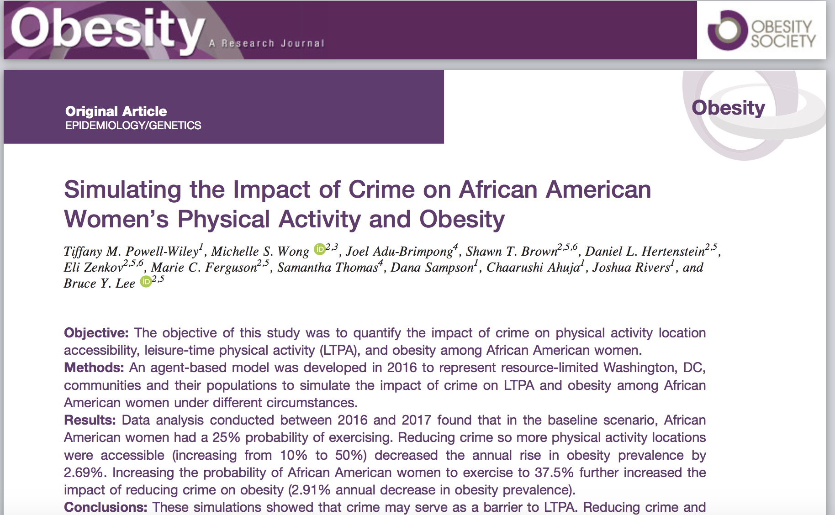
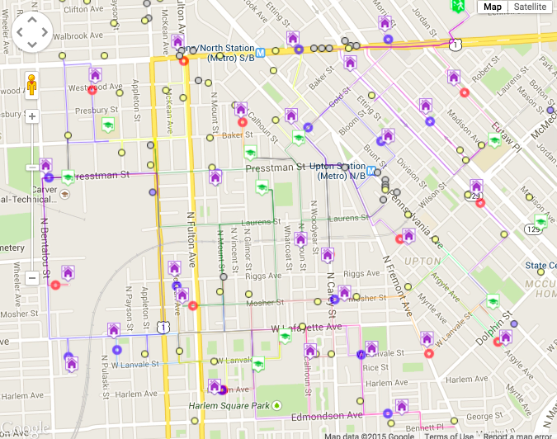
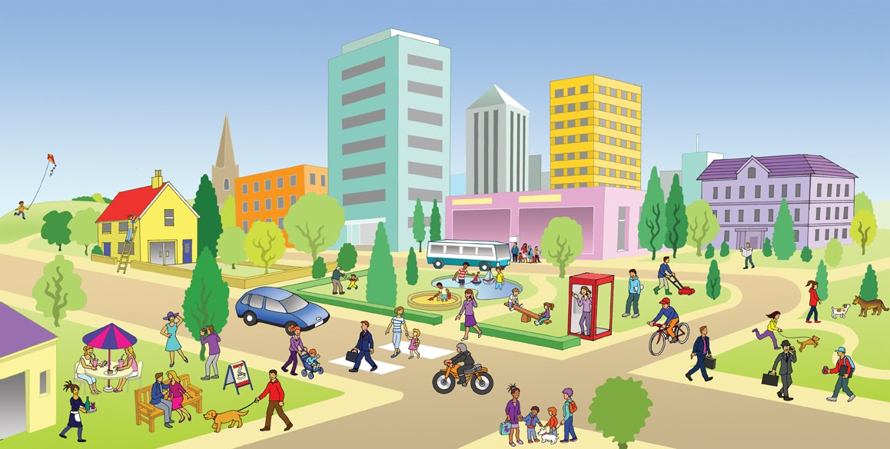
Virtual Population Obesity Prevention (VPOP) Labs: “SimCity” for obesity prevention
Notes:
Agent-based model (ABM)
Time step: one day
Each person represented by a computational agent
Gender
Age
Body mass index
Health-to-non-healthy food preference ratio
Virtual representations of homes, schools, food sources, and physical activity locations

Slide 5
An integrative statistics-guided image-based multi-scale lung model Ching-Long Lin, University of Iowa, NIH U01 HL114494
(Hypothesis) There exist sub-populations with homogeneous lung structural and functional characters (viz. clusters) among healthy, asthma and COPD populations.
(Done) We developed a Multiscale Imaging-based Cluster Analysis (MICA) for clustering healthy, asthma and COPD populations. The three major challenges that we have overcome to utilize large data sets acquired by NIH-funded multi-center trials:
inter-subject variability (due to, for example, gender, age and height),
inter-site variability (due to scanner and imaging protocol differences), and
definition of novel quantitative CT (QCT) imaging-based metrics at multiple scales (due to alterations at different disease stages) needed for machine learning.
(Impact) Cluster membership allows bridging individual and population scales toward precision medicine.

Slide 6
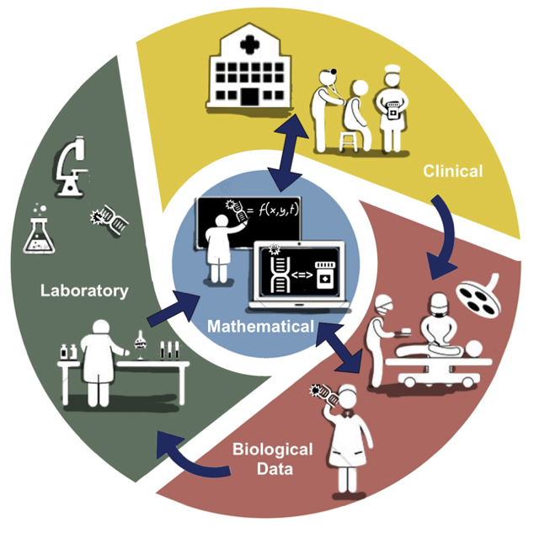
Multiscale Modeling of Bone Environment in Metastatic Prostate Cancer
Bone-Metastatic Prostate Cancer
in silico Mathematical Modeling
Public Literature Search
Bench-top in vitro and in vivo Experimentation
Monocyte Recruitment
Pro-inflammatory
Polarization
Anti-inflammatory
Polarization
Inflammatory Macrophages
Monocyte Macrophages
Bone Macrophages
Anti-Inflammatory Macrophages
Osteoclastogenesis
Differentiation
Maturation
Osteoclast
MSC and OB Precursors
BMP
MMP
MMP
Osteoblast
Injury
MMP
BMP
Osteogenesis
Osteolysis
11. Mechanistic multiscale models that bridge to the cell population level
12. Models that generate testable hypotheses regarding the biological underpinnings of tissues
15. Models to explore underlying mechanisms of individual-, community-, or population-level preventive or therapeutic interventions
16. Novel computational modeling approaches that account for simultaneous sources of data on multiple scales; from biological and physiological measures, to social and psychological variables, and to environmental or contextual or societal level factors

Slide 7
What still needs to be done for these challenges?
Initial examples of approaches and models addressing each challenge
Develop representations of other pathways connecting population scale with other scales.
Add increasing detail to existing approaches/models
Further develop and use such approaches/models to help design and test other policies and interventions separately and in combinations.
Develop new population, calibration, and validation approaches
New connections with data sources including Big Data
Connect with more and more decision makers and scientists to add more and more detail to the models.

Slide 8
What is needed to advance MSM in these areas?
Create a generation of multi-scale modelers and recognize it as a new discipline
Encourage collaboration between data-generating projects at different scales and multi-scale modelers.
Helping more decision makers understand how such MSMs can assist with their work.
Understanding the needs of decision makers and make MSMs more policy-relevant
More communication and dissemination to the public
More calls to link the population level with other scales
Funding and resources

Slide 9
Discussion for the MSM Consortium: How best to accomplish these?
Create a generation of multi-scale modelers and recognize it as a new discipline
Encourage collaboration between data-generating projects at different scales and multi-scale modelers.
Helping more decision makers understand how such MSMs can assist with their work.
Understanding the needs of decision makers and make MSMs more policy-relevant
More communication and dissemination to the public
More calls to link the population level with other scales
Funding and resources

Slide 10
Contact Info:
David Basanta, PhD: David.Basanta@moffitt.org Twitter: @dbasanta
Bruce Y. Lee, MD MBA: brucelee@jhu.edu Twitter: @bruce_y_lee
Ching-Long Lin, PhD: ching-long-lin@uiowa.edu
Liz Ginexi, PhD: lginexi@mail.nih.gov
Greg Bloss, MA, MPP: gbloss@willco.niaaa.nih.gov
Regina Bures, PhD: regina.bures@nih.gov

