Slide 1
2018 IMAG Futures Meeting Uncertainty Quantification
Moving Forward with the MSM Consortium
IMAG

Slide 2
Uncertainty Quantification – What has been accomplished?
Parameter uncertainty is addressable.
What exactly are the methodologies that were developed?
CVODES, DAKOTA, PSUADE, etc. (See https://www.pnnl.gov/main/publications/external/technical_reports/PNNL-20914.pdf).
Application specific uncertainty analyses.
Knowledgebases for reaction networks describing structure in standardized formats (Pathway tools, Kbase, COBRA/BiGG, EBI BioModel database).
UQ in perspective - Role of Models:
First, as a way to capture and communicate knowledge (Standardization important)
Second, as a tool for understanding processes, building intuition, and education. (Standardization and UQ important)
Third, to predict experimental observables. (UQ important)
IMAG

Slide 3
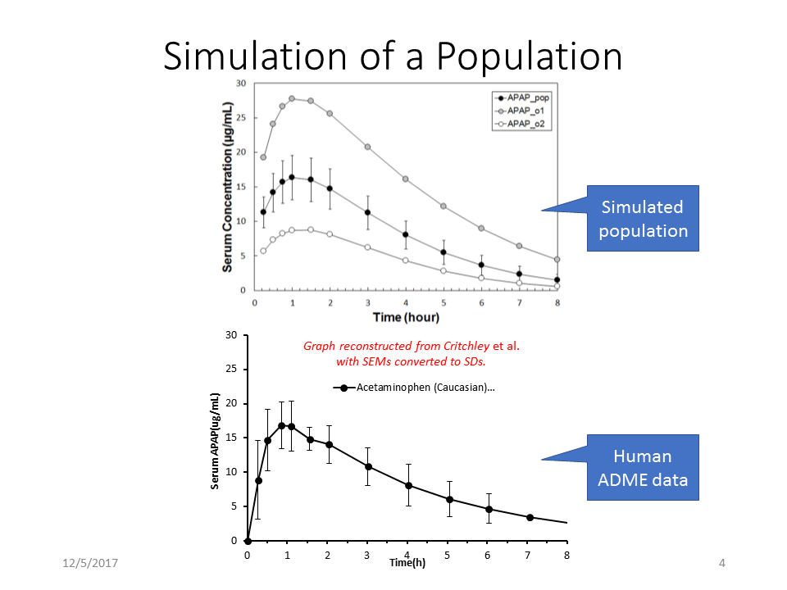
Success Story
The upper plot are the results for a simulated 1000 person population dosed with 1.4g Acetaminophen (APAP), plotting serum levels of drug versus time. The central line with error bars is the population average with standard deviations. The upper line is the simulated individual that had the highest peak serum concentration. The Lower line the simulated individual with the lowest peek APAP. The lower plot is published human clinical data (average of 9 individuals with standard deviations) at the same dose of APAP. Both the average time course and observed population variability are essentially identical between the simulation and the human clinical data. (J Sluka has the original powerpoint slides if they are needed.)

Slide 4
How have UQ methodologies impacted each field?
Now that quantifying parameter uncertainty is getting easier, beginning to think about model structural uncertainty, intrinsic stochasticity, possible incomplete or inaccurate data sets.
Clinical Impact?
Anecdotal cases in which model/experiment forced reevaluation of data analysis.
How do we use qualitative or semi-quantitative data in UQ?
Have new theories resulted from this work to improve the understanding of the problems in the field?
Emerging
Physics-Informed Deep Learning, Karniadakis, et al.
Inferring solutions of differential equations using noisy multi-fidelity data, Karniadakis, et al.
Distilling the logic of behavioral dynamics using automated inference, Nemenman, et al.
IMAG

Slide 5

UQ: What still needs to be done?
Are there methods from other fields that should be applied to your field?
Uncertain or semi-quantitative data: greater use/recognition of non-parametric methods in uncertainty quantitation, particularly when comparing noisy (uncertain) data to models and simulations.
Stochastic data: Distribution tests for comparing data from stochastic experimental processes to simulations. E.g., Kolmogrov-Smirnov statistic.
Neither stochastic data or uncertain data is well supported with UQ and optimization tools at the moment and we don’t have a formal way to describe them or capture this kind of observation.
Incompleteness/Uncertainty in models: Combined forward and inverse modeling
Knowledge-based AI/Machine Learning
General methods to compare models with different structures (incorporating different sets of mechanisms).
Methods to compare experiment and simulation when the data have structure that changes with space and time rather than a concentration/count time series forms (e.g., generation of metastases in an animal or SPIM images of a developing zebrafish embryo)? How do we determine goodness of fit with an experimental movie (especially if both are stochastic)? Are there any generic approaches that can help with this?
What further connections need to be made to address unmet needs?
http://www.quest-scidac.org
IMAG

Slide 6
Questions?

