Slide 1
Developing Credible Practice Guidelines for Modeling and Simulation in Healthcare: A Multifaceted Approach
https://simtk.org/home/cpms
Presented by Tina Morrison,
On Behalf of the Committee
2018 IMAG/MSM Consortium Future’s Meeting
March 22, 2018

Slide 2
Why did we form?
Who are we?
What we have been doing?
How we can support MSM?
Example – Poster
Other resources

Slide 3
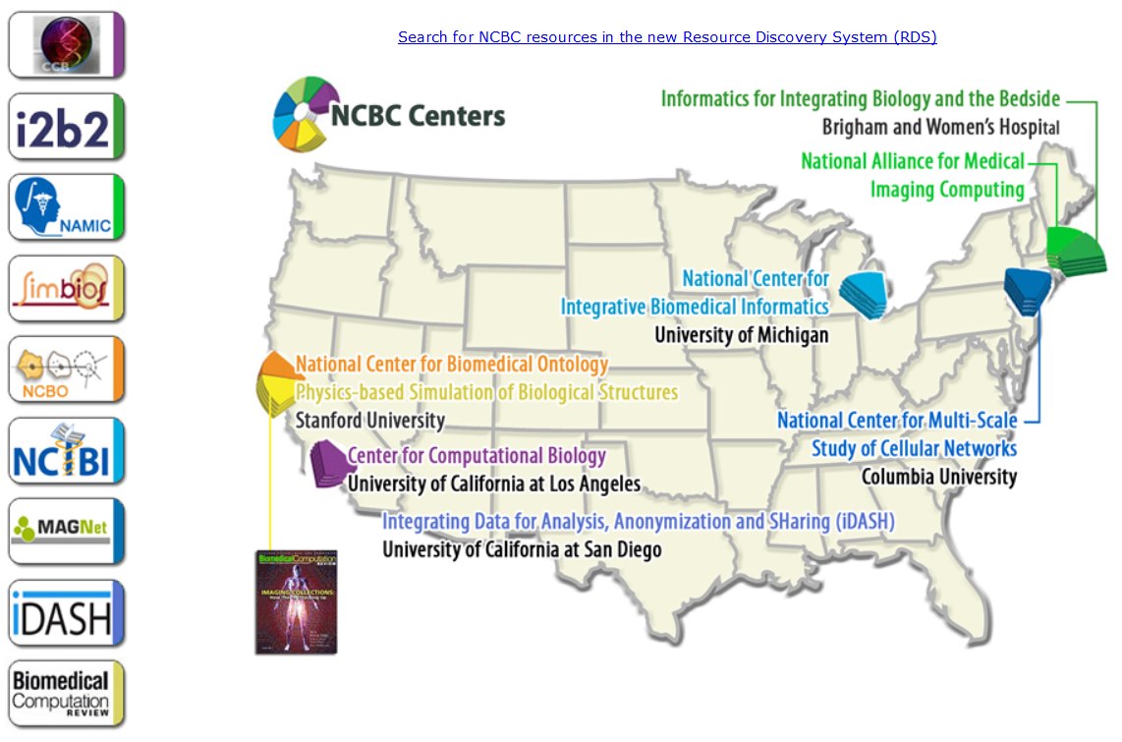
Background
Computational modeling and simulation (M&S) methods have substantial potential to support research, clinical decisions and education in healthcare.
Government agencies and industry are making substantial investments on R&D activities in simulation-based medicine and notable discoveries are being made.
http://www.ncbcs.org/
Notes:
Impetus for forming the group was that in 2011/2012, the IMAG/MSM consortium observed that the models being developed within the MSM consortium were not being translated to the clinic. Reasons for this include:
There was no unified standard/guideline for establishing the credibility of the model
The researcher may not have been working directly with a clinician to collect model inputs, feedback, etc.
A variety of US government agencies are investing in biomedical/clinical research. As an example, this slide shows a map of the National Centers for Biomedical Computing, which is a collection of government research centers funded by the NIH whose mission is to create innovative software programs and other tools that will enable the biomedical community to integrate, analyze, model, simulate, and share data on human health and disease. But we can’t just hope that the software or the models make it to the clinic. Thus, a need for a standard/guideline on how to translate a model to the clinic becomes clear.

Slide 4

The Challenge
Am I applying credible practice?
Common practice guidelines do not exist to ensure that appropriate credibility processes are followed
Adapted from http://beaver1003.com
Notes:
So we need to make researchers aware of the challenge and potential solutions to translating computational models to clinical practice.

Slide 5
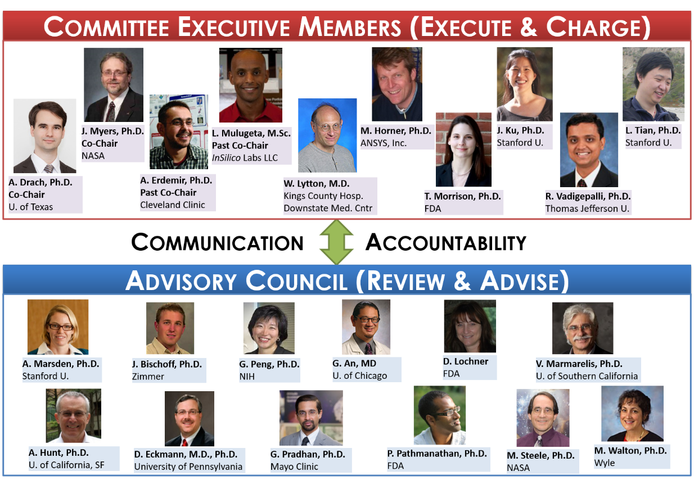
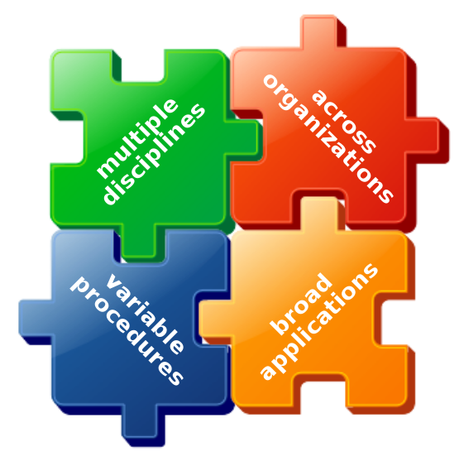
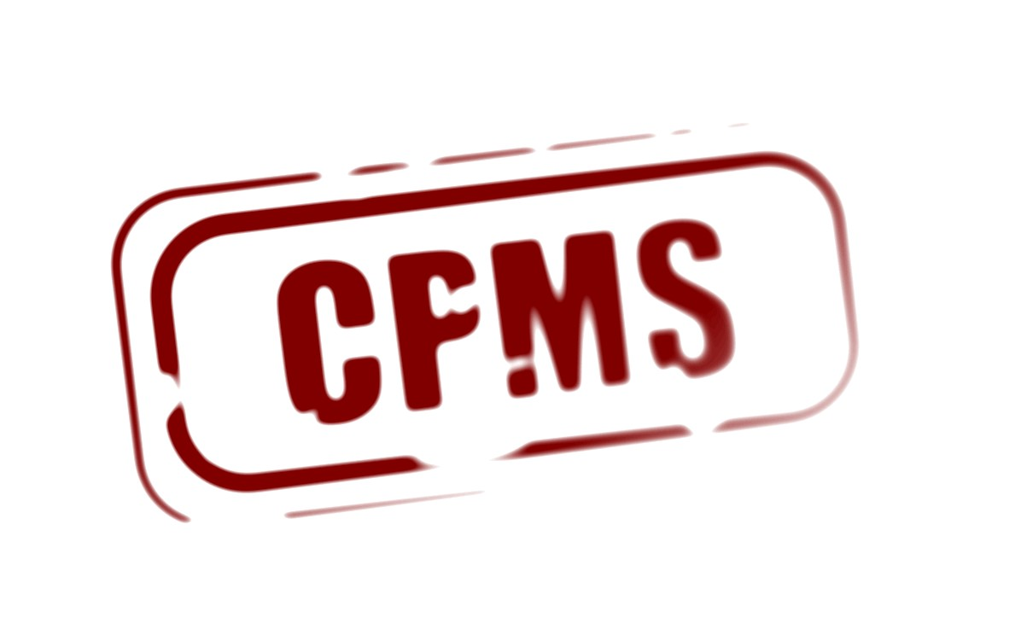











ABOUT THE COMMITTEE
Credible Practice
of M&S in Healthcare
To establish credible practice guidelines, consistent terminology and a model certification process, as well as to demonstrate workflows and identify new areas of research for reliable development and application of M&S in healthcare practice and research
& Multiscale Modeling (MSM) Consortium
Notes:
Our strategy is to recruit people representing the different disciplines and interest in healthcare. Membership of EC and AC represents the multi-disciplinary nature of our group.
We recognize that CM&S for healthcare is a multi-disciplinary pursuit with a wide range of applications, especially in government where fundamental research on human physiology, disease pathways, and other areas is emphasized.
Also, we are not trying to re-invent the wheel, but Take advantage of existing procedures and standards sources, e.g. ASME V&V standards, NASA guidelines, etc.
The end goal is to come up with a sufficiently flexible guideline such that researchers across a wide array of disciplines and applications can translate their results to the clinic.
The Executive Committee develops a roadmap for the committee. The Executive Committee then “executes” the charge of the Committee and the Advisory Council reviews and advises the executive Committee on the progress made toward the execution of the charges (e.g. TSR Survey Design process). The majority of the AC members are highly experienced and have significant vision/experience to impart to the team members.

Slide 6
Overview of Committee’s Charges
Guidelines & Procedures
  Credible practice in computational medicine
  Leveraging readily available techniques
  Define novel translational workflows to enhance credibility practice
Demonstrate Workflows
  Conduct studies to develop novel credibility assessment procedures
  Disseminating examples of credibility assessment
Consistent Terminology
  Unify the use of M&S vocabulary across all stakeholders
Promote Good Practice
  Bridge synergistic activities within the M&S communities
  conduct outreach activities.
Target End Products
“Guidelines for Credible Practice of M&S in Healthcare”
Proposed model certification process
Identify new areas of research to advance I & II

Slide 7
Ten Simple Rules (TSR) of Credible Practice
Primary deliverable: “Guidelines for Credible Practice of Modeling and Simulation in Healthcare”
Goal Oriented Activity: The CPMS Task Teams were charged to identify ten key elements or simple rules of credible practice in order to establish a foundation from which the “Guidelines for Credible Practice of Modeling and Simulation in Healthcare” can be developed.
Full details of this activity is available at: http://wiki.simtk.org/cpms/Ten_Simple_Rules_of_Credible_Practice
Notes:
Make into bullets

Slide 8
Two Main Approaches for TSR
Surveyed the Committee
  Publication in progress
Surveyed the Global Community
  A forum discussion thread has been initiated: https://simtk.org/forums/viewtopic.php?f=848&t=5616&sid=fdcab3f040d5c52b8667a0b0812d2e2b
  The raw data is also available at: https://simtk.org/websvn/wsvn/cpms/dat/Survey/Complete%20Survey%20Results_Clean_04242015.xlsx

Slide 9
Developing the Guidelines
DRAFT: “The Ten Simple Rules of Credible Practice of M&S in Healthcare”
Define context clearly
Use appropriate data
Evaluate within context
List limitations explicitly
Alignment between Committee survey and the Global Community survey
5. Use version control
6. Document adequately
7. Disseminate broadly
8. Conduct independent reviews
9. Test competing implementations
10. Conform to standards

Slide 10
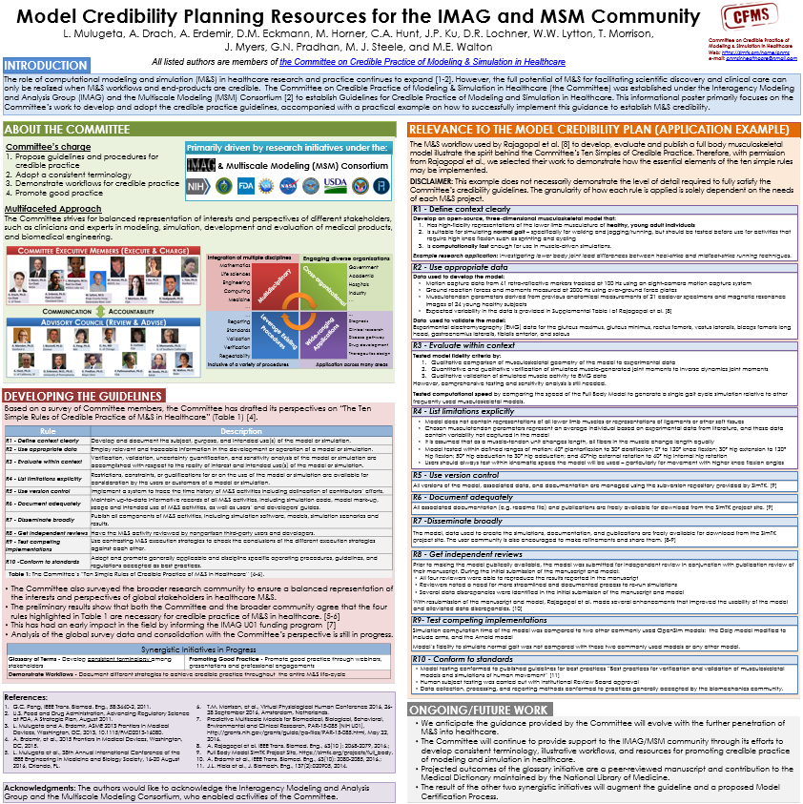
Committee’s Perspective on TSR of Credible Practice

Slide 11
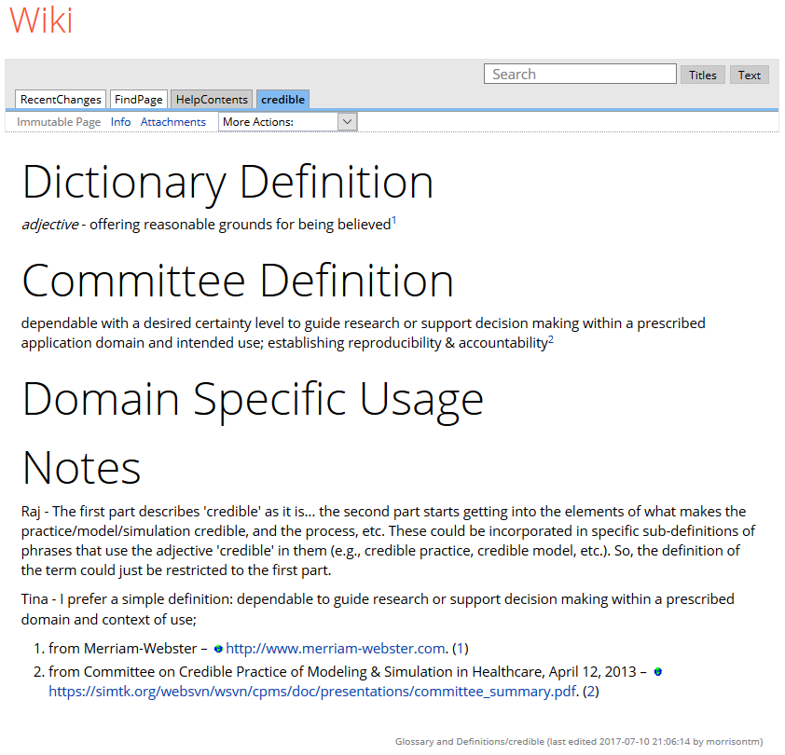
Synergistic Activities
Glossary
T o unify terminology among stakeholders
Webinars
T o illustrate processes to establish credibility
Workflows
T o document differences and overlaps in M&S strategies
Credibility approaches
T o identify community-based variations in the perception of credible practice

Slide 12
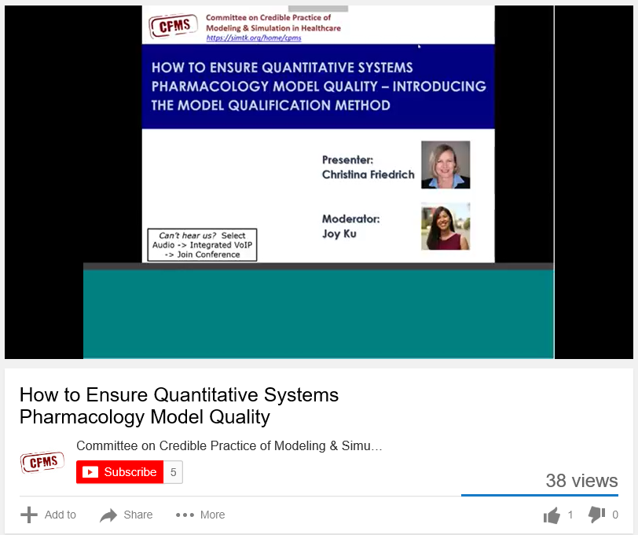
Synergistic Activities
“How to Ensure Quantitative Systems Pharmacology Model Quality – Introducing the Model Qualification Method,” featuring Christina Friedrich, PhD, Chief Engineer at Rosa & Co.
In case you missed it, you can view a recording of the event.
Glossary
T o unify terminology among stakeholders
Webinars
T o illustrate processes to establish credibility
Workflows
T o document differences and overlaps in M&S strategies
Credibility approaches
T o identify community-based variations in the perception of credible practice
https://www.youtube.com/watch?v=xk3_8DyoSPQ&feature=youtu.be

Slide 13
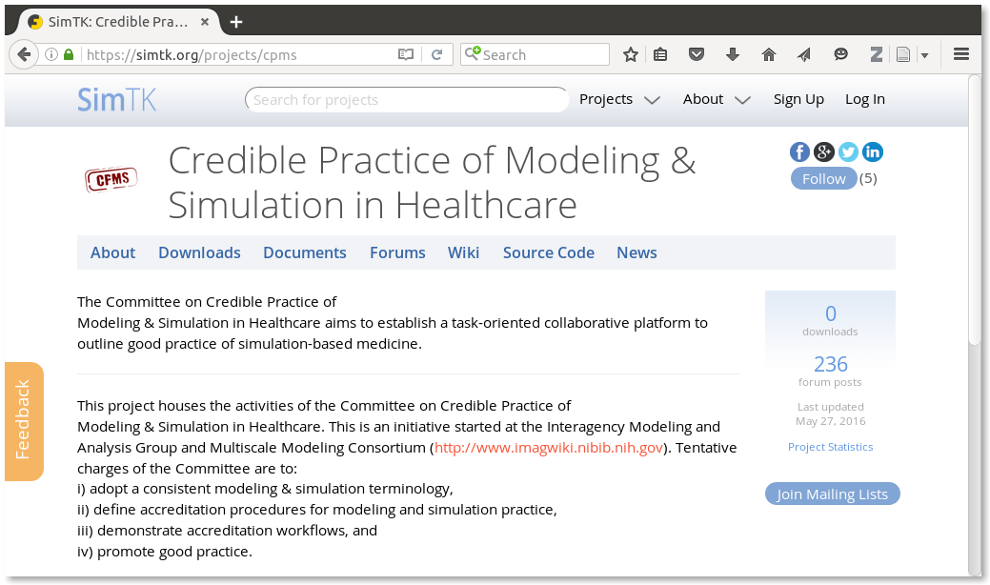
ENGAGE WITH THE COMMITTEE
Targeting global stakeholder community to ensure that guidelines capture the primary interests of the computational medicine community, and are widely adopted.
Open discussions and contribution to activities:
Wiki pages
Discussion forums
Meeting minutes
Repository access of all presentations, abstracts and posters
Version control
•
Check our website @ https://simtk.org/projects/cpms

Slide 14
Additional Resources
NASA Standard on Model Credibility
  NASA-STD-7009
  https://ntrs.nasa.gov/archive/nasa/casi.ntrs.nasa.gov/20160011121.pdf
  Handbook for 7009
  https://standards.nasa.gov/file/494/download?token=75YQPLOl
ASME V&V40 Standard
  Risk-informed Credibility Assessment Framework
    Will be published in July 2018
  Training slides:
  https://figshare.com/articles/FDA_Seminar_on_Computational_Modeling_for_Medical_Devices/5018783

Slide 15
Thank you!
You can also follow our regular progress via:
Meeting minutes and progress reports: https://simtk.org/docman/?group_id=848
Forum discussions: https://simtk.org/forums/viewforum.php?f=848
Wiki updates: http://wiki.simtk.org/cpms/
For more information, questions and suggestions, please contact us at:
CPMS Info
cpmsinhealthcare@gmail.com

Slide 16
Abstracts and Presentations
26th Annual Computational Neuroscience Meeting, 15-20 July 2017, Antwerp, Belgium
  Credibility, Replicability, Reproducibility in Simulation for research and clinical application
Frontiers in Medical Devices Conference: Innovations in Modeling and Simulation, 16-18 May 2017, Washington DC
  Ten ‘Not So’ Simple Rules for Credible Practice of Modeling and Simulation in Healthcare vs Considerations of Medical Device Development Tools program https://simtk.org/websvn/wsvn/cpms/doc/posters/fmd_2017.pdf
38th Annual International Conference of the IEEE Engineering in Medicine and Biology Society (EMBC’16), August 16-20, 2016, Lake Buena Vista, FL
  Developing credible practice guidelines for modeling and simulation in healthcare: a multifaceted approach
  https://simtk.org/svn/cpms/doc/presentations/EMBC_2016.pdf
Frontiers in Medical Devices Conference: Innovations in Modeling and Simulation, 18-20 May 2015, Washington DC
  Ten ‘Not So’ Simple Rules for Credible Practice of Modeling and Simulation in Healthcare: A Multidisciplinary Committee Perspective
  https://simtk.org/websvn/wsvn/cpms/doc/posters/fmd_2015.pdf
Notes:
Make into bullets

Slide 17
Abstracts and Presentations
2014 Interagency Modeling and Analysis Group Multiscale Modeling Consortium Meeting, 03-04 September 2014, Bethesda, MD
  Committee on Credible Practice of Modeling & Simulation: Progress and Forward Work
  https://simtk.org/websvn/wsvn/cpms/doc/presentations/IMAG_MSM_Meeting_Presentation_2014.pdf
2014 Interagency Modeling and Analysis Group Multiscale Modeling Consortium Meeting – Satellite Meeting, 05 September 2014, Bethesda, MD
  Common Practice Guidelines: A Significant Gap in Computational Modeling and Simulation in Healthcare https://simtk.org/websvn/wsvn/cpms/doc/presentations/IMAG_MSM_Satellite_Meeting_Presentation_2014.ppt
ASME 2014 Verification and Validation Symposium, 7-9 May 2014, Las Vegas, NV
  Pathway to Credible Practice Guidelines for Computational Modeling in Healthcare
  https://simtk.org/websvn/wsvn/cpms/doc/presentations/ASME_V&V_Symposium_Presentation_2014.pdf
Notes:
Make into bullets

Slide 18
Collaboration Opportunities
The Committee continues to interact John Rice, who is a representative for the Society for Simulation in Healthcare (SSH), and the DoD Human Factors Engineering Technical Advisory Group community.
The Committee has been engaging the Avicenna group (http://avicenna-isct.org/) to explore collaboration possibilities.
  Avicenna group was charged by the European Commission to develop a roadmap on how M&S can be used for in silico clinical trials.
  The effort is in the process of being integrated with the Virtual Physiological Human (VPH) initiative, and the Committee is working with VPH to identify appropriate collaborations regarding M&S credibility.
Notes:
Make into bullets

Slide 19
Other Presentations and Publicity
Executive and Advisory Council Members highlighted the Committee's efforts through various presentations at the following events:
  69th DoD Human Factors Engineering Technical Advisory Group Meeting, 4-8 May 2015, Orlando, FL. http://www.sa-meetings.com/TAG_69
  NASA Human Research Program Investigators’ Workshop,13-15 Jan. 2015, Galveston, TX. http://www.cvent.com/events/2015-human-research-program-investigators-workshop/archived-68497f3908b947999e10d2a1be551f54.aspx
  7th Pumps and Pipes Symposium, Texas Medical Center, 9 Dec. 2013, Houston, TX. https://storify.com/MethodistHosp/pumps-and-pipes-7-explorations

