Slide 1
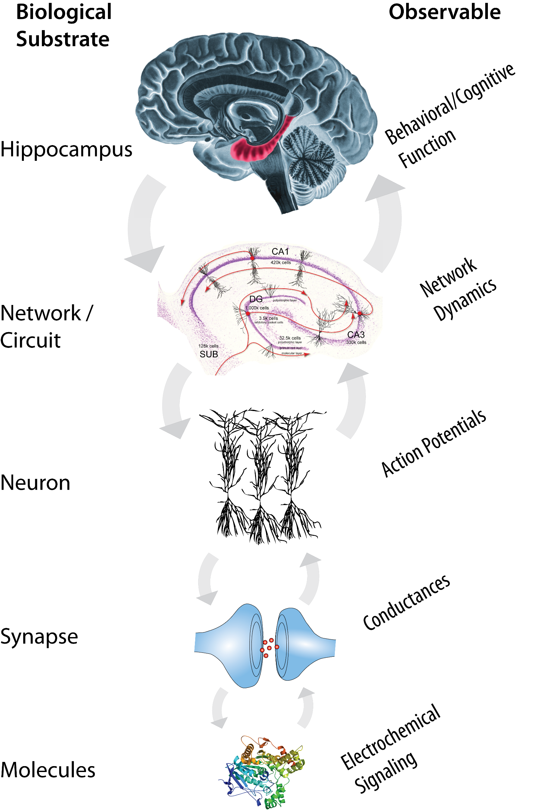
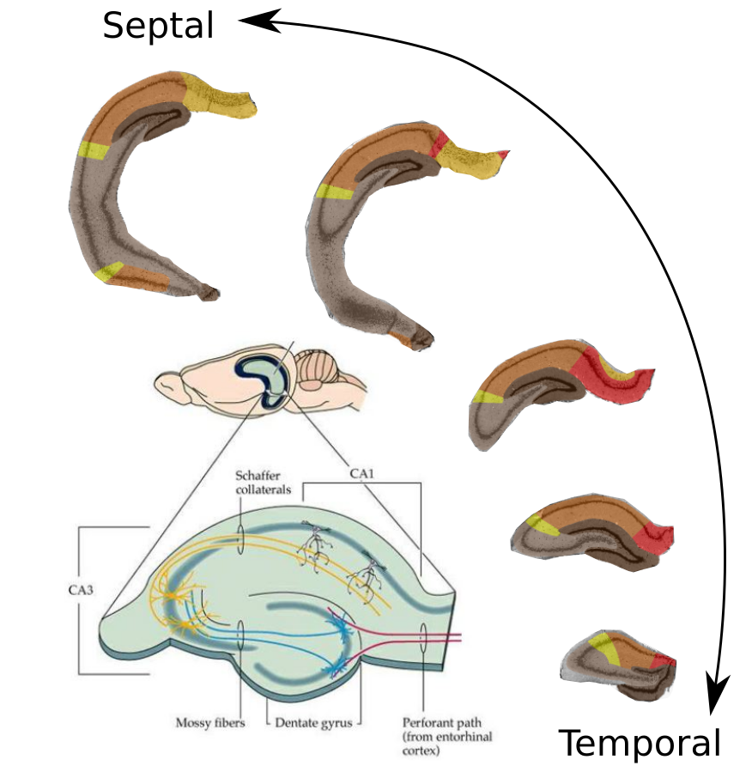
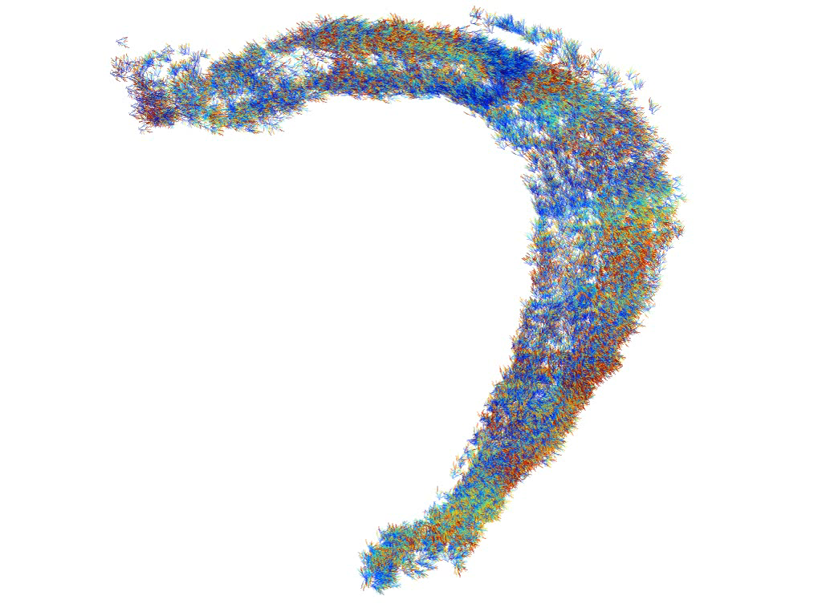
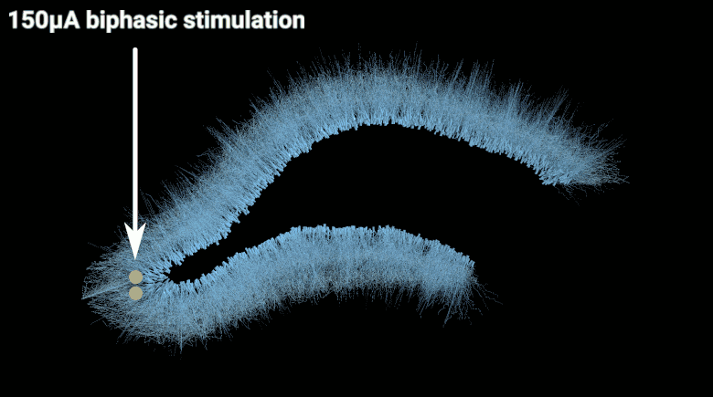
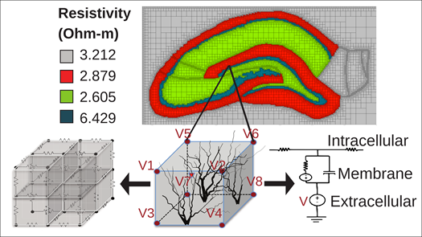
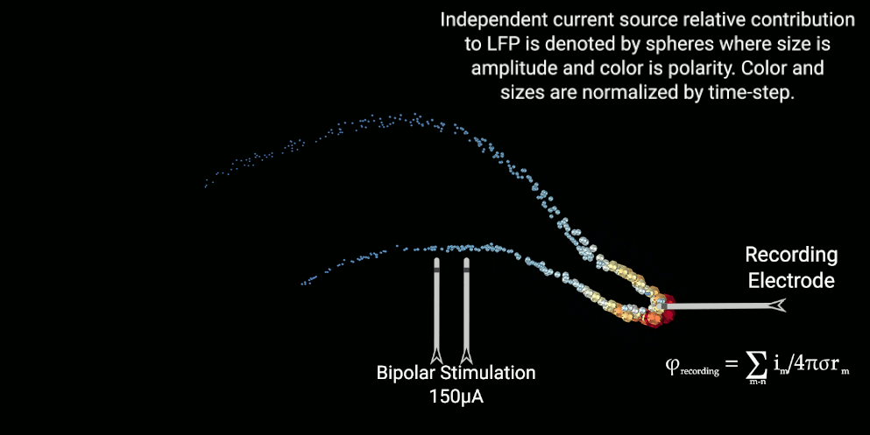
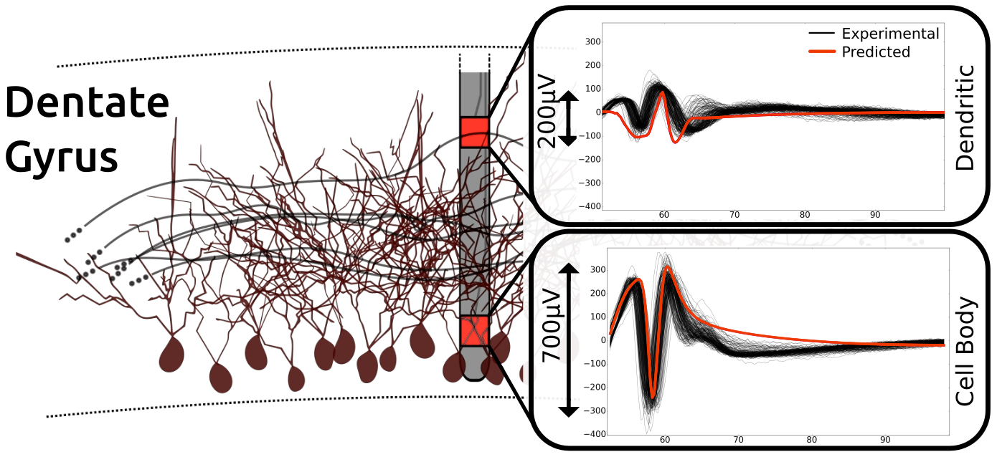
Award: U01 EB025830 PIs: Gianluca Lazzi, Theodore W. Berger
Multiscale Modeling of the
Nervous System
Simulating Electrode-Tissue Interactions
The brain has an inherent multi-hierarchical and multi-temporal nature. Our goals are to develop multiscale modeling tools and cross-scale linking methodologies, and apply these to study the effects of multi-hierarchical dynamics on the functions of hippocampal formation, as well as their impact on pathological dysfunctions.
Bridging multiple scales to construct a model of the hippocampus has allowed accurate prediction of evoked potentials in response to electrode-based stimulation of the perforant path. This result enables the study of specific electrode and stimulus parameters and the importance of various elements of tissue models.
Septal
Temporal
Large-scale, biologically-realistic neuronal network model of rat hippocampus composed of compartmental models of neurons with realistic morphologies. The distribution of red in the network is representative of the clustered activity seen below.
10
Septo-Temporal Position (mm)
0
250
0
250
0
250
Time (ms)
Time (ms)
0
Time (ms)
Spiking activity of the network as it propagates through the hippocampal circuit. Each dot corresponds to an action potential generated at a particular septo-temporal location and time. (A) Activity of dentate granule cells due to entorhinal input. (B) Activity of CA3 pyramidal cells due to dentate granule cell input from (A). (C) Activity of CA3 pyramidal cells due to combined entorhinal and dentate granule cell input.
Notes:
Define/explain it enough for a non-scientific person to explain to the general public (2-3 sentences)
The goal of the work is to develop a computational model and construct an entire virtual, three-dimensional structure of the brain (hippocampus) that contains every neuron and synapse found in a rat hippocampus that also accounts for the propagation of electrical fields through neural tissue, thereby creating an anatomically and biologically realistic neuronal network with which we can investigate multiple therapeutic strategies including drugs and the electrical stimulation of neurons. The large number of neurons and the incorporation of behaviorally relevant hippocampal input allow us to help predict the effects of drugs and electrical stimulation on system level dynamics and cognition.
Mention how can machine learning and AI help your project (2 sentences)
Large mechanistic models of complex systems have many parameters that can be estimated via Machine Learning (ML) methods to more accurately capture natural in vivo behaviors. However, owing to the high computational demands that accompany mechanistic models, we are developing ML methods that we use to reduce the complexity of models while preserving the functionality necessary to recapitulate natural behavior resulting in novel methods of cross-linking different levels of the multi-scale model.
List future challenges or next steps after your project is done (1 sentence)
Our present work has generated many tools of value to the broader community interested in multi-physics simulation of brain parts—one challenge we face is to package these tools and develop a framework that will facilitate use and collaboration that centers around these new resources.
Further details for Notes section - For the following communities (2 sentences):
Behavioral modeling: explain the new theories that will integrate within person dynamics with between person dynamics
Admittance Method-NEURON based brain models used to study prosthetics is naturally a patient-specific approach. New data pipelines and collaborations with imaging groups should be established to enable software and modeling tools to be patient-specific and have more substantial clinical value.
Currently, the multi-scale model represents an "average" individual that can capture the general trends of a population. However, the multi-scale model is also the most realistic and complete hippocampal network available. By converting the neural activity of the multi-scale model into a neural mass model, we can further constrain the neural mass model with patient-specific fMRI data to obtain a patient-specific model with which within person and between person dynamics could be investigated.
Multiscale modeling: explain how the math will address methodological challenges (e.g.: crossing scales, sparse data, uncertainty, modularity, spatiotemporal simulation challenges, etc.)
The Admittance Method-NEURON approach is dependent upon resistor meshes of varying resolution and geometry: refining the mesh to optimize its feature alignment with a specific region of tissue is an open problem that our project is seeking to address presently. Also, NEURON model behavior in response to stimulation is an emergent phenomenon that is governed by molecular dynamics at the synaptic level—new non-parametric methods of reducing the computational burden of synaptic model predictions brings new levels of accuracy at these higher length-scales of our hippocampal model.
We have developed a method for linking scales by reducing the complexity of lower-level mechanistic models, i.e., at the synaptic level, by replacing them with ML-based input-output models, i.e., the Laguerre-Volterra networks, which increases the speed of simulations while preserving the input-output properties of the mechanism. The scale of the neuronal network allowed us to develop metrics that can reveal an emergent spatio-temporal structure within the neural dynamics that would otherwise have been unobserved had the network size been smaller. In visualizing the neural activity, we have further been able to develop strategies for communicating the three-dimensional, spatio-temporal activity of the hippocampus.
Medical simulation: explain the math challenges being overcome (e.g. collision dynamics, cloth dynamics, haptics, etc.)
Using a resistor mesh model in conjunction with equivalent circuit-based neuronal models presents a unique set of challenges including including: graph-theoretical methods of optimizing neuron models, evolutionary algorithms for tuning model biophysics, matrix-solvers to speed up solve-times or reduce memory consumption, and the design of digital filters for system identification to reduce the computational overhead of large-scale mechanistic models.
One main challenge of the multi-scale model was to develop a computational platform that can integrate quantitative data at multiple scales and use appropriate approximations and solvers for each scale to construct a model that can investigate the consequences of lower-level properties on higher-level function. The kinetic schema and differential equations that comprise synaptic behavior was represented using a sparse Laguerre-Volterra Network formulation that could accurately represent synaptic behavior while reducing the number of equations that need to be solved at each integration step of the simulation.
Analysis: explain how new statistical approaches will provide mechanistic understanding of the system
The input-output approaches used in this work, i.e., the Laguerre-Volterra Network and its variants, can be used to deconstruct the dynamics into independent kernels that can be linked to various mechanisms. By changing the lower-level parameters and extracting the kernels of higher-level input-output representations of the system, we can identify the lower-level properties that contribute most to the dynamics of the higher-levels and quantify these contributions. For example, an input-output model of synaptic receptors can reveal what rate constants are most important in determining the dynamics of the postsynaptic current response. An input-output model at the level of neuronal networks will integrate the contributions of all the lower-level properties and the sensitivity of the dynamics at the neuronal network level to those properties. The choice of the input and output will determine which dependencies are being investigated, e.g. spiking input and spiking output or electrical stimulation input and local field potential output.
BRAIN: explain the theory behind the math/stats and how it will be used to understand how the brain works; explain the level of data dependency on your model (e.g.: (a) completely abstract toy model, (b) a coarse-grained model based on a high level view of previous data, (c) a model based directly on one kind of data (e.g., neural recordings) or (d) a model synthesizing multiple data types (e.g., neural recordings and connectomics).
The neuroscience community has produced and organized vast amounts of information concerning the hippocampus. However, the amount and availability of the data has yet to completely reveal the principles underlying the function of a neural region. Many models have used small parts of this data to constrain their parameters which then generate theories that can be very useful but also limited to the scope/scale of the data used. The multi-scale model is an attempt to construct a functional compendium that can integrate large amounts of information across multiple scales to overcome the limitations of previous models.
Our multi-scale model of hippocampus divides the hippocampus into three major scales: synaptic, neuronal, and tissue, and begins with a detailed mechanistic model representation for each scale. Kinetic state models are initially used to represent synaptic receptors; a compartmental modeling approach represents the subcellular and cellular properties of neurons using capacitors and resistors; and the Admittance Method models the electrical properties of extracellular neural tissue as a network of resistors. Each scale uses data relevant for that scale to constrain and validate the parameters, e.g., excitatory postsynaptic current recordings for synaptic receptors, electrophysiological properties for neurons, and local field potential recordings for network activity and the response of the network to extracellular electrical stimulation.
Input-output models are used to cross-link the scales to reduce the computational complexity of the model and preserve the functional properties of the scale. By changing lower-level properties and observing the resulting changes in network level dynamics or cognitive function, i.e., encoding of spatial information, we can begin to understand how the lower-level properties contribute to emergent behavior at higher-scales.

