Slide 1
Advancing model development & discoverability through the National Library of Medicine.
IMAG Multiscale Modeling Consortium
Webinar 11/28/2017
Patricia Flatley Brennan, RN, PhD Director, National Library of Medicine

Slide 3
Abstract
Investigators are developing new and quite sophisticated models to interrogate large data sets.
Characterizing model provenance and performance will enhance the reusability of models, and afford better model validation and determination of the conditions under which the models perform best.
Thus, it is timely to consider how to
* formally characterize models * define relevant metadata
* make models directly discoverable.
In this webinar, the Director of National Library of Medicine will lead a discussion to set the foundation of how to create a library of models that will enhance the integrity, discoverability and appropriate re-use of models.

Slide 4
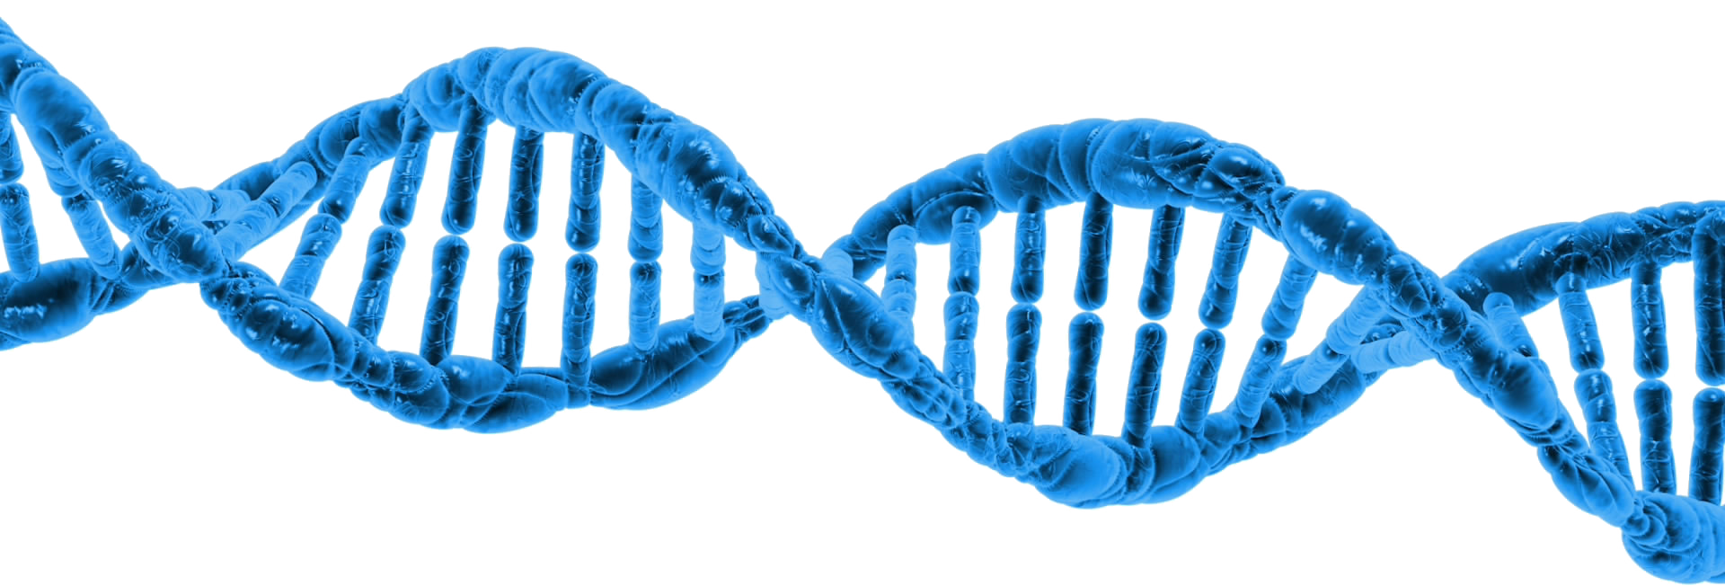
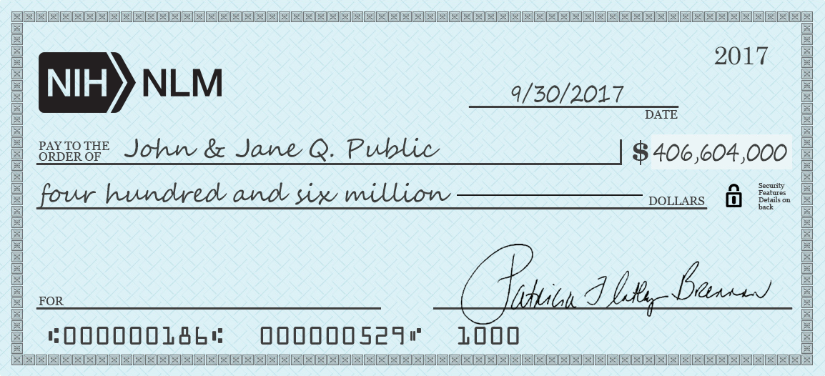
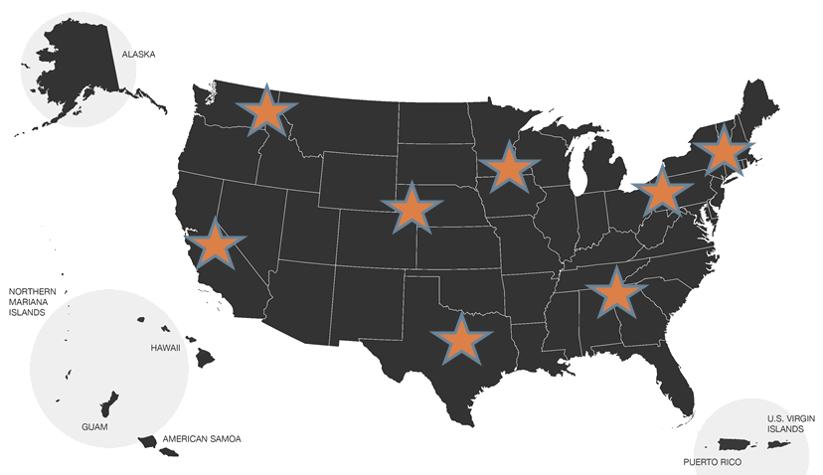
NLM by the Numbers
1
2
3
4
5
6
7
4M
visits/day
NCBI
700 staff
1,000+
calls/minute
1,700 staff
T15 T32
national network
6,500
member libraries
6 responses
30
500,000
specialized
data users/day
RxNorm
7 divisions
expenditures

Slide 5
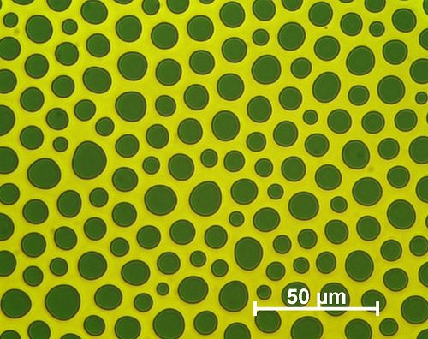
Preserve
Notes:
Walk through all of this – preserve the past, the valuable artifacts, but present-day materials must be collected with an eye to preservation
Preserve physical
Preserve digital
Share stories
Support scholarships

Slide 6
Why does anyone care about models?
R, R, R
Rigor, Reproducibility, Reuse

Slide 7
Why does a library care about models?
Characterization
What elements are essential to describe a model completely and uniquely
Curation
Principled ways to assign metadata to models in machine-computable ways
Collection
Purposefully obtain, identify. store and make accessible
Within published article
Free-standing products of research
Connect
Link models to data, research reports, patents, investigators
Communicate
Inform the scientific public
Motivate use

Slide 8
Why does a library care about models?
CREATE

Slide 9
Characterizing models
Minimum data elements – what really matters?
Model type
Purpose
Assumptions
Use
Scale
Model verification – is it implemented properly
Model validation – does it match the real world

Slide 10
Unique id’s –the starting point
Unique
Machine Readable
Free to generate and access
Consistent across journals and publishers
Public registration authorities
RRID: Scicrunch.org
doi: doi.org

Slide 11
Formalizing model identification (curation)
Resource Identifiers (RRIDs)
Specific at the model level
Investigator initiated
Voluntary
a priori assignment (assigned on development)
doi – digital object identifier
kernel = recognition & interoperability
technical and social infrastructure for the registration and use of persistent interoperable identifiers, called DOIs, for use on digital networks.
registration authority for the ISO standard (ISO 26324) for the DOI system

Slide 12
RRIDs characterize Methods
identify the model organisms, cells lines, antibodies, and tools (such as software or databases) you have used
Blogs, software took kits, algorithm implementation
include Research Resource Identifiers (RRIDs) within the materials and methods section of their papers
doi’s characterize objects
Complete declarations (objects, articles, books)
ISO standard, computational registry

Slide 13
Collection What does a library of models look like?

Slide 14
RRIDs & doi’s in PubMed

Slide 15
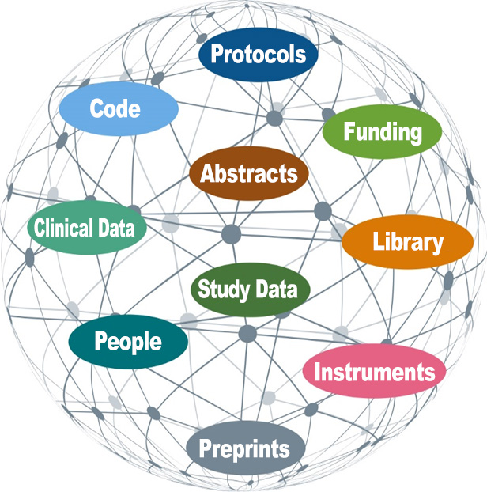
Connecting a sphere of discovery: digital research objects
Models
Literature
Pathways
Notes:
A comprehensive research data infrastructure for NIH connecting NLM and NIH Research Infrastructure

Slide 16
Communicate
NIH policies and guidelines on rigor, reproducibility and transparency
increasing dominant model of interacting with the literature through automated agents; therefore, the conventions foster greater machine-processability.
Literature synthesis requires universal machine access to key entities

Slide 17
NIH and Model Declaration
Guidelines for Rigor and Transparency for almost all awards in starting in May of 2016
Validation, verification, and version control
Best practices revealed
Tractable contributions of research

Slide 18
Questions for discussion
What does a library of models look like?
Who would use it?
How does it differ from model descriptions in articles?
How is authority imbued?
Should models be stored separately from the data they are used on and the reports they are used for?
How can the NLM help advance multi-scale modeling?

Slide 19
Reaching me
@NLMdirector
patti.brennan@nih.gov
emey87 / IconArchive / CC BY-NC-ND-4.0

