Slide 1
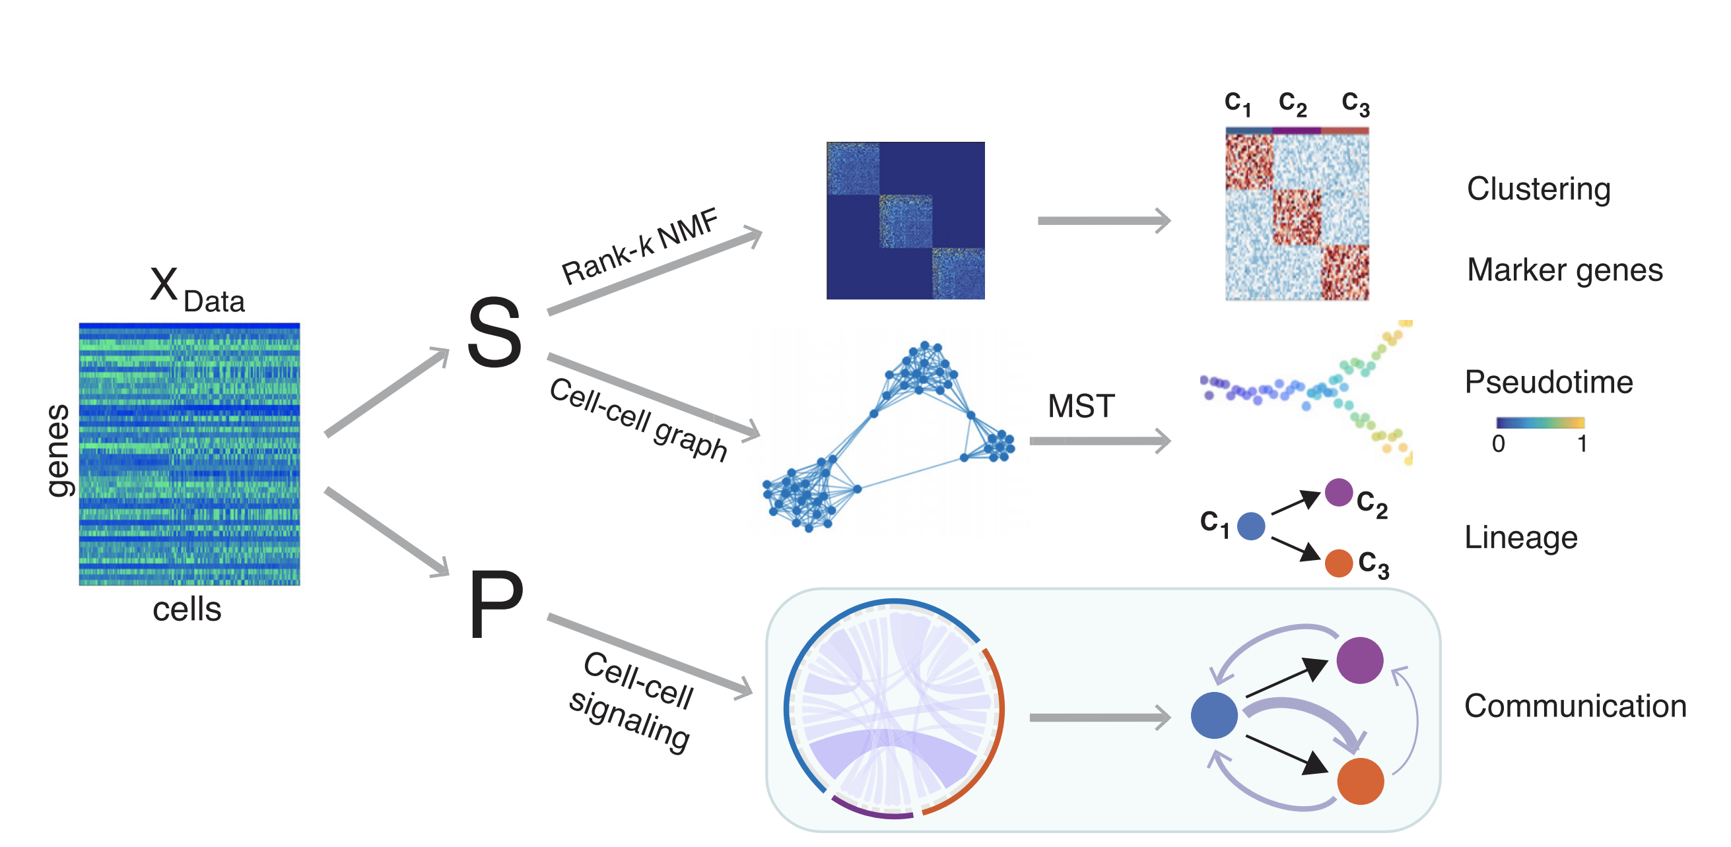
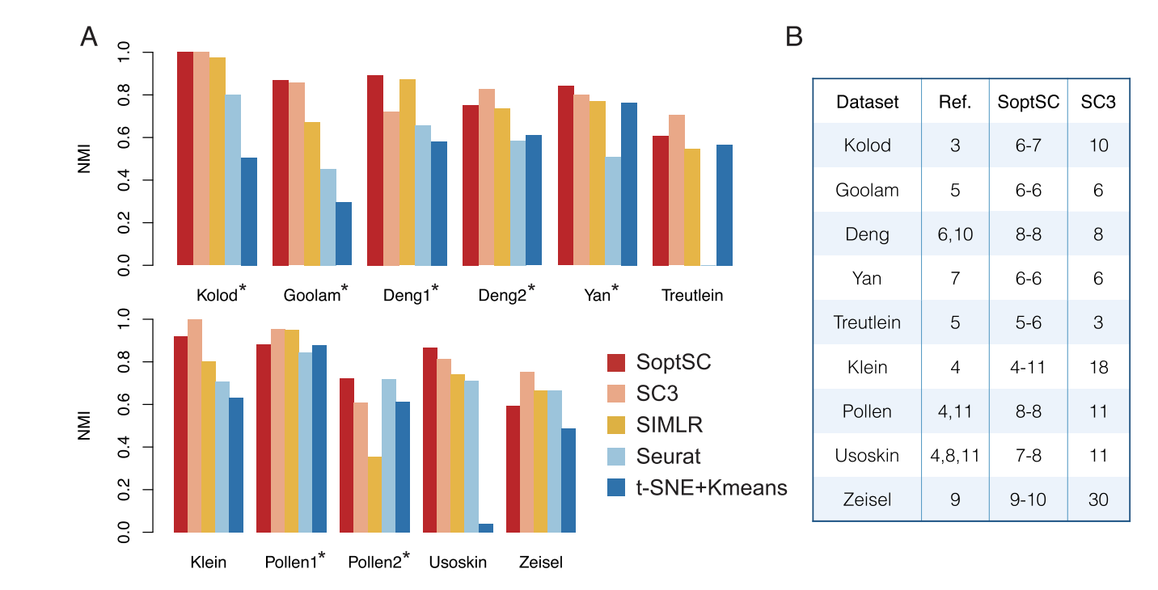
Overview of SoptSC Model Credibility Report
1.
1. Overview of the SoptSC. Input gene expression matrix X, learns cell-to-cell similarity matrix S. Clustering by non-negative matrix factorization on S. Markers for clusters via product of factorized latent matrix and X. Cell-cell graph (constructed from S) used to infer pseudotime. Lineage via a minimum spanning tree over the cluster–cluster graph derived from the cell–cell graph. Cell-cell communication is predicted by SoptSC via cell–cell signaling probabilities that are based on single-cell gene expression of specific genes within a pathway in sender-receiver cell pairs.
2.
2. Benchmarking SoptSC against current methods for clustering. (A) Compare SoptSC, SC3, SIMLR, Seurat, and t-SNE + k-means by NMI (B) Prediction of the number of clusters by SoptSC or SC3, compared to a reference number of clusters (Ref.) from the original study
Shuxiong Wang, Matthew Karikomi, Adam L MacLean, Qing Nie. Cell lineage and communication network inference via optimization for single-cell transcriptomics.
Nucleic Acids Research, Volume 47, Issue 11, 20 June 2019, Page e66. DOI: ﻿10.1093/nar/gkz204.

