Slide 1
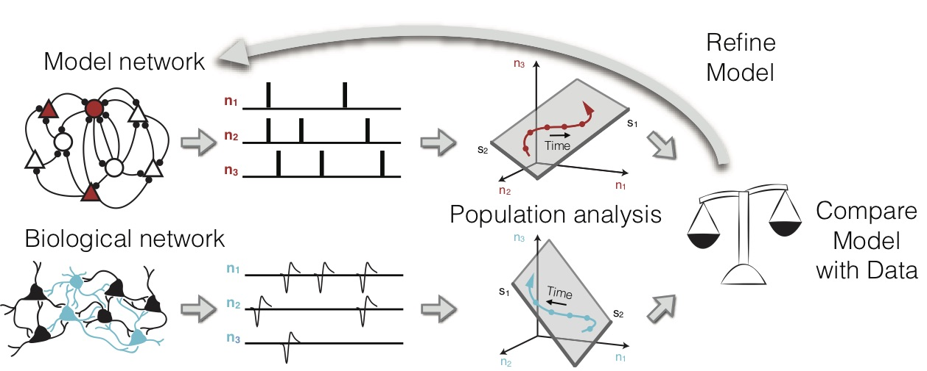
Neural population dynamics within and across cortical areas
The model Our research combines large-scale network modeling,
large-scale neural recordings, and neural population analyses to
understand the key network principles that drive behavior.
[Williamson, Doiron, Smith & Yu (2019), Current Opinion in Neurobiology 55, 40-47]
What is new inside? Rather than attempting to correspond model neurons to real neurons directly, a key innovation of our proposal is to compare low-dimensional representations of population activity between model networks and real data. The central idea is that different neurons in the same network represent different views of the underlying latent variables, as identified using dimensionality reduction. This provides a virtuous loop between experiment and models that provides insights into how the circuitry of cortical networks support population-wide dynamics.
How will this change current practice? We lack deep understanding of the circuit mechanics that underlie the rich dynamics exhibited in the nervous system. Our work aims to provide a general modeling framework to investigate how the biology of neuronal circuits create and shape population-wide dynamics.
End Users Our approach will be useful for both modelers attempting to determine
how their model can match population data as well as experimentalists who want to
find new models that can explain their findings. Software tools and example data will
be available in MATLAB and accessible to a broad community.
Brent Doiron & Matt Smith (University of Pittsburgh) and Byron Yu (Carnegie Mellon)
Grant Support: NIH R01 EB026953
Notes:
Our project is designed to innovate new ways of benchmarking the match between models of populations of neurons and data from real populations of recorded neurons (see our review - Williamson, Doiron, Smith & Yu, 2019, Current Opinion in Neurobiology 55, 40-47). Rather than matching directly at a single neuron level, we instead will attempt to match the low-dimensional representation of population activity, which frees us to consider the essence of neuronal interactions without dwelling unnecessarily on the features that are less relevant. In addition, we are developing machine learning-driven approaches to optimize model parameters, a process that is currently guided primarily by intuition. This approach has a broad utility for other types of models that are matched to data, in particular where the evaluation of the model is computationally intensive and many models can match the first-order statistics. We hope to extend this work to form a general framework, beyond the particular model types and data sets that we are studying, to model large-scale networks of neurons and the match to real neuronal networks.
Our models and networks of neurons are biologically realistic spiking neurons, in which variability is generated internally by chaotic dynamics. Our approach incorporates real neuronal recordings as well as anatomical and functional data that inform the network architecture.
Brent Doiron, bdoiron@pitt.edu
Matt Smith, matt@smithlab.net
Byron Yu, byronyu@cmu.edu

