Slide 1
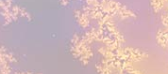
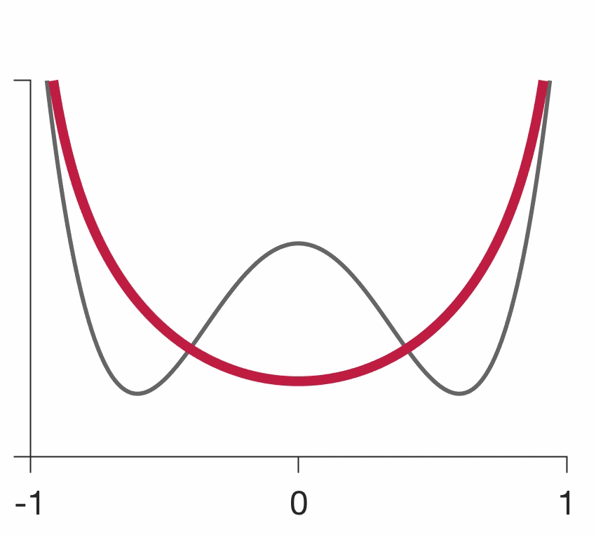
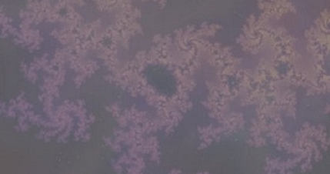
Discovering dynamic computations from large-scale neural activity recordings
The model
Purpose: Massively-parallel technologies generate large-scale activity maps from the brain. To reveal fundamental dynamic features in these data, principled and scalable computational methods are needed.
Premise: Existing methods rely on fitting ad hoc parametric models and have limited capacity to faithfully capture population dynamics in the data.
Objective: Develop a broadly-applicable non-parametric inference framework for discovering population dynamics directly from the data without a priori model assumptions.
What is new inside?
We extend latent dynamical models to a general form, where the latent dynamics are governed by arbitrary dynamical-systems equations in which driving forces are directly optimized to effectively search through the space of all dynamical models.
How will this change current practice?
Our framework leads to a conceptual shift from model fitting to model discovery.
Our methods deliver an interpretable model of neural dynamics, reconstruct population dynamics with millisecond precision on single trials and reveal heterogeneous contributions of single neurons to circuit-level computations.
End Users
Neuroscientists collecting large-scale neural activity data in behaving animals. A software with our methods written in Python will be freely available on GitHub.
Non-parametric framework: Neural activity depends on a low-dimensional neural population state (blue dot) via firing-rate functions. Population state evolves in time (blue line) governed by general-form dynamical equations.
Model discovery movie: an optimization algorithm morphs the dynamics landscape in the model (red line) to match the ground-truth (grey line) on synthetic data.
Dynamics landscape
Population state
Tatiana Engel, PI
Anne Churchland, co-I
Cold Spring Harbor Lab
Grant support: NIBIB 1R01EB026949-01
Notes:
NOTES
define/explain it enough for a non-scientific person to explain to the general public (2-3 sentences)
Neural circuits in a mammalian brain generate dynamic activity patterns that support behavioral and cognitive functions and are distorted in mental disorders such as Parkinson, schizophrenia and epilepsy. Our research develops unbiased computational methods to extract dynamics from large-scale neural activity recordings. We validate these novel methods using large-scale recordings of decision-related neural activity from two cortical areas in two different species.
mention how can machine learning and AI help your project (2 sentences)
We develop new machine learning algorithms for optimizing over spaces of models rather than fitting parameters of a single model. The expressive capacity of our framework is comparable to modern artificial neural networks, thus many results about training and generalization behavior apply to both our framework and neural networks.
List future challenges or next steps after your project is done (1 sentence)
The next step after completion of this project will be to apply the new powerful tools we develop to neurophysiological datasets to reveal mechanisms of neural computations on single trails.
Further details (2 sentences):
BRAIN: explain the theory behind the math/stats and how it will be used to understand how the brain works; explain the level of data dependency on your model (e.g.: (a) completely abstract toy model, (b) a coarse-grained model based on a high level view of previous data, (c) a model based directly on one kind of data (e.g., neural recordings) or (d) a model synthesizing multiple data types (e.g., neural recordings and connectomics).
Our model is based directly on neural activity recordings data (category c). We develop a theory and algorithms for non-parametric discovery of dynamical models directly from the data. Our methods are broadly applicable to different behaviors and neural circuits in the brain and can reveal computations performed by brain areas on single trials.
PI name, email:
Tatiana Engel, engel@cshl.edu

