Slide 1
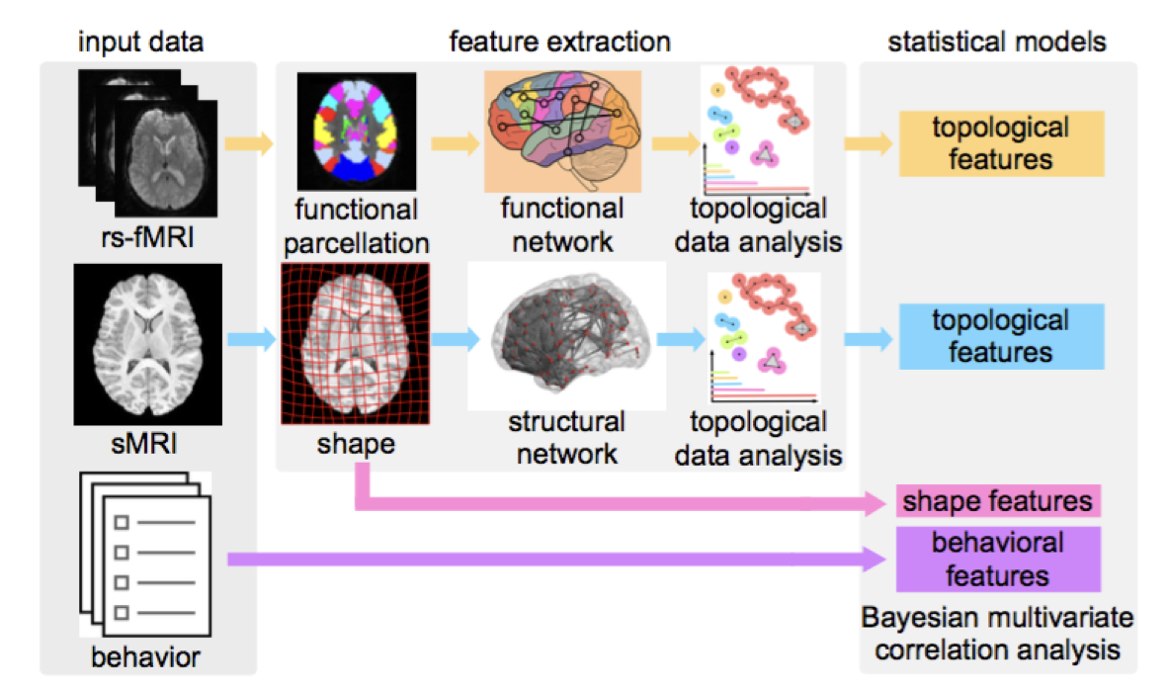
Beyond Diagnostic Classification of Autism
The model: This project develops novel statistical methods for combining heterogeneous imaging and behavioral data to understand how properties of complex brain networks give rise to behavioral phenotypes. Our hypothesis is that multivariate descriptors of brain network topology, combining features of grey matter shape and function, will better explain the complex impairments found in Autism Spectrum Disorders (ASD) .
.
What is new inside?
1. Develop image analysis algorithms (diffeomorphic image registration
and hierarchical Bayesian model) for extracting individualized features of brain shape and function.
2. Employ computational topology and topological data analysis algorithms to describe complex structural and functional brain networks, and capture the topology of the network simultaneously across multiscale.
3. Develop Bayesian multivariate correlation analysis for combining topological features from both structural and functional networks, shape features and neuropsychiatric behavioral measures.
How will this change current practice? Potential impact to the neuroscience community for studying the brain basis of neuropsychiatric disorders. The project provides powerful and distributed features of brain structure and function, individualized and age-specific brain biomarkers, and the ability to combine multiple imaging modalities and investigate their relationships to multiple dimensions of behavior .
End Users: Develop tools and techniques to be used by the neuroscience community to advance research in understanding the brain basis of behavior in neuropsychiatric disorders.
Bei Wang, Tom Fletcher, Jeffrey S. Anderson, Brandon A. Zielinski NIH R01 1R01EB022876-01
Notes:
define/explain it enough for a non-scientific person to explain to the general public (2-3 sentences)
A major barrier to creating effective treatments for autism is the lack of understanding of the specific brain mechanisms involved and how these are related to specific behavioral symptoms.
We propose to develop novel statistical methods for combining heterogeneous imaging and behavioral data to understand how properties of complex brain networks give rise to behavioral phenotypes in autism and other neuropsychiatric disorders.
mention how can machine learning and AI help your project (2 sentences): We are develop Bayesian statistical methods for finding correlations in high- dimensional and heterogeneous data, and we will use this to analyze the relationship between brain networks and behavior.
List future challenges or next steps after your project is done (1 sentence): We will investigate how the dynamics of brain networks (in the time-varying setting) correlates with behavior measures.
Further details for Notes section
Our project focuses on developing novel analysis of complex brain networks from structural and functional imaging and using this to link brain features to behavioral phenotypes. These algorithms will be used to discover brain biomarkers of behavioral traits in Autism and other neuropsychiatric disorders.
PI name, email: Bei Wang (beiwang@sci.utah.edu)

