Slide 1
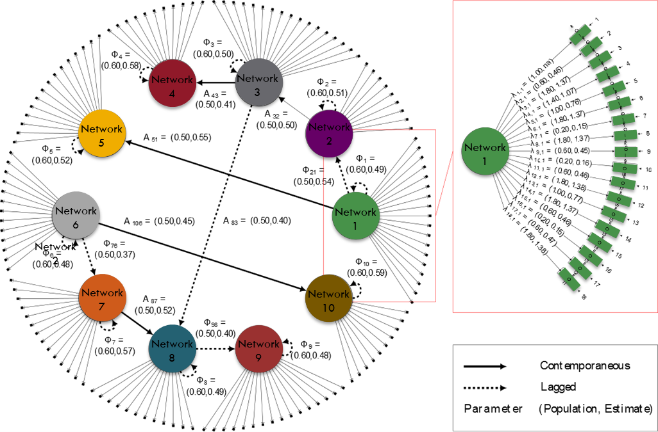
Multiscale Modeling of Brain Processes: LV-GIMME
The model: GIMME enables data-driven modeling of brain processing.
What is new inside? This funding has enabled two substantial
improvements to GIMME: multiscale modeling and unsupervised
classification of individuals. The new approach is called “LV-GIMME”.
Multiscale modeling enables examination of brain processes as they occur across multiple spatial resolutions. The graph to the right depicts the dynamic relations among brain networks as well as relations among brain regions within a given network. One could add more resolution scales (e.g., voxels).
Researchers can also use LV-GIMME to subset individuals to identify those who have similar brain processes using a unsupervised classification approach that, with the present funding, we have been able to evaluate and validate using both simulated and empirical functional MRI data. The method is able to appropriately classify individuals according to the task they are conducting by using only time courses of brain activity.
How will this change current practice? With LV-GIMME, researchers can explore how brain processes differ within a predefined category (e.g., diagnostic status, gender) by identifying subsets of individuals with similar dynamic patterns. The multiscale resolution allows researchers to
simultaneously investigate research questions at the voxel, region, and network levels.
Taken together, the new method will enable greater understanding of the varied
endophenotypes, getting the field closer to personalized of treatment plans.
End Users Researchers with functional MRI data are the initially intended end users.
Gates, K.M.
University of
North Carolina
NIBIB: 1R01 EB022904-01
Notes:
Instructions:
Submit 1 slide by COB Monday 2/25/19
Title - headline your theory-driven, mechanistic model
name the specific mathematical or statistical method and variations thereof
To include in NOTES section
define/explain it enough for a non-scientific person to explain to the general public (2-3 sentences)
We developed a new method, LV-GIMME, for looking at brain processes of individuals. Individuals may differ even if they are all part of the same category, such as gender or diagnostic status. As an example, this method can be used to identify different brain processes that may occur within a given diagnostic category such as ADHD, which can lead to treatment plans that are better tailored for those subsets.
mention how can machine learning and AI help your project (2 sentences)
Our method is a machine learning algorithm for model building and unsupervised classification.
List future challenges or next steps after your project is done (1 sentence)
The next step is to allow for bidirectional as well as directional relations among nodes.
Further details for Notes section - For the following communities (2 sentences):
Multiscale modeling: explain how the math will address methodological challenges (e.g.: crossing scales, sparse data, uncertainty, modularity, spatiotemporal simulation challenges, etc.)
Our method accounts for the errors in measurement that can occur at multiple scales of resolution (e.g., voxel, region, and network levels in human functional brain imaging). It also introduces sparsity in the matrices for the relations among these varied levels, thus aiding in interpretation and inferences. Finally, community detection is used to subset individuals with similarities in their patterns of relations. This enables identification of patterns that are similar for ALL individuals in the sample, patterns that are similar for SOME individuals in the sample, and finally INDIVIDUAL-LEVEL aspects are allowed to emerge.
PI name, email: K. M. Gates, gateskm@email.unc.edu

