Slide 1

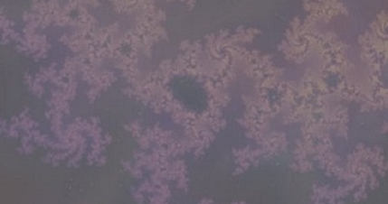
The complexity dividend: when sophisticated inference matters
A
B
C
The model
A: We constructed a novel hierarchy of inference strategies that are ranked in terms of computational complexity (cognitive cost)
B: We found that increasing complexity gives progressively smaller gains in accuracy: a (power) law of diminishing returns
C: The benefits of complexity depend on uncertainty. Complex strategies are not worth the effort if the world is too variable or too stable. In between, there is a complexity dividend (color in the volatility-noise plane showing the simplest effective strategy).
What is new inside?
A new way of formalizing relationships between particular cognitive operations including working memory and adaptive updating and assessing their relative computational costs.
How will this change current practice?
University of Pennsylvania
Gaia Tavoni, Vijay Balasubramanian, Joshua Gold
NIBIB EB026945
A principled way to understand the conditions that require complex cognitive operations
End Users: Anyone studying cognitive operations
Notes:
The problem: Statistical inference in noisy and changing environments can be solved by strategies of different complexity. More complex strategies typically reduce errors but also incur larger computational costs. What is the cognitive cost that is worth paying to perform effective and efficient inference?
Our solution: Our new theory and modeling approaches allow us to identify fundamental relationships between inferential accuracy and computational complexity. These approaches provides extensive, quantitative predictions for the specific environmental and task conditions most likely to require particular cognitive functions, including working memory and adaptive decision-making.
Future challenges: Extending the framework to include practical approaches to measure computational complexity in behavior and neural data, and compare those measurements to predictions of this new theory.
BRAIN initiative grant: R01 EB026945
PIs: Joshua Gold (jigold@pennmedicine.upenn.edu), Vijay Balasubramanian (vijay@physics.upenn.edu)

