Slide 1

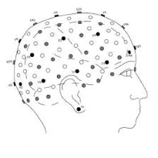
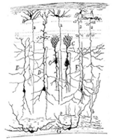
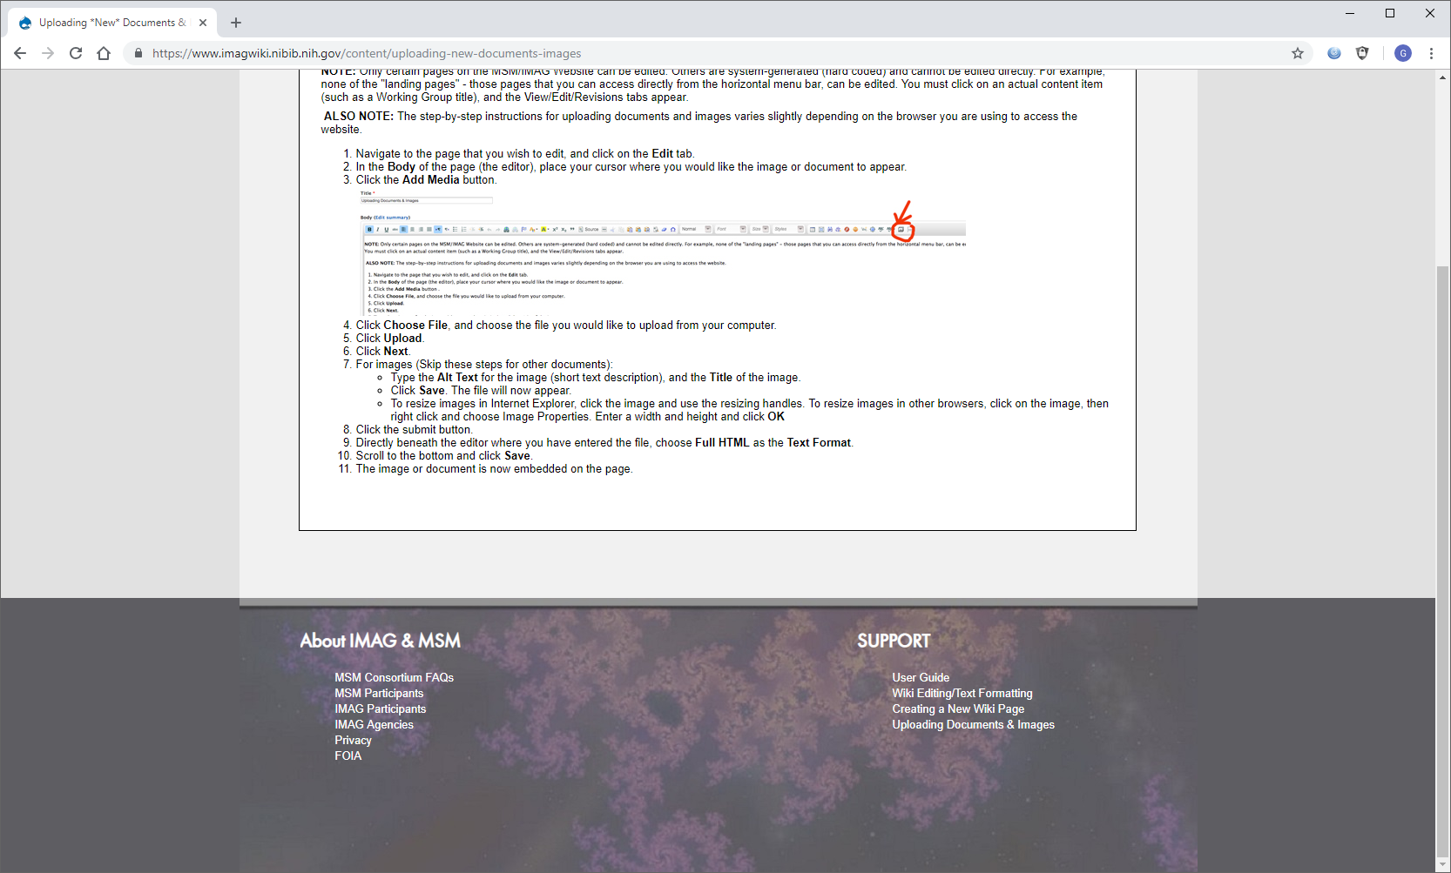
Human Neocortical Neurosolver (HNN): A new software tool for circuit level investigation of human MEG/EEG
The model: HNN is a user-friendly software tool for researchers and clinicians to develop and test hypotheses on the cellular and circuit level origin of their human EEG or MEG data. HNN’s foundation is a principled model of a neocortical circuit designed to account for the biophysical origin of EEG/MEG signals with enough detail to interpret circuit level activity.
Human
Electrophysiology
Computational
Neural Model
(Translator)
Cell & Circuit
Activity
What is new inside? HNN uniquely calculate the primary electrical currents underlying EEG/MEG signals from the net intracellular current flow in populations of neocortical pyramidal neuron dendrites (see red arrows above). This construction allows one to one comparison between model output and source local human data in real units of nano-Ampere-meters (nAm).
How will this change current practice? EEG/MEG are the two prominent noninvasive methods to human brain activity with fine temporal resolution. Yet, it is still difficult to infer the underlying neural dynamics in detail without simultaneous invasive recordings. HNN provides this translational bridge that can
ultimately improve our understanding of human information processing and lead to
new treatment methods for neuropathology.
Stephanie R. Jones, PhD Brown University
Matti Hamalainen, PhD
Mass General Hospital
Michael Hines, PhD
Yale University
NIBIB/NIMH: R01EB022889
End Users HNN is designed for researchers and clinicians without experience in the mathematics and coding of neural dynamics to be able interpret neural origin of their human EEG / MEG data in a user-friendly graphical user interface (GUI)-driven software. HNN runs on all platforms and is distributed at http://hnn.brown.edu.
Notes:
Instructions:
Submit 1 slide by COB Monday 2/25/19
Title - headline your theory-driven, mechanistic model
name the specific mathematical or statistical method and variations thereof
To include in NOTES section
define/explain it enough for a non-scientific person to explain to the general public (2-3 sentences)
Human brain activity can be measured non-invasively with electro- and magneto-encephalography (EEG/MEG). These signals are correlated with nearly all healthy and pathological human behavior. Yet, the underlying neural generators of the signal are unknown limiting our understanding of how the brain works or how to develop treatment to improve neuropathology. HNN is a new user-friendly software tool that simulates the neural activity underlying EEG/MEG signals, providing an unprecedented interpretive bridge between the extracranially measured signal to the underlying neural generators.
mention how can machine learning and AI help your project (2 sentences)
First, machine learning can be used to identify classes of healthy and or pathological EEG/MEG waveforms that then serve as targets to interpret with families of neural models using HNN. Of note, the patterns of brain activity recorded outside of the head are limited and consist mainly of sensory evoked responses and low frequency oscillations, minimizing the space of waveform classification. Second, machine learning can be used to identify parameter spaces in the HNN model (e.g. synaptic weights) that accurately account for classes of waveforms identified in the data.
List future challenges or next steps after your project is done (1 sentence)
The goal of HNN is to engage researchers and clinicians world-wide to use HNN in a meaningful way to interpret healthy and pathological human brain activity, and to ultimately develop novel treatment strategies (e.g. pharmacological and/or brain stimulation ) to improve pathological brain function. For this to be successful, there will need to be (1) continued integration between human and animal research, which HNN uniquely provides opportunity for, and (2) continued software maintenance and updates to meet the needs of the community.
Further details for Notes section - For the following communities (2 sentences):
BRAIN:
The primary electrical currents in the brain that underlie human EEG and MEG signals are known to be generated by the net post-synaptic current flow in pyramidal neuron dendrites. As such, a minimal model necessary to understand the biophysical origin of these signal should include the canonical laminated structure of the neocortex, including (i) pyramidal neurons with dendritic processes that span multiple layers, (2) inhibitory neurons, and (3) layer specific input pathways. HNN’s uniquely contains this level of biophysical detail and, importantly, is embedded in a user friendly GUI so that researchers who do not have the expertise to build such complex and detailed models have a tool to develop and test hypotheses on the neural origin of their data. We provide tutorials on how to begin to simulate the most commonly measured EEG/MEG signals, including sensory evoked responses and low frequency brain rhythms. HNN enables direct comparison of model output to recorded data, and visualization of underlying cell and circuit processes, including layer specific cell spiking activity. This detailed interpretation enables direct connection to the wealth of microcircuit data being studied in animal models with cutting edge electrophysiological and genetic techniques.
Contact PI:
Stephanie R. Jones, PhD
Stephanie_Jones@Brown.edu

