Slide 1
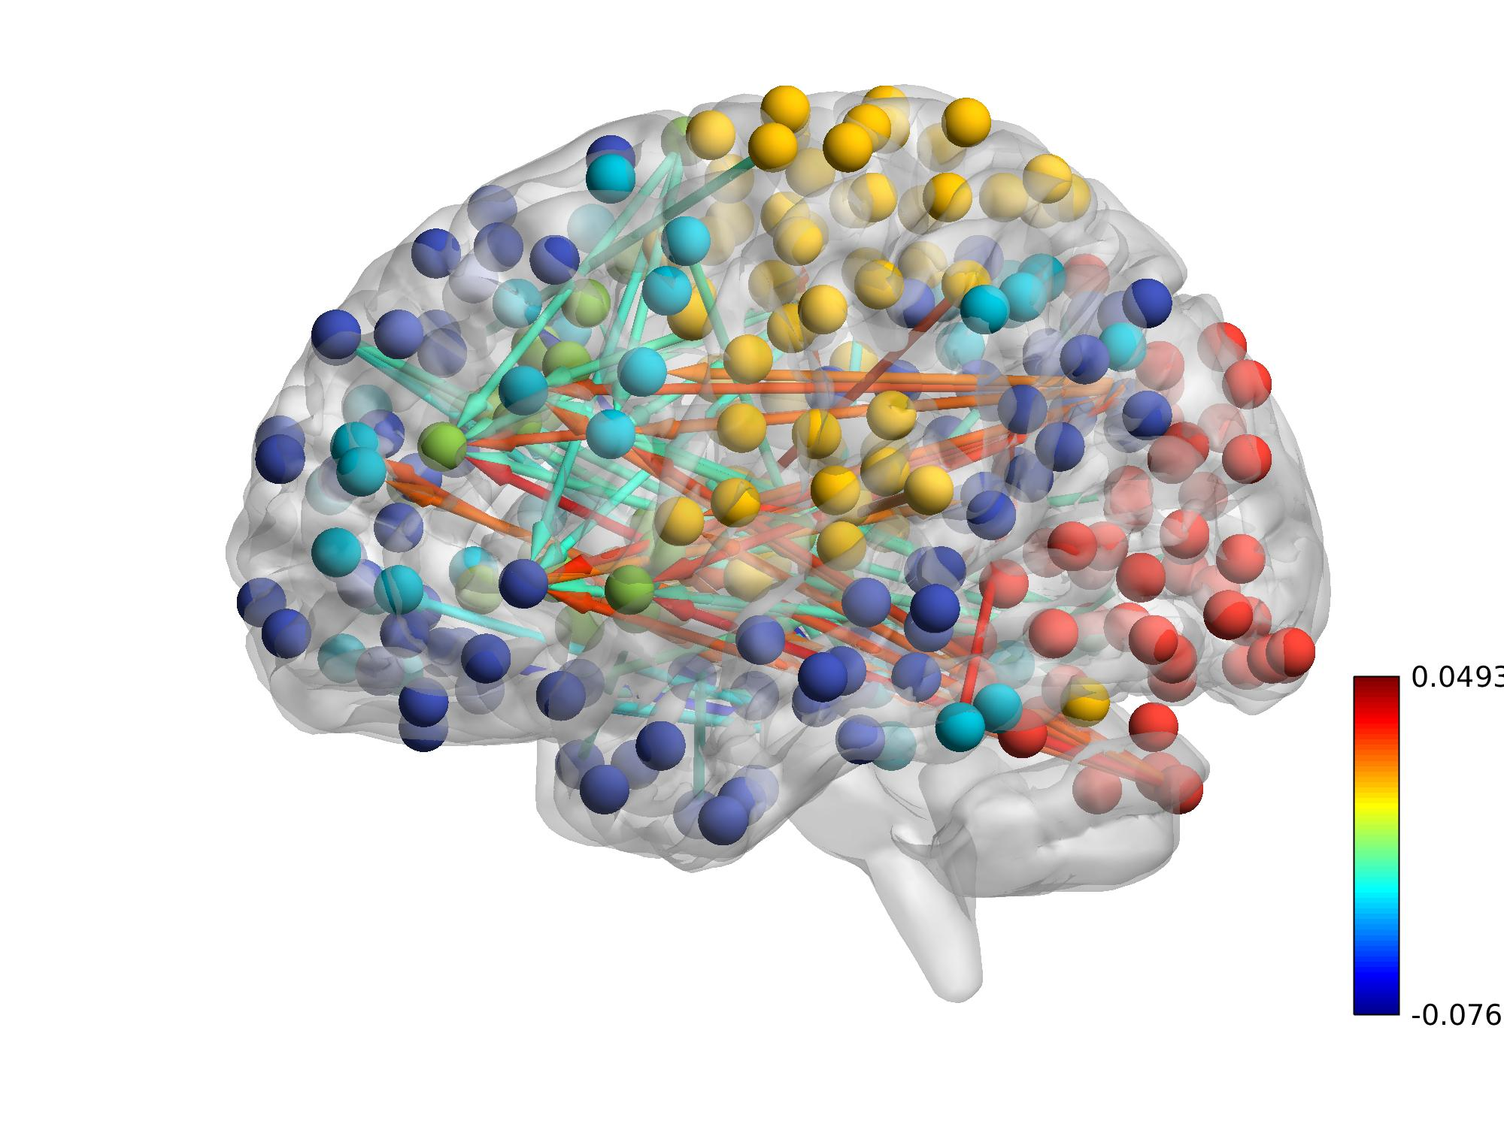
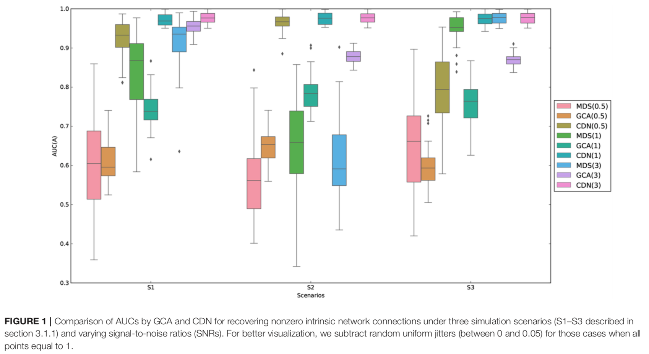
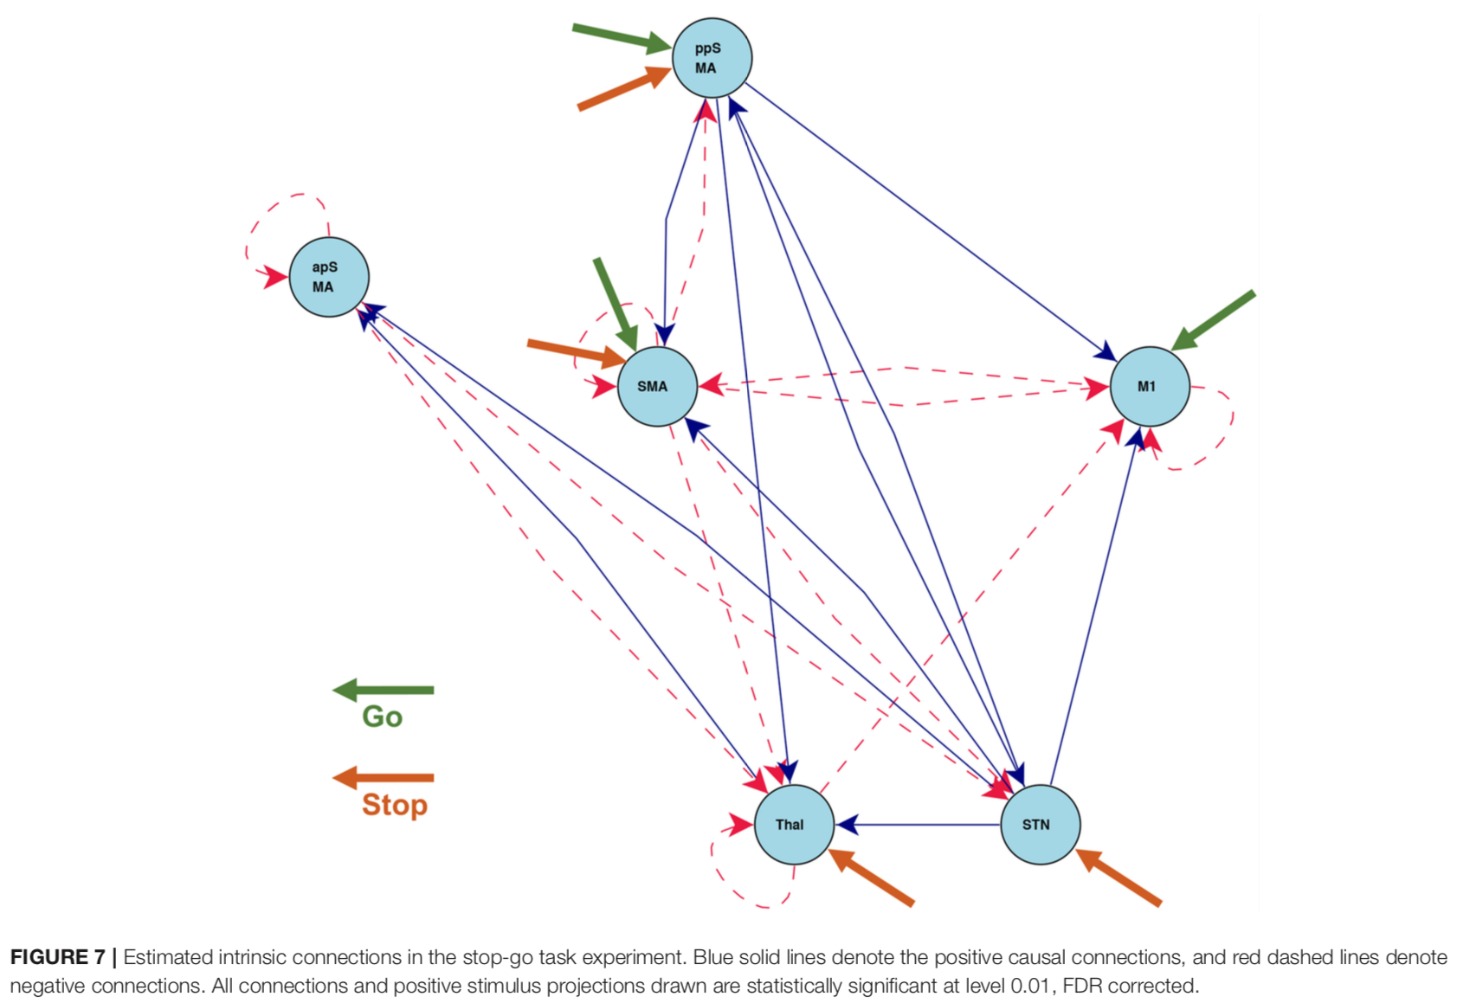
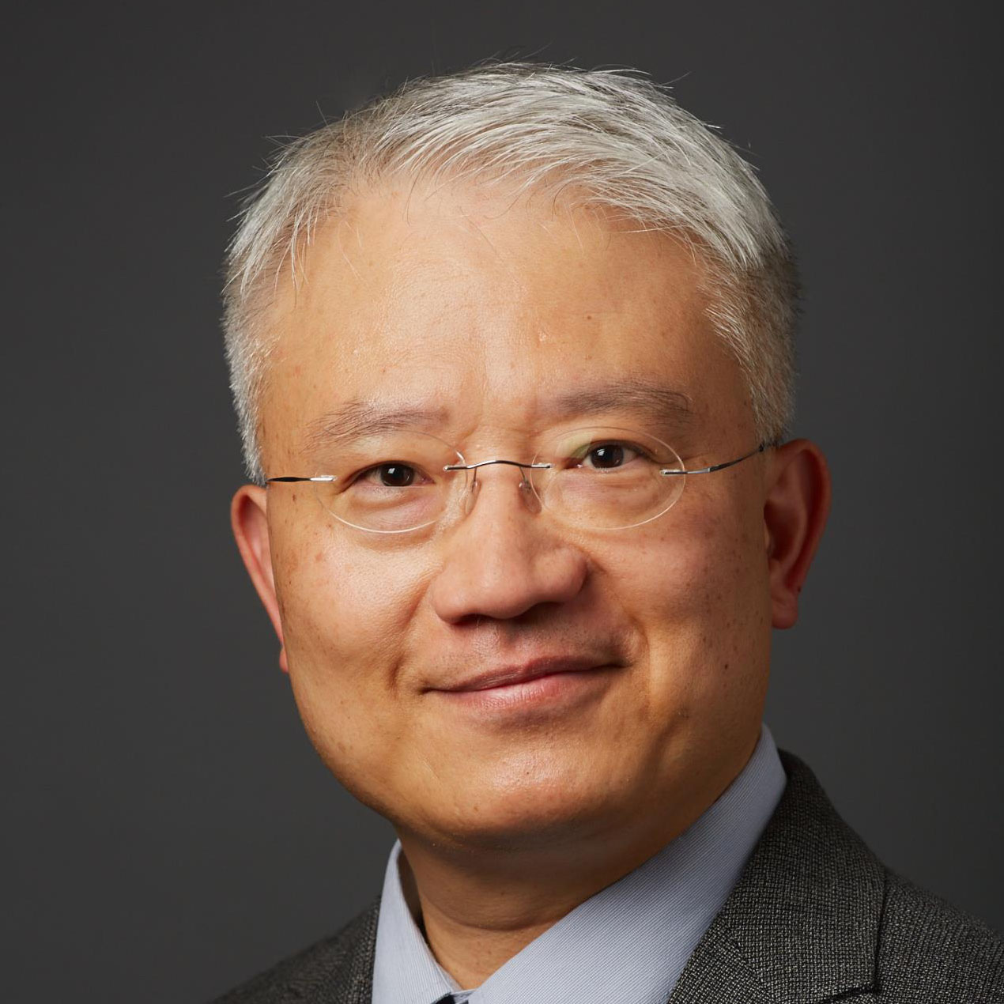
Machine Learning Models for Large-scale Brain Networks
The model Modeling how brain networks process external input is a central topic in fMRI analysis. Classical statistical methods fall into two extremes: (1) simple (and unrealistic) models (e.g. correlations) for large-scale data; (2) sophisticated models (e.g. DCM) for small brain networks (e.g. 5-10 regions) often for validating a few hypotheses under heavy assumptions. We employed machine learning (ML) and optimization algorithms to achieve the better parts of both extremes: sophisticated models for large-scale brain networks during tasks. Our ML enabled a flexible approaches to include various components: prior knowledge, ordinary differential equations (ODE), functional data analysis, regularization/Bayesian priors, constraints and etc. Our optimization algorithms made it computationally feasible to fit our models, in a data-driven way, to tens of terabytes of data.
What is new inside?
We modeled unobserved neuronal signals using functional basis expansion. This also allowed us to apply math operators (e.g. differentiation and integration) to continuous time series.
We employed ML to construct novel objective functions in order to link the neuronal signals with observed fMRI BOLD signals and task stimuli, using a DCM-like ODE model. This transformed ODE modeling from mainly a researcher-driven hypothesis validation approach to a data-driven discovery tool for identifying novel and causal mechanisms at a large scale.
We also introduced constraints to stabilize model fitting and to enhance model interpretation.
We developed convex optimization algorithms to facilitate fast computation for large-scale data.
How will this change current practice?
This enables researchers to study causal and dynamic brain networks using a data-driven and evidence-driven approach instead of hypothesis-driven.
This also enables large-scale modeling of brain mechanism without the computational constraints of previous approaches.
End Users neuroscientists with minimal Python/R programming experience.
Our software packages have been publicly distributed.
Xi Luo (UTHealth), Brian Caffo (JHU), Chiang-shan Li (Yale)
R01EB022911
Notes:
Instructions:
Submit 1 slide by COB Monday 2/25/19
Title - headline your theory-driven, mechanistic model
name the specific mathematical or statistical method and variations thereof
To include in NOTES section
define/explain it enough for a non-scientific person to explain to the general public (2-3 sentences)
We used machine learning to search the best ordinary differential equation model that fits big fMRI data. This enables discovering novel brain mechanisms and information processing at a large scale.
mention how can machine learning and AI help your project (2 sentences)
Machine learning enables constructing data-evidence-driven models of the brain, while being flexible enough to incorporate prior scientific evidences. It also enables fast computational algorithms to find automatically the best brain model supported by data.
List future challenges or next steps after your project is done (1 sentence)
Develop easy-to-use interfaces for neuroscientists or general public even without any programing experience. Expand our ML approach to integrate data from multiple modalities.
Further details for Notes section - For the following communities (2 sentences):
BRAIN: explain the theory behind the math/stats and how it will be used to understand how the brain works; explain the level of data dependency on your model (e.g.: (a) completely abstract toy model, (b) a coarse-grained model based on a high level view of previous data, (c) a model based directly on one kind of data (e.g., neural recordings) or (d) a model synthesizing multiple data types (e.g., neural recordings and connectomics).
Our models discover the causal and dynamic mechanisms of the brain using ODEs and machine learning. These models currently apply to fMRI data with any experimental designs: event-related, block designs, and resting-state.
PI name, email:
Xi Luo, rossi.stat@gmail.com

