Slide 1
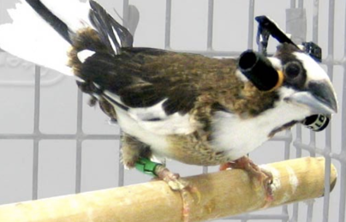
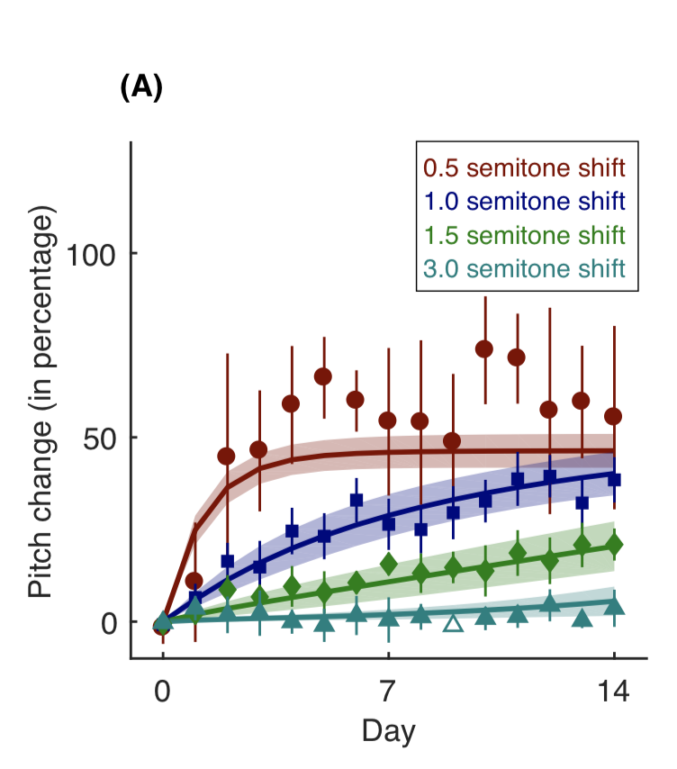
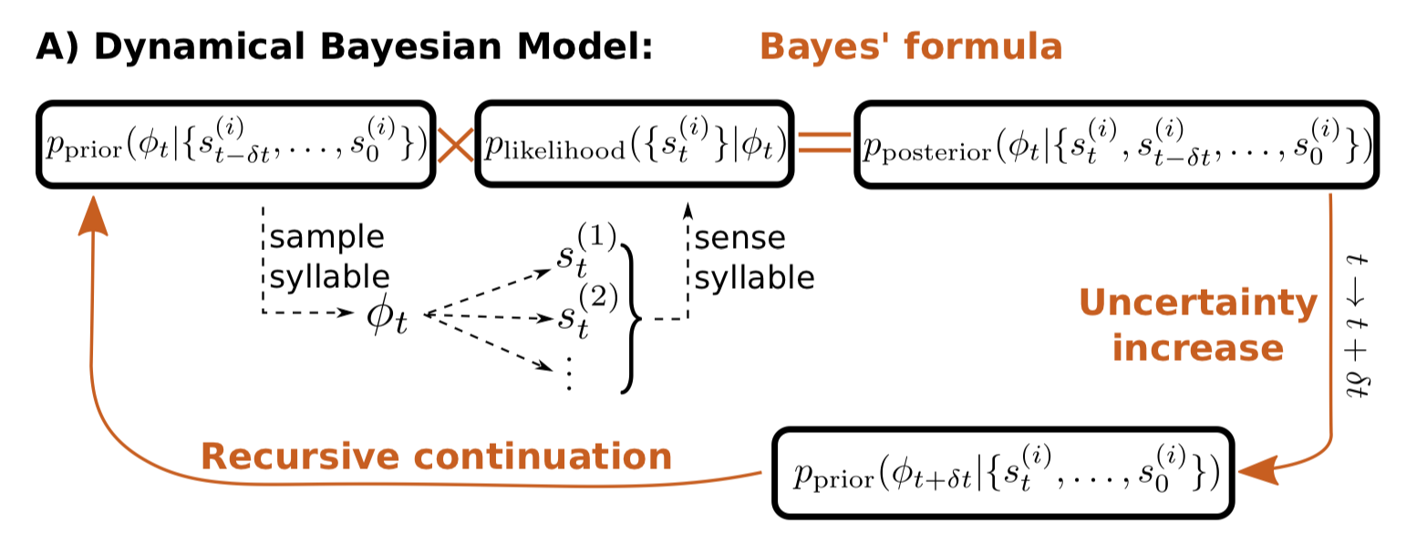
Non-Gaussian Bayesian Theory of Sensorimotor Learning
The model helps to understand complex motor skills acquisition by animals. We proposed and validated the theory that posits that animals control the entire distribution of motor commands they generate, and update it using Bayesian principles. The distribution of motor commands has long, non-Gaussian tails, which explains why many animals do not respond to large sensory errors, but correct small ones. The primary data analyzed includes pitch sung by birds after a sensorimotor perturbation.
What is new inside?
How will this change current practice?
New view of sensorimotor loop (distribution error, not target error). Design optimal perturbations. Lift critical periods.
End Uses Modeling sensorimotor learning and its neural underpinnings in different animals. Data: behavior and neural quantifications.
Ilya Nemenman
Sam Sober
NIBIB 5 R01 EB022872
Notes:
PI name, email: Ilya Nemenman, ilya.nemenman@emory.edu

