Slide 1
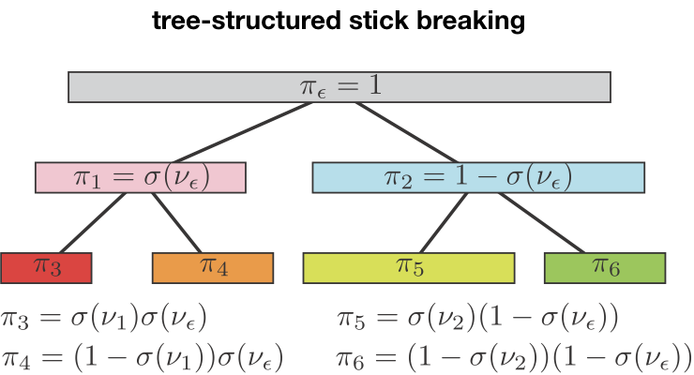
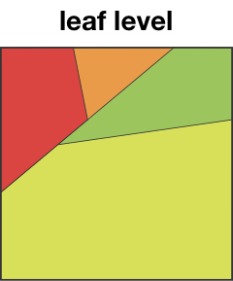
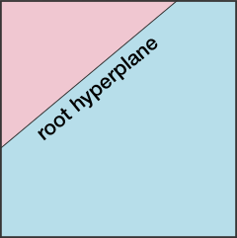
Multi-scale modeling of neural dynamics
Interpretable neural time series model to gain insight into how they work, make predictions about how they will behave, and develop strategies for controlling them.
Tree-structured recurrent switching linear dynamical systems:
Hierarchically decomposing nonlinear dynamics to be locally linear while allowing fully Bayesian sampling inference.
This method improves visualization and human understanding of
complex nonlinear neural dynamics without trial averaging.
End Users: statistically inclined experimentalist with large-scale population recording Open source Python implementation available. https://github.com/catniplab/tree_structured_rslds
videos of Lorenz attractor modeled with 2 or 4 locally linear dynamics
Nassar, J., Linderman, S. W., Bugallo, M. & Park, I. M. Tree-Structured
Recurrent Switching Linear Dynamical Systems for Multi-Scale Modeling.
(accepted in ICLR 2019; arXiv:1811.12386)
Il Memming Park Stony Brook University
NIBIB 1R01EB026946-01
Notes:
As higher-dimensional neural population recordings become available, the question arises of whether we can learn the underlying dynamical law that governs neural information processing solely based on the recorded neural activities. To understand the complex law governing the neural population, we decompose the intricate space of brain states into multiple regions with simple description.
The statistical inference of this interpretable model hinges strongly on machine learning techniques to make it feasible. In particular, we leverage efficient Polya-Gamma augmented Monte Carlo Markov Chain based inference to find model parameters and brain states along with associated uncertainty.
Our next challenge is to test this model on neural signal from animals engaged in simple tasks to uncover their internal state and strategy.
This model is agnostic of circuit or system models, and completely dependent on large-scale neural time series data that exhibits low-dimensional dynamics. It automatically provides a multi-resolution view of the inferred dynamics.
Il Memming Park, memming.park@stonybrook.edu

