Slide 1
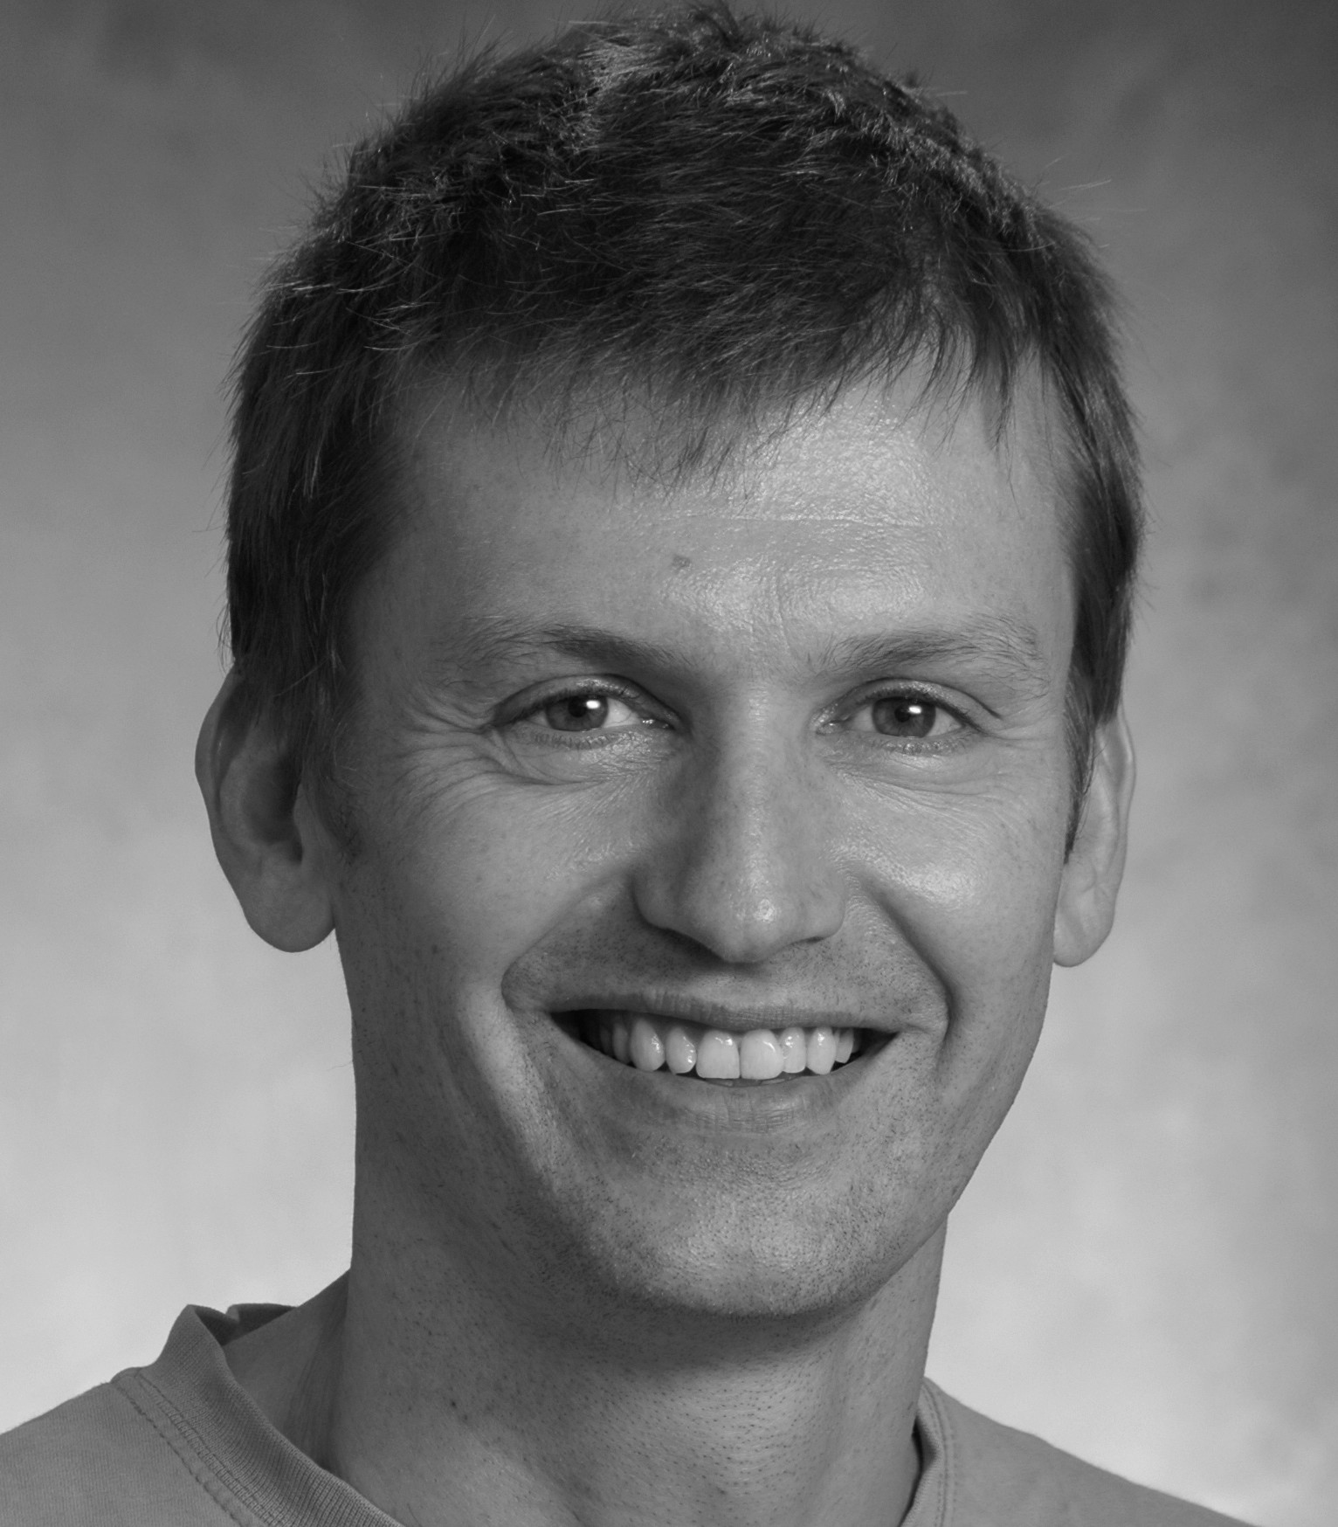
Models of sequence learning in recurrent neural networks
The model
Model 1: Recurrent rate model with online temporally asymmetric Hebbian plasticity and various stabilization mechanisms: Understanding in which conditions the network learns persistent or sequential activity as a function of the inputs.
Model 2: Recurrent rate model with temporally asymmetric Hebbian connectivity matrix: Calculation of storage capacity, and understanding of how sequence properties (like sparseness) depend on parameters of the learning rule.
Model 3: A universal architecture for learning temporal sequences. A model of spiking neurons that can emulate and learn both the order and the duration of each element in a sequence (see attached video).
What is new inside?
Previous models of sequence learning have typically not been biologically realistic and at the same time they have not been rigorously analyzed. Our models are addressing these two concerns.
Model 1: Calculation of `phase diagram’ showing the different phases reached by the network during learning (in particular, persistent activity and sequential activity
Model 2: Calculation of network storage capacity
Model 3: A universal architecture with timing elements that use recurrent connectivity and message passing elements that depend on the convergence of excitation and inhibition. The model also uses a novel biologically inspired learning rule.
How will this change current practice?
Shows that models with simple temporally asymmetric learning rules can explain diversity of dynamics observed in delayed response tasks in cortex
Shows the potential importance of the layered organization of cortex in learning both the order
and duration of temporal sequences
End Users
These could be used by experimental groups to model their data, or by theorists to further
develop the theory. Code available in on github.
Harel Shouval (University of Texas, Houston)
Nicolas Brunel (Duke University)
Grant support: NIH R01EB022891
Notes:
Notes on Video: This video represents 4 cortical micro-columns each with a different preferred orientation. This animation shows the activation of deep layers neurons in yellow, these are the timers, and the superficial layer neurons in blue, these are the message passers. Initially each column is activated only by external stimuli. After training it is sufficient to activate the first element, and the network completes the sequence with the correct order and approximately correct duration.
Notes on Models:
Brain networks are thought to be able to learn dynamical sequences of activity from their external inputs, that represent sequences of external inputs and/or motor actions that need to be performed by an animal. We have investigated the mechanisms by which recurrent networks can learn to generate sequences from their external inputs, using the mechanism of synaptic plasticity.
We have not used methods from machine learning or AI in this project since the focus in on biologically plausible learning rules, as opposed to the rules that are used in machine learning. However, we expect machine learning will eventually gain from a better understanding of neurobiological learning rules.
Most of the analysis has been performed with simplified rate models. The next challenge is to extend the work (in particular the analytical calculations) to more realistic spiking network models. Model 3 is a more biologically realistic spiking model and for model 3 currently results are based on simulations and are not yet analytical.
The main theoretical tools are (1) dynamical systems analysis of a complex network with dynamical neurons and synapses, for the study of both fixed point attractors and transients; (2) dynamical mean-field theory to compute characteristics of sequences in the large N (network size) limit. (3) extensive simulations of dynamical systems.
PI names: Harel Shouval (UT Houston), Nicolas Brunel (Duke)
Harel Shouval, harel.shouval@uth.tmc.edu
Nicolas Brunel, nicolas.brunel@duke.edu
1

