Slide 1
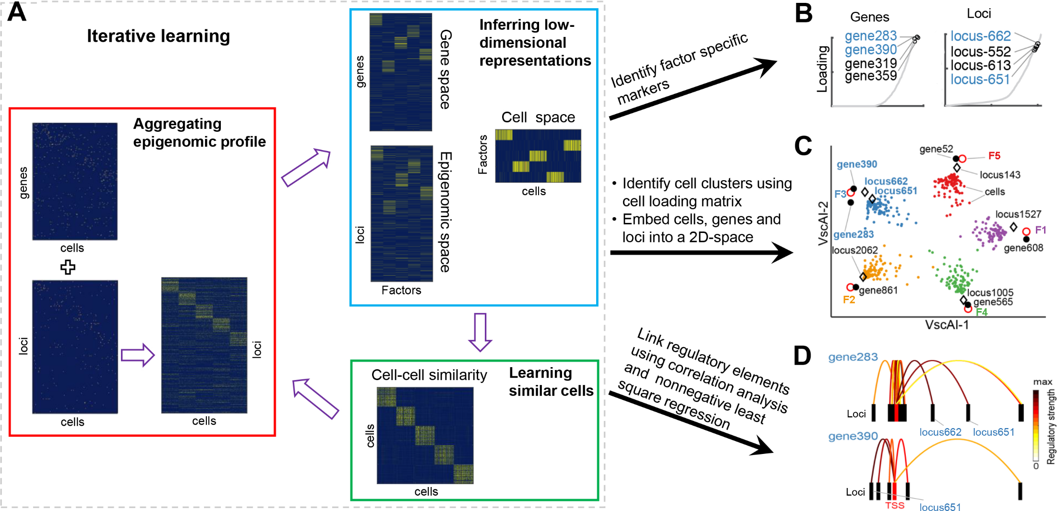
Overview of scAI and its model credibility report
S. Jin, L. Zhang, & Q. Nie. Genome Biol. 2020, 21(1):25

