Slide 1
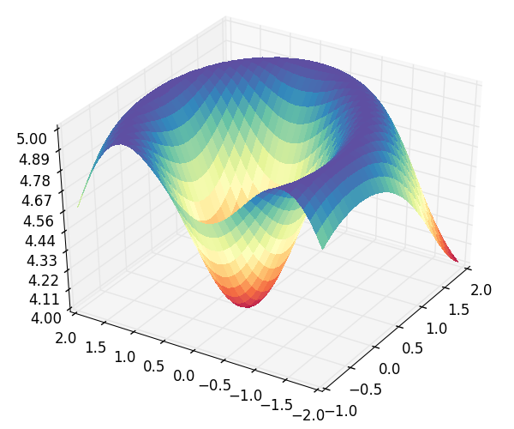
The Reference Model For Disease Progression
A
B
Process CHD
The most validated diabetes cardiovascular model known worldwide
Ensemble model where models cooperate and/or compete
Validates model results against outcomes observed in multiple clinical trials
Uses Machine Learning and High Performance Computing
Extracts data from ClinicalTrials.Gov
aA+bB+cC+dD
Eq EH | E | E | E | E | …
Eq AD | A | B | C | D | …
Pop 1 | 4 | 6 | 2 | 1 | …
Pop 2 | 2 | 4 | 6 | 1 | …
Pop 3 | 2 | 3 | 9 | 2 | …
… | … | … | … | … | …
Pop 3
D
C
No CHD
MI
Survive MI
CHD Death
Pop 2
Pop 1
E
F
eE+fF+gG+hH
Process Stroke
Death
No Stroke
H
G
Stroke
Survive Stroke
Stroke Death
Discrete Fitness Matrix
Process Competing Mortality
Alive
Other Death
Continuous Fitness Space

