Slide 1
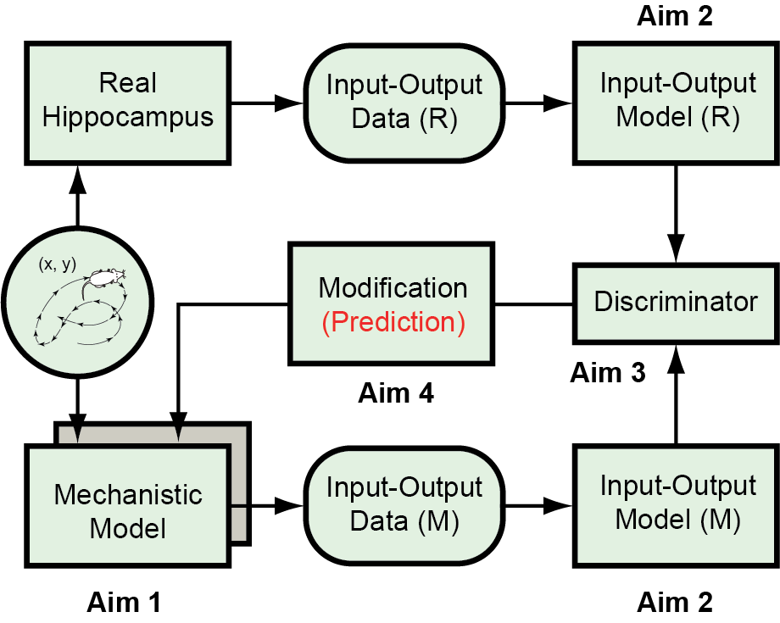
Mechanistic and Input-Output Modeling of the Hippocampus
A modeling paradigm that synergistically combines mechanistic and input-output modeling techniques to build a full-scale realistic model of the hippocampus that are functionally indistinguishable from the real hippocampus
Modeling framework inspired by the generative adversarial network (GAN)
Full-scale mechanistic model as the generative model (Aim 1)
Large-scale input-output model-based discriminative model (Aim 2 & 3)
A GAN-like procedure that (1) identifies discrepancies between the mechanistic model and the real hippocampus, (2) optimizes the mechanistic model, and (3) suggests new experimental validations (Aim 3 & 4)
This paradigm seeks to provide a general computational framework for integrating biological knowledge, hypotheses, and input-output data to gain deeper understanding of cognitive functions
End Users: Neuroscientists who are interested in building biologically and functionally realistic models of the brain; modelers who want to constrain their biological models with large-scale population recordings during behaviors
Dong Song
University of Southern California
NIDA 1RF1DA055665
Notes:
PROJECT ABSTRACT
Large-scale realistic model of neuronal network is a powerful tool for studying neural dynamics and cognitive functions. It integrates multi-scale neurobiological mechanisms/processes identified through diverse hypotheses and experimental data into a single platform. However, due to its high complexity and lack of neuron-to-neuron correspondence to experimental data, it is difficult to constrain, validate and optimize such a model using large-scale neural activities recorded from behaving animals, which are most relevant to cognitive processes. We propose to develop a novel modeling paradigm inspired by the generative adversarial network (GAN) to synergistically combine both mechanistic and input-output (machine learning) modeling techniques to build large-scale realistic models that are functionally indistinguishable from actual neuronal networks. We will apply this paradigm to the modeling of the hippocampus to reveal how spatial information is encoded and re-encoded in the hippocampal neuronal networks during navigation. Specifically, full-scale mechanistic model of the hippocampus will be constructed as the generative model to simulate how hippocampal circuits generate ensemble spiking activities in response to 2D trajectories during navigation. Large-scale population-level input-output models will be developed to statistically characterize input-output properties of the real hippocampus and the hippocampal mechanistic model. The input-output models of the mechanistic model will be evaluated by a discriminator against the ground truth input-output models of the real hippocampus. This forms the discriminative model that (1) identifies discrepancies between the mechanistic model and the real hippocampus, and (2) guides the optimization/modification of neuron model and connectivity parameters of the generative model. This procedure will be performed iteratively until the discriminator fails to distinguish the generative (mechanistic) model from the real hippocampus. In addition, the modifications to the mechanistic model generated by this paradigm will provide falsifiable predictions that can be further tested experimentally. We expect to use this combined mechanistic and input-output modeling strategy to unveil how (1) causal relations between spiking activities across different hippocampal subregions, and (2) place fields of hippocampal neurons, are determined by multi-scale neurobiological mechanisms and the interplay between these mechanisms. The proposed methodology will provide a general computational framework for integrating biological knowledge, hypotheses, and large-scale input-output data to gain deeper and more quantitative understanding of cognitive functions.

