Slide 1
Data science framework for facilitating the workflow for data aggregation and analysis
MoC3 U19: Motor Control Circuits, Computation (Costa, Zuckerman Institute, Columbia University)

Slide 2
Data science requirements
Tool set
General
Lab’s workflow will be based on general guidelines for easy sharing
Data handling
Flexibility in modeling the labs workflow
Software handling
Will not depend on specific key person in the lab
User friendly for the labs and RC team
Analysis management

Slide 3
Data science framework
Lab based workflow
Stand alone
Pipeline manager
Database
Software control
User friendly
Flexible

Slide 4
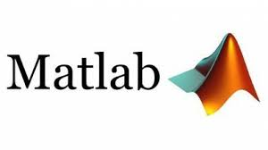
The selected tools
Lab based workflow
Stand alone
DataJoint
MySQL
GitHub
User friendly
Flexible

Slide 5
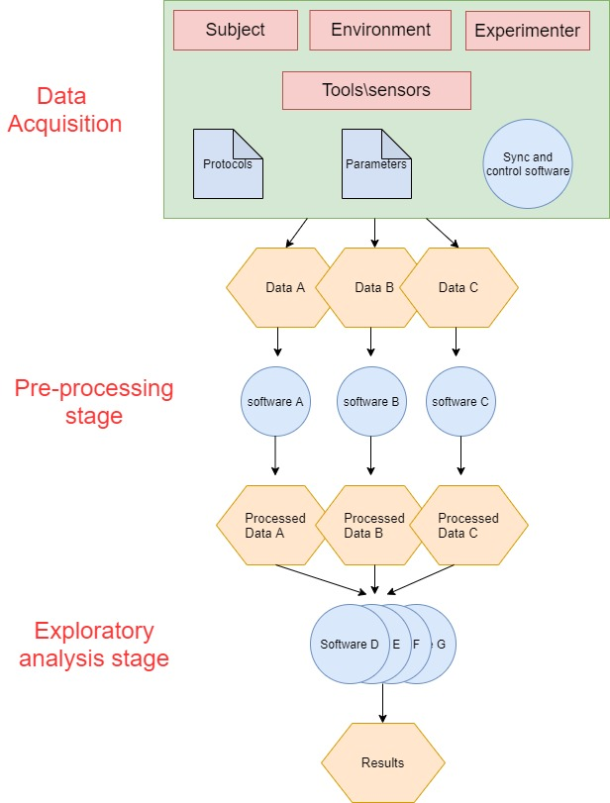
Common language for experimental workflow across MoC3 labs
A typical schema contains three main stages:
Data acquisition session
Preprocessing stage
Exploratory analysis stage
Each stage contains:
input (from a database) action output (to a database)

Slide 6
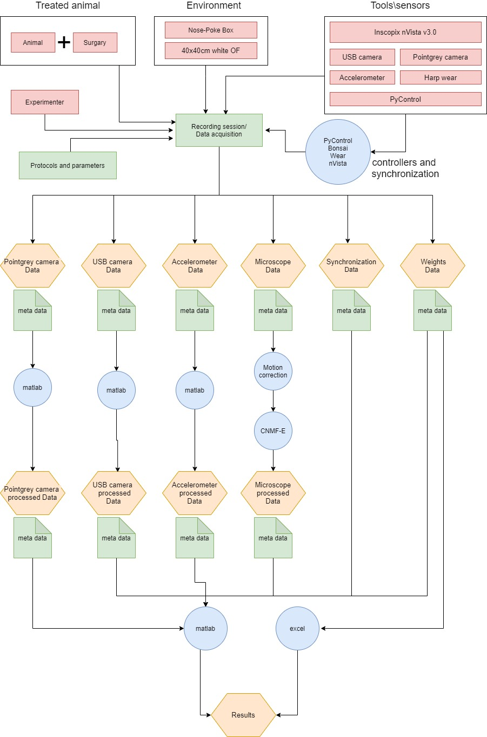
Example of detailed pipeline from an MoC3 lab
The main differences between labs are in the details and the research focus but the common workflow structure can be seen.

