Slide 1
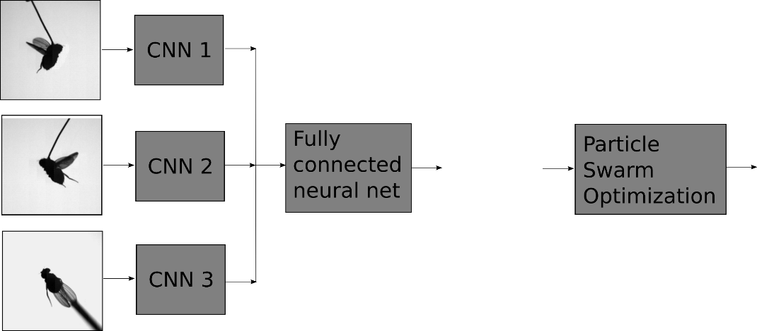
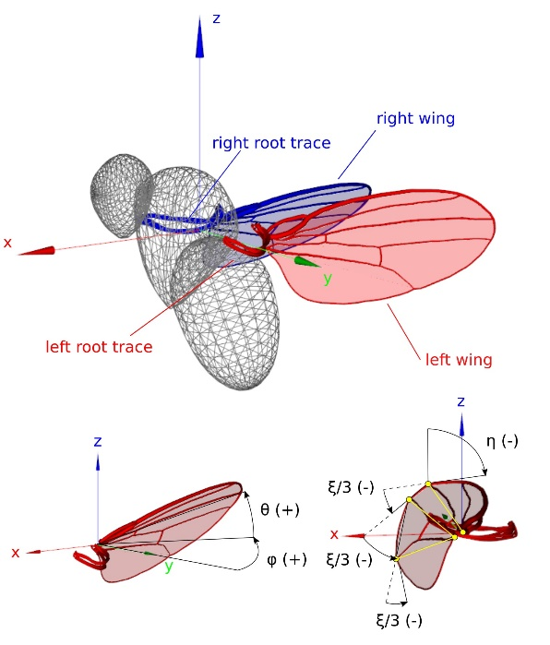
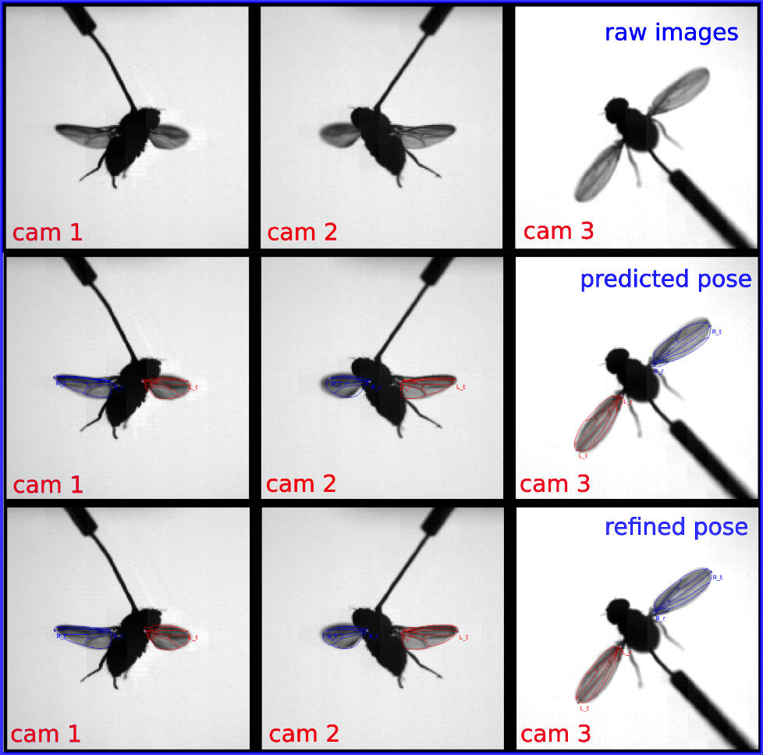
Accurate 3D pose reconstruction using Convolutional Neural Networks and Particle Swarm Optimization.
Flies control wing motion using 12 steering muscles per wing. To investigate how steering muscles actuate wing motion, we build a setup consisting of 3 high-speed cameras and a microscope which can image muscle activity through the cuticle using a genetically encoded fluorescent calcium-indicator (GCaMP7F). We have recorded a large dataset of high-speed images (>7 million frames) coupled to muscle fluorescence images. To be able to derive the aerodynamic function of the steering muscles it is paramount to accurately reconstruct the 3D wing pose from the high-speed images.
predicted pose
refined pose
$$\left[\begin{matrix}\begin{matrix}\hat{φ_{L}} & \hat{φ_{R}} \\ \hat{θ_{L}} & \hat{θ_{R}} \\ \hat{η_{R}} & \hat{η_{R}}\end{matrix} \\ \begin{matrix}\hat{ξ_{L}} & \hat{ξ_{R}} \\ \hat{x_{L}} & \hat{x_{R}}\end{matrix} \\ \begin{matrix}\hat{y_{L}} & \hat{y_{R}} \\ \hat{z_{L}} & \hat{z_{R}}\end{matrix}\end{matrix}\right]$$
$$\left[\begin{matrix}\begin{matrix}φ_{L} & φ_{R} \\ θ_{L} & θ_{R} \\ η_{L} & η_{R}\end{matrix} \\ \begin{matrix}ξ_{L} & ξ_{R} \\ x_{L} & x_{R}\end{matrix} \\ \begin{matrix}y_{L} & y_{R} \\ z_{L} & z_{R}\end{matrix}\end{matrix}\right]$$
Our automated wing tracking methodology uses a hybrid approach of machine learning and 3D model fitting. The output of the algorithm is a vector describing wing orientation ($φ$, $θ$, $η$), wing root position ($x$,$y$,$z$) and shape ($ξ$). The workflow per frame consists of 2 steps:
3 Convolutional Neural Networks (CNN) take in the images of each view and extract relevant features (i.e. wing veins, contours). The feature vectors of each view are combined in a fully connected neural network which has learned a non-linear regression between the feature vectors and the pose vector.
The predicted pose vector is usually close to the true pose, however to improve accuracy and reliability we use 3D model fitting on the images. A Particle Swarm Optimization algorithm performs a local search around the predicted pose and uses contour-matching as a cost metric. The pose with the highest overlap between model and image in each view is selected as the refined pose.

