Slide 1
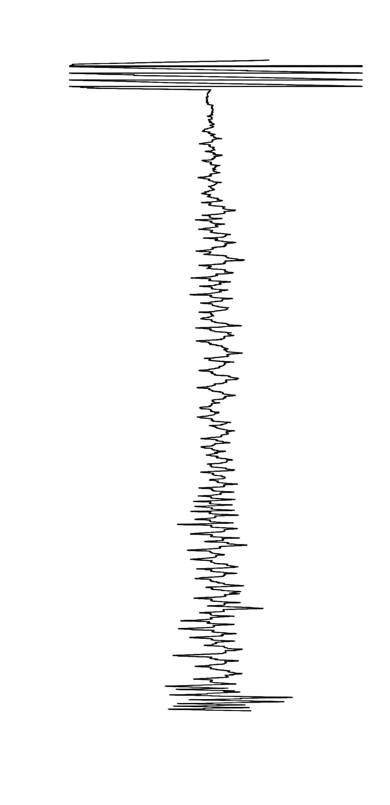
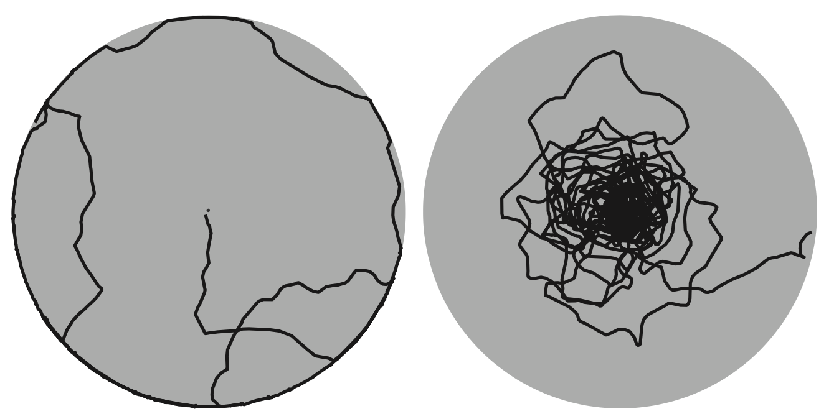
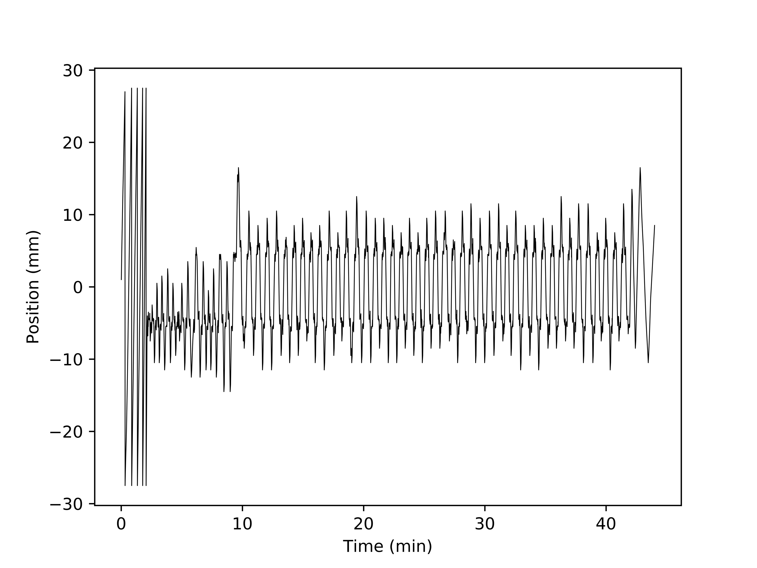
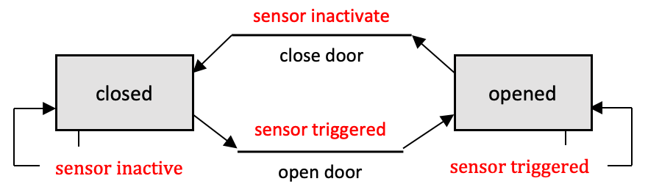
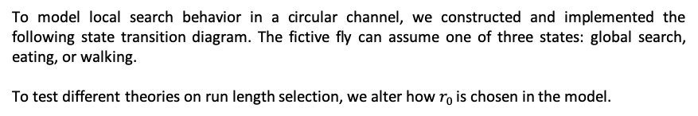
State-based modeling of local search in Drosophila
Goal
State transition diagram to model local search
By using state transition based modeling, we can determine the neural mechanisms governing local search.
To model local search behavior in a circular channel, we constructed and implemented the following state transition diagram. The fictive fly can assume one of three states: global search, eating, or walking.
To test different theories on run length selection, we alter how $r_{0}$ is chosen in the model.
Background
After finding a drop of food in nature, hungry flies execute a local search where they walk away from and then return to the food site.
Before food
After food
Food site
Kim and Dickinson (2017)
To simplify the analysis, we constrain the flies to a circular channel and optogenetically induce local search.
activation protocol on
position
0
11
time (minutes)
State transition diagrams
State transition diagrams are commonly used to model engineering systems where states are connected by deterministic or stochastic transitions.
Model generates realistic traces
Conclusion
Upon finding a food site, the fly initiates a local search.
The search is then expanded when the fly encounters the second food site.
A state transition diagram based model of local search implementing run length selection based on path integration generates realistic traces.
By implementing different mechanisms for path length selection and comparing the generated search to real data, we can determine the underlying neural mechanisms.
Simulation
In this example, an automatic door is opened when a sensor is triggered and is otherwise closed.
position
Data
position
0
1
0
time (minutes)

