Slide 1
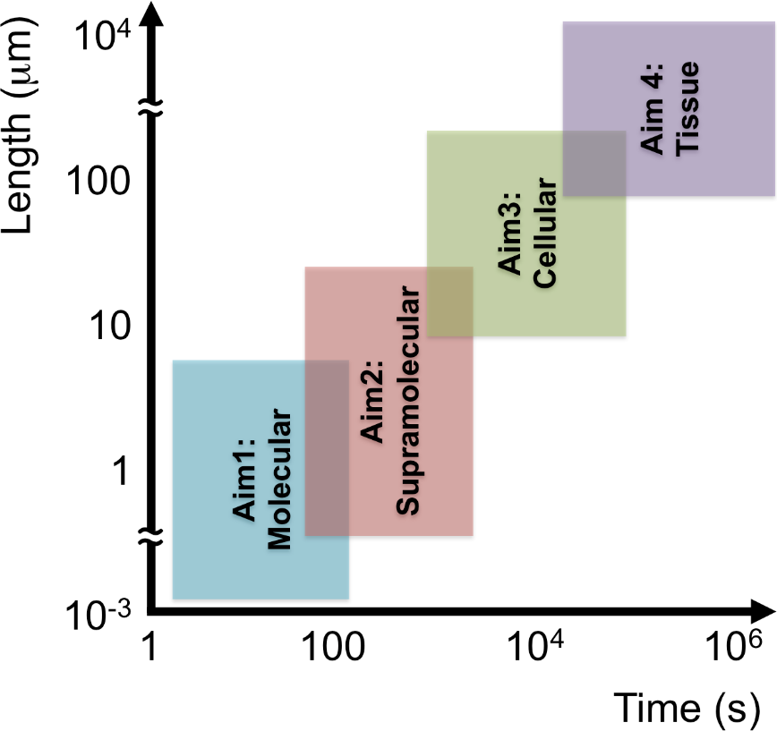
Multiscale Models of Wound Healing
The model
Proper healing of cutaneous wounds requires collective and coordinated cellular behavior that spans multiple length and time scales. The rate of wound repair is limited by the slow recruitment of fibroblasts, whose migration is elicited by gradients of platelet-derived growth factor (PDGF). We have been developing models of fibroblast chemotaxis with consideration of molecular, supramolecular, cellular, and tissue-level dynamics, which span disparate time (seconds to weeks) and spatial (nm to cm) scales.
What is new inside?
We combine a host of modalities (reaction-diffusion, continuum mechanics, data-driven correlation, statistical physics, hybrid modeling) to model aspects of wound healing at different scales. The output(s) of each scale’s model naturally informs or serves as the input(s) of the next scale.
How will this change current practice? A handful of biologicals are currently approved for treatment of wounds; however, the current treatments have limited efficacy. Knowledge of molecular, cellular, and tissue-level processes need to be connected to inform and predict outcomes of improved therapeutic strategies.
End Users: We envision that our models will be used by other researchers who wish to build upon them and by modeling groups in the pharma industry (several companies now have systems pharmacology groups). Basic expertise in computational modeling will be required.
Jason Haugh (PI), North Carolina State University
James Bear, UNC-Chapel Hill
Timothy Elston, UNC-Chapel Hill
NIBIB, EB018816
Notes:
To include in NOTES section
define/explain it enough for a non-scientific person to explain to the general public (2-3 sentences)
mention how can machine learning and AI help your project (2 sentences)
List future challenges or next steps after your project is done (1 sentence)
To understand how wounds heal and predict how we might improve wound healing outcomes, we need to connect molecular, cellular, and tissue levels of abstraction. Wound healing requires the coordinated movements and functions of different cell types elicited by spatial cues in the tissue. We are modeling how populations of cells collectively sense and respond to those cues.
Machine learning approaches are being pursued in this project to 1) automate the tracking of cells in movies of cell migration experiments; and 2) compress information about cell shape and cell shape changes during cell migration.
The future challenge will be to refine the model with multiple cell types, multiple spatial cues (including mechanical cues), and multiple intracellular reaction pathways.
Further details for Notes section - For the following communities (2 sentences):
Multiscale modeling: explain how the math will address methodological challenges (e.g.: crossing scales, sparse data, uncertainty, modularity, spatiotemporal simulation challenges, etc.)
The primary methodological challenge encountered in this project is crossing scales. Our approach to this is to define gradient sensing as an inherently biochemical process and cell movement as an inherently mechanical one. The cytoskeleton (containing actin filaments and non-muscle myosin) serves as the natural interface between the two.
PI name, email: Jason Haugh, jason_haugh@ncsu.edu

