Slide 1
Status Update to the IMAG on the
Activities and Accomplishments of the CPMS
https://simtk.org/home/cpms
Presented by Lealem Mulugeta
On Behalf of the Committee
Interagency Modeling and Analysis Group Monthly Meeting
Tuesday March 4, 2014

Slide 2
Overview of Committee’s Charges
Guidelines & Procedures
  Credible practice in computational medicine
  Leveraging readily available techniques
  Define novel translational workflows to enhance credibility practice
Demonstrate Workflows
  Conduct studies to develop novel credibility assessment procedures
  Disseminating examples of credibility assessment
Consistent Terminology
  Unify the use of M&S vocabulary across all stakeholders
Promote Good Practice
  Bridge synergistic activities within the M&S communities
  conduct outreach activities.
End Products
“Guidelines for Credible Practice of M&S in Healthcare”
Proposed model certification process
Identify new areas of research to advance I & II

Slide 3
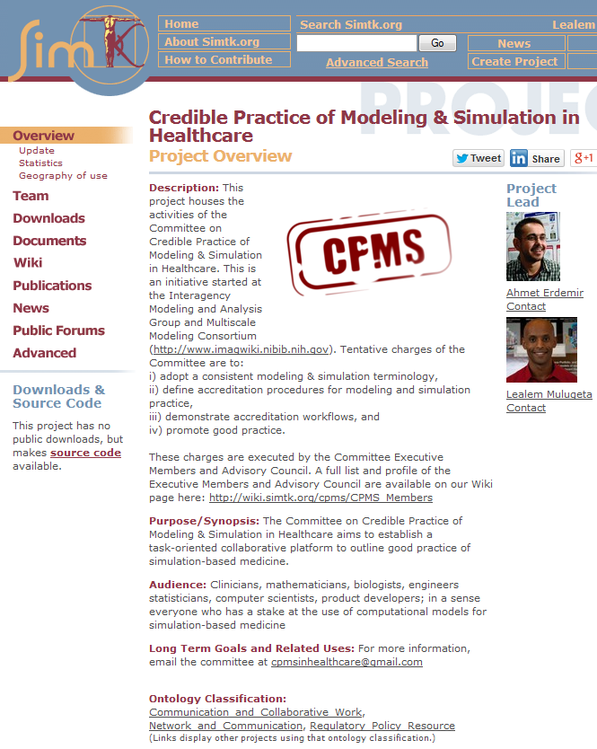
Committee’s Website and Online Resources (1/2)
Open platform to allow all stakeholders to participate and monitor on-going activities :
Meeting minutes
Wiki pages for content generation and planning for key activities
Publications
Public forum for active participation and monitoring of in new ideas the Committee is considering
Subversion repository for access of latest versions of all downloadable products
URL: https://simtk.org/home/cpms

Slide 4
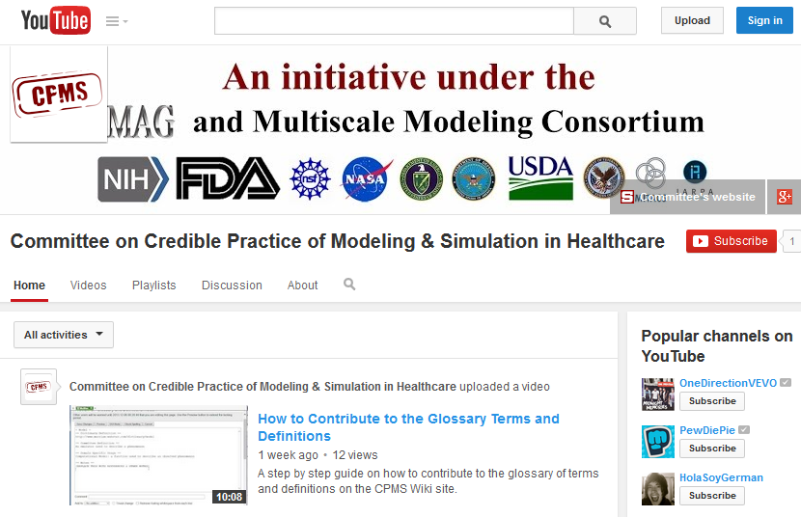
Committee’s Website and Online Resources (2/2)
Recently established a YouTube Channel to share any video recorded media generated by the Committee (e.g. Webinars and Tutorials )

Slide 5
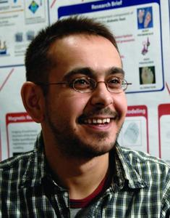

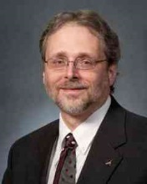
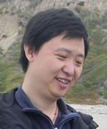
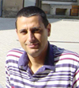
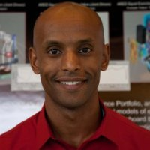
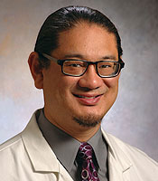
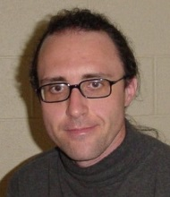
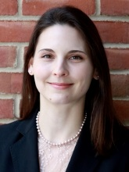
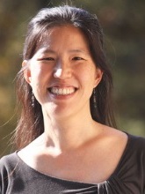
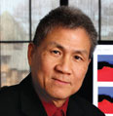
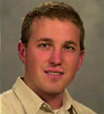
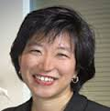
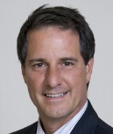
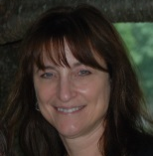
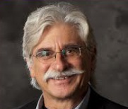
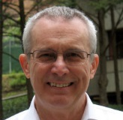
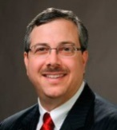
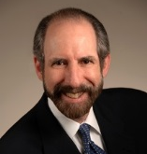
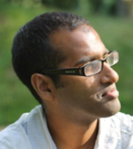
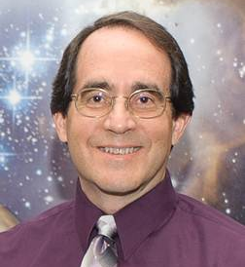
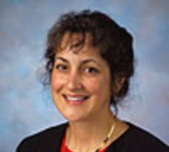
Full Committee Roster as of October 2013
Committee Executive Members (Execute & Charge)
A. Erdemir, Ph.D.
Co-Chair
Cleveland Clinic
W. Lytton, M.D.
Kings County Hosp.
Downstate Med. Cntr
J. Myers, Ph.D.
NASA
L. Tian, Ph.D.
Stanford U.
M. Garbey, Ph.D.
U. of Houston
L. Mulugeta, M.Sc.
Co-Chair
USRA
G. An, MD
U. of Chicago
J. Barhak, Ph.D.
Independent
T. Morrison, Ph.D.
FDA
J. Ku, Ph.D.
Stanford U.
Communication Accountability
Advisory Council (Review & Advise)
W. Kam Liu, Ph.D.
Northwestern U.
J. Bischoff, Ph.D.
Zimmer
G. Peng, Ph.D.
NIH
J. Thomas, M.D.
Cleveland Clinic
D. Lochner
FDA
V. Marmarelis, Ph.D.
U. of Southern California
A. Hunt, Ph.D.
U. of California, SF
D. Eckmann, M.D., Ph.D.
University of Pennsylvania
R. Germain, M.D., Ph.D.
NIH
P. Pathmanathan, Ph.D.
FDA
M. Steele, Ph.D.
NASA
M. Walton, Ph.D.
Wyle
Interagency Modeling and Analysis Group (IMAG) & Multiscale Modeling Consortium (MSM)
For full credentials of the CPMS members: http://wiki.simtk.org/cpms/CPMS_Members
Notes:
Add photos

Slide 6
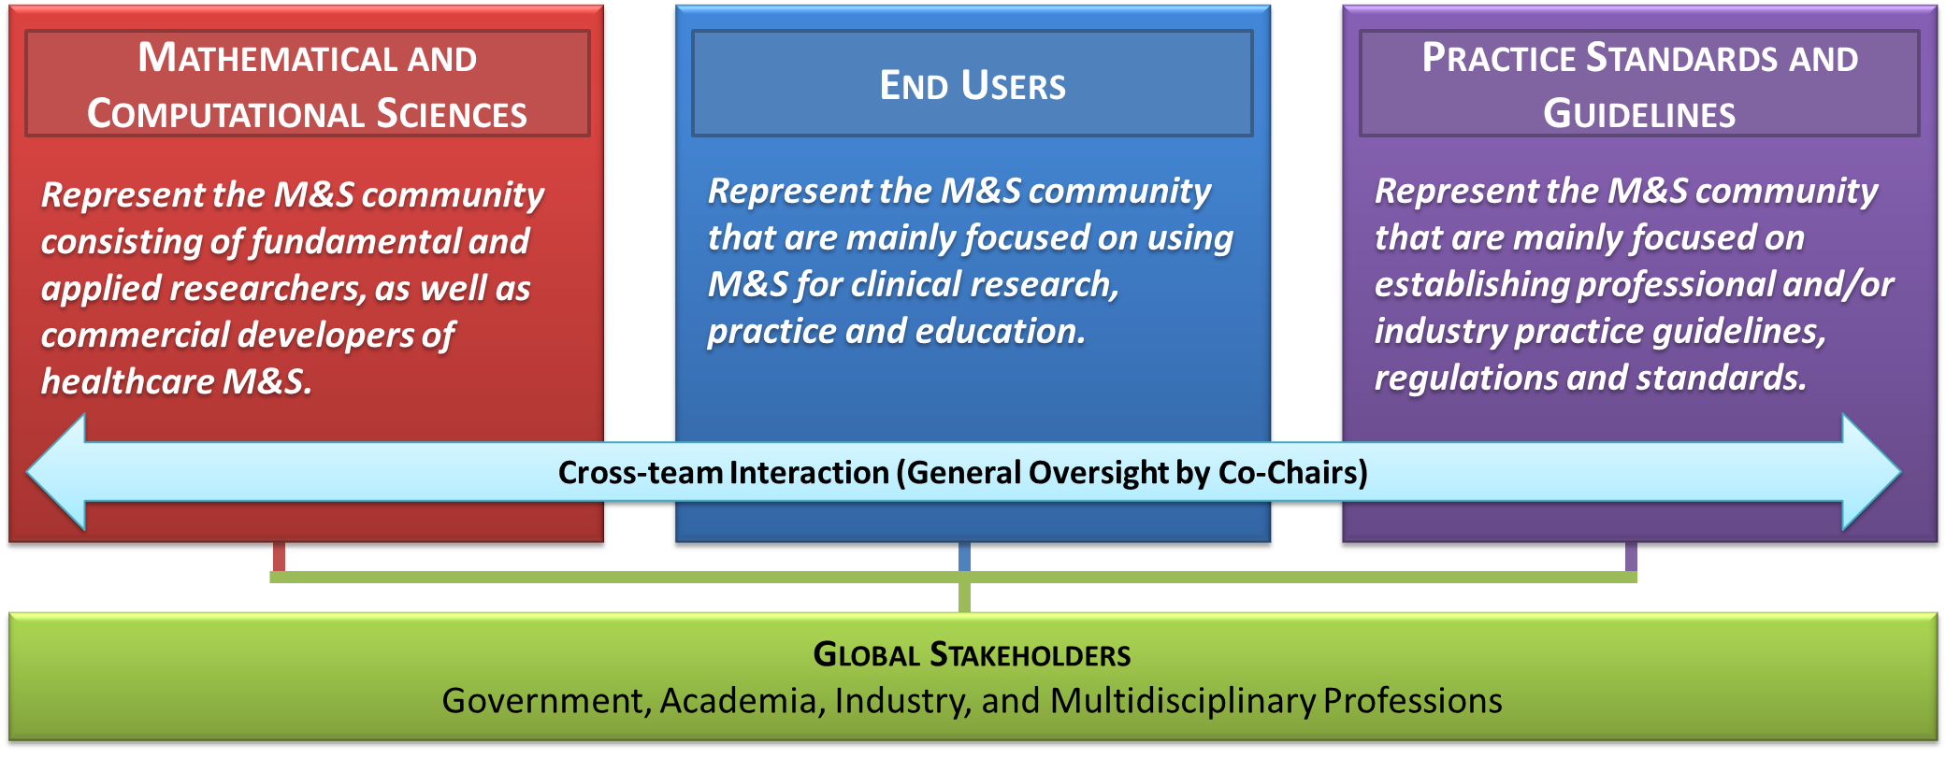
Team Based Implementation Strategy
Use team-based structure to:
Establish a balanced representation of the interests and perspectives of the different stakeholders
Bridge synergistic activities in simulation-based medicine throughout the M&S communities
More information is available at: http://wiki.simtk.org/cpms/CPMS_Task_Teams

Slide 7
Ten Simple Rules of Credible Practice
Primary deliverable: “Guidelines for Credible Practice of Modeling and Simulation in Healthcare” – by 03/2015
Goal Oriented Activity: The CPMS Task Teams were charged to identify ten key elements or simple rules of credible practice in order to establish a foundation from which the “Guidelines for Credible Practice of Modeling and Simulation in Healthcare” can be developed.
Full details of this activity is available at: http://wiki.simtk.org/cpms/Ten_Simple_Rules_of_Credible_Practice
Notes:
Make into bullets

Slide 8
Current Status on the Ten Simple Rules Activity
To initiate the Ten Simple Rules task, 26 simple rule candidates were generated and surveyed internally.
Six Diverse Examples
Explicitly list your limitations
Attempt validation within context
Attempt verification within context
Document your code
Develop with the end user in mind
Practice what you preach
Make sure your results are reproducible
Internal Survey Results
# | Consolidated & Rephrased Rules
1 | Plan and develop the M&S with clear definition of the intended purpose or context, and with end-user input
2 | Document the your code and the M&S (domain of validity/invalidity, intended use, user guide, etc), and make your code readable
3 | Use version control
4 | Test the M&S Appropriately within Context (V&V, UQ, sensitivity analysis (SA), test cases)
5 | Use appropriate data
6 | Disseminate whenever and whatever possible
7 | Explicitly list the limitations of the M&S
8 | Adopt and promote standard operating procedures
9 | Use competition of multiple implementations to check and balance each other
10 | Make it easy for anyone to reproduce and/or falsify your results
11 | Use traceable data that can be traced back to the origin
12 | Define your evaluation metrics in advance
13 | Have the M&S reviewed by independent users/developers/members
The results of the internal survey will be analyzed and reported in more detail in the coming months. This may result in a Journal article, which is still under discussion among the Executive and Advisory Council Members.
Full details are available at: http://wiki.simtk.org/cpms/Ten_Simple_Rules_of_Credible_Practice/Summary_of_Results

Slide 9

Next Step: Ten Simple Rules, Guidelines & Cert.
Public Survey of the new 33 simple rule candidates to ensure that we capture the perspectives and interests of the global stakeholder community (April-June 2014)
Seeking IRB Exemption for public survey through Cleveland Clinic and Stanford University (P.I.’s Ahmet Erdemir, PhD and Joy Ku, PhD)
Analyze data, and publish results: July 2014 – March 2015
Full survey implementation plan: http://wiki.simtk.org/cpms/Ten_Simple_Rules_of_Credible_Practice/Survey_Design
Community Generated
Ten Simple Rules
I
VI
II
VII
III
VIII
IV
IX
V
X
“Guidelines for Credible Practice of M&S in Healthcare”
Proposed model certification process
Survey of Models to develop a better understanding of the needs and successes of different types and applications of M&S in healthcare (augment public survey results)

Slide 10
Abstracts, Presentations & Collaboration Opportunities (1/2)
ASME 2013 Frontiers in Medical Devices: Application of Computer Modeling and Simulation (September 2013 in Washington, DC)
  Presented a poster: https://simtk.org/websvn/wsvn/cpms/doc/posters/asme-fda_2013%20CPMS%20Poster.pdf
  Extended Abstract: https://simtk.org/websvn/wsvn/cpms/doc/abstracts/asme-fda_2013.pdf
Society for Simulation in Healthcare (SSH) International Meeting on Simulation in Healthcare (January 27, 2014 in San Francisco, CA)
  Invited panel presentation & discussion: https://simtk.org/websvn/wsvn/cpms/doc/presentations/IMSH_Presentation_2014.pptx
  Notes from Panel discussion: http://wiki.simtk.org/cpms/IMSH_Community_Participation
  Extended abstract: https://simtk.org/websvn/wsvn/cpms/doc/abstracts/IMSH2014_Abstract.pdf
  Collaboration and stakeholder engagement:
    John Rice, Chair of the SSH Technology and Standards Committee (TCM) has engaged us with the intention of working with the TCM to have SSH adopt the language of CPMS regarding credible practice in healthcare
    Yue Dong, Chair of the SSH Healthcare Systems Modeling & Simulation Affinity Group is interested in exploring how we may be able to leverage off of each other’s efforts regarding the implementation of M&S for clinical care
    Numerous medical practitioners and model developers have been very active in participating in our discussions, and we plan to engage all of them in on-going efforts
Notes:
Make into bullets

Slide 11
Abstracts, Presentations & Collaboration Opportunities (2/2)
2014 Symposium on Human Factors and Ergonomics in Health Care: Leading the Way (March 2014 in Chicago, IL)
  Discussion panel on “Application of Modeling and Simulation for Human Factors Assessment and Evaluation in Healthcare Panel”
  Chair: John Rice (Independent)
  Panel Members: John Rice (Independent), Stephen Small (The University of Chicago), David Jaeger (Harley Ellis Devereaux), Simone Youngblood (Johns Hopkins University), Ahmet Erdemir (Cleveland Clinic)
ASME Verification and Validation Symposium (May 2014 in Las Vegas, NV)
  Abstract accepted: https://simtk.org/websvn/wsvn/cpms/doc/abstracts/ASMEV&V2014_Abstract.pdf
Notes:
Make into bullets

Slide 12
Notable Developments in the Committee’s Framework
As a by product of lessons-learned from various activities, the Co-chairs are in the process of drafting the Committee’s “By-Laws” or “Charter” in an attempt to establish how the Committee will make decisions and implement new activities
  NOTE: Due to time constraints, this will likely not to be completed and implemented until the next Committee election period (i.e. after March 2015). In the meanwhile, we will deal with new items on a case-by-case basis and democratic voting process.
Recent proposal was made to add “Technology” to the Committee’s charges. This proposal was not implemented based on a majority vote. Summary of results are available here: https://simtk.org/forums/viewtopic.php?f=848&t=4595&start=20#p11308

Slide 13
Thank you!
You can also follow our regular progress via our:
Meeting minutes and progress reports: https://simtk.org/docman/?group_id=848
Forum discussions: https://simtk.org/forums/viewforum.php?f=848
Wiki updates: http://wiki.simtk.org/cpms/

