Slide 1
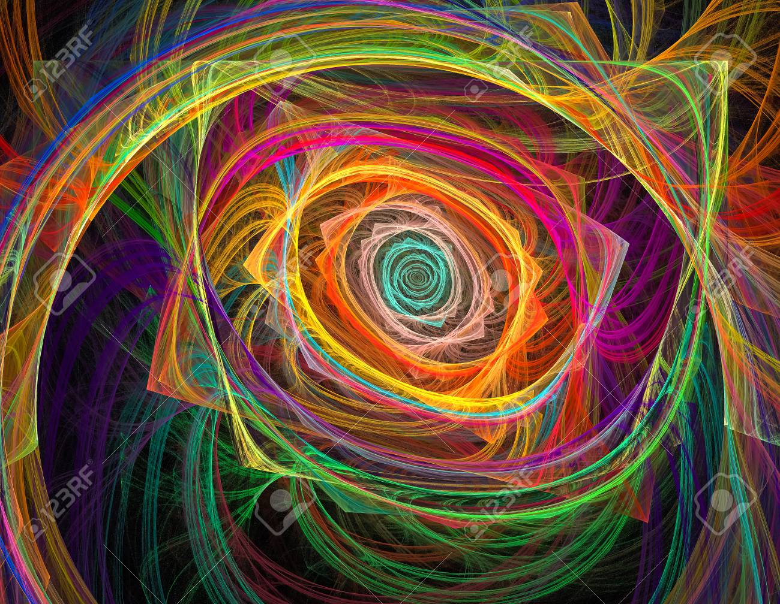

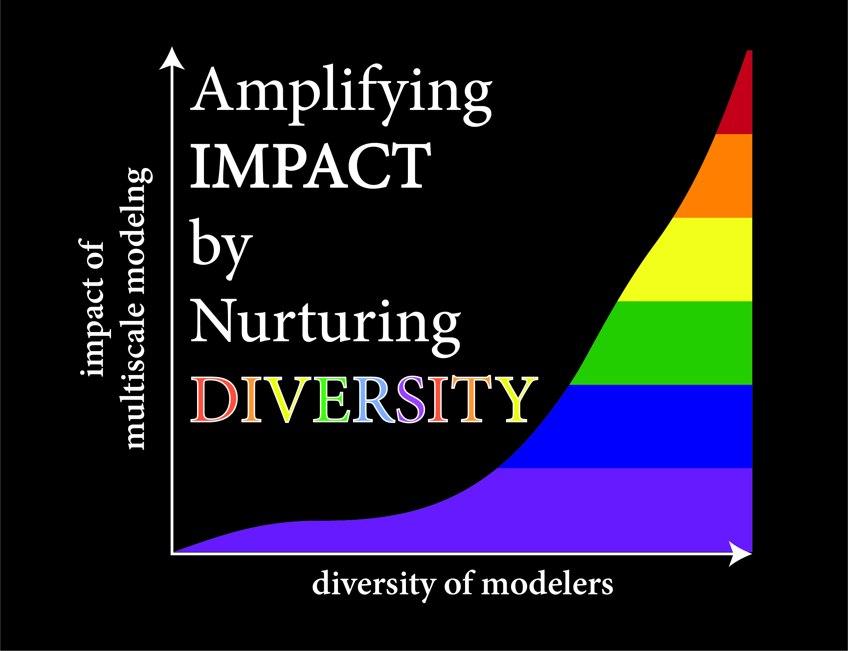














Interagency Modeling and Analysis Group
meet.google.com/vth-ophz-ych
IMAG-AND Futures Meeting
March 17th, 2020

Slide 2
Increasing the diversity multi-scale modelers will increase the impact of multi-scale modeling work on society.

Slide 3
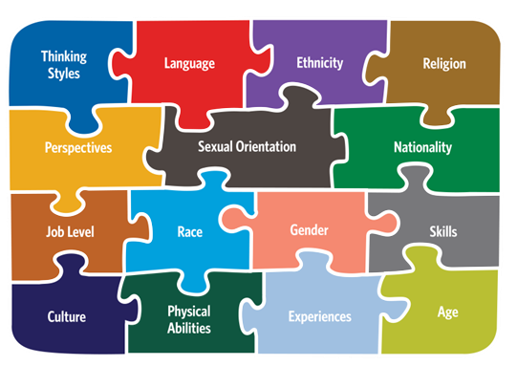
There are many ways to define how each of us is unique, making us diverse as a group.
Notes:
Diversity is excellence expressing itself through the intersections of
perspectives and lived experiences.
diversity very holistically.
Our department and university are strong advocates of diversity and inclusion.

Slide 4
There are also many ways that make our field diverse.
Addressing and nurturing diversity of Multiscale Modeling workforce
Diverse Contexts for Multiscale Modeling
Diverse Approaches for Multiscale Modeling
Diverse Approaches and Considerations in Model Credibility Practices
Diverse Funding for Multiscale Modeling
Diverse Pedagogy for Multiscale Modeling
Diverse Impacts of Multiscale Modeling

Slide 5
“Diversity is being invited to the party.
Inclusion is being asked to dance.”
-- Vernā Myers
Notes:
Highlight that diversity and inclusion at UVa is a shared initiative between faculty and students

Slide 6
IMAG-AND futures agenda
1:00-1:20pm Welcoming remarks (Grace Peng, Silvia Blemker, Shayn Peirce-Cottler)
1:20-2:40pm Trainee Oral Presentation Competition:
  1:20-1:40 pm: Angela Jarrett: “Integrating multiple scales and imaging modalities to predict tumor response for individual patients and generate personalized therapy regimens”
  1:40-2:00 pm: Peng Zhang: “Integrating machine learning in multiscale modeling for blood flow and platelet-mediated thrombosis initiation”
  2:00-2:20 pm: Christian Guerrero-Juarez: “Towards a multiscale synthesis of skin regeneration: Single cell transcriptomics and modeling reveal functional fibroblast heterogeneity in skin wounds”
  2:20-2:40 pm: Kyoko Yoshida: “Multiscale model of pregnancy-induced heart growth: Integrating hormonal signaling and mechanics”
2:40-2:50pm Break
2:50-3:10pm Future of Diverse Contexts for Multiscale Modeling:
  Inez Lam: “Computational Systems Pharmacology of Antibody-Drug Conjugates: A Joint Academia-Industry Experience”
3:10-3:30pm Future of Diverse Approaches for Multiscale Modeling:
  Ali Khalilimeybodi: “Developing Context-specific hypertrophy network identifies new interactions in b-adrenergic-induced hypertrophy”
3:30-3:50pm Future of Diverse Data for Multiscale Modeling:
  Chani Hodonsky: “Inclusive study design at every scale improves genomic analysis and clinical application for everyone”
3:50-4:00pm Closing remarks and award announcement

Slide 7
IMAG-AND futures meeting “asynchronous” activities
Online Mentor List:
https://www.imagwiki.nibib.nih.gov/mentor-list
Online Trainee Poster Competition:
https://www.imagwiki.nibib.nih.gov/current-imag-meeting/attendee-information-and-presentations

Slide 8
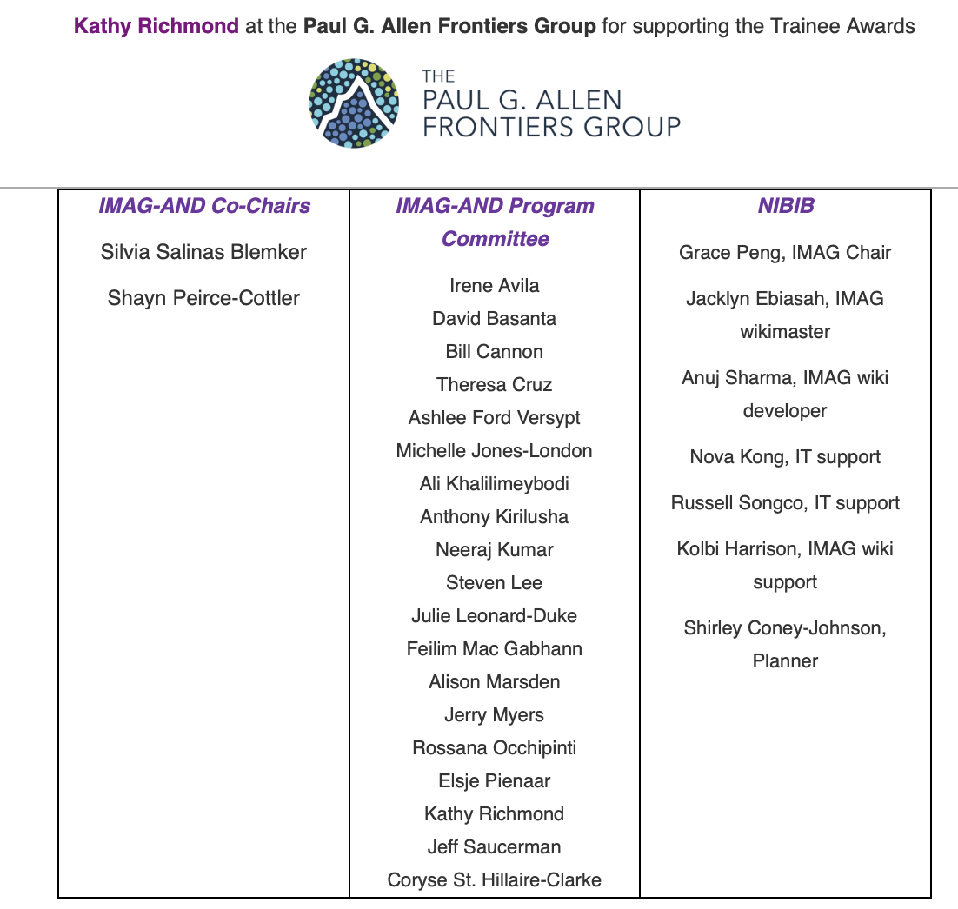
Thank you!

Slide 10
For the end of the meeting

Slide 11
And the winner is!...

Slide 12
Thank you!

