Slide 1
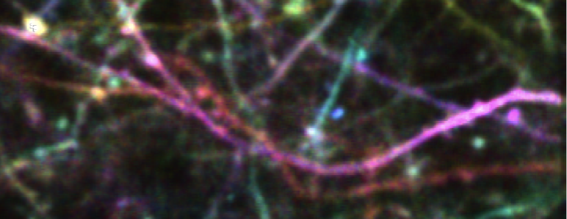
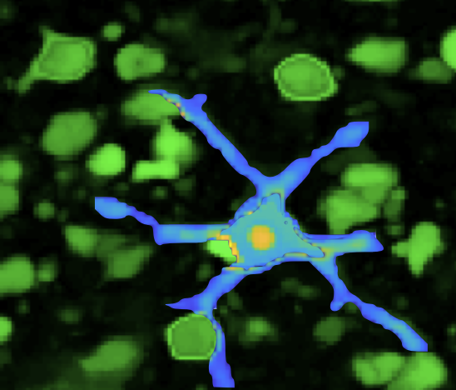
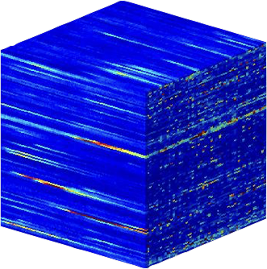
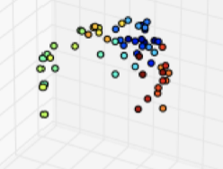
Data-driven analysis for neuronal dynamic modeling
Gal Mishne, Yale
R01EB026936, NIBIB, NINDS
End-to-end modeling and analysis framework for multi-trial neuronal activity across multiple modalities and spatiotemporal scales: 1) low-level processing of raw calcium imaging data , 2) mid-level organization of extracted interconnected neuronal time-traces, 3) high-level analysis of evolving network of neurons and behavior over long term learning.
What is new inside?
New methods for extracting neuronal regions of interest from calcium imaging data based on non-linear similarities via the graph-Laplacian, which are insensitive to the acquisition modality (one-photon, two-photon) and morphology (cell bodies, dendrites, wide-field data).
2) Tensor-based modeling of multi-trial multi-modal data, integrating neuronal activity with behavior and uncovering joint latent variables with nonlinear geometric methods.
How will this change current practice?
A unified analysis framework that enables unsupervised and unbiased data exploration and discovery in ensemble data, leveraging nonlinear representations that will become essential as animal models perform multiple complex tasks.
End Users: Labs using calcium imaging or other multi-neuronal ensemble data, code will be made freely available online.
Notes:
Title: Data-driven analysis for neuronal dynamic modeling
Algorithm: spectral representations, co-manifold learning for tensor data
We are developing an end-to-end framework to analyze time-series from neuro-imaging data acquired over multiple weeks as an animal learns a task.
This framework will address imaging challenges (extracting neuronal structures from videos, alignment of videos across days, handling multiple acquisition modalities) as well as unsupervised analysis of the activity of hundreds of neurons jointly with the observed motor behavior, across multiple time-scales: from immediate execution of behavior through a single trial to multiple days of learning.
This project employs both manifold learning for unsupervised latent variable discovery as well as deep recurrent networks to model behavior and neuronal activity on short to long temporal scales.
Future challenges: as the scale of the data grows, there will be need for fast and scalable graph constructions.
Multiscale modeling: By designing new metrics for determining similarities in ensemble data and integrating them in manifold embeddings, we address both local and global time-scales.
BRAIN: we develop graph-based modeling and nonlinear embeddings of diffusion operators at different levels of analysis. This approach enables designing similarity metrics adapted to the domain as well as performing multi-modal analysis. Nonlinear manifold learning enables greater flexibility in data representation than existing linear approaches, yet remains largely unexplored in neuroscience.
PI: Gal Mishne, gal.mishne@yale.edu

