Slide 1
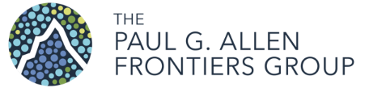
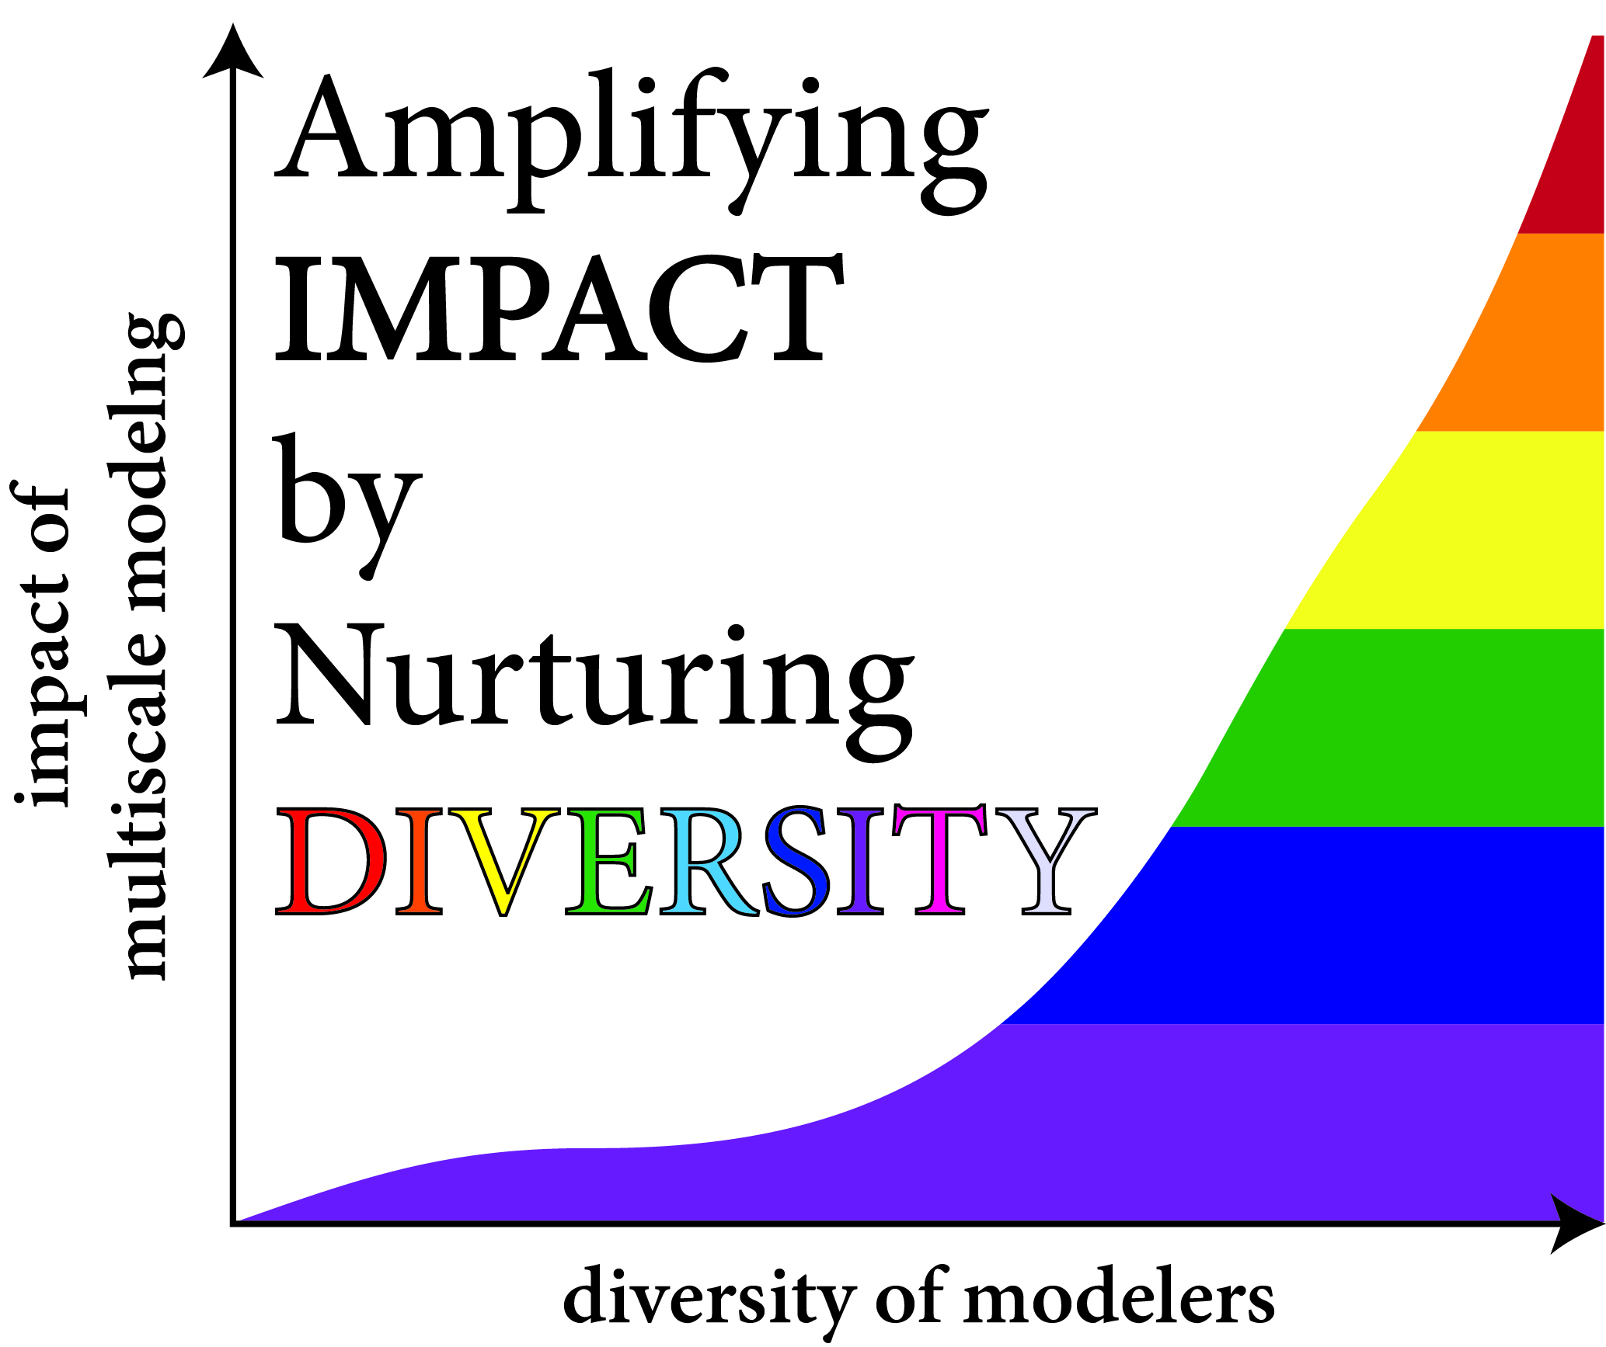
2020 Interagency Modeling and Analysis Group Annual Meeting: Amplifying Impact by Nurturing Diversity
(IMAG-AND) - Futures
Trainee Oral Presentation Competition
~ First Place ~
Dr. Kyoko Yoshida, Ph.D.
Dr. Grace C.Y. Peng, Ph.D.
IMAG Chair, Program Director
National Institute of Biomedical Imaging & Bioengineering
Dr. Silvia Blemker, Ph.D.
Meeting Co-Organizer
Dr. Shayn Peirce-Cottler, Ph.D.
Meeting Co-Organizer

Slide 2
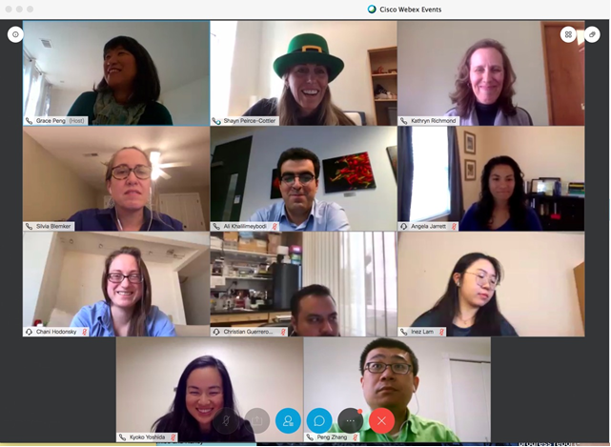

Slide 3
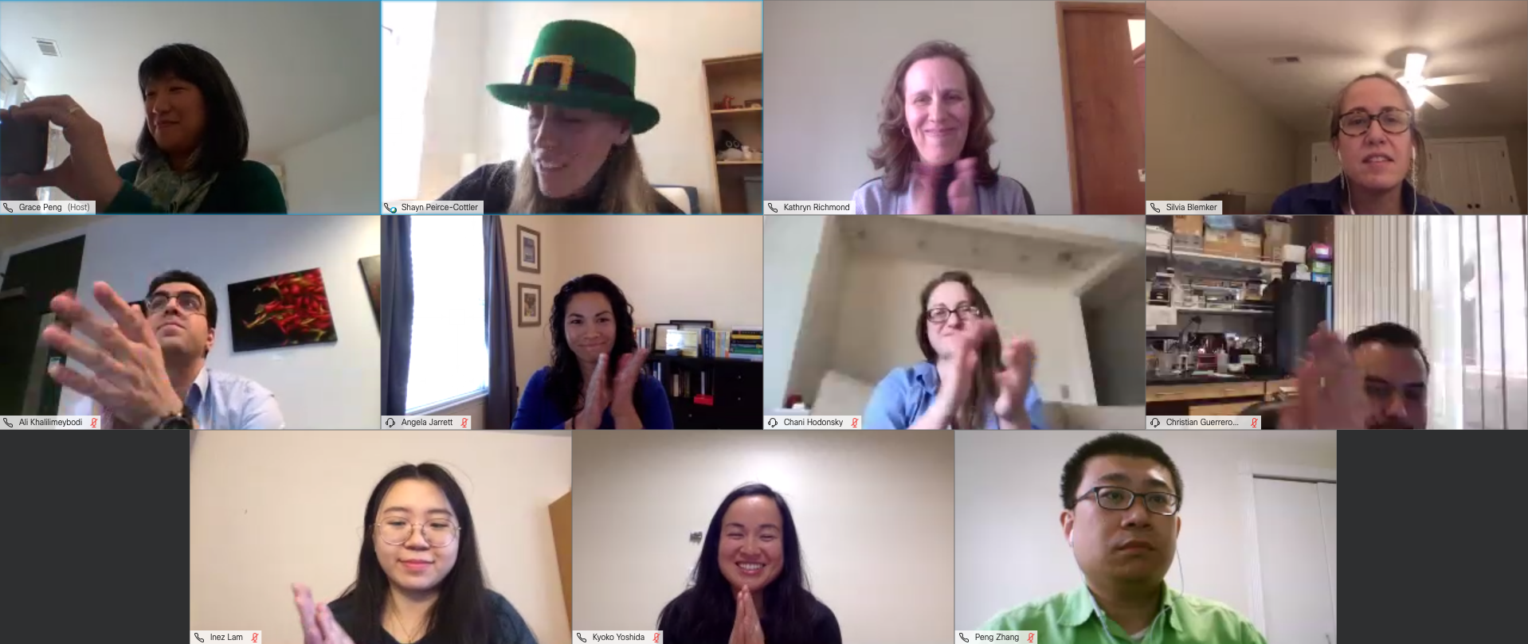

Slide 4
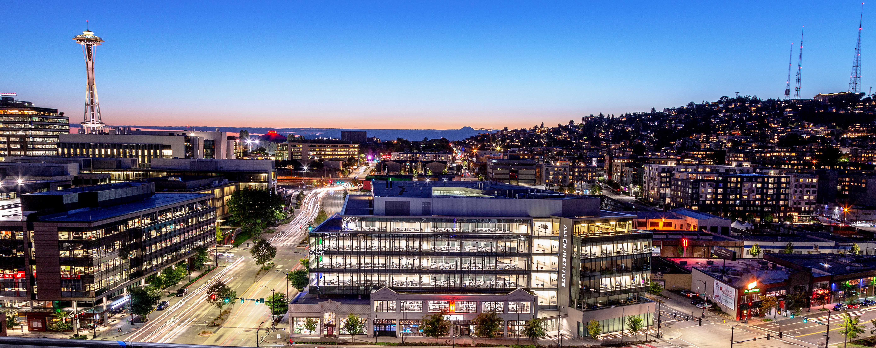
Trainee Presentation Competition Awards sponsored by:
Established 2003 by Paul G. Allen
South Lake Union, Seattle, WA
500 employees+
$150 MM annual budget
Frontiers Group has directed > $200M in external biosciences research funding
big science
team science
open science
hard problems
complexity
foundational biology
big science
team science
open science
hard problems
complexity
foundational biology
data
knowledge
tools
data
knowledge
tools
frontier science
pioneers/thought leaders
Allen Dist. Inv./Allen Discovery Centers
and Partnerships
breakthrough insights

