Slide 1
Webinar: NCCIH’s Participation in the “Predictive Multiscale Models for Biomedical, Biological, Behavioral, Environmental and Clinical Research (U01, PAR-15-085)
October 6, 2015 2:30 p.m.
Moderator: Anita McRae-Williams
Presenter: Wen G. Chen, PhD

Slide 2
Outline
What is the U01 PAR on “Predictive Multiscale Models”?
NCCIH Mission and Conceptual Framework
NCCIH’s High Priority Interest Topics for this PAR with Examples and Potential Collaborators
Submission and Review Information

Slide 3
Outline
What is the U01 PAR on “Predictive Multiscale Models”?
NCCIH Mission and Conceptual Framework
NCCIH’s High Priority Interest Topics for this PAR with Examples and Potential Collaborators
Submission and Review Information

Slide 4
PAR-15-085 Predictive Multiscale Models for Biomedical, Biological, Behavioral, Environmental and Clinical Research (U01)
Why is it important to have predictive multiscale models?
What types of science and research will be supported by this PAR?
What is the required expertise?
Once funded, how will the cooperative agreement (U01) be implemented?

Slide 5
Why Do We Need Predictive Multiscale Models for Biomedical and Biological Systems?
help integrate diverse data
create testable hypotheses
identify and share gaps in knowledge requiring further research
uncover biological mechanisms
make predictions about clinical outcome or intervention effects

Slide 6
What Types of Science and Research Will Be Supported?
It must be MULTISCALE:
link different spatial or temporal scales; or different levels of aggregation (w. ref. a wide range of social, behavioral, and population modeling); or different scientific fields; different physiological systems and/or environmental systems
It must aim to be PREDICTIVE:
make realistic scientific predictions to address problems and issues in the environment; in the human body (e.g. to prevent, diagnose and treat the diseases or aberrations in normal development, and/or to predict treatment outcomes), and among individuals, groups, and within populations

Slide 7
What Types of Science and Research Will Be Supported? (continued)
It should identify a challenging multiscale problem or approach that is currently not being addressed and propose to develop predictive models that will be unique, push the boundaries, and may lead to higher risk projects.
It may expanding an existing model to address a new breakthrough challenge in multiscale modeling of biological or biomedical systems.

Slide 8
What Is the Required Expertise?
Highly interactive partnerships are expected. Examples include but are not limited to:
Experimental and modeling expertise to develop models that create testable hypotheses leading to new investigational studies,
Mathematical and/or statistical expertise with domain-modeling expertise to develop new methods that will enhance the function of the models,
Expertise focused on different spatial or temporal scales, or different levels of aggregation, or different experimental and observational scales, or different deterministic and statistics-driven scales,

Slide 9
What Are the Required Expertise? (continued)
Highly interactive partnerships are expected. Examples include but are not limited to:
Expertise from mature modeling fields with expertise from fields with an emerging use of models,
Expertise relevant for biological and behavioral modeling; such as computational neuroscience, systems biology, physiome research, agent-based modeling, system dynamics, microsimulation, decision theory, economics, cognitive science, affective neuroscience, and social network theory

Slide 10
Implementation of the U01 Cooperative Agreement
Grantees will become members of the Multiscale Modeling (MSM) Consortium;
Multiscale Modeling (MSM) Consortium Plan: project outcomes, milestones, timeline for both scientific progress and participation within the MSM Consortium is required;
Collaborative activities that contribute to the needs of the wider MSM community are encouraged, including leading working groups, hosting webinars, sharing data, models, expertise and other efforts;
Program staff from the IMAG award agency will have a significant, although not dominant, role in the planning and execution of the supported activities.

Slide 11
Outline
What is the U01 PAR on “Predictive Multiscale Models”?
NCCIH Mission and Conceptual Framework
NCCIH’s High Priority Interest Topics for this PAR with Examples and Potential Collaborators
Submission and Review Information

Slide 12
NCCIH Mission Statement
The mission of NCCIH is to define, through rigorous scientific investigation, the usefulness and safety of complementary and integrative health interventions and their roles in improving health and health care.

Slide 13
Framework for Research on Complementary and Integrative Health (CIH) Approaches
Efficacy/Effectiveness Studies
Dissemination & Implementation Studies
Exploratory/Pilot Studies

Slide 14
Predictive Multiscale Modeling
Mechanistic/Exploratory/Pilot Studies
Efficacy/Effectiveness Studies
Dissemination & Implementation Studies

Slide 15
Outline
What is the U01 PAR on “Predictive Multiscale Models”?
NCCIH Mission and Conceptual Framework
NCCIH’s High Priority Interest Topics for this PAR with Examples and Potential Collaborators
Submission and Review Information

Slide 16
Predictive Multiscale Modeling
Mechanistic/Exploratory/Pilot Studies
Efficacy/Effectiveness Studies
Dissemination & Implementation Studies

Slide 17
NCCIH High Priority Topics for Predictive Multiscale Models (MSM) Research
Predictive and/or modifiable mechanisms of natural products or mind and body approaches for pain management.
Predictive and/or modifiable mechanisms of mind and body approaches for post-traumatic stress (disorder), sleep disorders or disturbances, anxiety, or depression.
Preventative strategies that links genetics, molecular mechanisms, intracellular signaling, brain circuits, and/or environment with responders and non-responders of complementary interventions.
Predictive models of systems level biological activity of natural products
Predictive mechanistic pathways and regulatory networks in microbiota brain-gut interactions and related bio-behavioral networks

Slide 18
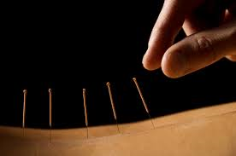
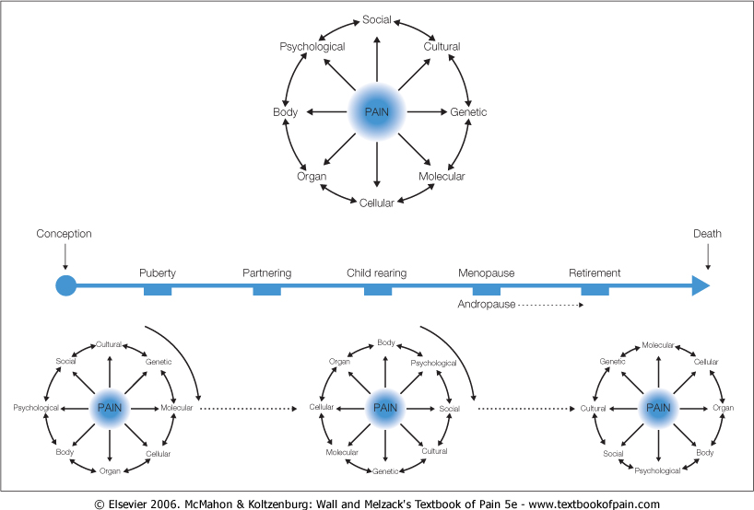
Example One: Predictive Models of Multi-scale Measures for the Effects of Acupuncture, Hypnosis, Meditation, or Tai Chi on Pain Management

Slide 19
Potential Collaborators
Bruce R. Rosen; Randy Gollub
“Neuroimaging Acupuncture Effects Brain Activity in Chronic Low Back Pain”
P01AT006663
Institution: Massachusetts General Hospital
bruce@nmr.mgh.harvard.edu; rgollub@partners.org
Kirsten Tillisch; Bruce D. Naliboff
“Neuroimaging Biomarkers of Mind-Body Treatment Response in Chronic Visceral Pain”
R01AT007137
Institution: University of California at Los Angeles
ktillisch@mednet.ucla.edu; bruce.nali@gmail.com

Slide 20
Example Two: Predictive Models of Multi-Scale Measures for Meditation, Yoga, and/or Herb Effects on Mild-to Moderate Depression, Sleep, Stress, or Anxiety
personality traits
brain
environment
molecules
Depression, Sleep, Stress, Anxiety
genes
Responders vs. Non-Responders

Slide 21
Potential Collaborators
Richard Davidson
“Wisconsin Center for the Neuroscience and Psychophysiology of Meditation”
P01AT00004952
Institution: University of Wisconsin at Madison
rjdavids@wisc.edu
Richard B. Van Breemen
“Botanical Dietary Supplements for Women’s Health”
P50AT000155
Institution: University of Illinois at Chicago
breemen@uic.edu

Slide 22
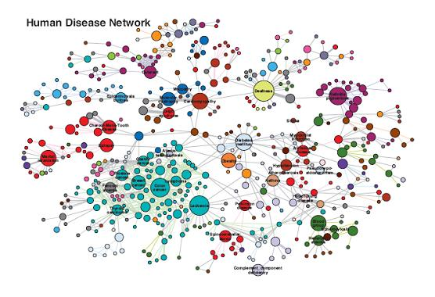
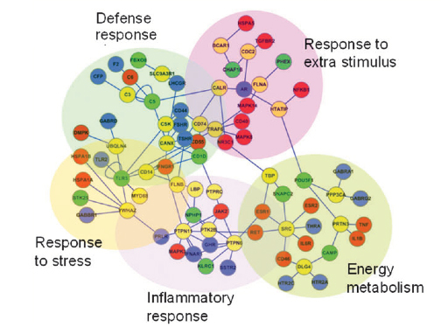
Example Three: Predictive Models of Systems Level Biological Activities of Natural Products, Especially in the Context of Complex Natural Product Mixtures
Human Disease Networks
Biological Networks
absorption, transport, metabolism, elimination

Slide 23
Potential Collaborators
Steven Polyak
“Mechanisms of Silymarin Hepatoprotection”
University of Washington
R01 AT006842
polyak@uw.edu
Nadja Cech
“Strategies to Investigate Synergy in Botanical Medicines”
University of North Carolina Greensboro
R01 AT006860
nbcech@uncg.edu

Slide 24
Example Four: Predictive Models of the Interactions between Genes and Natural Product, such as Supplements, Diets, Botanicals, and Their Influences on Medicine and Health Outcomes
Health Outcomes

Slide 25
Potential Collaborators
Ski Chilton
“Role of PUFA-Gene Interactions in Health Disparities”
Wake Forest University
R01 AT008621-01A1
schilton@wakehealth.edu
Ilya Raskin
“Health Promoting Effects of High-Polyphenol Foods May Be Mediated through Gut Microbiome”
Rutgers University
R01 AT008618
raskin@AESOP.Rutgers.edu

Slide 26
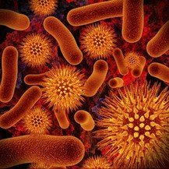
Example Five: Predictive Models of Networks of Microbiota-Brain-Gut Interactions, or the Interactions of Such Networks with Related Omics, Bio-behavioral Networks, or Intervention Strategies and Health Outcomes
Dinan T., et al., Journal of Psychiatric Research, Volume 63, 2015, 1–9

Slide 27
Potential Collaborators
Elhanan Borenstein
“A Computational Framework for Designing Microbiome Manipulation”
University of Washington
DP2AT007802
elbo@u.washington.edu
David Kumpp
“Mechanisms of Probiotic Analgesia”
Northwestern University
R01 AT007701
d-klumpp@northwestern.edu

Slide 28
Outline
What is the U01 PAR on “Predictive Multiscale Models”?
NCCIH Mission and Conceptual Framework
NCCIH’s High Priority Interest Topics for this PAR with Examples and Potential Collaborators
Submission and Review Information

Slide 29
Key Submission Dates and Key Contacts
Submission deadlines:
2016: January 29, May 30, September 29
2017: January 30, May 29, September 29
Letter of Intent Contact: (due one month before submission deadlines)
Grace C.Y. Peng, Ph.D. Telephone: 301-451-4778 Fax: 301-480-1614 Email: grace.peng@nih.gov
NCCIH Scientific/Research Contact:
Wen G. Chen, Ph.D. National Center for Complementary and Integrative Health (NCCIH) Telephone: 301-451-3989 Email: chenw@mail.nih.gov

Slide 30
NCCIH Special Requirements for Clinical Research
NCCIH Clinical Research Toolbox for proposals using an interventional design:
https://nccih.nih.gov/grants/toolbox

Slide 31
Questions?

Slide 32
A written summary of this webinar will be available on NCCIH’s Web Page in a few weeks, please email Anita McRae-Williams at Anita.McRae-Williams@nih.gov if you would like to receive a copy when it is available for posting.
Speaker Contact Information:
Wen G. Chen, Ph.D.
Program Director
Division of Extramural Research
National Center for Complementary and Integrative Health (NCCIH)
NIH, DHHS
Email: chenw@mail.nih.gov
Phone: (301)-451-3989

