Slide 1
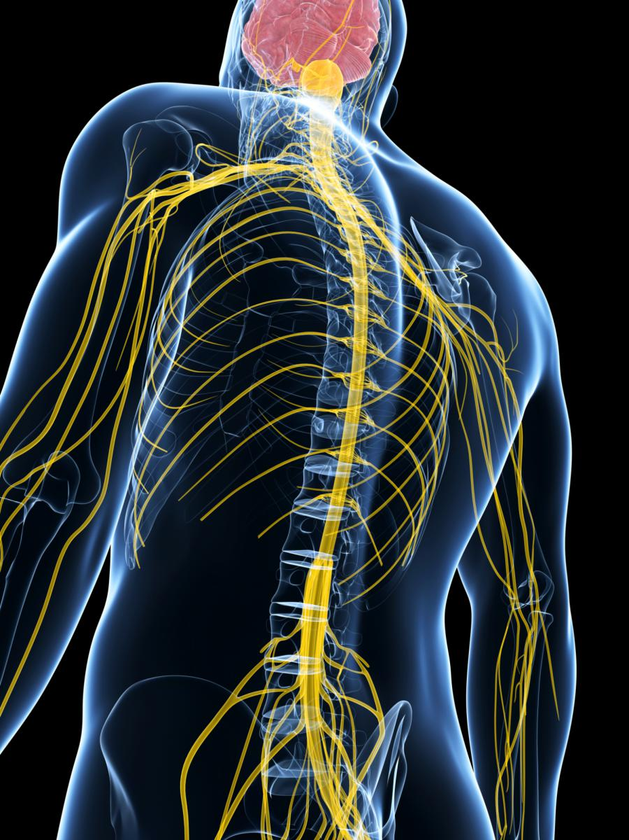
Stimulating Peripheral Activity to Relieve Conditions (SPARC)
A New Common Fund Program
RFA-RM-15-002
Funding Opportunity Announcement
Information to Applicants

Slide 2
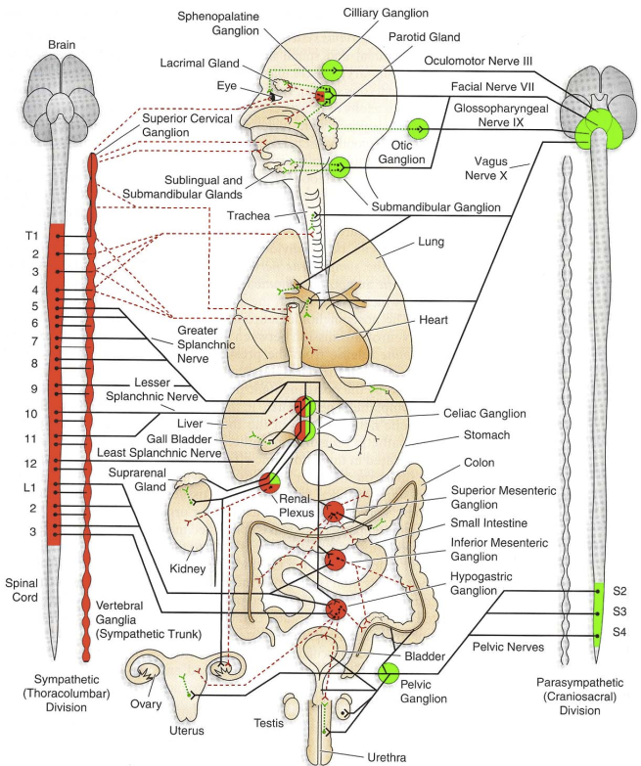
SPARC- Stimulating Peripheral Activity to Relieve Conditions
Opportunity: Neuromodulation of end-organ function holds promise in treating many diseases/conditions.
Challenge: The mechanisms of action remain poorly understood.
1
Technology
Therapy
Biology
2
Notes:
SPARC will:
Serve as a community resource that provides the broader public and private research communities with the scientific foundation necessary to create more effective and minimally invasive neuromodulation therapies.
Catalyze development of a new class of neural control devices to precisely treat a wide variety of diseases and conditions. The program will create detailed, integrated functional and anatomical neural circuit maps in multiple organ systems; maps will be used to pilot other techniques and technologies for new or improved neuromodulation therapies
This will require interdisciplinary expertise that is likely to evolve over time and may involve partnership with non-traditional partners. Requirements necessitate fluid management:
Detailed knowledge of physiology and neurophysiology of visceral organ systems, and inter-individual as well as inter-species variation
Diverse expertise with multiple neural mapping technologies
Development of novel electrode designs
Novel surgical procedures
Detailed stimulation protocols leveraging insights from the functional maps

Slide 3
RFA-RM-15-002
Exploratory Technologies to Understand the Control of Organ Function by the Peripheral Nervous System for SPARC (U18)
Tools for discovery of mechanisms (focusing on stage 1, not stage 2 of previous slide)
Letter of Intent Due Date: March 14, 2015
Please attach Specific Aims to email
Application Due Date: April 14, 2015
2 year awards, up to $200K direct costs/year
Questions: SPARC_NextGen-Tools@mail.nih.gov

Slide 4
Types of Tools for Discovery
For understanding and mapping of autonomic control of internal organs in health or disease
Tailored to specific use case/mechanism under study
New, novel, enhanced
Not general platform
Section I bulleted list of examples
Section IV specific instructions
Research strategy, U18 budget, etc.
Guidelines: http://grants.nih.gov/grants/guide/rfa-files/RFA-RM-15-002.html

Slide 5
Requirements
Must describe how the proposed technology will be tailored to investigate the mechanisms of neural control of end organ function, and how the technology will be appropriately designed to achieve these specific goals.
Must define the specific technology challenge(s) that is being addressed in this exploratory project, the final end product of the proposed technology design, and how it is envisioned that the outcomes will integrate with the SPARC program - that is to inform the mechanism of neural control of end organs which will drive the design of next generation neuromodulation therapy.
Must provide a timeline and milestones that describe the work that will be completed during the project period. Each milestone should include the criteria for success and the rationale.

Slide 6
Other Considerations
Applicants interested in developing technologies specific to animal models must justify the model as one that will potentially have broad use for the SPARC program overall, within the next four years.
NOT RESPONSIVE:
Applications primarily proposing SPARC data collection, curation, integration and broad sharing of neuroanatomy data and neuromodulation tools will not be considered responsive to this FOA.
Projects developing new technologies, or modifying existing technologies without a targeted use case to study a mechanism of neural control of end organ function (i.e. general purpose platforms) will not be considered responsive to this FOA.

Slide 7
Tips to Applicants
End deliverable is a tool or technology, NOT a biological discovery
Collecting feasibility data for establishing a tailored tool
To further develop technology in future efforts
To be used by biologists for knowledge discovery
Read Section IV requirements very carefully!!
http://grants.nih.gov/grants/guide/rfa-files/RFA-RM-15-002.html

Slide 8
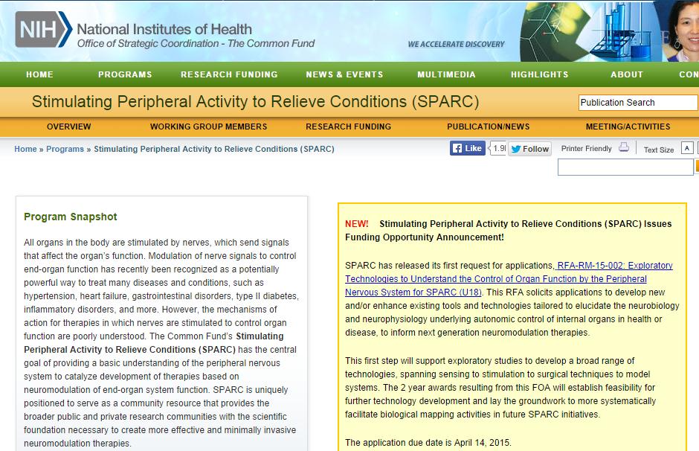
http://commonfund.nih.gov/sparc
Search: NIH SPARC
Requests for Information (RFI)
Workshops
Funding Opportunity Announcements (FOAs)

