Slide 1
A unified framework to study history dependence in the nervous system
History dependence allows the brain to change its response rates to an identical stimulus depending on previous activity.
There is no unified theoretical framework to study these types of processes independent of their biophysical origin.
We have suggested that history dependence can be studied using the fractional order reaction-diffusion equation.
This equation makes use of temporal fractional order derivatives that are the natural mathematical tool to study scale free history-dependent dynamics.
We have applied this formalism to study diffusion in dendrites and voltage spiking mechanisms.
The objective of this project is to build a framework that can be applied across scales of neuronal organization to study history dependence, from biochemical synaptic activity to sensory processing.
  Synaptic
  Neuronal – chemical and electrical
  Network
  Sensory
  Electronic implementations

Slide 2



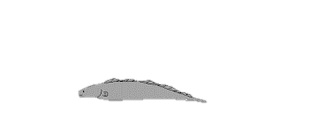
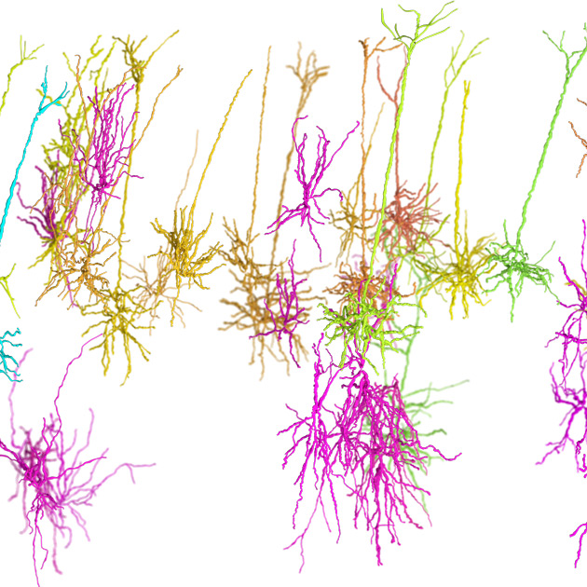
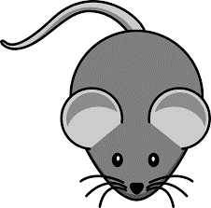

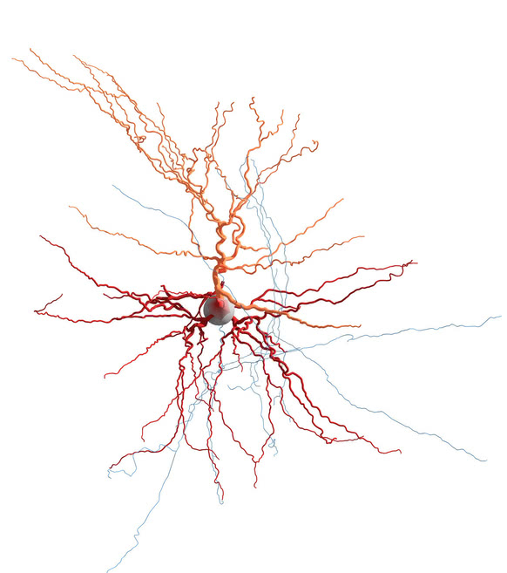

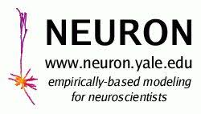


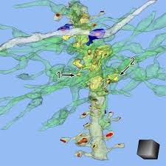
We will interact with multiple partners:
Compare cerebellar-like structures models and experiments
Compare alternative network models
Fractional spiking models
Families of reversed engineered biophysical models
Compare alternative single cell models and experiments
Compare across species
Cell-to-network
Tool Development Support
NEST developer space

