Slide 1
Learning precise spatiotemporal sequences via biophysically realistic circuits with modular structure
How does the brain learn and encode complex sequences? How does it recall those sequences based on only partial reactivation?
We have created a biophysically realistic model of sequence learning that can learn and recall the duration, order, and specific timing of elements in a sequence. It can learn both Markovian and non-Markovian sequences and can embed multiple sequences in the network simultaneously.
For more details please refer to:
Learning precise spatiotemporal sequences via biophysically realistic circuits with modular structure
I. Cone, H. Z. Shouval
bioRxiv 2020.04.17.046862; doi: https://doi.org/10.1101/2020.04.17.046862
Ian Cone^{1,2}, Harel Shouval¹
1. Department of Neurobiology and Anatomy, University of Texas Medical School at Houston, Houston, TX, USA
2. Applied Physics Program, Rice University, Houston, TX, USA

Slide 2
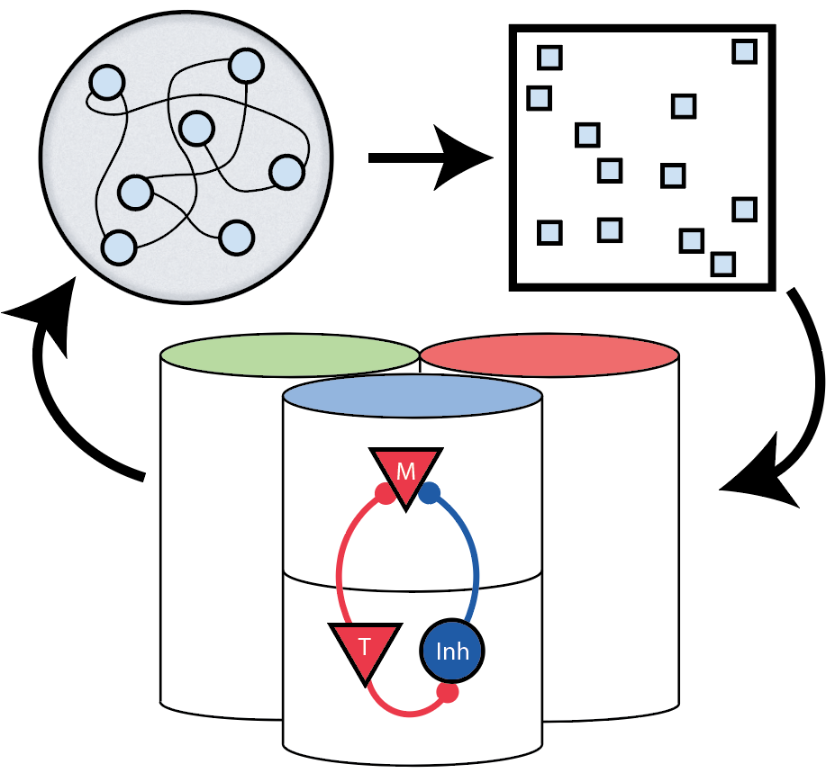
A three-stage model for non-Markovian sequence learning and recall
Stage one: cortical columnar network with biophysically realistic cell types
Stage two: Fixed (non-learning) liquid state machine
Stage three: Sparse, pattern separating net
Ian Cone^{1,2}, Harel Shouval¹
1. Department of Neurobiology and Anatomy, University of Texas Medical School at Houston, Houston, TX, USA
2. Applied Physics Program, Rice University, Houston, TX, USA

Slide 3
A three-stage model for non-Markovian sequence learning and recall
The external stimuli are observed in the columnar network
The LSM takes columnar inputs and therefore produces a history dependent representation of the observed sequence
The sparse net takes the LSM state and projects it into a highly separated space, before using Hebbian learning to connect back to the columnar network
Ian Cone^{1,2}, Harel Shouval¹
1. Department of Neurobiology and Anatomy, University of Texas Medical School at Houston, Houston, TX, USA
2. Applied Physics Program, Rice University, Houston, TX, USA

Slide 4
Results
Colorbars indicate stimulus given, traces indicate mean FR of stimulus-sensitive neural population
Before learning, blue stimulus only triggers recall of blue sensitive neurons
After learning, blue stimulus triggers recall of entire non-Markovian sequence presented during training
Ian Cone^{1,2}, Harel Shouval¹
1. Department of Neurobiology and Anatomy, University of Texas Medical School at Houston, Houston, TX, USA
2. Applied Physics Program, Rice University, Houston, TX, USA

