Slide 1
NeuroCAAS (Neuroscience Cloud Analysis as a Service)
http://neurocaas.org
Paninski Lab

Slide 4
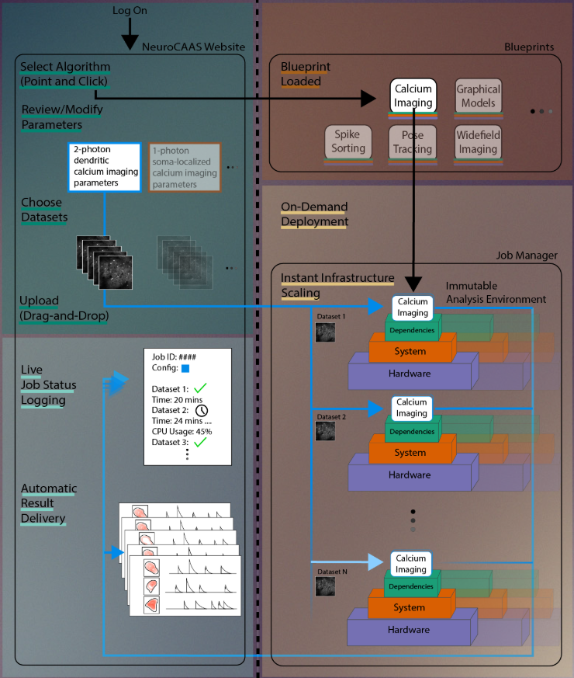
User workflow
NeuroCAAS workflow

