Slide 1
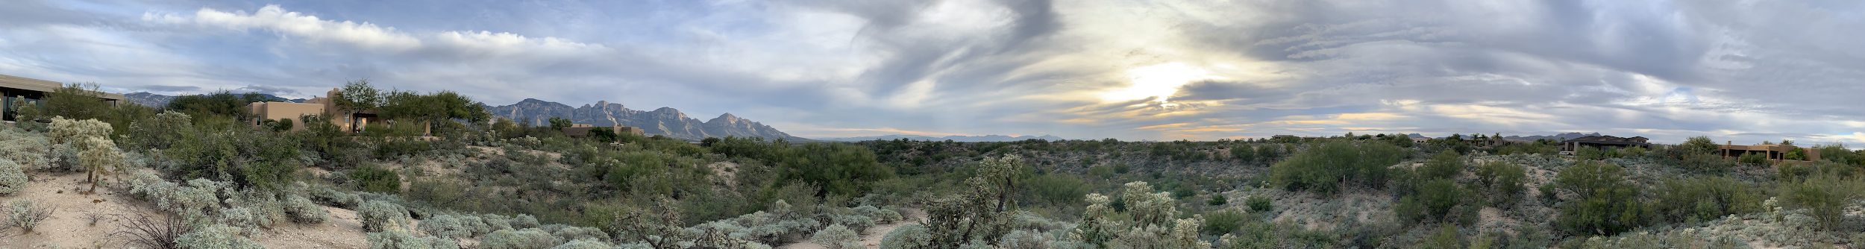



AutoMATES: Automated Model Assembly from Text, Equations, and Software
Saumya Debray, Adarsh Pyarelal, Rebecca Sharp, Marco A. Valenzuela-Escárcega, and Clayton T. Morrison
ml4ai.github.io/automates
Automating Scientific Knowledge Extraction
Joshua Elliot (Program Manager)

Slide 2
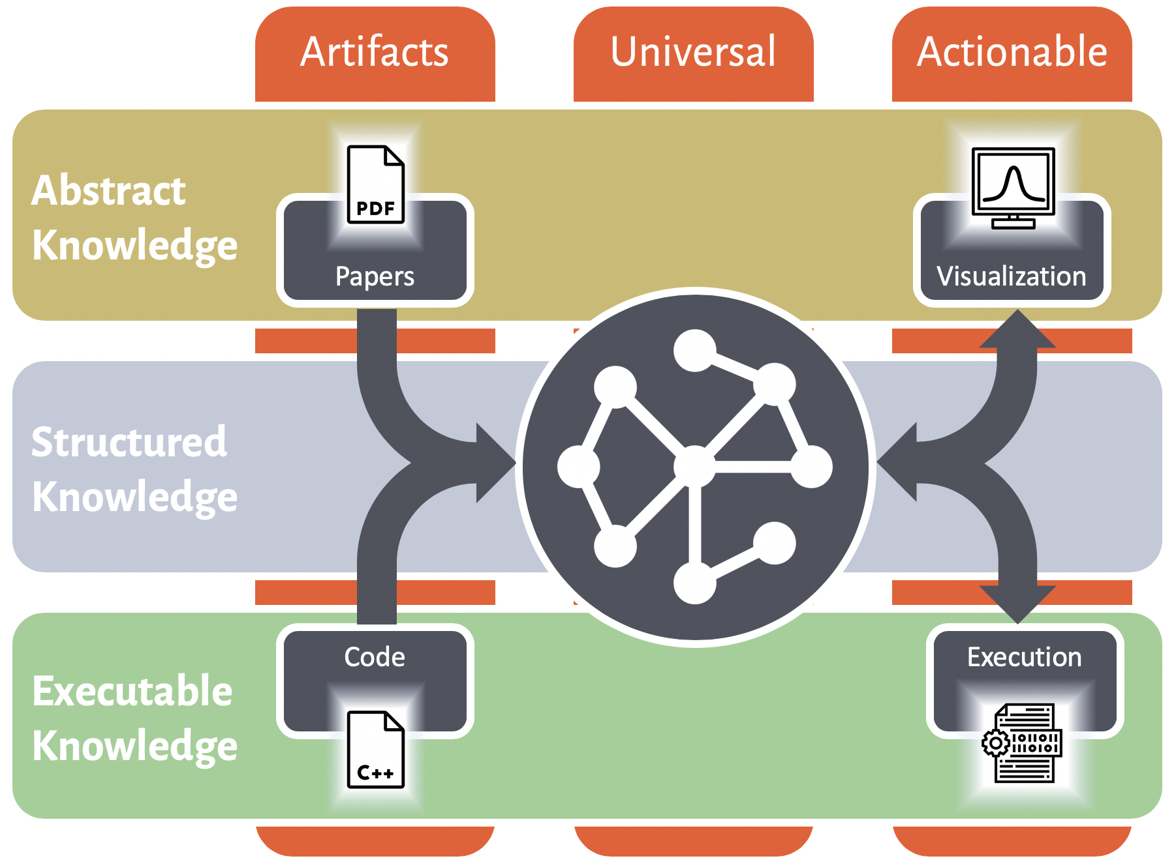
Motivation: Knowledge Extraction and Synthesis
ml4ai.github.io/automates

Slide 3
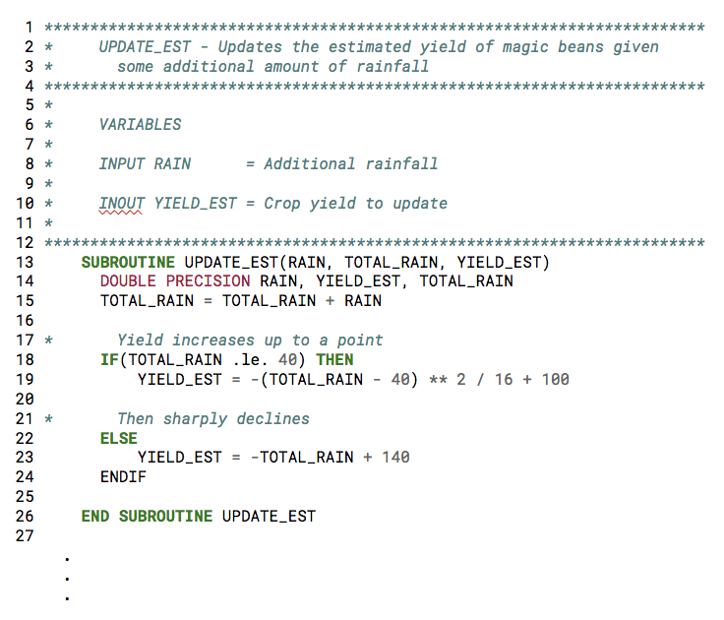
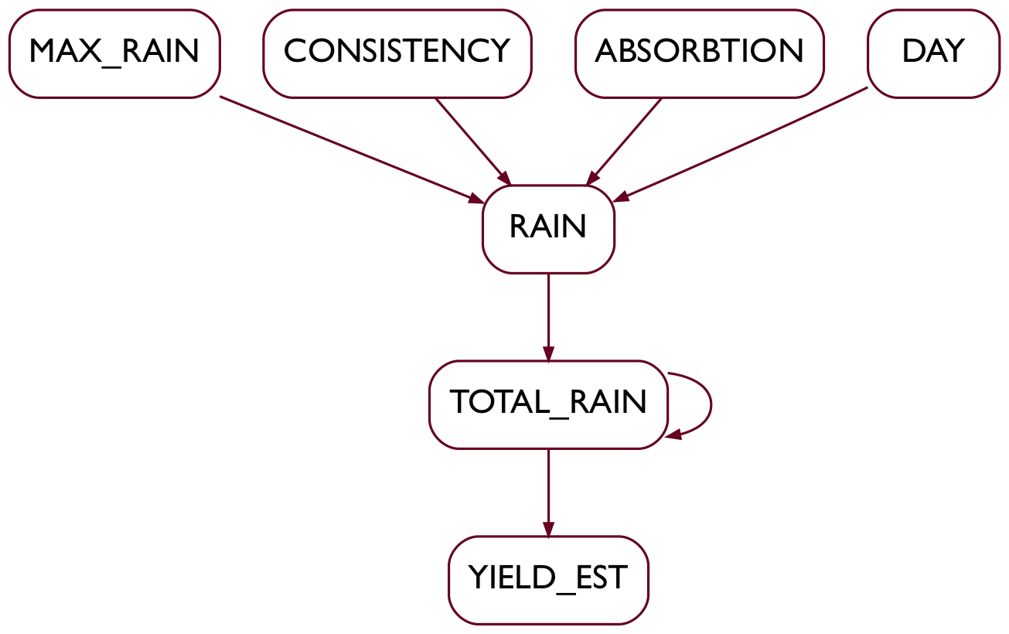
ml4ai.github.io/automates
Motivation: Knowledge Extraction and Synthesis
Many detailed expert models encoded in software and described in text
… however…
Software requires manual curation to integrate
Textual descriptions and software are not integrated
Goal: Construct and curate semantically-rich representations of scientific models by integrating: natural language descriptions and equations from publications and documentation, with the software that implements those models.

Slide 4
Reading Code
ml4ai.github.io/automates
variable
(Fortran)
Grounded Function Network (GrFN)
function
def sir_assign_infected(beta, S, I, R, dt):
return (-(beta*S*I) / (S + I + R)) * dt
Code is extracted to a Grounded Function Network (GrFN)
The GrFN expresses functional relations between variables
Notes:
Program Analysis
Code is extracted to a Grounded Function Network (GrFN) expressing functional relationships between variables.

Slide 5
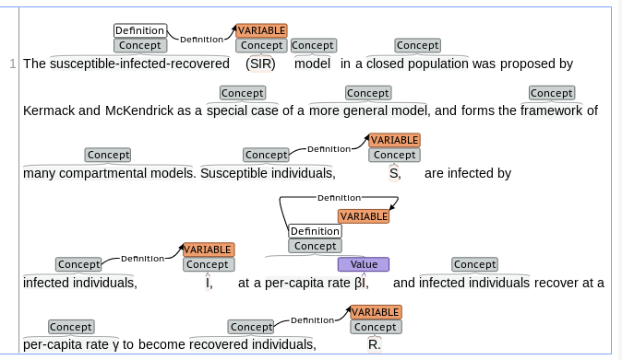
Reading Text and Equations
ml4ai.github.io/automates
\frac{dS}{dt} = \frac{\beta I S}{N}
Text Reading identifies variables, domain concepts, and units
Equations are read and translated into a structured representation
Text and Equation terms are linked
Notes:
Text and Equation Reading
Identify variables, domain concept descriptions, and units.
Read equations and translate them to a structured representation.
Link text and equation terms.

Slide 6
Grounding Code to Scientific Concepts
ml4ai.github.io/automates
Domain concepts from text and equation reading are
linked to GrFN variables
Notes:
Model Extraction and Grounding
Programs often do not separate models from other code (e.g., solver)
Analysis of GrFN identifies Model and separates from Solver
Domain concepts are linked to code variables in GrFN

Slide 7
Isolating and Extracting Models
ml4ai.github.io/automates
Full program GrFN
Programs often do not separate the Model from the Solver
The Model expresses how the world changes
The Solver executes the model to produce a simulation
Analysis of GrFN identifies Model and separates from Solver
Notes:
Model Extraction and Grounding
Programs often do not separate models from other code (e.g., solver)
Analysis of GrFN identifies Model and separates from Solver
Domain concepts are linked to code variables in GrFN

Slide 8
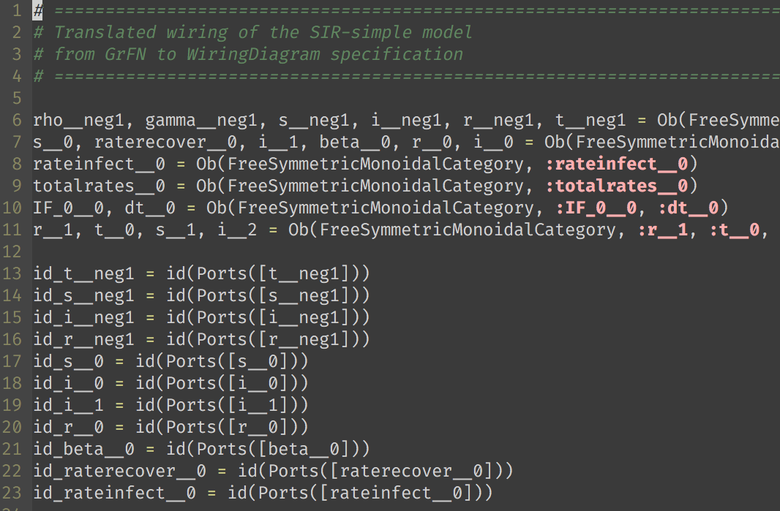
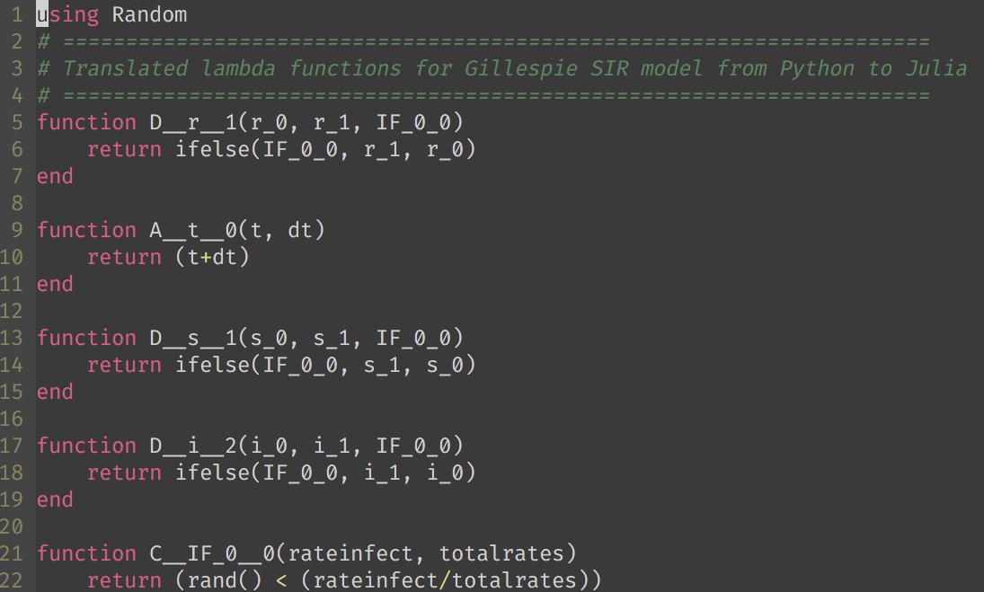
ml4ai.github.io/automates
Var: S
Def: “Susceptible population”
Units: “per capita”
Isolated GrFN representation of Model available for further analysis
– GrFN variable grounding can be connected to domain ontologies
– Model GrFN is translated to model manipulation frameworks
(e.g., GTRI’s SemanticModels.jl and Galois’s AMIDOL (Julia))
Notes:
The isolated Model GrFN is translated into SemanticModels.jl (Julia)
And GrFN variable grounding information connects to domain ontologies

Slide 9
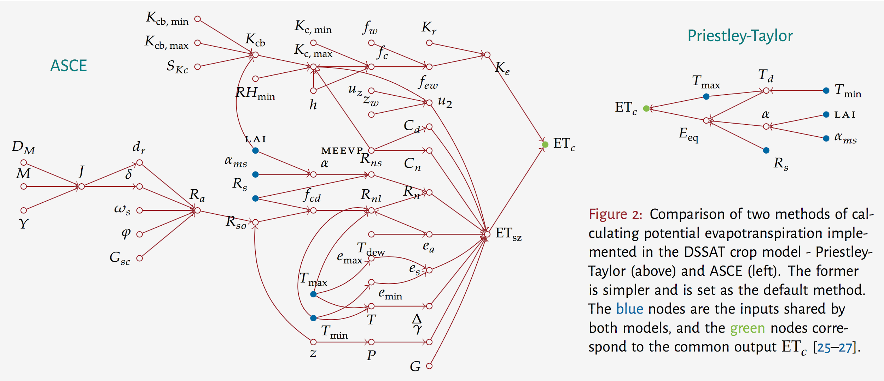
Model Comparison
ml4ai.github.io/automates
Notes:
Two models of evapotranspiration from the DSSAT model
- two methods of calculating the same quantity, potential evapotranspiration
- obviously, one is much more computationally complex than the other
- when is it worth the extra computational cost?
- which model is more robust/sensitive to input parameters? for what values of the parameters? can we systematically answer this question?
- the networks shown on the slide are hand-constructed by reading the source code, equations, and text, and normalizing variable names by hand - we would ideally like to automate this process.

Slide 10
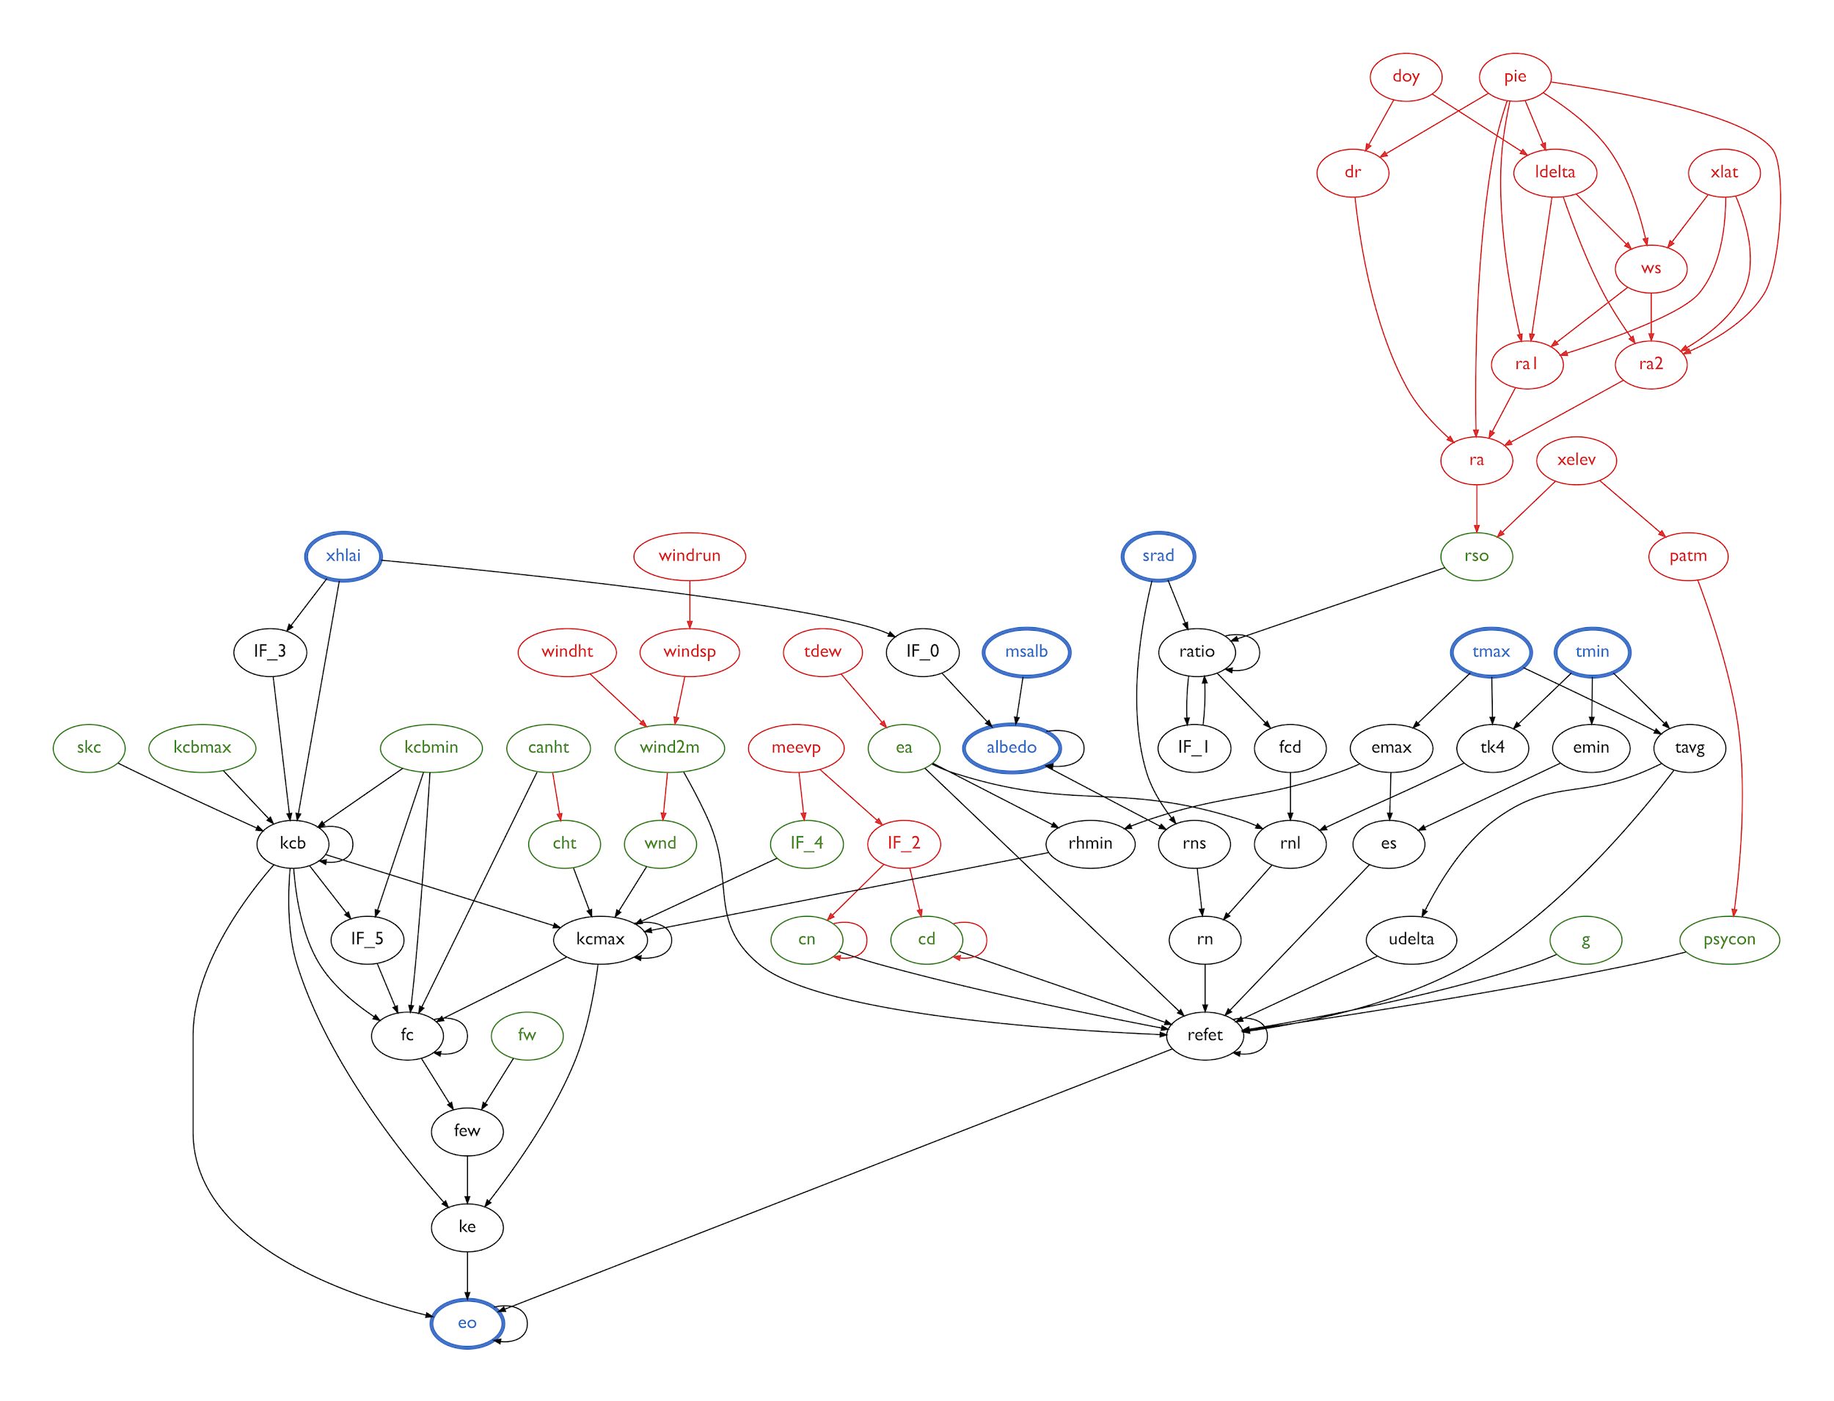
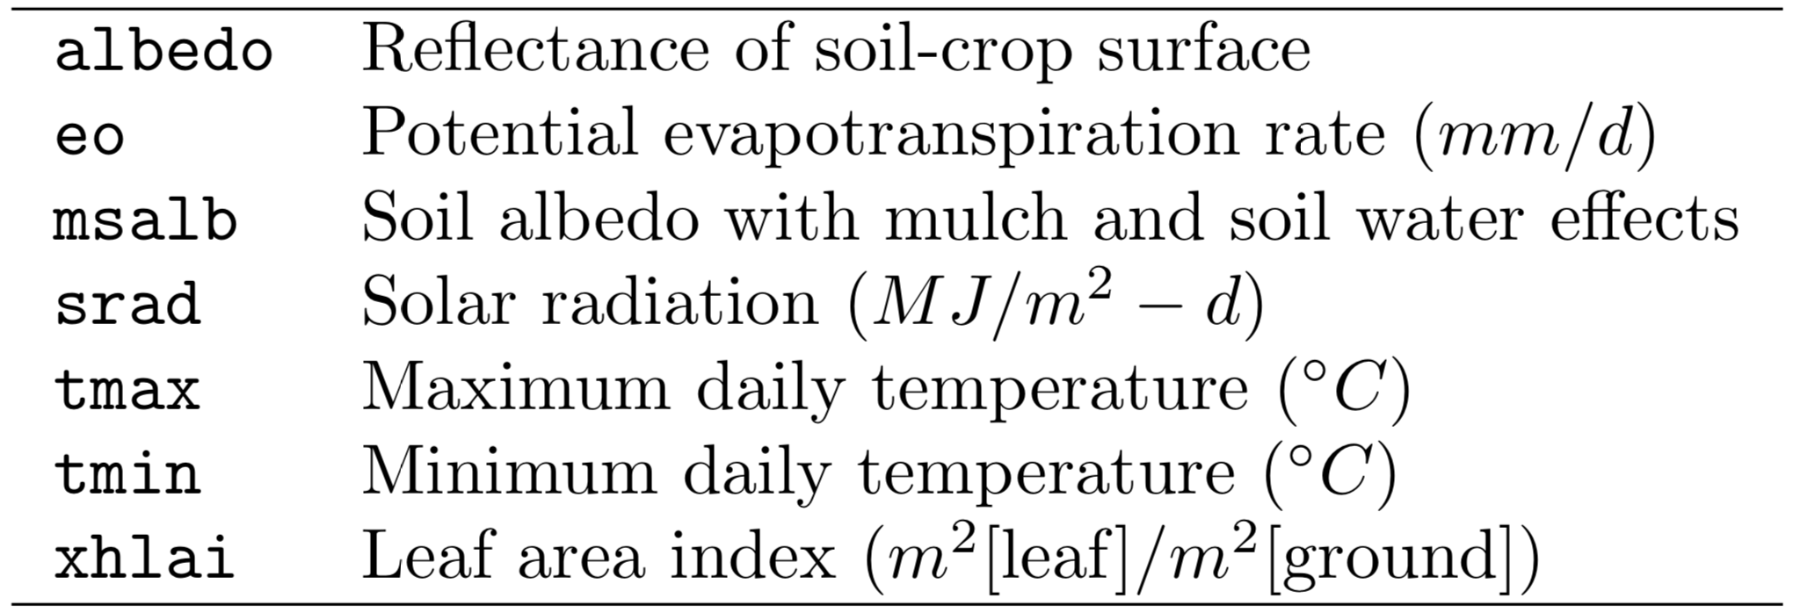
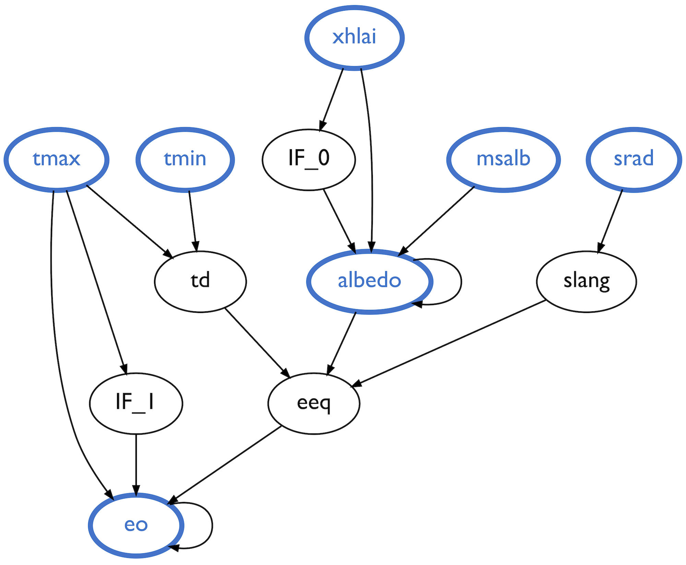
ml4ai.github.io/automates
Model Comparison
Shared Variables
Priestley-Taylor (PT)
American Society for Civil Engineering (ASCE)

Slide 11
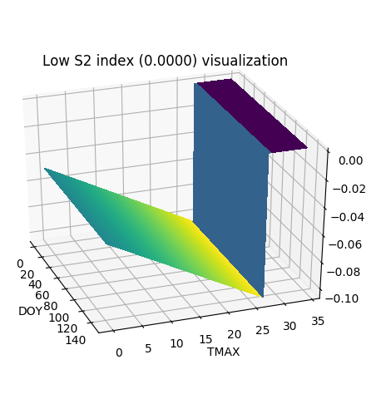
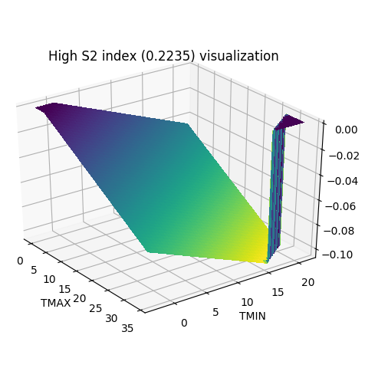
ml4ai.github.io/automates
Model Analysis
dLAI
dLAI
DOY
TMAX
TMIN
TMAX
Sensitivity index computation using Sobol sensitivity analysis
Computing the sensitivity indices allows us to see which variables and which pairs of variables account for the most variance in overall model output
Notes:
In the images shown above we see two 3D surfaces. Each of these are constructed from our PLANT.for Fortran program. The z-axis for both of these plots is the model output, dLAI (change in Leaf Area Index) from the PLANT program. The xy coordinates of the two plots represent the input variable pairs with lowest and highest sensitivity respectively. Here highest sensitivity means the pair of inputs that induce the greatest amount of variability in the output. The graphics are here to help us visualize the difference. As you can see from the graphic on the left, dLAI remains unchanged with respect to DOY, whereas both TMIN and TMAX affect the variability of dLAI, and they do so jointly, as evident by the flattening of the surface on the right in two locations.
DOY = day of the year
TMAX = Daily maximum temperature (c)
TMIN = Daily maximum temperature (c)
dLAI = daily increase in leaf area index (m2/m2/d)

Slide 12
Summary
ml4ai.github.io/automates
Integration of model semantics
from text, equations and software
into a uniform framework for analysis.
Automating linking of software to text discourse context
Model comparison and sensitivity analysis in a uniform framework
Model augmentation and composition
Contextual debugging and model communication

Slide 13
Thank you!
ml4ai.github.io/automates
AutoMATES: https://ml4ai.github.io/automates/
Delphi (Modeling): https://ml4ai.github.io/delphi/
Reach (Reading biomedical text): https://github.com/clulab/reach
BioContext (Reading biological context): https://ml4ai.github.io/BioContext/
Eidos (Open domain reading): https://github.com/clulab/eidos

Slide 14
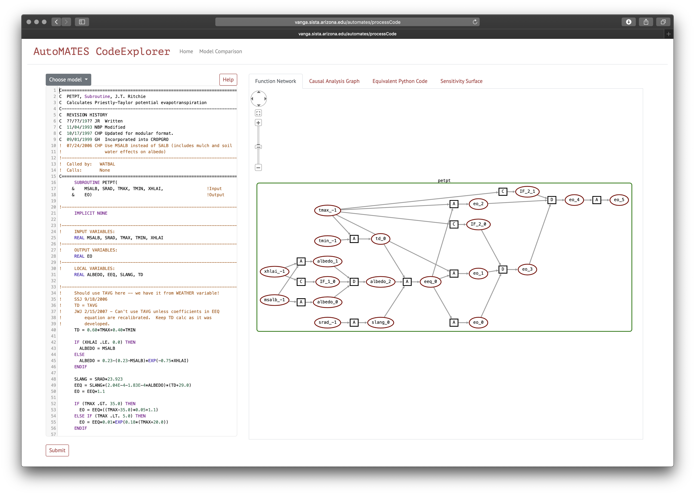
CodeX: http://vanga.sista.arizona.edu/automates
Dockerized: https://ml4ai.github.io/automates/documentation/deliverable_reports/m6_milestone_report/#codeexplorer-webapp
Notes:
https://ml4ai.github.io/automates/documentation/deliverable_reports/m6_milestone_report/#codeexplorer-webapp

Slide 15
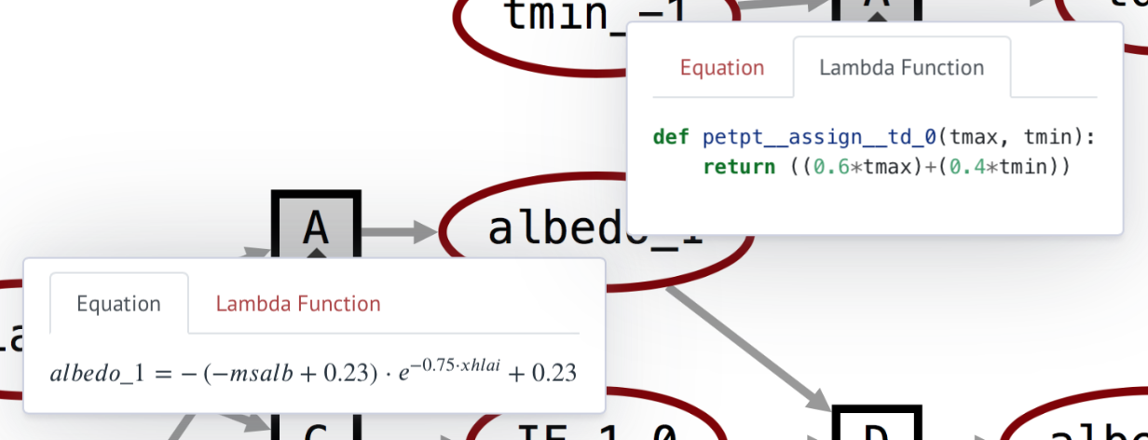
CodeX: http://vanga.sista.arizona.edu/automates

Slide 16
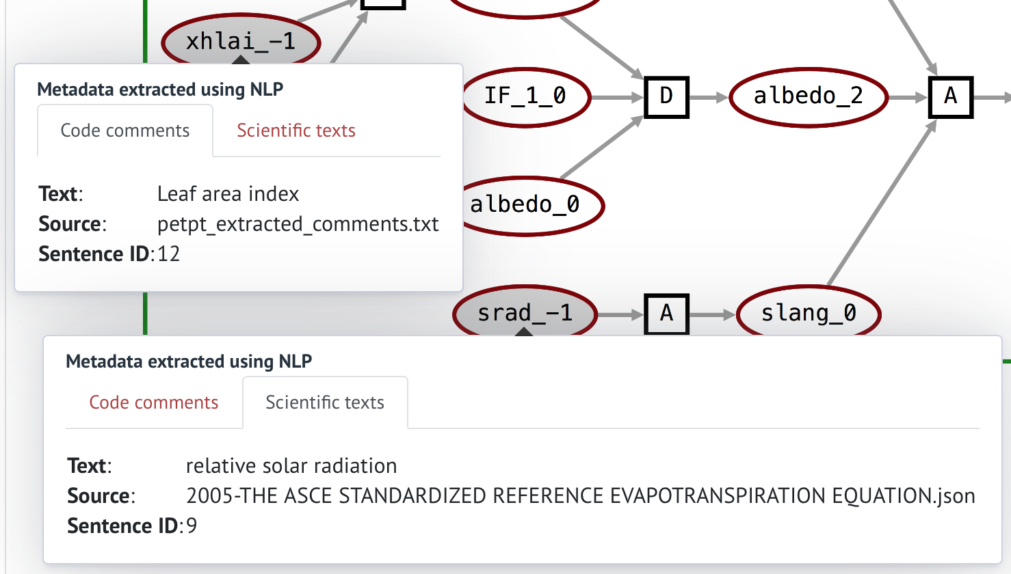
CodeX: http://vanga.sista.arizona.edu/automates

Slide 17
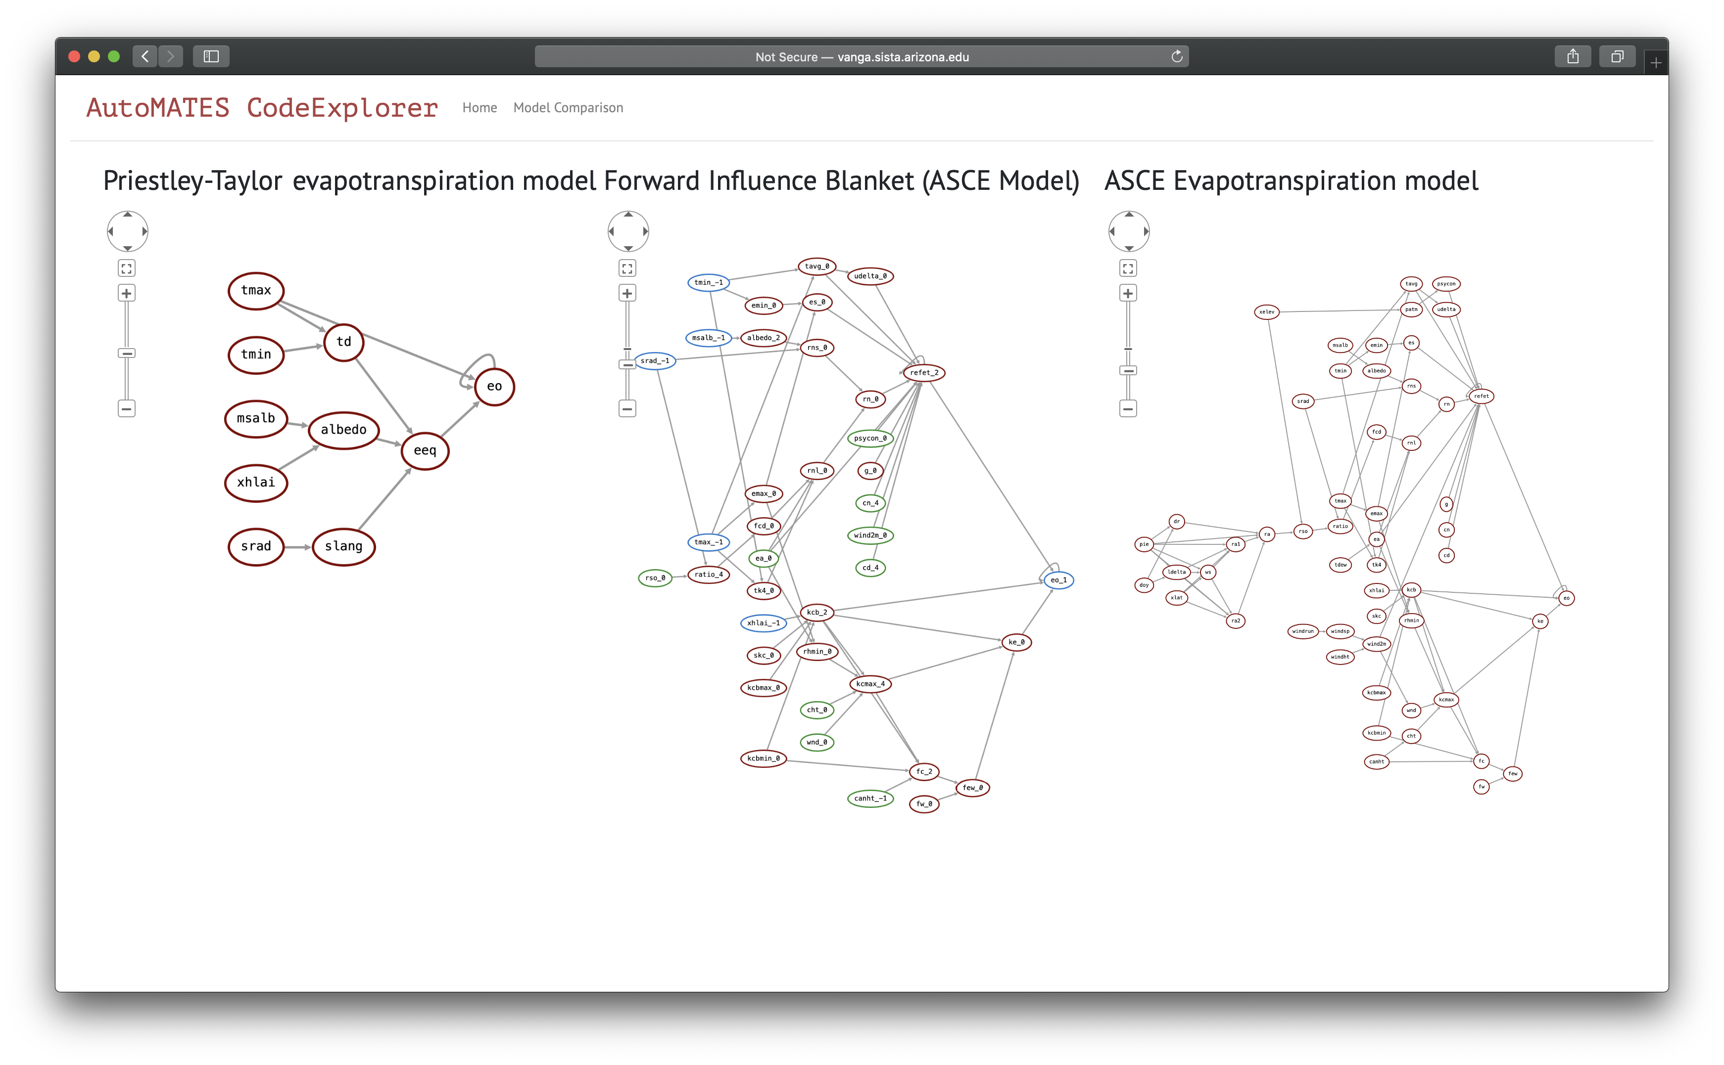
CodeX: http://vanga.sista.arizona.edu/automates

Slide 18
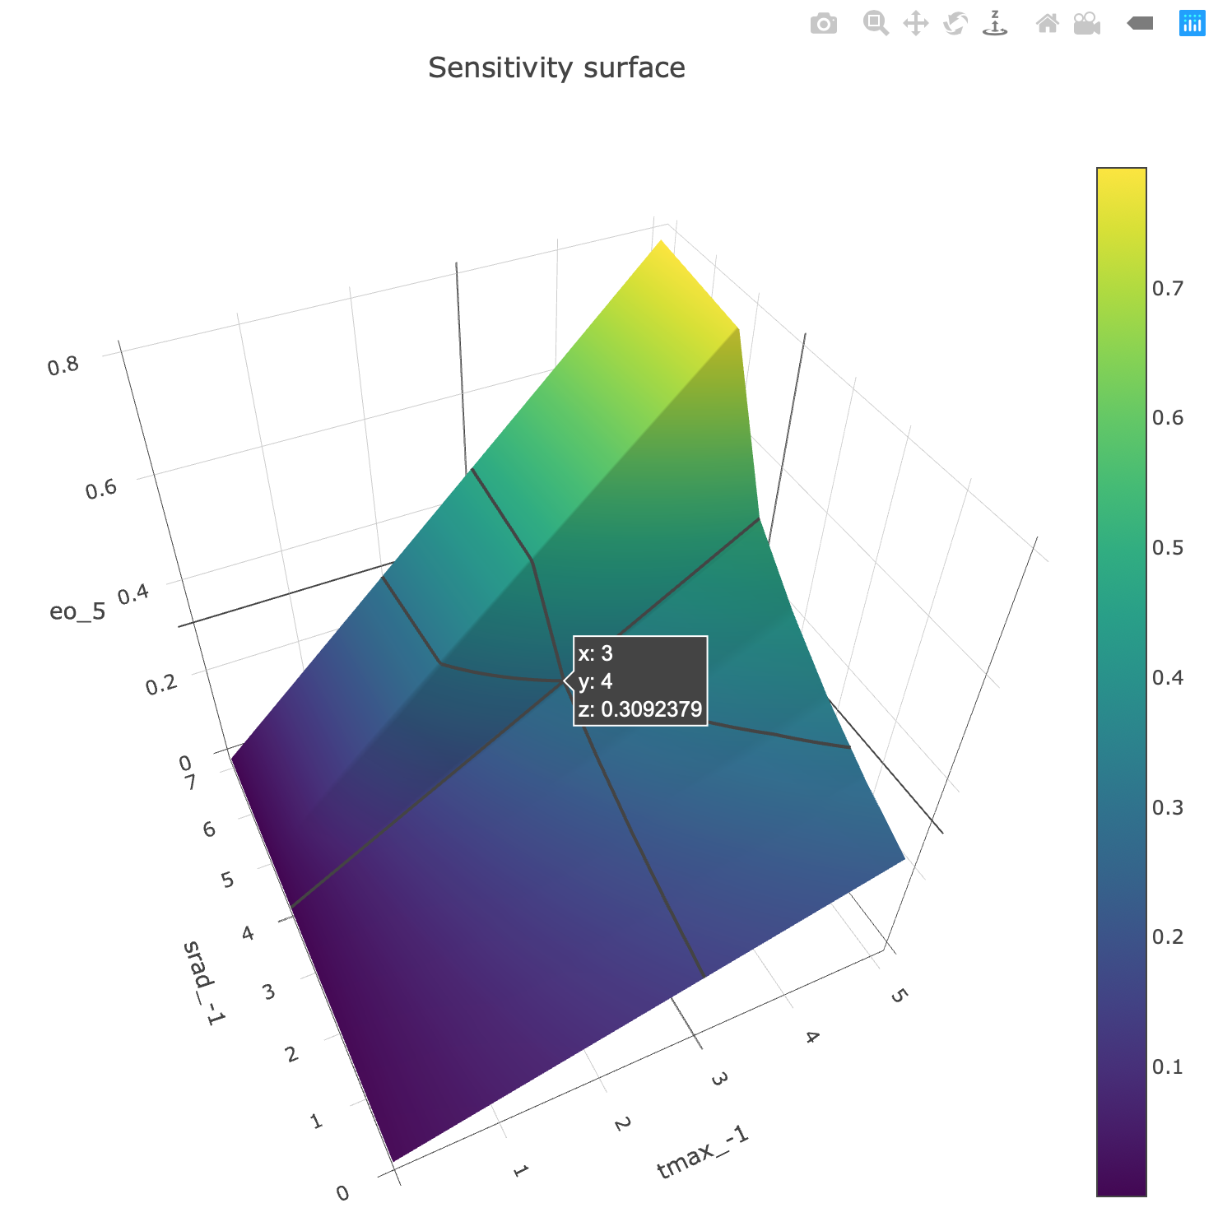
CodeX: http://vanga.sista.arizona.edu/automates

