Slide 1
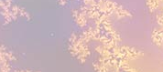
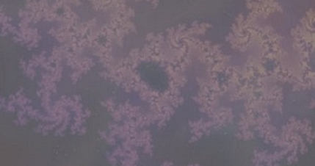
Detecting behavioral change points with passively collected smartphone sensor data
1. What health behavior problems are we trying to solve?
Can we predict adverse events prior to their occurrence by detecting changes in the behavior of at-risk patients? Our focus: Can the occurrence of mania/psychosis be predicted from preceding behavioral changes?
2. Data collection designs:
Smartphone sensor data collected unobtrusively/passively: GPS, accelerometer, call/text logs, screen on/off logs, WiFi, bluetooth, app usage, gyroscope.
Data is collected continuously. Some analyses allow for continuous covariates (hazard modeling) while others require discretization (change point detection). Many digital biomarkers of behavior have a natural daily definition due to circadian behavioral patterns, so discretizing to the level of the day leads to most meaningful/interpretable measures.
Change point detection is unsupervised. Outcome is the occurrence of an adverse event. An implicit assumption is made that behavioral changes precede adverse events.
A patient’s post-processed daily digital biomarkers derived from smartphone sensor data.
PIs: Baker, Rauch
Modeling: Barnett
U01 MH116925 NIH/NIMH
Notes:
Instructions:
Submit 3 slides by Tuesday 2/19/19. Example ready by the 2/15/19.
Title - headline your theory-driven, mechanistic model
name the specific mathematical or statistical method and variations thereof
NOTES section
define/explain it enough for a non-scientific person to explain to the general public (2-3 sentences)
mention how can machine learning and AI help your project (2 sentences)
List future challenges or next steps after your project is done (1 sentence)
Notes section - For the following communities (2 sentences):
BRAIN: explain the theory behind the math/stats and how it will be used to understand how the brain works
Behavioral modeling: explain the new theory that will integrate within person dynamics with between person dynamics
Multiscale modeling: explain how the math will address methodological challenges (e.g.: crossing scales, sparse data, uncertainty, modularity, spatiotemporal simulation challenges, etc.)
Analysis: explain how new statistical approaches will provide mechanistic understanding of the system
Medical simulation: explain the math challenges being overcome (e.g. collision dynamics, cloth dynamics, haptics, etc.)

Slide 2
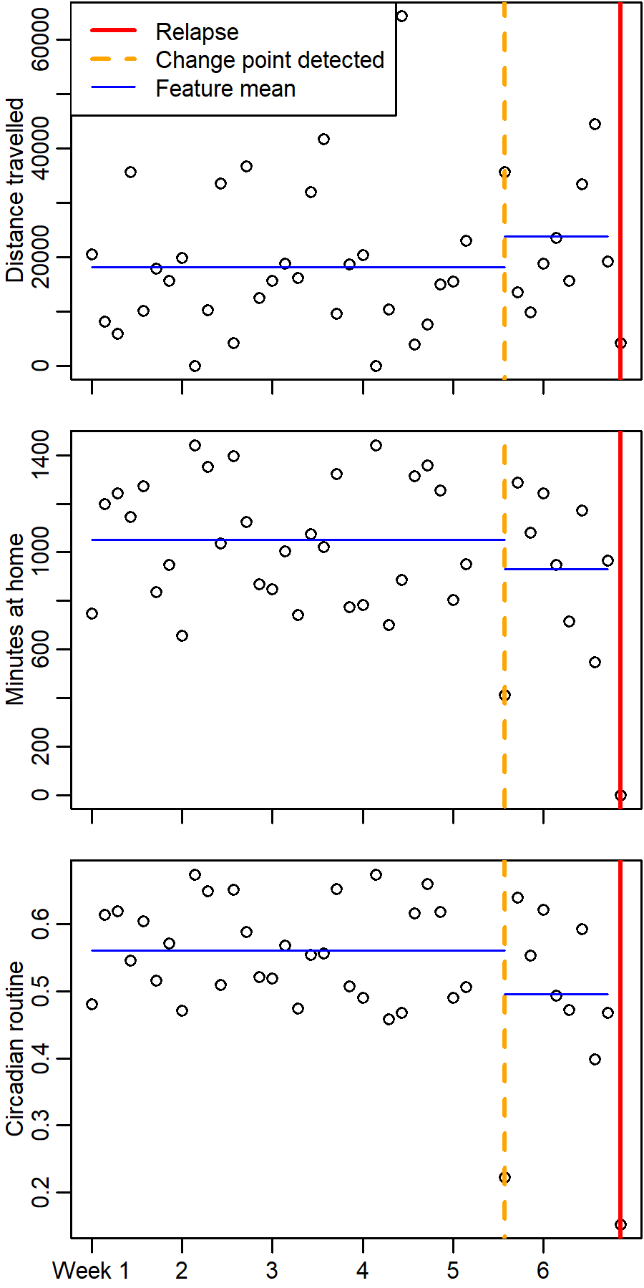
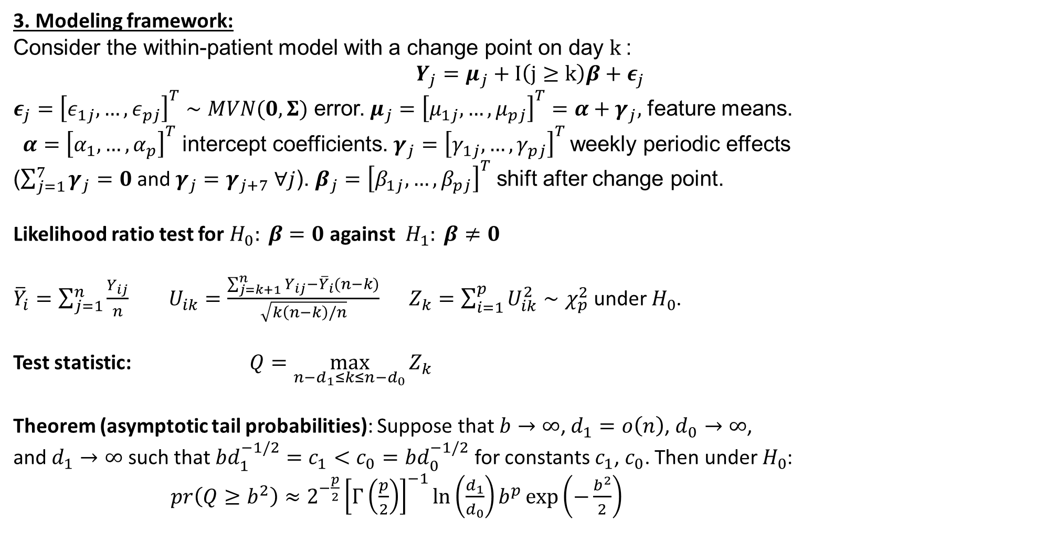
Detecting behavioral change points with passively collected smartphone sensor data
3. Modeling framework:
Consider the within-patient model with a change point on day $k$:
$$Y_{j}=μ_{j}+I\left(j≥k\right)β+ε_{j}$$
$ε_{j}={\left[ε_{1j},…,ε_{pj}\right]}^{T}∼MVN(0,Σ)$ error.$μ_{j}={\left[μ_{1j},…,μ_{pj}\right]}^{T}=α+γ_{j},$ feature means.
$α={\left[α_{1},…,α_{p}\right]}^{T}$ intercept coefficients.$γ_{j}={\left[γ_{1j},…,γ_{pj}\right]}^{T}$ weekly periodic effects
($\sum_{j=1}^{7}{γ_{j}}=0$ and $γ_{j}=γ_{j+7} ∀j$).$β_{j}={\left[β_{1j},…,β_{pj}\right]}^{T}$ shift after change point.
Likelihood ratio test for $H_{0}: β=0$ against${ H}_{1}: β≠0$
${\overline{Y}}_{i}=\sum_{j=1}^{n}{\frac{Y_{ij}}{n}}$ $U_{ik}=\frac{\sum_{j=k+1}^{n}{Y_{ij}}−{\overline{Y}}_{i}(n−k)}{\sqrt{k\left(n−k\right)/n}}$ $Z_{k}=\sum_{i=1}^{p}{U_{ik}^{2}}∼χ_{p}^{2}$ under $H_{0}$.
Test statistic: $Q=\max_{n−d_{1}≤k≤n−d_{0}}{Z_{k}}$
Theorem (asymptotic tail probabilities): Suppose that $b→∞$, $d_{1}=o\left(n\right)$, $d_{0}→∞$,
and $d_{1}→∞$ such that $bd_{1}^{−1/2}=c_{1}<c_{0}=bd_{0}^{−1/2}$ for constants $c_{1}$, $c_{0}$. Then under $H_{0}$:
$pr\left(Q≥b^{2}\right)≈2^{−\frac{p}{2}}{\left[Γ\left(\frac{p}{2}\right)\right]}^{−1}\ln\left(\frac{d_{1}}{d_{0}}\right)b^{p}\exp\left(−\frac{b^{2}}{2}\right)$
PIs: Baker, Rauch
Modeling: Barnett
U01 MH116925 NIH/NIMH
Notes:
Instructions:
Submit 3 slides by Tuesday 2/19/19. Example ready by the 2/15/19.
Title - headline your theory-driven, mechanistic model
name the specific mathematical or statistical method and variations thereof
NOTES section
define/explain it enough for a non-scientific person to explain to the general public (2-3 sentences)
mention how can machine learning and AI help your project (2 sentences)
List future challenges or next steps after your project is done (1 sentence)
Notes section - For the following communities (2 sentences):
BRAIN: explain the theory behind the math/stats and how it will be used to understand how the brain works
Behavioral modeling: explain the new theory that will integrate within person dynamics with between person dynamics
Multiscale modeling: explain how the math will address methodological challenges (e.g.: crossing scales, sparse data, uncertainty, modularity, spatiotemporal simulation challenges, etc.)
Analysis: explain how new statistical approaches will provide mechanistic understanding of the system
Medical simulation: explain the math challenges being overcome (e.g. collision dynamics, cloth dynamics, haptics, etc.)

Slide 3
Detecting behavioral change points with passively collected smartphone sensor data
4. Challenges:
Handling missing data: Smartphone sensor data can be missing under a variety of missing data mechanisms. Most commonly data is Missing At Random (MAR) or Missing Completely At Random (MCAR) due to scheduled missingness so as to avoid excessive battery strain. However some missing data will be Not Missing At Random (NMAR), e.g. patient turning off phone or manually disabling certain sensors.
Dimension reduction: Behavioral biomarkers obtained from smartphone data can be highly correlated/redundant. Data transformations such as factor analysis or dimension reduction can increase statistical power of change point detection by reducing redundancies in the data. Challenge: longitudinal factor analysis, i.e. determining universal factors applicable across the sample that are also effective for within-person analyses (e.g. change point detection).
Online analyses: To move beyond retrospective analysis and apply change point detection in practice for patient monitoring, models need to be updated daily as data is collected. For larger cohorts with long follow-up periods, this can become computationally burdensome unless each patient’s change point model is constructed such that they all can updated in an online fashion.
5. How will this change current practice?
Patient measurements are made possible without relying on self-report.
Enables monitoring of at-risk patients so that problematic behavioral changes
are detected prior to adverse events rather than after.
PIs: Baker, Rauch
Modeling: Barnett
U01 MH116925 NIH/NIMH
Notes:
Instructions:
Submit 3 slides by Tuesday 2/19/19. Example ready by the 2/15/19.
Title - headline your theory-driven, mechanistic model
name the specific mathematical or statistical method and variations thereof
NOTES section
define/explain it enough for a non-scientific person to explain to the general public (2-3 sentences)
mention how can machine learning and AI help your project (2 sentences)
List future challenges or next steps after your project is done (1 sentence)
Notes section - For the following communities (2 sentences):
BRAIN: explain the theory behind the math/stats and how it will be used to understand how the brain works
Behavioral modeling: explain the new theory that will integrate within person dynamics with between person dynamics
Multiscale modeling: explain how the math will address methodological challenges (e.g.: crossing scales, sparse data, uncertainty, modularity, spatiotemporal simulation challenges, etc.)
Analysis: explain how new statistical approaches will provide mechanistic understanding of the system
Medical simulation: explain the math challenges being overcome (e.g. collision dynamics, cloth dynamics, haptics, etc.)

