Slide 1
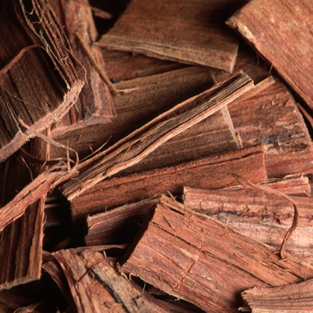

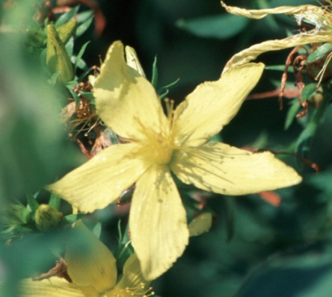
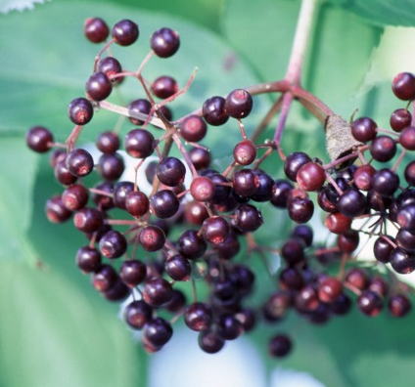
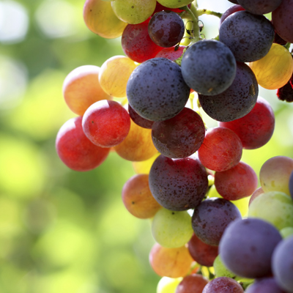
Modeling and funding opportunities
Barbara C. Sorkin, Ph.D.
Director, NIH Centers for Advancing Research on Botanicals and Other Natural Products
Office of Dietary Supplements
National Institutes of Health
IMAG-MSM, March 22, 2017

Slide 2
Resources for botanical DS research: NIH CARBON Program
Botanicals and Metabolic Resiliency, Pennington Biomedical Research Center, LSU, Rutgers
Botanical Dietary Supplements for Women’s Health, University of Illinois at Chicago
Dietary Botanicals in the Preservation of Cognitive and Psychological Resilience, Icahn School of Medicine at Mount Sinai
Center for High-Throughput Functional Annotation of Natural Products, University of Texas Southwestern Medical Center, Simon Fraser University, UC Santa Cruz
Center for Natural Products Technologies, University of Illinois at Chicago
https://ods.od.nih.gov/Research/Dietary_Supplement_Research_Centers.aspx

Slide 3
Challenges in botanical research: component interactions
Elfawal, et al., PLoS One, 2012

Slide 4
Challenges in botanical research: accelerating the process
Schulze, et al, Chem Biol, 2013

Slide 5
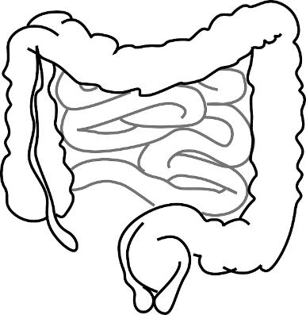
Why modeling for botanical-animal interactions?
A B C D E F G
liver
Hypothetical interactions in metabolism and activity:
F slows absorption of G
D inhibits CYP450 metabolism of E
A increases ability of microbiome to generate bioactive metabolite(s) from C
Gastrointestinal system and gut microbiome

Slide 6
Funding opportunity
PA 16-319
Administrative supplements for research on dietary supplements
Barbara C. Sorkin, Ph.D.
Website: https://ods.od.nih.gov
Email: sorkinb@mail.nih.gov
Notes:
What are some ways that research on botanicals is likely to be more challenging than drug research?

