Slide 1
Multiscale Modeling of Blood Flow and Platelet Mediated Thrombosis
PI: Danny Bluestein, Co-PIs: Marvin J. Slepian, Yuefan Deng
Credibility Plan: Validation of model parameters
  Geometrical, rheological, and material properties of coarse grained molecular dynamics (CGMD) platelet model validated using published literature and in vitro experiments
  In silico shear-mediated platelet shape change validated with scanning electron microscopy images of platelets exposed in Hemodynamic Shearing Device (HSD)
  Flow-mediated platelet flipping, aggregation, and adhesion models validated with high magnification DIC microscopy and high framerate capture of shear-mediated platelet behavior in microchannels
  Antiplatelet agent-induced membrane fluidity modeling validated using a dielectrophoresis (DEP) setup
  Changes in Credibility Plan from Year 1
  Platelet-platelet recruitment/aggregation validated with flow-mediated platelet aggregation in microchannels
  Machine learning approaches to optimize high performance computing (HPC) and aggregation prediction.
Unique aspects of the credibility plan
  Utilizes in-house equipment (HSD, DEP, DIC microscopy, and microchannel setup) for validation
  Identifies and quantifies the dominant sources of uncertainties, while minimizing global uncertainties arising from model and computational parameters
  Model parameters interfaced with in vitro observations via a database

Slide 2
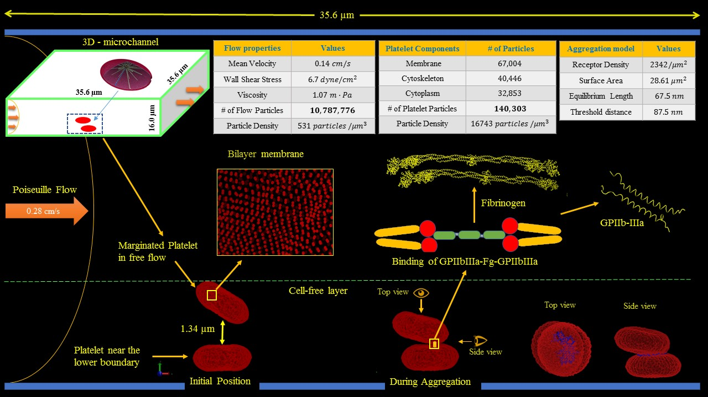
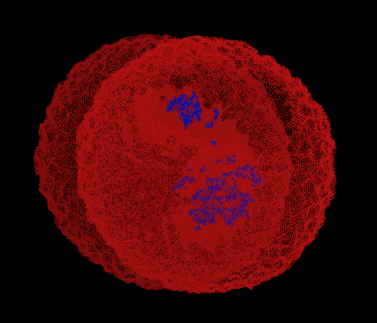
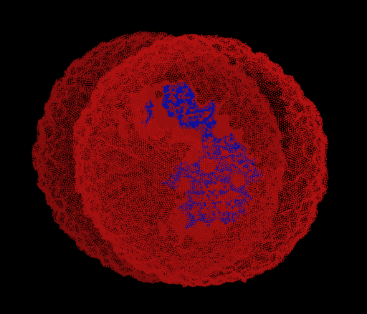
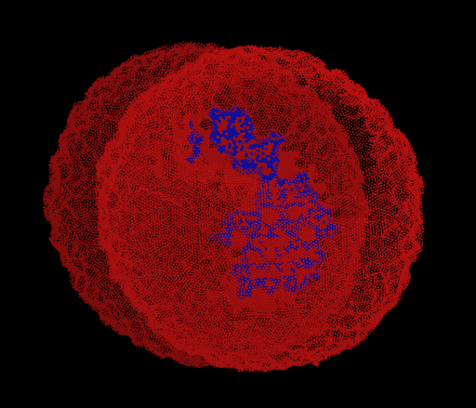
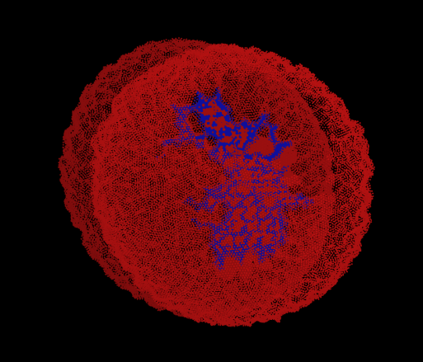
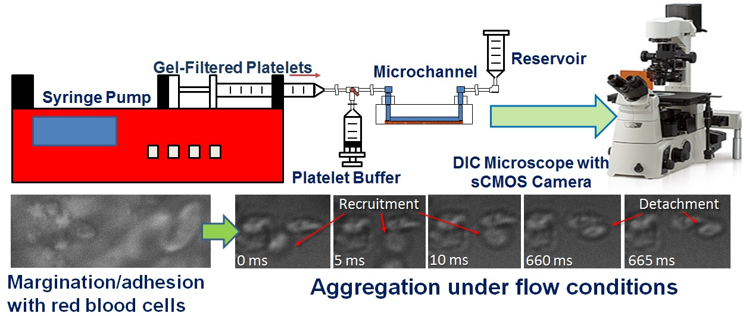
Determination of model parameters by correlating with in vitro results
Shear-Mediated Platelet Aggregation
Deformable platelet
(contact area: 2.00 μm²)
Models interface with database of parameters recorded from platelet experiments
Experimental results and model algorithms available on Harvard Dataverse (From Year 3)
Considering storage/computation on Google Cloud Platform

Slide 3
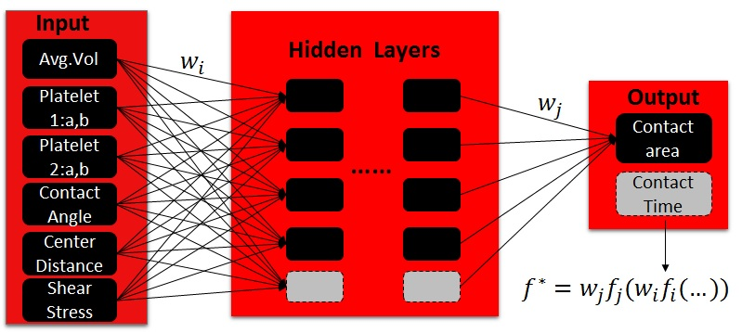
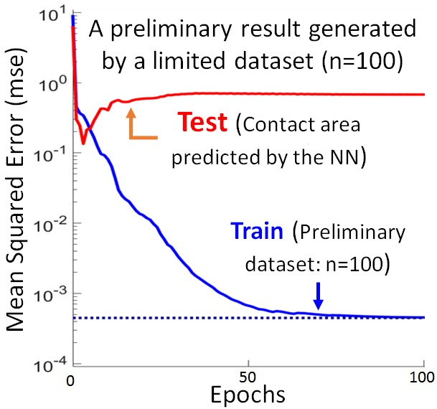
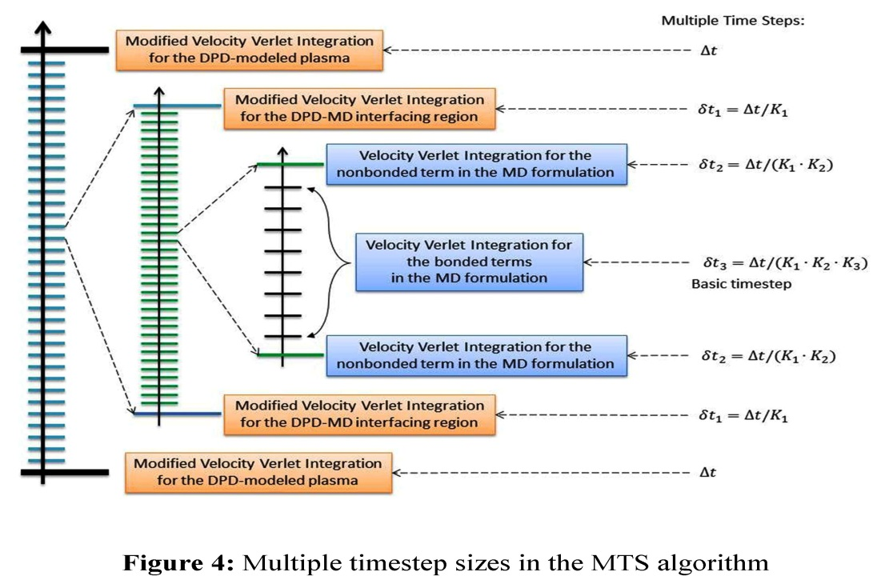
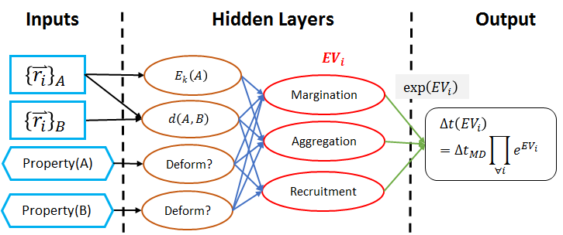
Challenges and Review
Machine Learning-Powered Solutions
Challenges and Known Issues
Lack of techniques to observe platelet deformation, activation, aggregation, adhesion under flow conditions
Large number of unknown parameters in the modeling and simulations
Adapting discrete particle-based methods (DPD-CGMD) to describe continuum multiscale phenomena
More Efficient Algorithms on HPC Resources: MTS (Multiple Time Stepping) + ATS (Adaptive Time Stepping)
Requirements for Third Party Reviews
Knowledge of LAMMPS molecular dynamics software
Familiarity with both MD and DPD theory
Familiarity with basics of platelet activation, aggregation, and adhesion
HPC resources for large multiscale simulations

