Slide 1
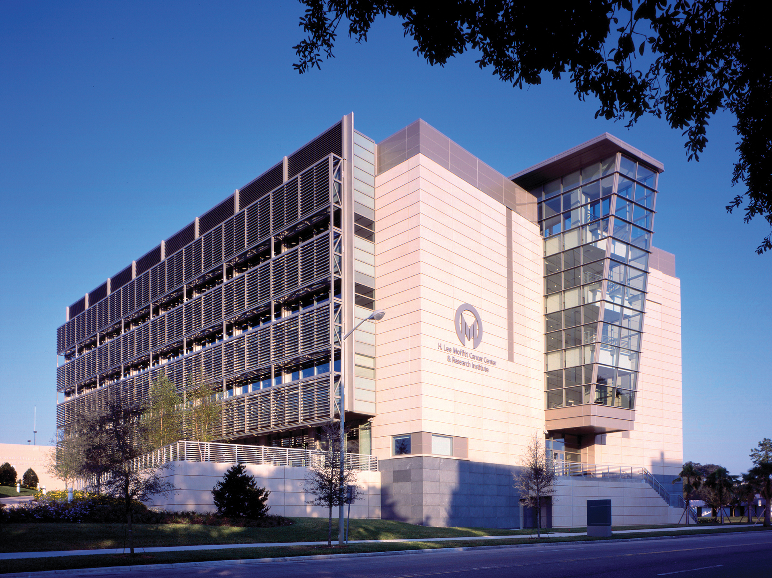


The bone metastasis ecosystem: credibility plan
David Basanta & Conor Lynch

Slide 2
Intended utility and audience
To ensure that it remains relevant it has to leverage multi scale modeling, explain biology and have clinical impact.
Audience thus includes:
    modelers,
    experimentalist
    doctors/patients

Slide 3
Key components
Mechanisms
Integration/parameterization
Validation
Translatability
Open source

Slide 4
Year 1 progress
Preparing the code
Info for simTK
Validation and integration

Slide 5
Challenges and opportunities
Not all our tools are open source (Matlab)
Not all the data is easy to share (clinical data)
Steep learning curve of some MSM tools

Slide 6
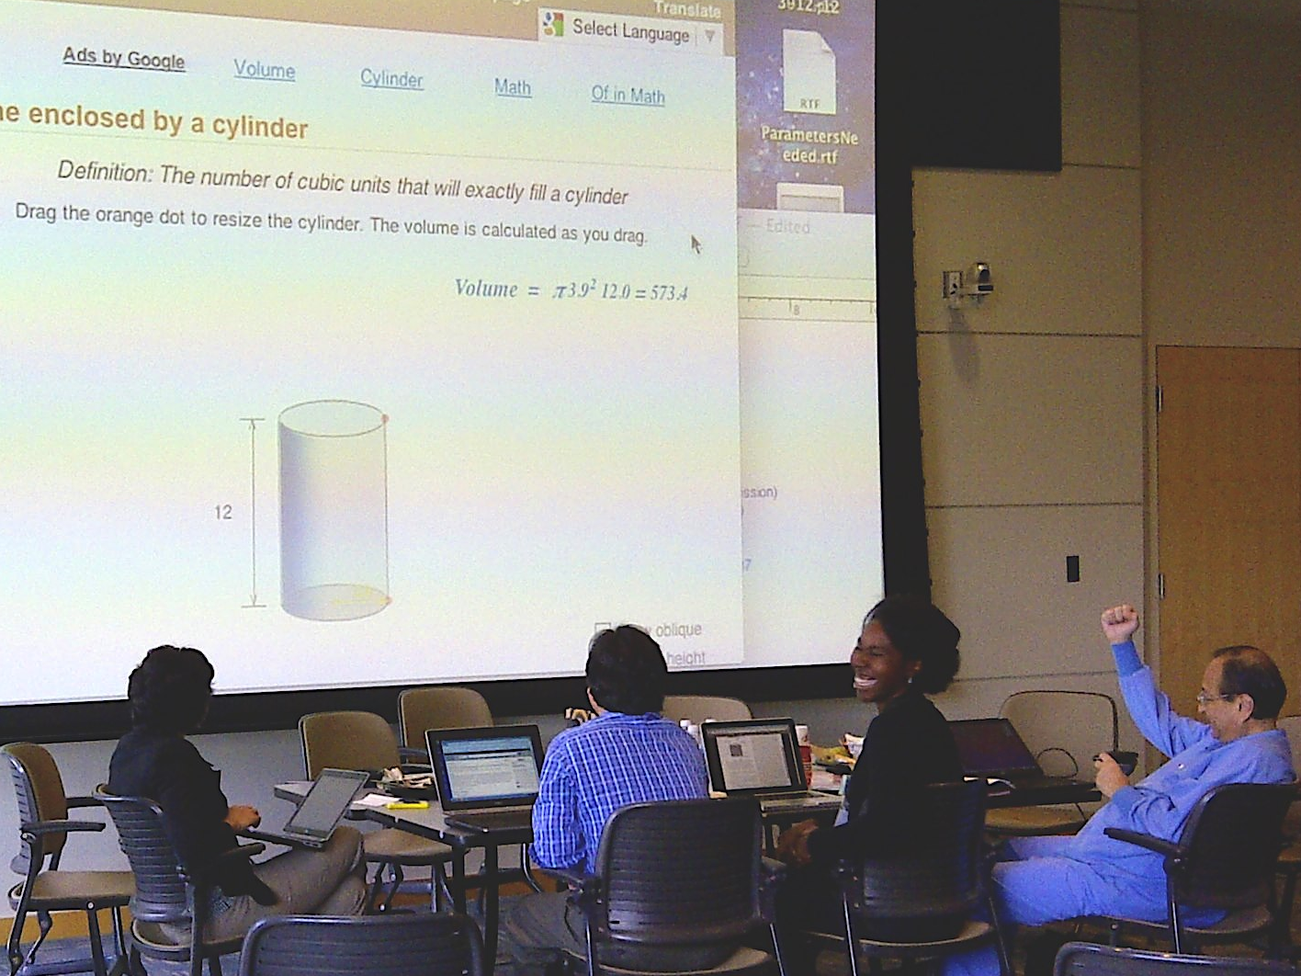
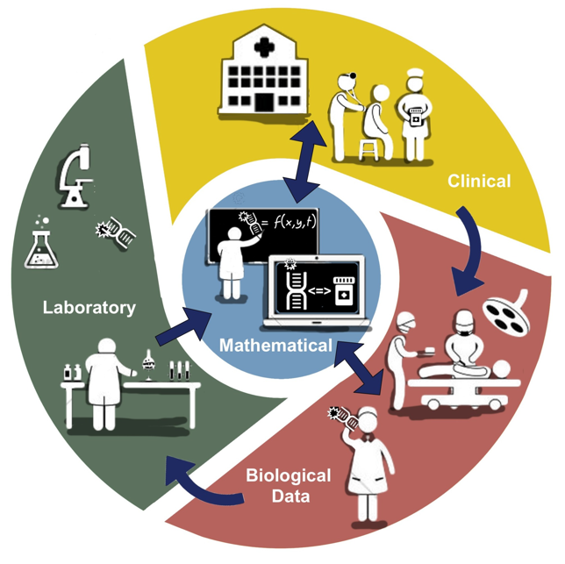
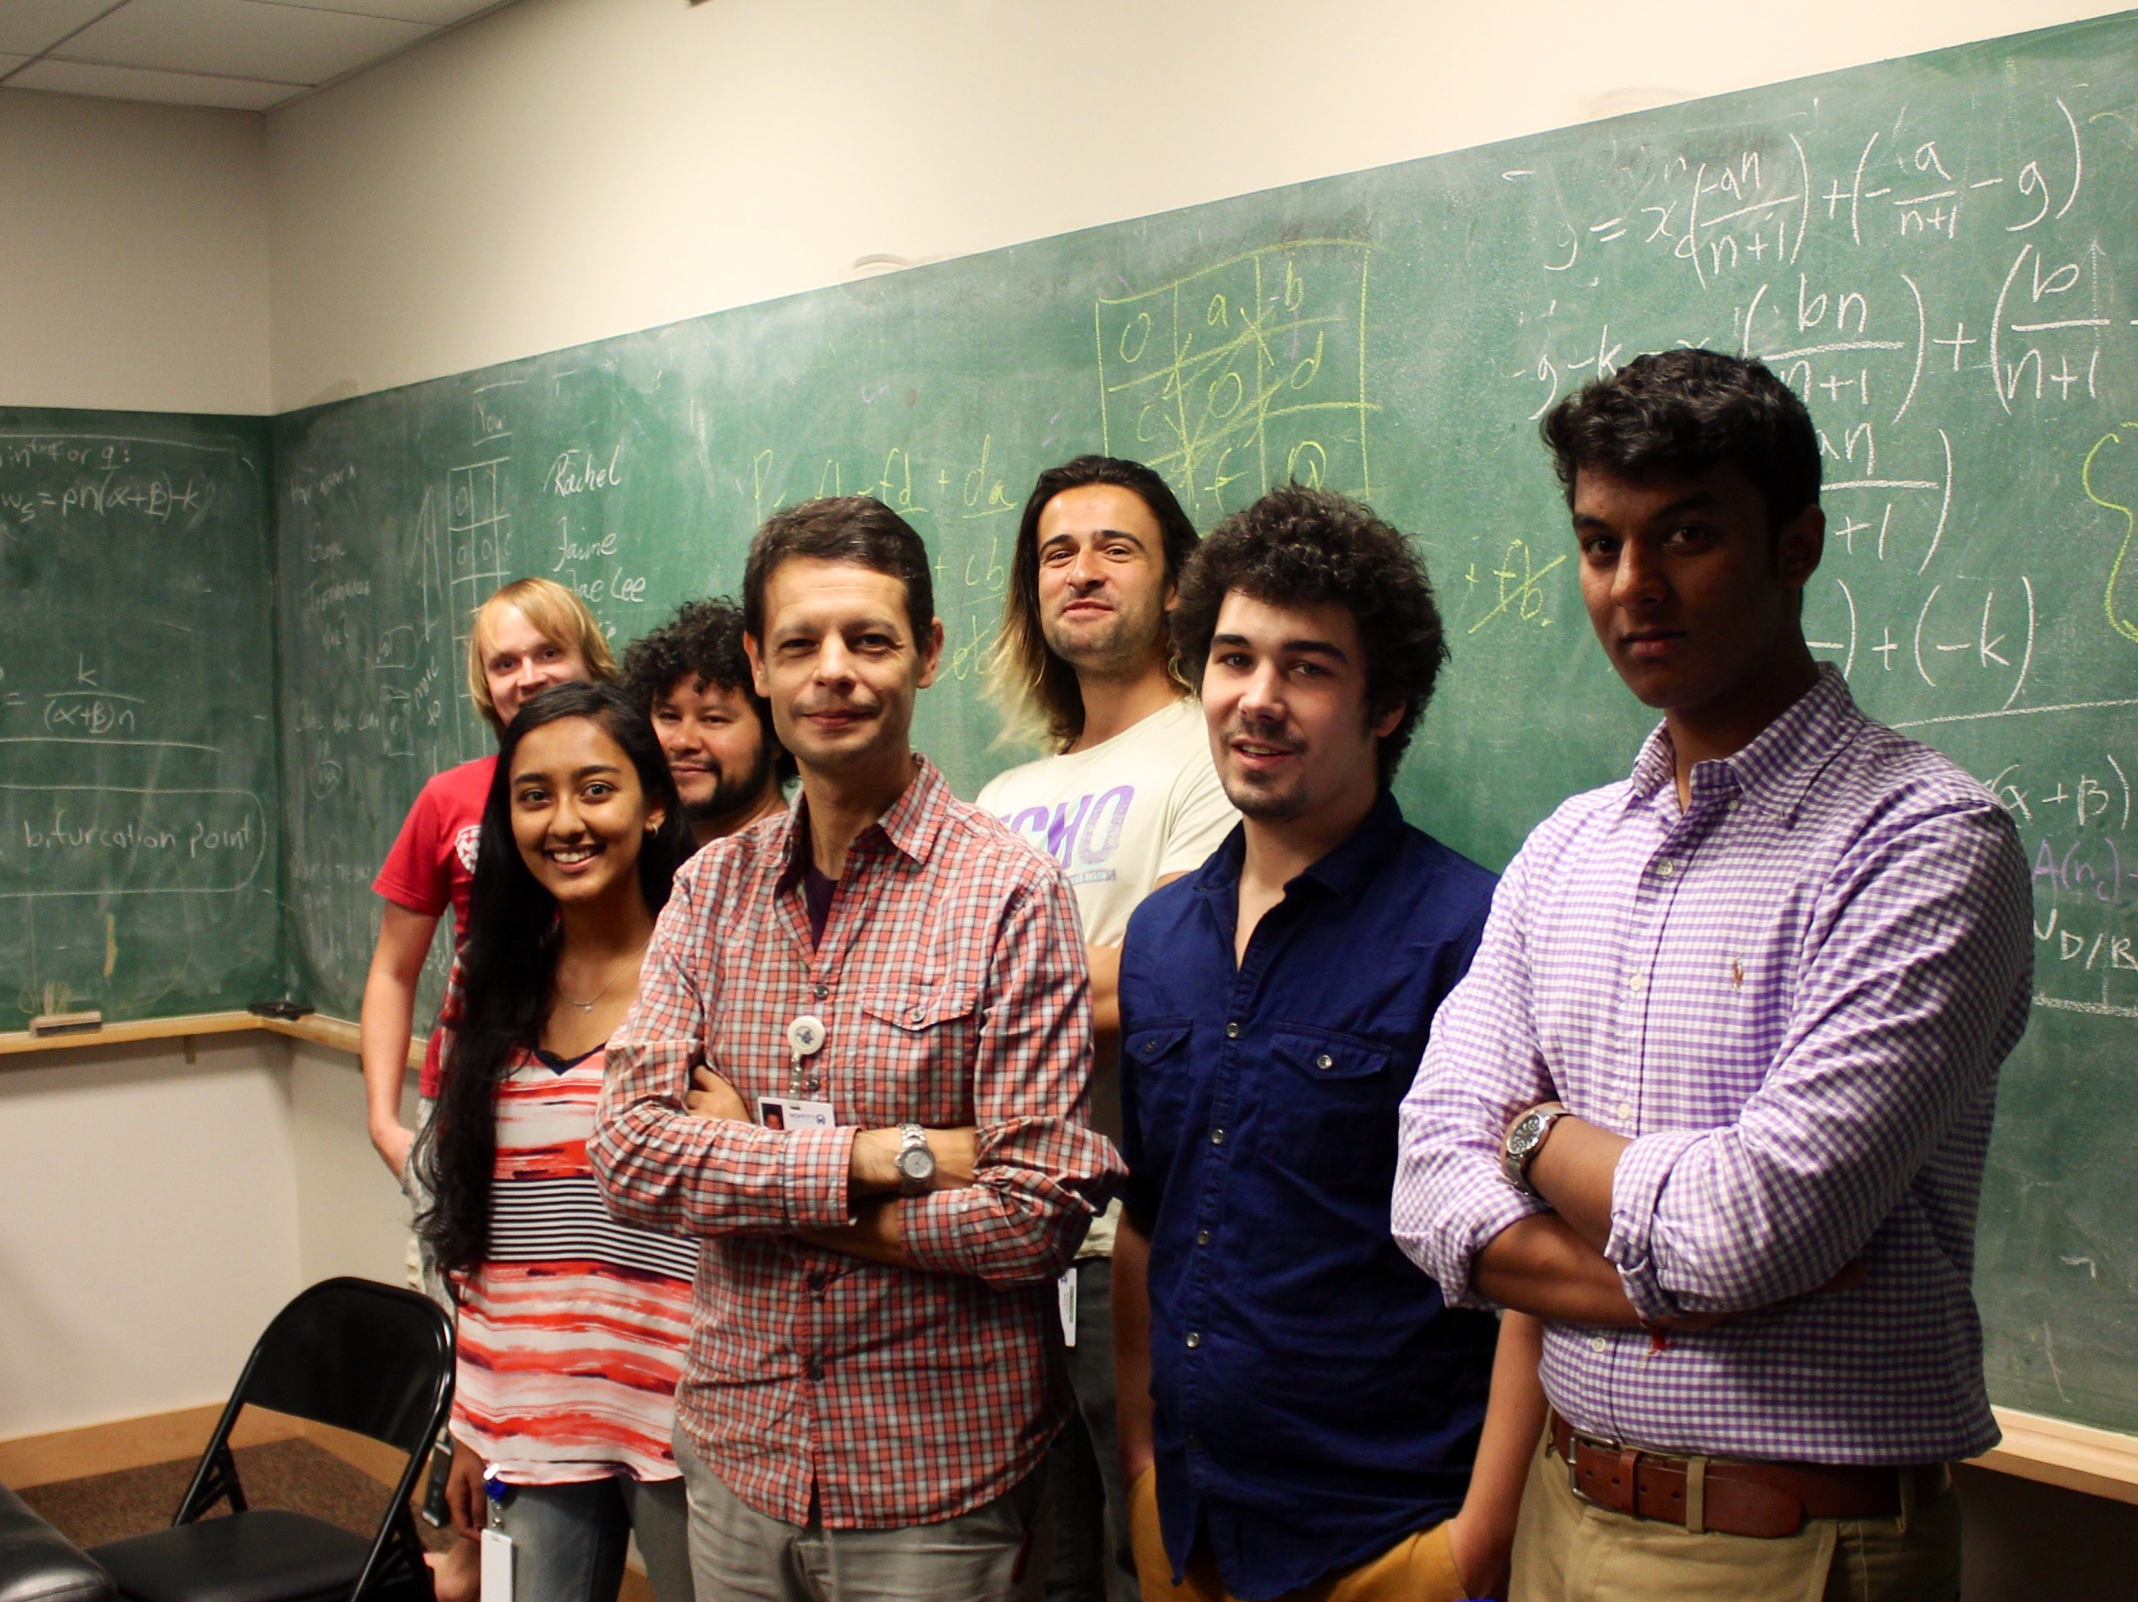
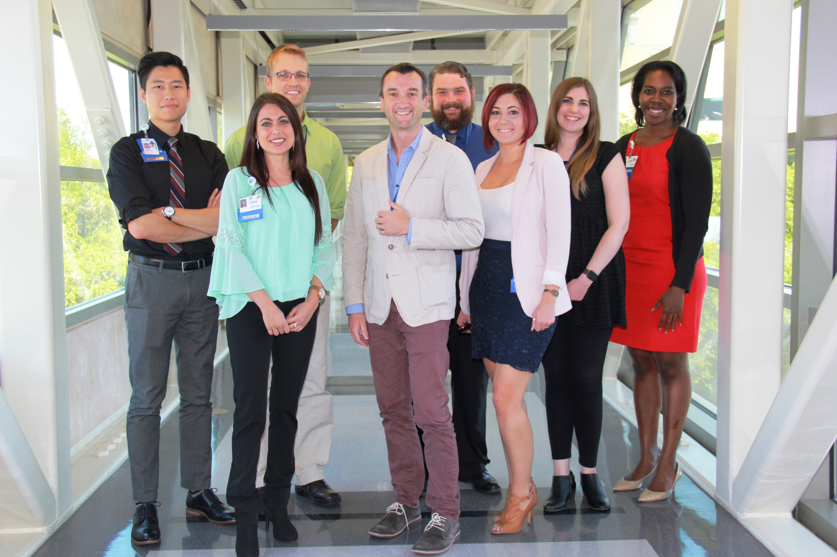
Uniqueness of the model credibility plan

Slide 7
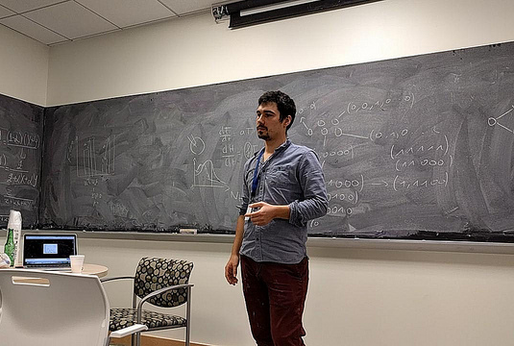
3rd party evaluation
Sandy
Anderson
Bob
Gillies
Seminars

Slide 8
Questions?

