Slide 1

Using Principles of Self-Organization to Model Metabolism: Prediction of Rate Constants, Concentrations and Enzymatic Regulation
William Cannon – Methods and Theory, Code
Jeremy Zucker, cyc.pnnl.gov, Code
Neeraj Kumar, Theory
Doug Baxter, HPC
Scott Baker, Fungal Biologist
Pacific Northwest National Laboratory
Meaghan Jankowski, Jennifer Hurley, Circadian Biologist
Rensselaer Polytechnic Institute
Tina Kelliher, Jay Dunlap, Circadian Biologist
Geisel School of Medicine, Dartmouth
Sam Britton, Mikahl Banwarth-Kuhn, Mark Alber - UQ
UC Riverside

Slide 2

Multiscale Modeling Challenge
ODEs: Circadian clock oscillator, minute time steps
Optimization: Metabolism
  Enzyme reactions on millisecond time scale
  Central Metabolism steady state calculated in < 5 seconds
  Extending to secondary metabolism
Notes:
The project is about the multiscale modeling of circadian rhythms in cells from enzymatic reactions on the millisecond time scale to the operation of the clock regulatory proteins on the 24 hour timescale.
The biological goal is to understand how metabolism feeds back onto the circadian clock and influences it.
But an emerging story, I argue, is how energy metabolism drives cellular differentiation, and on the evolutionary time scale, drives adaption of regulation to optimize thermodynamic cost and benefits.
Try as you might, even with cell regulation, you have to follow the second law of thermodynamics.

Slide 3

Self Organization and Energy Dissipation - Convection Cells
Cold
Water
Hot
Heat Convection Cell
Finding simplicity in complexity: General principles of biological and nonbiological organization, Perez Velazquez, Jose L., Journal of Biological Physics, 2009.
Notes:
To understand our approach to modeling, we have to take a step back and understand some high-level principles about how self-organization arises in nature.
The simplest example is a convection cell, in which we have a container full of some fluid and we apply heat to the bottom of the container and simultaneous cool the top of the container such that there is a steep energy gradient.
What happens is, the system, at first, has more or less random movements of the hot fluid to the top of the container as the system tries to dissipate heat.
As we raise the temperature, the gradient becomes steep enough that the random movements give way to circular, coordinated patterns of hot fluid rising, then cooling and dropping. These structures are called dissipative structures in physics.

Slide 4
Self-Organization in Nature
Non-equilibrium driving forces result in self-organization.
Apparent in structure or function
Self-organized structure: easy to visualize – many examples.
Notes:
Just as the convection cell results in self-organized flows, so too do we see these self-organized structures elsewhere in nature. Not just tornadoes and hurricanes, but also the carbon cycle, nitrate cycle, the phosphorous cycle in the environment and well-known cycles in the cell such as the cell cycle, circadian rhythms, and the TCA cycle.

Slide 5
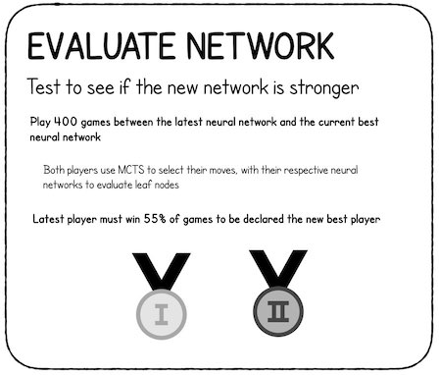
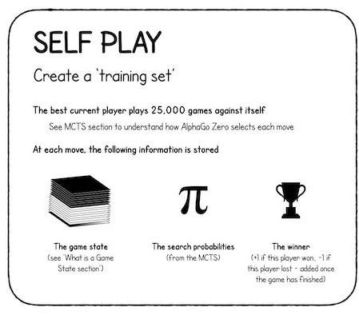
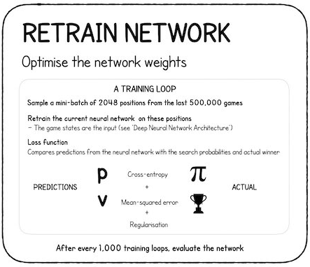
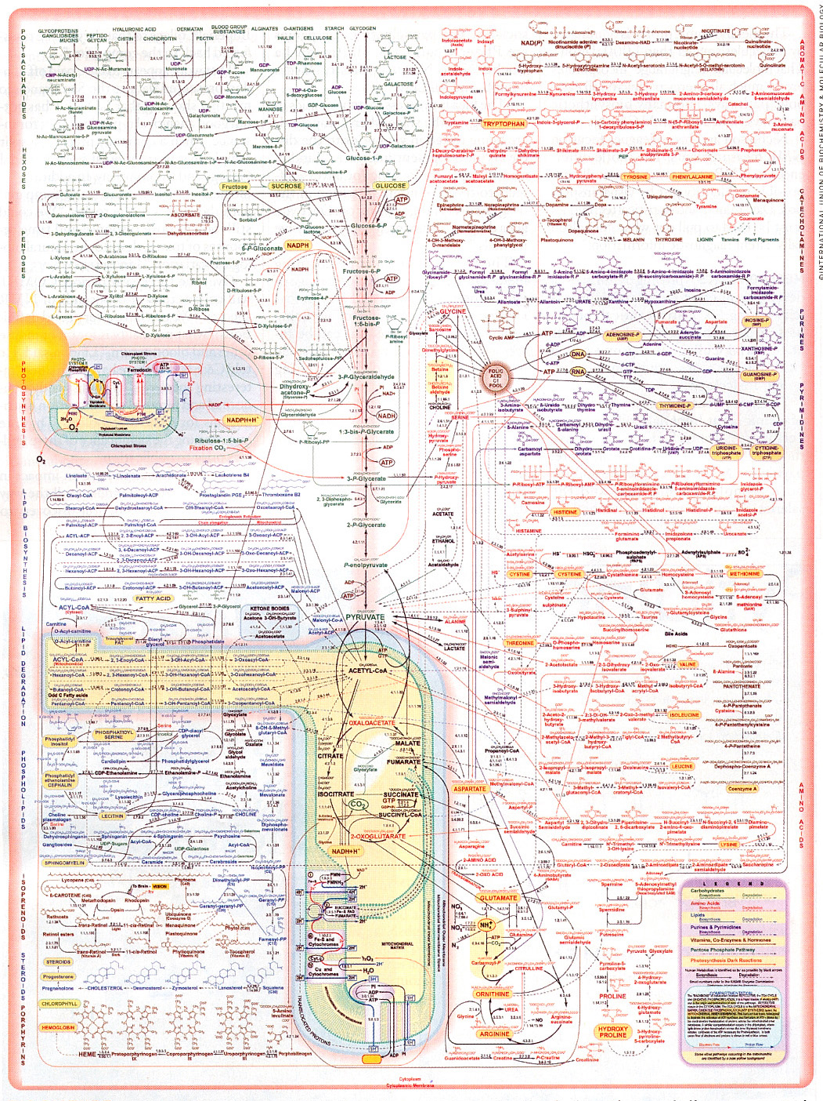
Dissipative Structures Maximize Entropy/Probability
Machine Learning
AlphaGo
Minimizing Disagreement <==> Maximizing Caliber (Alignment)
Human Learning &
Brain Science – Karl Friston
Cellular
Metabolism?
Dixit, P.D., et al., Perspective: Maximum caliber is a general variational principle for dynamical systems. Journal of Chemical Physics, 2018. 148(1)
Notes:
Basically, what these dissipative structures do is maximize entropy or equivalently minimize disagreement with their environments.
When it is stated it as minimizing disagreement, we can find this metaphor used in:
Brain Science, especially in the work of Karl Friston at University College, London - for instance I want to minimize disagreement with reviewers when I write an R01 — and
… and Artificial Intelligence, as well. For example, in the Alpha Go program, the goal is to compete against another simulation and learn how not to lose. Here, losing is disagreeable.
The key for physical and biological systems is to minimize thermodynamic disagreement as quickly as possible.
In physics, when we minimize the disagreement with respect to some constraint, it is known as maximizing the caliber or alignment, which is closely related to the entropy production rate. [1]
What about metabolism? How can we implement this principle? After all, metabolism has thousands of reactions for which we need rate constants.
To do this, we use the principle of maximum entropy production, or more precisely maximum entropy production rate – the rate at which entropy is produced. Let me explain.

Slide 6
Maximum Entropy and Maximum Caliber
Maximum Entropy
(Will later relax this assumption)
Maximum Caliber: add in physical and biological constraints, eg.:
  Max metabolite conc. < 1 mM
  Max enzyme rate 10⁵ sec⁻¹
  Min enzyme rate 1 sec⁻¹
  Enzyme concentrations
Mass Action kinetics
Marecelin-De Donder Eqn
Notes:
Maximum entropy is the principle, or assumption, depending on the application, that everything should be distributed according to its natural distribution. Hence, the disagreement that we are trying to minimize is the disagreement with the natural distribution.
For chemicals, the natural distribution is the Boltzmann distribution, which does not necessarily imply equilibrium – it depends on the boundary conditions.
But we usually describe chemical reactions using the law of mass action, shown here, which simply says that the rate of a chemical reaction is proportional to the concentration of the reactants.
What we do is reformulate the law of mass action into an equation with both kinetic and thermodynamic terms, known as the Marcelin-De Donder equation, developed in the 1930s, and then we assume that the dynamics all occur on the same time scale.
This is convenient, because not only is the system now driven only by the thermodynamic forces, which we can readily calculate, but the energy surface is now convex. That is, there is a smooth path to a single global minimum.
Once we find this global minimum and the respective rates and concentrations, we back-calculate rate constants, which gives us the true dynamics of this thermodynamically optimal system. Later I’ll show how we relieve this assumption of thermodynamic optimality.
We make this a maximum caliber distribution by adding in experimental constraints using reinforcement learning, which I’ll go into in a minute. And the reinforcement learning is what gives us the ability to predict regulation.

Slide 7
Modeling Procedure
Optimize to get Maximum Entropy Distribution
Determine Loss function values – disagreement with experiment
Optimize with reinforcement to get Maximum Caliber Distribution
  Thermodynamically optimal state given experimental constraints
  Output: concentrations, reaction fluxes, free energy changes
    Back-calculate rate constants
Optional: from thermodynamically optimal state, randomly sample for sub-optimal steady states that represent a population.
Simulate non-equilibrium, non-steady states.
Notes:
So in a nutshell this is the process
Optimize to get Maximum Entropy Distribution
Determine Loss function values – disagreement with experiment based on metabolite values.
Optimize with reinforcement to match experimental constraints and get a Maximum Caliber Distribution
Thermodynamically optimal state given experimental constraints
Get Steady State Concentrations, reaction fluxes, free energy changes
Back-calculate rate constants
Optional: randomly sample for sub-optimal steady states that represent a population.
Simulate non-equilibrium, non-steady states.

Slide 8
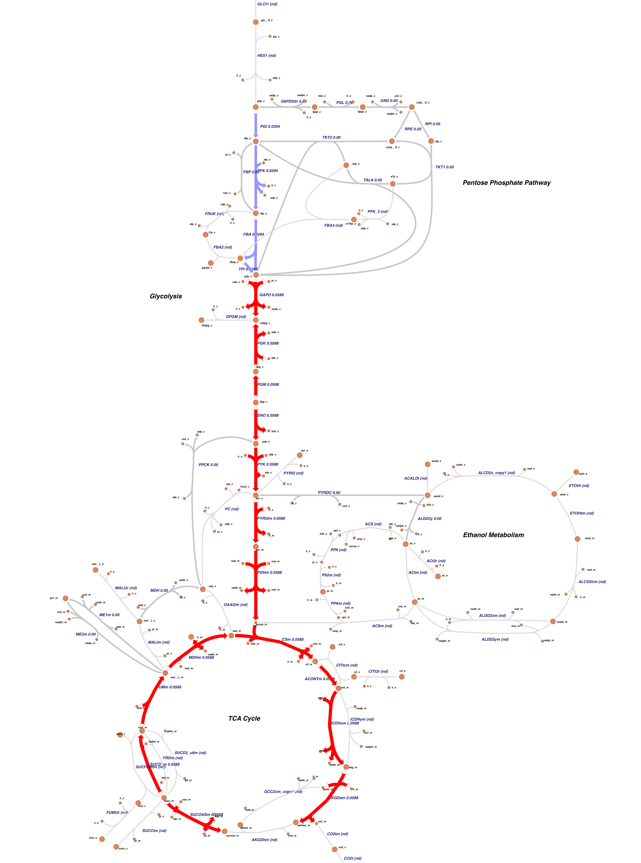
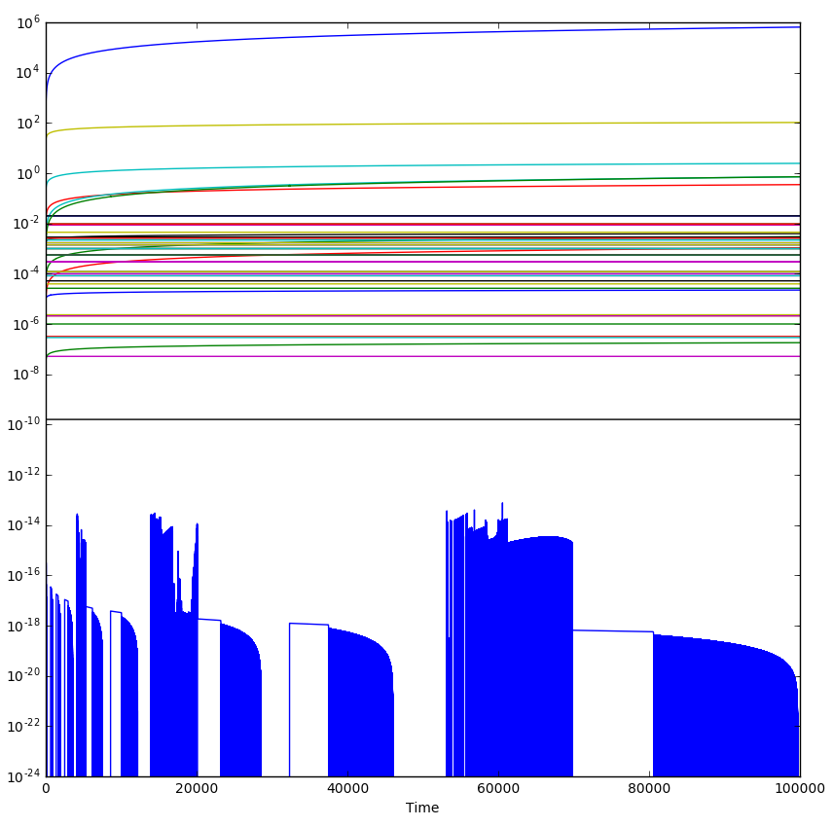
Neurospora crassa central metabolism
Maximum Entropy Simulation – no constraints
High Energy Glucose In
Metabolite Concentrations
1 mM
Simulation Time
Low Energy CO₂ Out

Slide 9
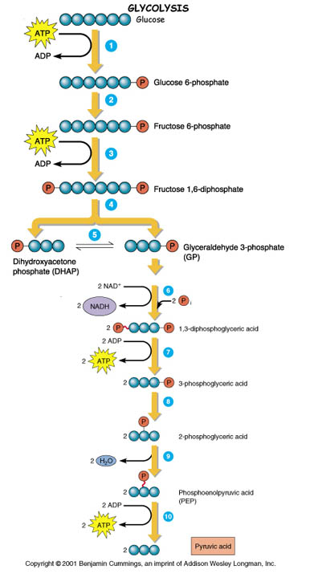
Loss Function: Compare Simulation to Data
Experimental measurement
Simulation prediction
Adjust enzyme activity until the simulation and experimental measurement agree.
Adjust enzyme activity until the simulation and experimental measurement agree
Adjust enzyme activity until the simulation and experimental measurement agree
Adjust enzyme activity until the simulation and experimental measurement agree

Slide 10
Maximum Caliber: Control Theory & Reinforcement
Loss Function – which enzymes need to be regulated?
Control Theory: By how much?
Reinforcement Learning of Experimental Observations…
  Policy Search
Resulting in Regulation of Enzyme Activity
  Results are in agreement with literature.

Slide 11
Policy Search
Start from initial random states
Approaches: For those reactions with L > 0,
  Randomly regulate reactions
    Can take many, many hours to find solution.
  Regulate reactions with greatest loss function value first
    eh.
  Choose reaction based on Concentration Control Coefficient
  Regulate Upstream reactions first
    Assume that downstream reactions have little impact on upstream products
    Same policy result regardless of initial state
    Takes seconds
    Very good solutions
  Regulate Reactions with lowest entropy production rate first
    Same policy result regardless of initial state
    Seconds
    Best solutions so far

Slide 12
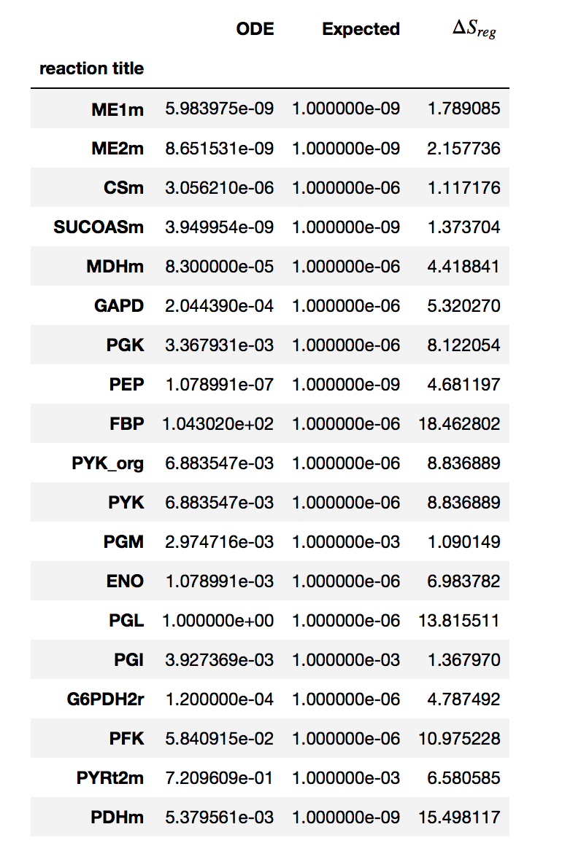
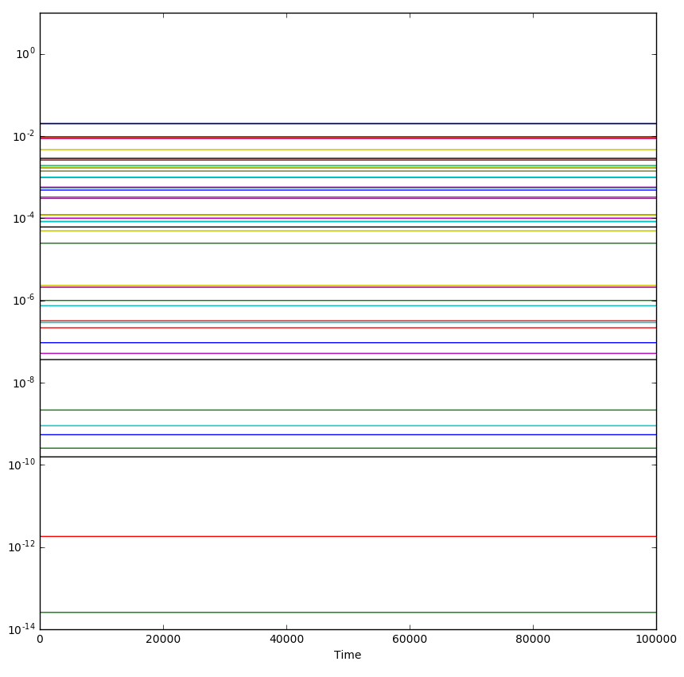
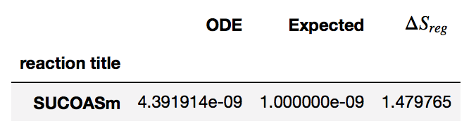
Maximum Caliber: Inferred regulation in glycolysis
Before Regulation
After Regulation
L_{reg}
Metabolite Concentrations
1 mM
Notes:
Regulated Reactions:
Fructose BisPhosphatase - controls gluconeogenesis
Phospho Glucono Lactonase - entry way into Pentose Phosphate pathway
Phospho Fructo Kinase
Pyruvate dehydrogenase
Pyruvate Kinase (not shown)

Slide 13
Glycolysis: Energy, Power, Conductance & Flux
-ΔG
Power
Resistance
Flux
Feed back inhibition:
Molecular Potentiometer
[ATP]

Slide 14
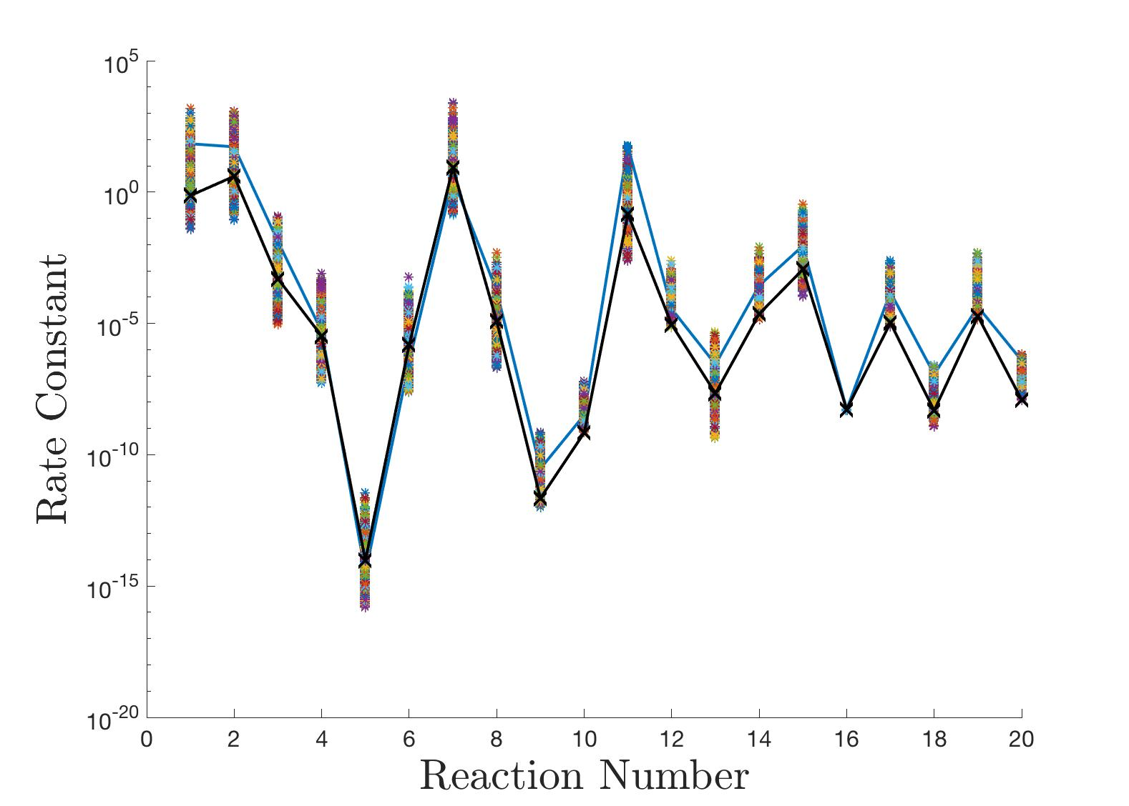
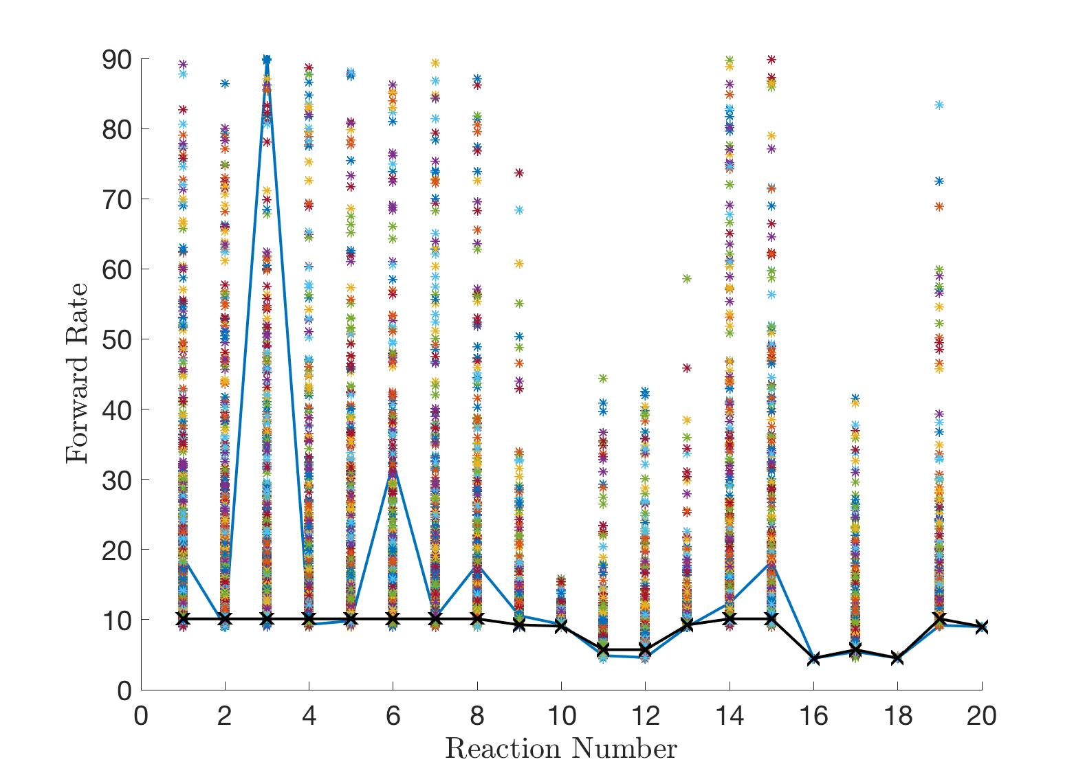
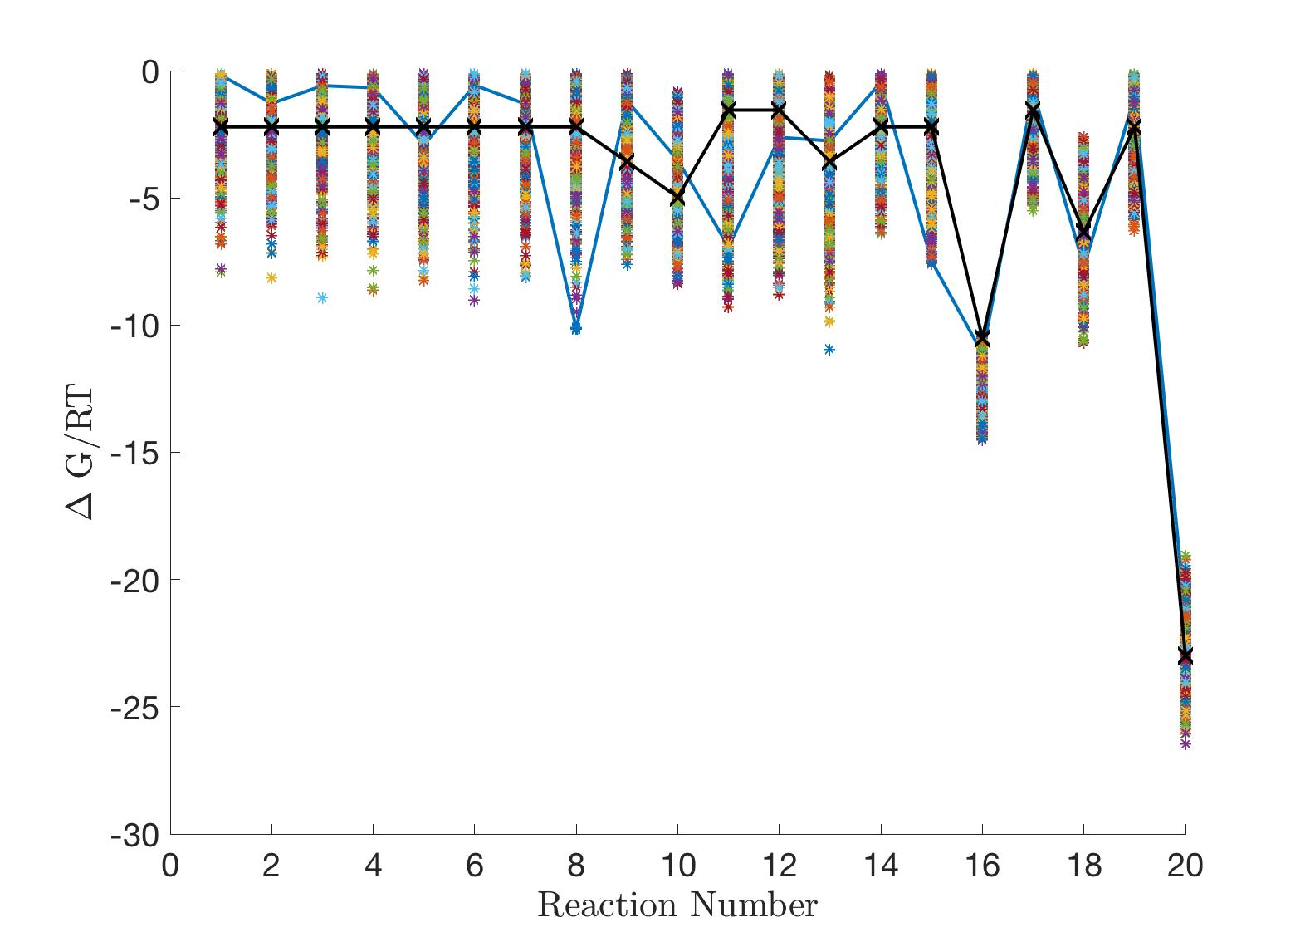
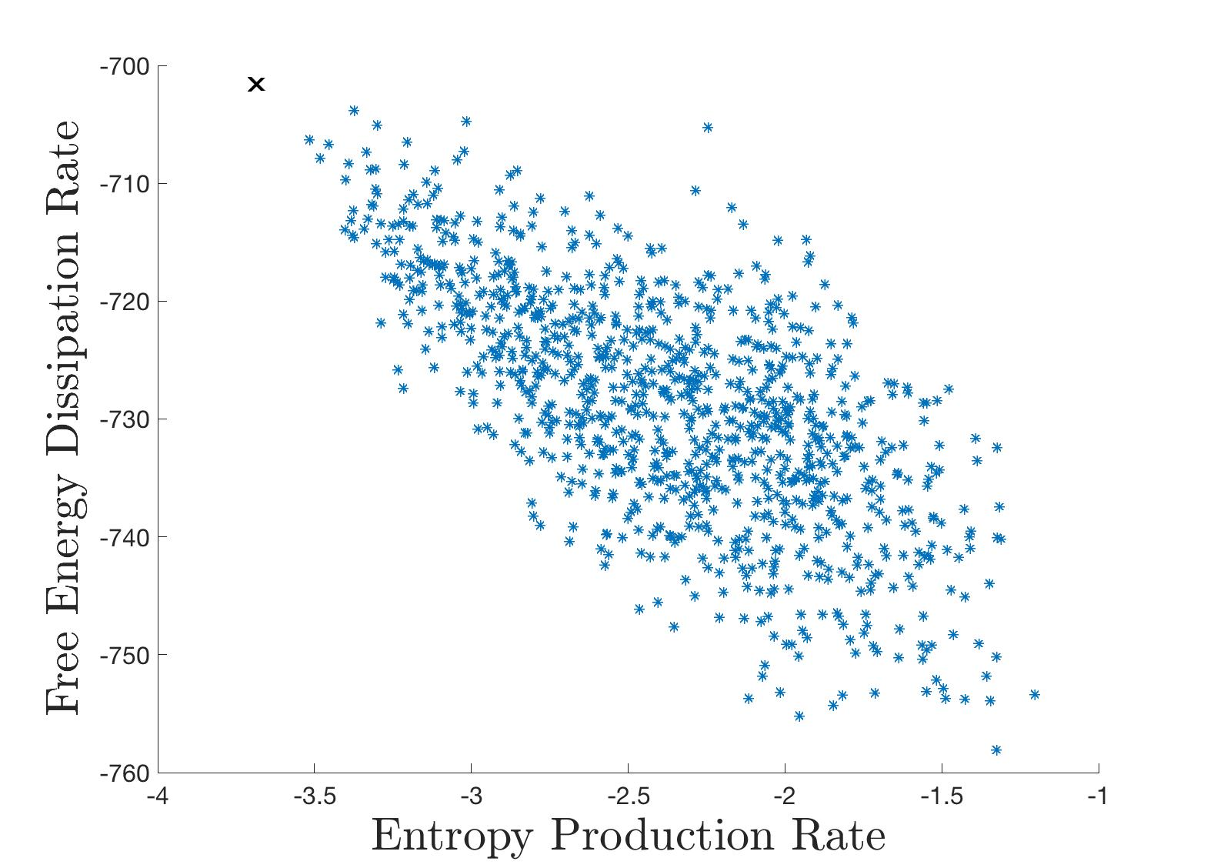
Relaxing the Assumption of Maximum Entropy: an Ensemble of 1000 Models in ~20 min.
Optimal Individual
Population
Average Reaction Free Energy
Notes:
Takes about 20-30 minutes to generate 1000 models
In each of the first three plots, the x-axis is the reaction number
Variance in rate constants
Variance in rates
Variance in reaction free energies
Entropy production rate of each individual vs avg reaction free energy.

Slide 15
Multiscale Modeling Challenge
ODEs: Circadian clock regulation, minute time steps
Optimization: Metabolism
  Enzyme reactions on millisecond time scale
  Central Metabolism steady state calculated in < 5 seconds
  Extending to secondary metabolism
Notes:
So, here is how we will approach the multiscale modeling challenge:
We are modeling the circadian clock protein dynamics on the 24 hour timescale using ODEs and ODE solvers.
But we assume, and experiment backs it up, that central metabolism comes to steady state much faster.
So, we assume a pseudo-steady state, and solve the ODEs of metabolism with nonlinear least squares, which is very fast.
Next, we will be extending this to secondary metabolism.

Slide 16
How Far Can We Go By Combining Theory and Experiment?
Kinetics, thermodynamics of Metabolism:
Differentiation: In progress - In Neurospora, filamentous state oscillates between filamentous growth and cell cycle.
  Regulation accentuates bifurcations in phase space
  Not enough cellular resources to do everything at once
Predict Enzyme Levels. Similar in approach to metabolites but some assembly required.
More?
Cannon, W.R., et al., Prediction of metabolite concentrations, rate constants and post-translational regulation using maximum entropy-based simulations with application to central metabolism of Neurospora crassa. Processes, 2018. 6(6)https://doi.org/10.3390/pr6060063
Do top down and bottom up modeling to accelerate understanding.
Notes:
Kinetics and thermodynamics of metabolism
Differentiation - in progress
Predict Enzyme levels?
Some of the work is reported here:

Slide 17




Investigators and Funding
PNNL
Jeremy Zucker
Doug Baxter
Neeraj Kumar
Scott Baker
UC Riverside - UQ
Sam Britton
Mikahl Banwarth-Kuhn
Mark Alber
Dartmouth
Jay Dunlap
Tina Kelliher
RPI
Jen Hurley
Meaghan Jankowski
Hannah De los Santos
NIBIB
Grace Peng

Slide 18
Thank You
2021 Society for Mathematical Biology Annual Meeting
University of California Riverside July 2021
Focus on Integration of Machine Learning and Multiphysics Modeling

