Slide 1
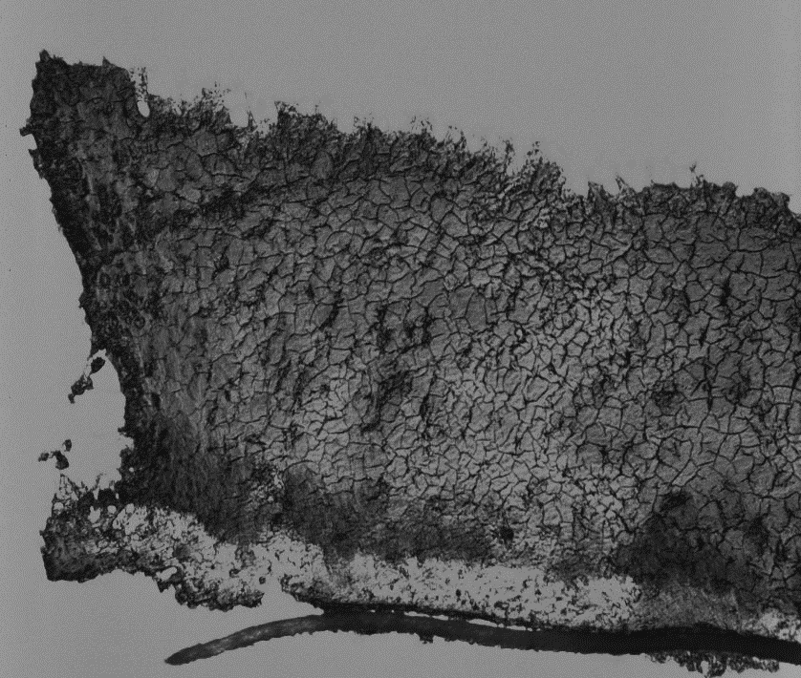
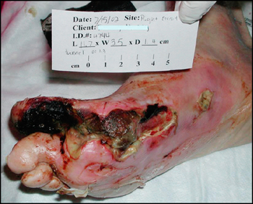
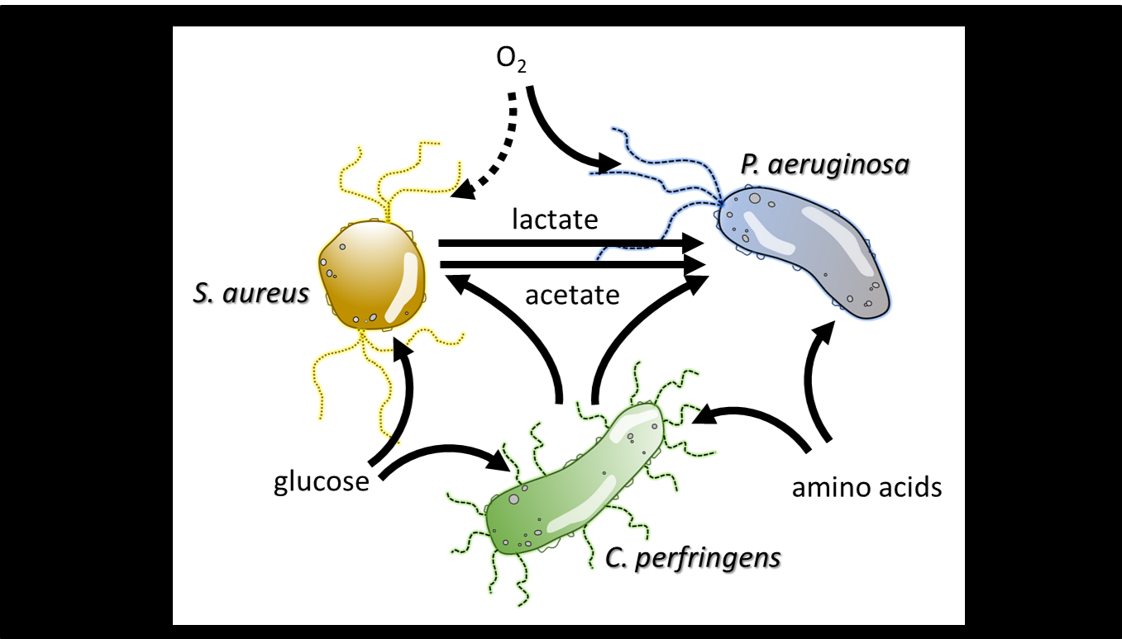
Predictive Multiscale Modeling of Chronic Wound Biofilms
NIH NIBIB U01EB019416
Ross P. Carlson, Michael Henson, Luke Hanley, Matthew Fields
Montana State University, UMass, Amherst, University of Illinois, Chicago
Chronic wounds are categorized as nonhealing wounds that do not proceed through resolution within ~3 months. Chronic wounds impact over 8 million US patients and cost an estimated $30-60 billion in healthcare costs annually. Chronic wounds are challenging to treat using traditional antibiotics because they are typically colonized by interacting consortia growing as recalcitrant biofilms.
In vitro and in silico pathogen consortia
The Model quantifies the complex spatial and temporal dynamics of biofilm consortia. The wound pathogens are represented using genome-scale, metabolic reconstructions; phenotypes are predicted using linear programming (LP) optimization methods. Pathogen metabolic models are imbedded in a discretized control volume where mass balances are enforced using partial differential equations which account for pathogen reaction and metabolite diffusion processes.
What is new and how will this change current practice? The models enable multiscale, spatially and temporally resolved predictions of pathogen behavior in chronic wounds. The pathogen phenotype problem is solved using novel lexicographic LP optimization algorithms to account for alternative and infeasible optima. The methodology will eventually enable personalized medicine where metagenomic data from a patient’s wound will inform an in silico wound model for optimizing treatment.
End users of the model will be scientists informing clinicians on wound treatment strategies. Ultimately this technology will enable personalized medicine where models tailored to specific patient chronic wound composition can be fed into an in silico model and used to predict optimized treatment strategies.
Key Publications: Phalak et al., 2016 doi.org/10.1186/s12918-016-0334-8
Carlson et al., 2018 doi: 10.1042/BST20170242
Henson and Phalak, 2018 doi.org/10.1371/journal.pcbi.1006558
Notes:
Chronic wounds are categorized as nonhealing wounds that do not proceed through resolution within a standard time period. Nonhealing, chronic wounds impact over eight million US patients and cost an estimated 30-60 billion USD in healthcare costs annually. We have built computational and experimental tools to analyze the complex interactions between chronic wound microorganisms and local environments so therapeutic strategies can be optimized.
Computational models require parameters which can be difficult to extract from complex experimental data sets. Machine learning and AI will facilitate the identification of meaningful model parameters through the analysis of large, multicondition biofilm growth data sets.
We have developed a suite of computational tools that predict interactions and emergent properties of biofilm pathogens with spatial and temporal resolution; we have also developed new experimental methodologies including a new biofilm reactor, to make spatial and temporal measurements of biofilm growth. A major challenge will be integrating the full range of computational and experimental methodologies which are measured and predicted on different size and time scales.
Multiscale modeling: Biofilms as inherently modular and multiphasic with multiple species of bacteria embedded in a polymer hydrogel, exchanging chemicals across aqueous intercellular spaces, while interacting with local physical environments. The modeling methodology addresses these challenges by embedding genome scale metabolic models for individual species within a partial differential equation model quantifying the aqueous phase chemicals. The approach integrates biotic chemical reactions with abiotic diffusion processes.
Ross P Carlson, rossc@montana.edu

