Slide 1
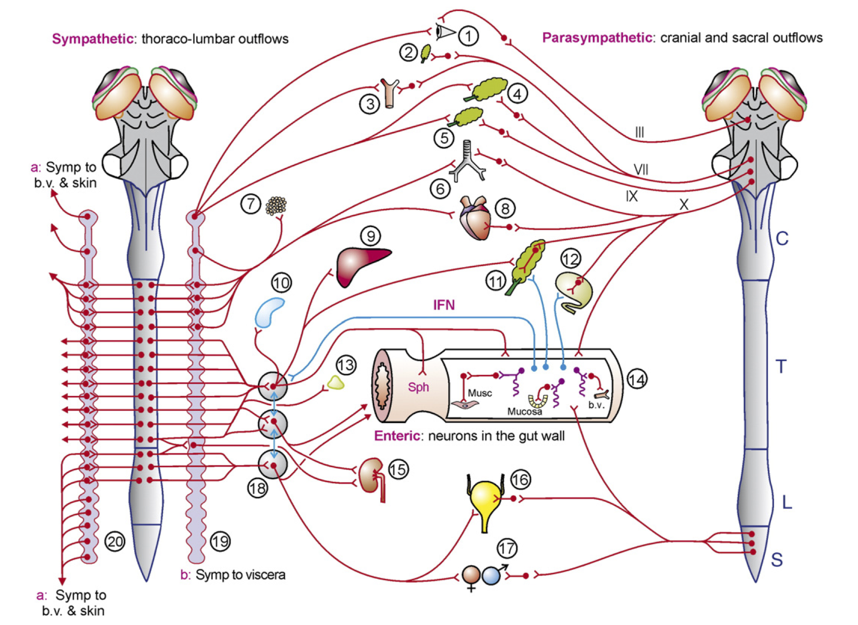
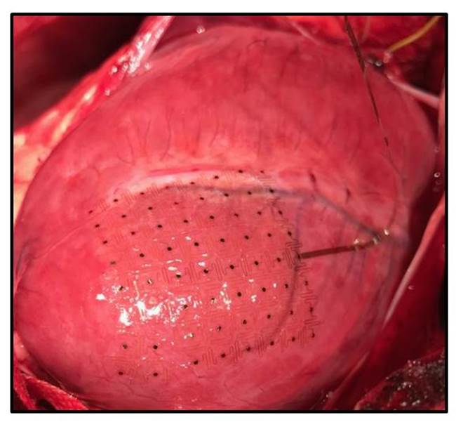
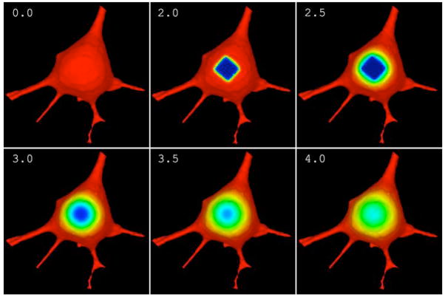

MSM in SPARC: Plans and Stretch Goals
Bower
Ardell UCLA
Virtual Cell
Furness 2006
Rogers Illinois
Gene Civillico, Ph.D.
SPARC Program Manager
NIH/OD/DPCPSI/OSC
Notes:
Register today for the Interagency Modeling and Analysis Group (IMAG) 10th Anniversary Multiscale Modeling (MSM) Consortium Meeting.
March 22-24, 2017
NIH Natcher Conference Center
NIH Main Campus
Bethesda, MD
Keynote Address: Dr. Subra Suresh, President, Carnegie Mellon
Welcome: Dr. Roderic Pettigrew, NIBIB; Dr. Patti Brennan, NLM
Themes
Theme 1: Where have we been and where are we going?
Theme 2: Translating models for policy change
Theme 3: MSM for medical devices
Theme 4: Stakeholder perspectives - scientists, clinicians, industry
Highlights
100 multiscale modeling projects
Latest MSM methodologies from other IMAG communities
Review of model credibility plans
MSM Consortium working groups
Government initiatives and agency policies for modeling
See agenda at https://www.imagwiki.nibib.nih.gov/imag-events/imag-celebrating-10th-anniversary-multiscale-modeling-consortium
Register at https://www.eventbrite.com/e/imag-10th-anniversary-multiscale-modeling-consortium-meeting-tickets-29818641359

Slide 2
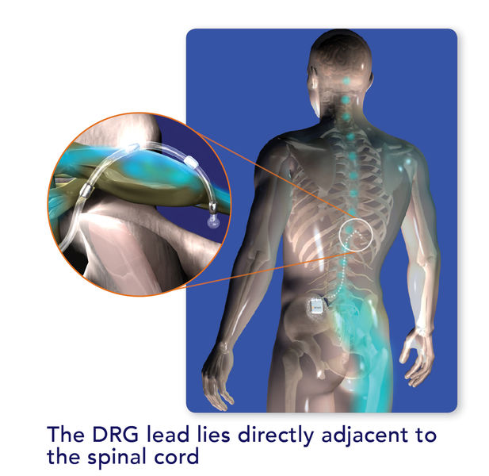
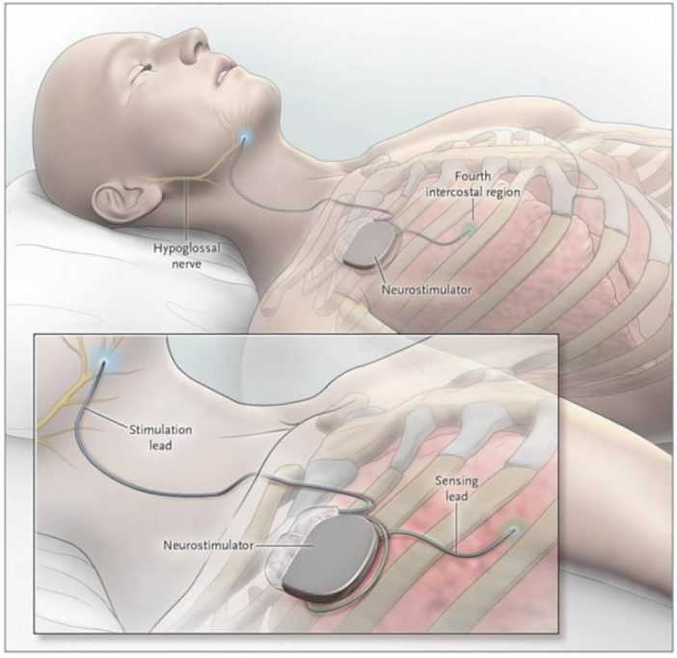
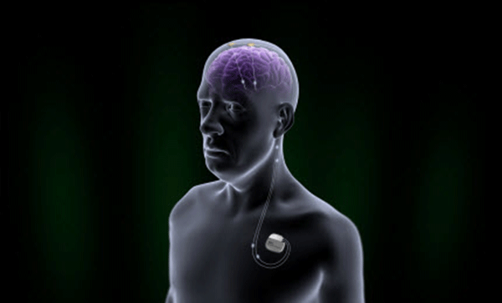
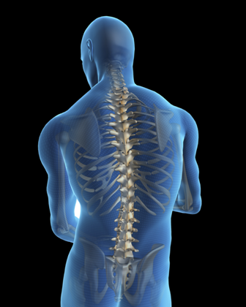
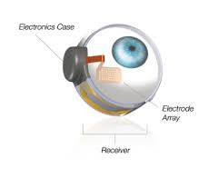
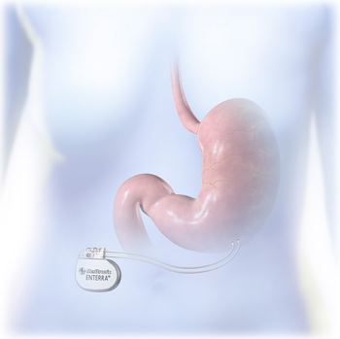
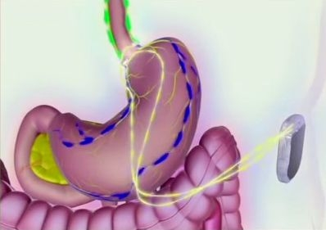
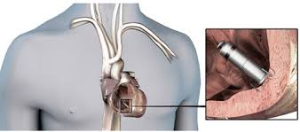
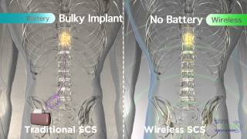
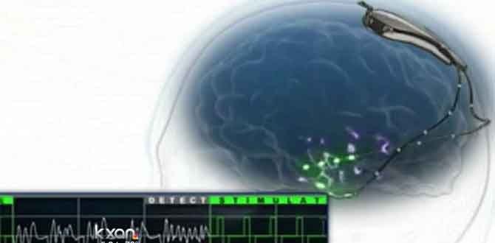
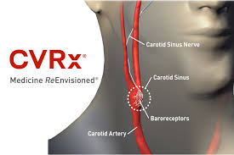
Neuromodulation: Recent FDA Market Approvals
StimWave 510(k)
Medtronic Micra PMA
Second Sight Argus II HDE
Inspire, PMA
St. Jude Brio PMA
Enteromedics Maestro, PMA
Medtronic Enterra II HDE
Nevro Sensa PMA
NeuroPace, PMA
CVRx® Rheos HDE
St. Jude Axium PMA
Notes:
Talking about PMAs
Inspire – great example of approval. Got CE mark – closed loop, stimulates hypoglossal nerve 4 muscles. Clinical trials have failed because of targeting.
DAGRID. Implant everybody, turn everybody on for 6 months – identify responders, then do blinded offs. Better than going two-thirds on, blinded 1/3 off.
Enteromedics maestro. Block. Got CE mark, did trial in US. 24% weight loss in on arm, 16% in off arm. Common theme – huge placebo effects that get you CE mark.
Neuropace. 37% reduction in monthly seizures, 17% sham moanthly reduction in seizures. 6-7% had serious event associated with the surgery
St Jude Brio PMA
Constant current stim
Spinal cord stims aren’t being sham=controlled, because stim is perceptible so you can’t try.
They’re allowed to evaluate them based on non-inferiority
Nevro Sensa 10 kHz stim for pain
Reduction in paresthesia
St Jude Axium
Both showed about 80% reduction on pain scale (happy face)
All this stuff is same IPG as cardiac pacemaker with different interface, based
Except MDT Micra PMA which is wireless and snaked in with a catheter. Starts to get to a profile that’s injectable
HDEs
Second sight Argus II HDE
64 channels
CVRx Rheos Missed primary endpoint but controlled hypertensions (in 42% in on arm, 24% in off arm), so have to let people keep it.
HDE to do battery replacements and apply for reimbursement
MDT Enterra II HDE
Nausea and gastroparesis
510(k)
StimWave (what is name of product?)
Wireless transfer of power (is this because the power supply is on the outside?)
There’s a lot more things that got CE marks that were not approved. Here come some of those…

Slide 3
Many randomized controlled trials miss their prespecified primary efficacy endpoints
Boston Scientific NECTAR Trial (Vagal Nerve Stimulation, Heart Failure)
BioControls INOVATE Trial (Vagal Nerve Stimulation, Heart Failure)
Medtronic SYMPLICITY (Renal Denervation, Hypertension)
CVRx® Rheos (Baroreflex Activation Therapy)
Apnex (Hypoglossal Nerve Stimulation, Sleep Apnea)
St. Jude BROADEN Trial (DBS Area 25, Depression)
Medtronic RECLAIM Trial (DBS Ventral Capsule/Ventral Striatum, Depression)
Medtronic SANTE Trial (DBS ANT, Epilepsy)
Common Themes:
  followed successful open label studies
  large sham arm effect
  remarkable response in some patients
SCS/Vagal Nerve = No RCT Trial (Approved by FDA in 1989 and1997)!
Notes:
Biocontrols – closed loop system, syncs with the heart rate
Renal denervation - ablate renal nerves with RF catheter
All the above – sham arm had a large effect
Endpoints of the above are ultrasound investigation of heart structure (cardiac remodelling, surrogate for pressure at the ventricle that would create backflow, creates pulmonary edema)
Rheos
Primary endpoint was 10 mm drop. Half of patients in OFF arm had 10 mm drop.
Apnex, hypoglossal nerve stim, sleep apnea
Tried to do same trial design as inspire and got shot down. Note that inspire prescreened for suitable anatomy
Broaden, reclaim, CE mark, good open label, failed primary endpoint. Very subjective metrics.
Biomarkers are subjective, not automated
SANTE – data looks like neuropace’s, got shot down. (7-5 panel decision)
Neuropace (12-0)
SCS/vagal – new products aren’t asked for sham-controlled study, only asked for 10% noninferiority to existing , because of earlier approval in a different environment
YOU NEED THE MAP AND THE BIOMARKER

Slide 4
Why is treatment response so inconsistent?
In many (most? all?) cases, we don’t know:
  Desired cellular target
  What the target is actually “seeing”
  Minimum activation volume to create effect
  Optimal temporal pattern to create effect
  Variance in anatomy from subject to subject
  Variance in pathology from subject to subject
  Effect of drug interactions
  Long-term adaptation (systemic, neural interface)
  Translatability of animal study results…
Spatial scale
Orientation of fibers
Myelination
Notes:
The target model that unconsciously underlies an incredible amount of biomedical research is derived from drug orthodoxy. And there are good reasons for this. Potassium channels are the same size in mice and humans. Vascular perfusion works essentially the same way in mice and humans.
Patients are on lots of drugs that impact the pathways you’re looking at
Differences in orientation/size/degree of myelination of nerve fibers and distance to electrode matter
Electrode size, cathode/anode spacing and insulation matter
END OF THIS SLIDE: so – we need your help!
We don’t know these things because the study of autonomic circuits has been neglected…

Slide 5
SPARC Ultimate Goal:
Build predictive functional maps of the human PNS in relation to selected organ targets

Slide 6

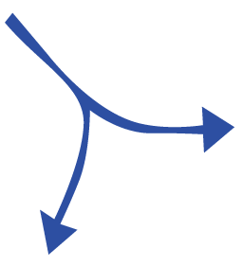

SPARC Component Structure
ANATOMICAL & FUNCTIONAL MAPPING
TRANSLATIONAL PARTNERSHIPS
NIDDK
DATA & RESOURCE CENTER
NCATS/NINDS
Program Manager and Staff in OSC (“Common Fund”) set overall vision and make adjustments
NIBIB
TECHNOLOGY DEVELOPMENT
NIBIB/NINDS
Notes:
new markets: real talk.

Slide 7
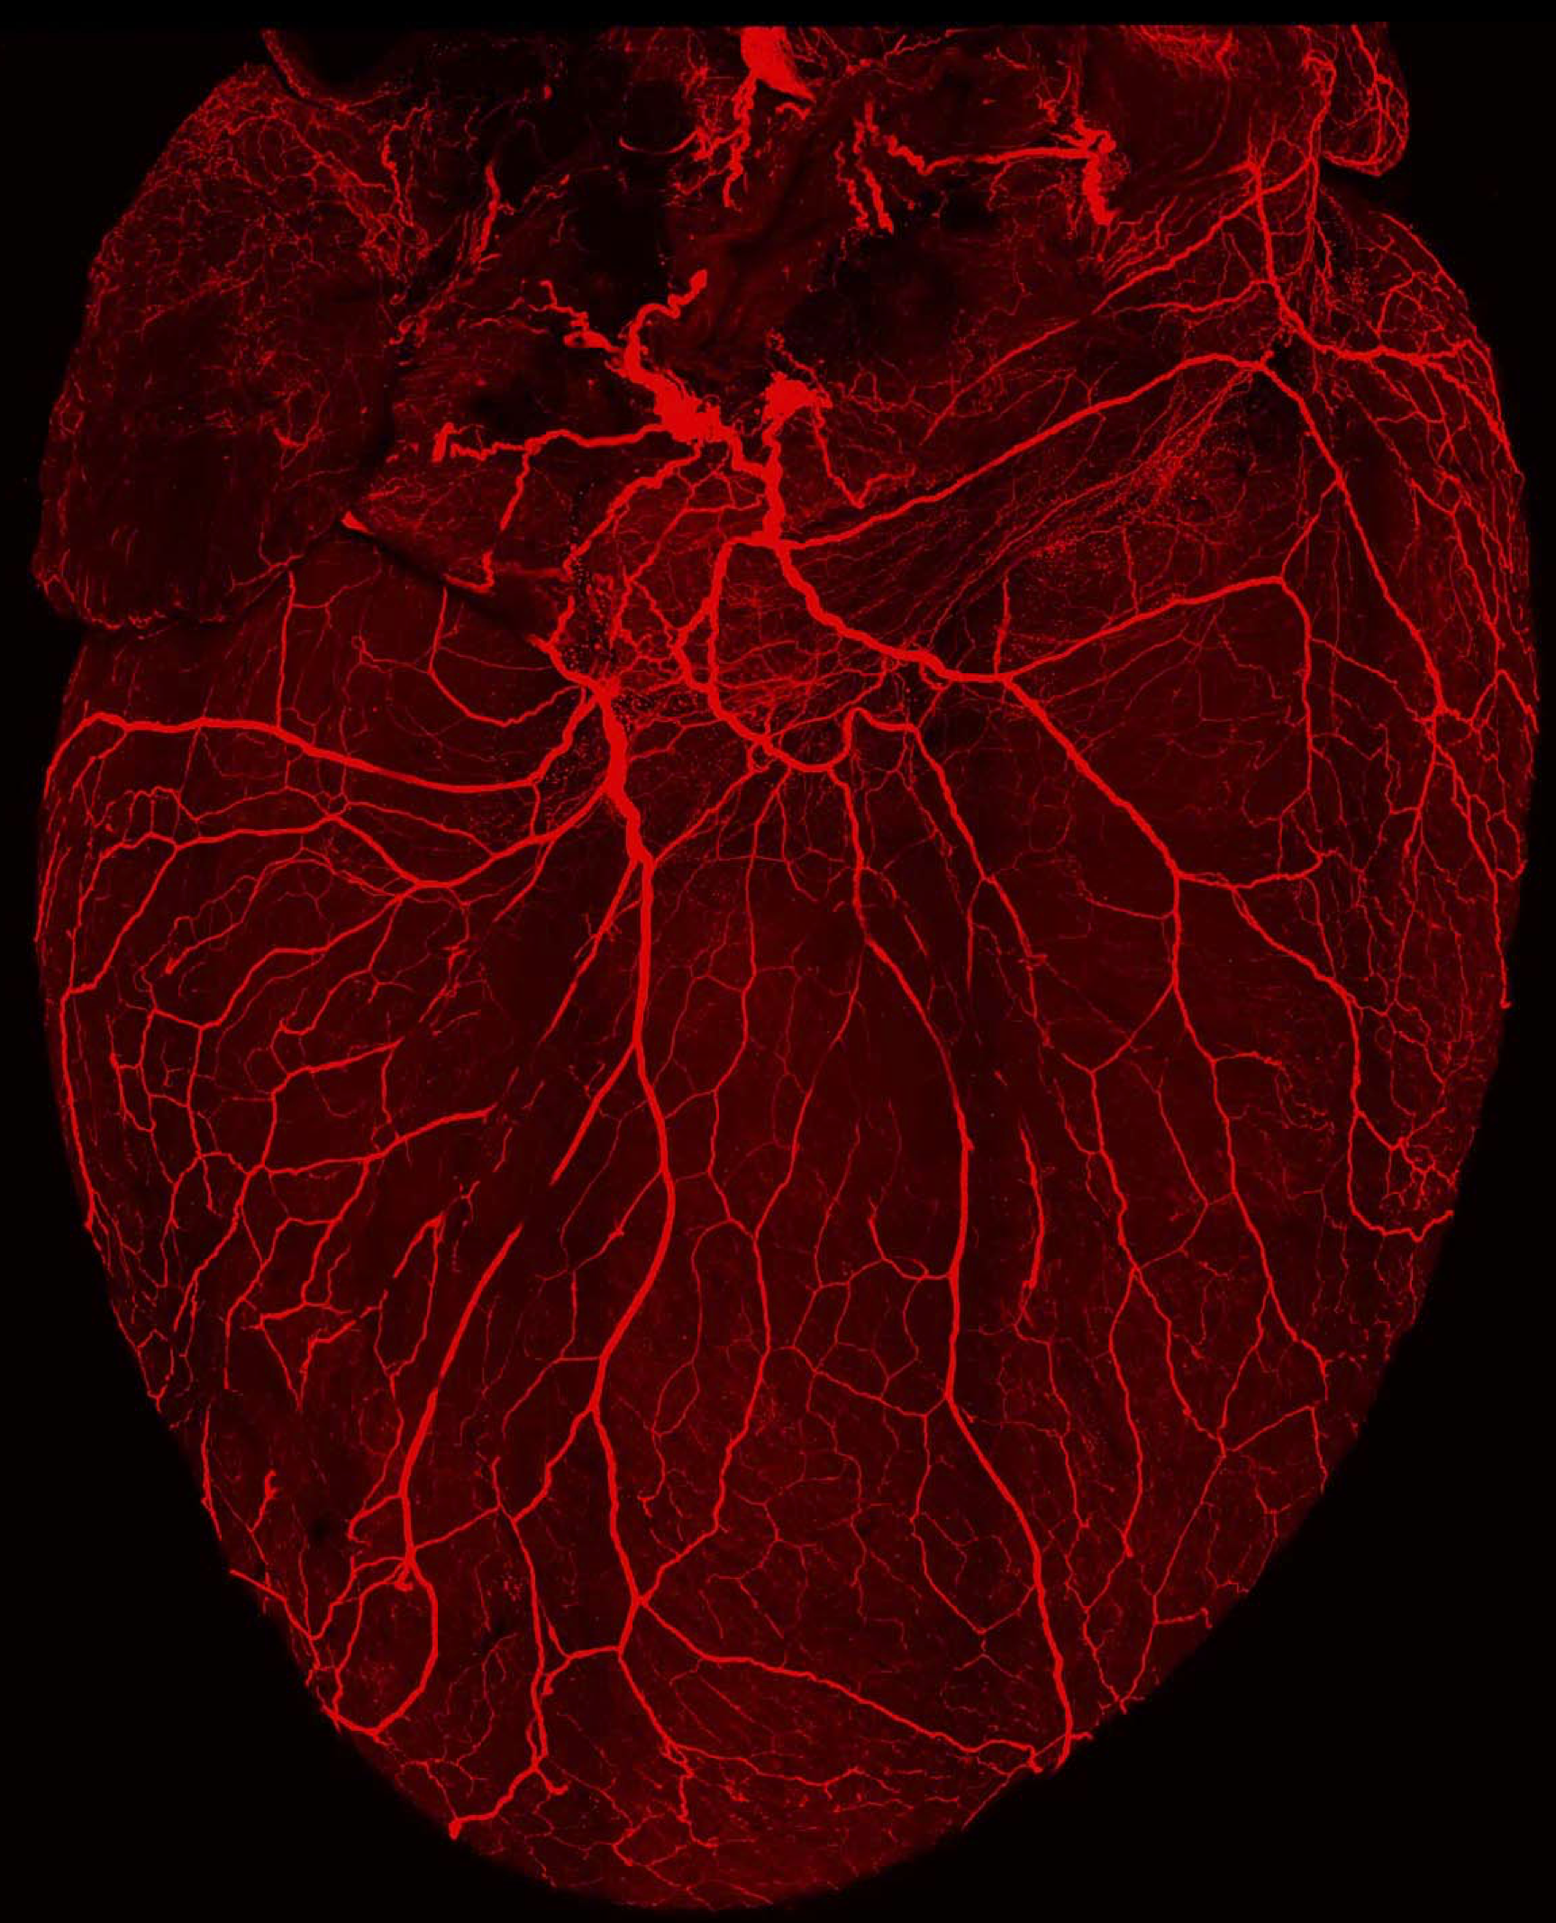
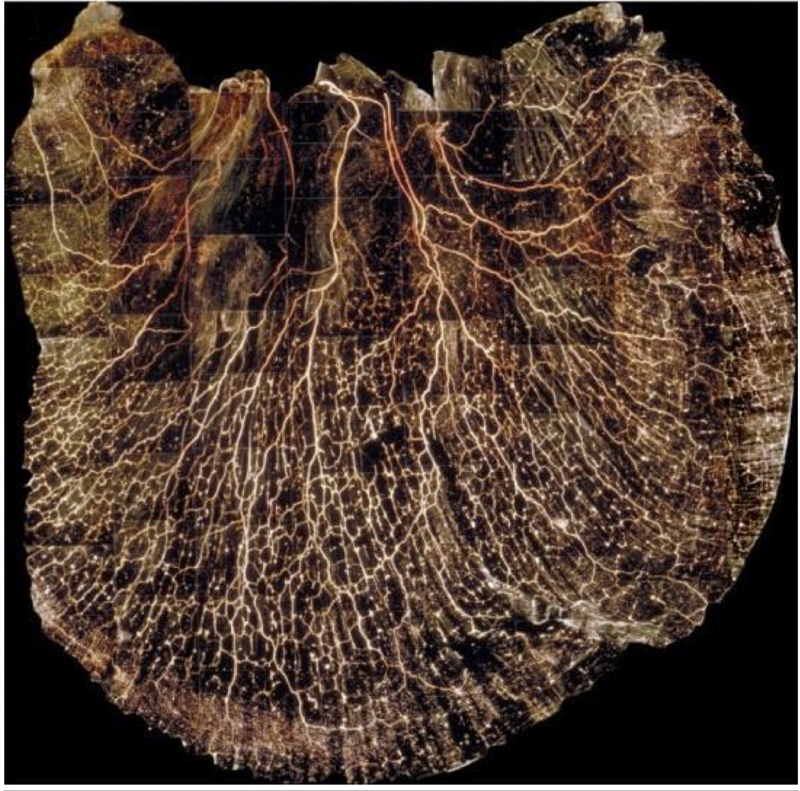
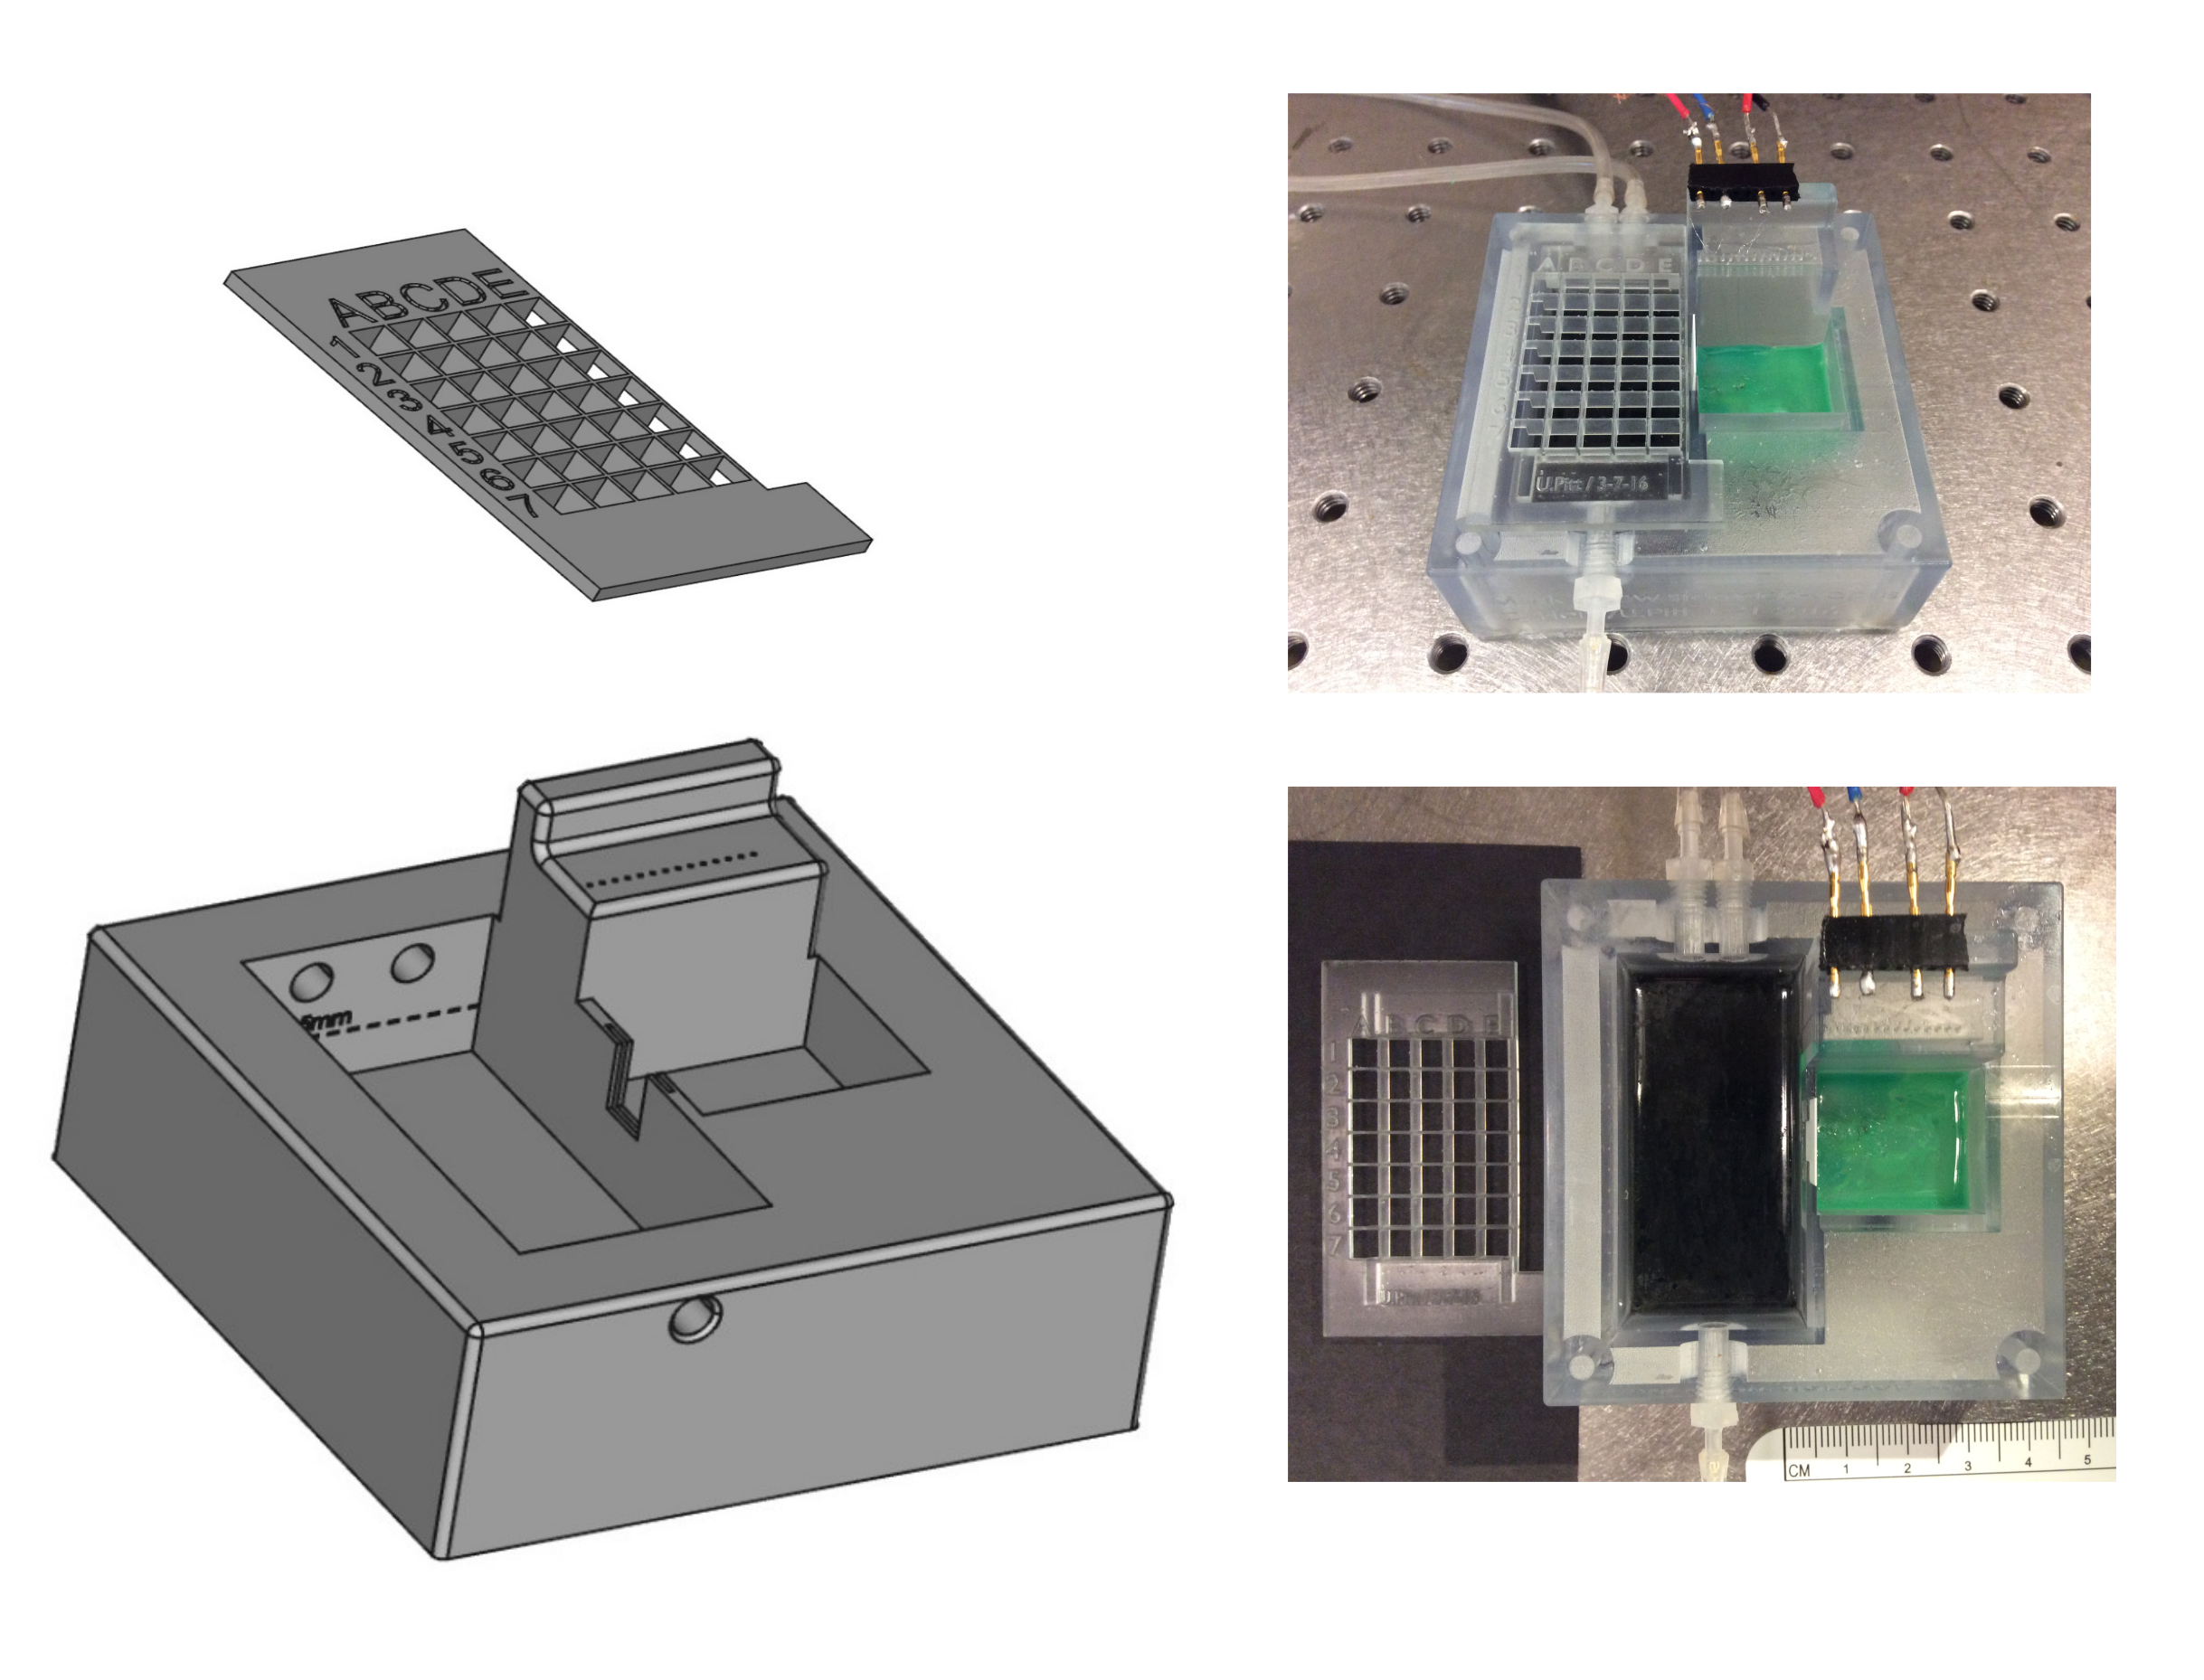
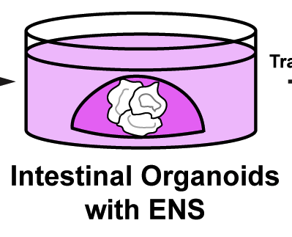
SPARC Consortium Snapshot, March 2017
Comprehensive (Shivkumar/UCLA)
Auricular branch of vagus (Napadow/MGH)
Comprehensive (Powley/Purdue)
Mapping
Comprehensive (Howard/Toledo)
Transcriptome (Southard-Smith/Vanderbilt)
Comprehensive (Bolser/U FL)
Pulmonary neuroepithelial cells (Sun/UCSD)
SCG Physiological Atlas (Lewis/Case Western)
Adipose tissue (Columbia, Pennington )
Pancreas (Campbell-Thompson/U FL)
Bladder (Keast/Melbourne)
Translation
Canning (Hopkins)/Nuviant
Synapse VNS for asthma
Chen (Hopkins)/Boston Sci
SCS for gastric motility
Yin (Transtimulation)/CVRx
VNS for diabetes
(Ardell/UCLA)
Cardioneural mapping electrodes
(Strohl/Case)
Rabbit OSA model
(Howard/Toledo)
Mouse lines for ENS study
(Okusa/UVA)
Ultrasound modulation
(Davis/Pitt)
Viral bladder tools
Tools
(Bruns/Pitt)
Spinal root interface
(Farajidavar/NYIT)
Implantable gastric platform
(Wells/Cinncinnati)
Human GI organoids
(Vulchanova/UMN)
Viral tools
(Durand/Case)
Intrafascicular nanowire
(Horn/Pitt)
Vagal-gastric communication
(Gereau/WashU)
Conformal bladder electronics
Data
TBD TBD TBD TBD – APPLY!
Notes:
Tomorrow at 1:30
Afferent Stimulation and Modulation of the Autonomic Nervous System Forum 2, 3, and 4 Moderators: Jeffrey L. Ardell, PhD; Robert Foreman, PhD
Tomorrow at 3:30
Autonomic Efferent Targets for Therapeutic Control of Visceral Function Forum 2, 3, and 4 Moderators: Lawrence P. Schramm, PhD; Jiande Chen, PhD
Jiande Chen
Saturday at 3:30
Non-pain indications session
Kingman Strohl
NIC IV session
Dominique Durand

Slide 8

Powley et al JCN 2016
Why is that happening?
What is there?
“Organ readout”
How can we access it reliably?
How can we measure the result?
How should we modulate it?

Slide 9
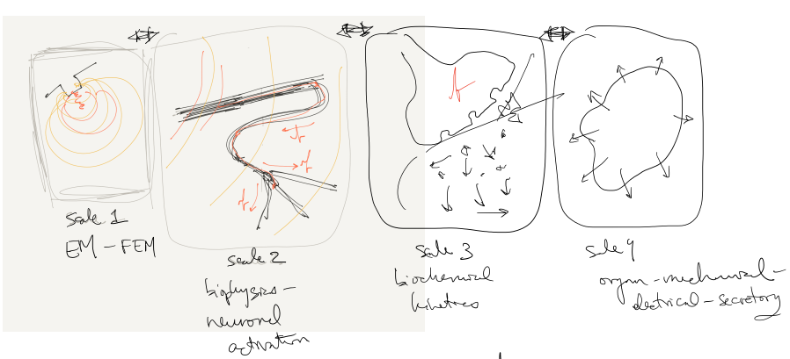
container
SPARC4
connectors
SPARC1/SPARC2
Notes:
Who builds the single-physics pieces?
SPARC1 and 2? Are they doing this already? If not we need to add to awards.
Where is the handoff between 1-2 and 4? Who is responsible for bringing a piece “up to code”?
Modeling core:
Gets the pieces online
Builds the connections between them
Builds the container that lets you interact with the resulting multiscale model
Identifies model components that are driving variability in combined model output. Recommends experiments.

Slide 10
SPARC4: Data and Resource Center Cores
Just released!
Mandatory (minimal!) LOI due April 7th by email
https://go.usa.gov/xXBkA
DAT-CORE
MAP-CORE
SIM-CORE
Store, organize, manage and track access to data and resources generated by SPARC.
Build interactive, modular, continually updated visualizations of nerve-organ anatomy and function
Host and connect simulations to create predictive multiscale, multiphysics models of neuromodulation of organ function
Notes:
OT3 Multi-component Research Project
5 years, $10M, budget able to increase or decrease as needed

Slide 11
SIM-CORE
Help us make something new!
Host component simulations
Build links between simulations to create composite multiscale, multiphysics models
Build an interface to the composite model that does not require access to the underlying models. Users should be able to run composite models in either direction.
Build uncertainty quantification into composite model outputs by propagating uncertainties from all component model parameters. Quantify and make available to users the contributions to overall output uncertainty from component parameter and input uncertainties.
Notes:
Either direction: by specifying a neuromodulation pattern and receiving a predicted organ readout, or specifying a desired organ readout and an intervention point and receiving a neuromodulation pattern.

Slide 12

SPARC Contacts & Resources
Office of the NIH Director Team
Dr. Gene Civillico, Program Manager gene.civillico@nih.gov (301) 351 4180
Dr. Felicia Qashu, Program Officer, OT Project Manager felicia.qashu@nih.gov (301) 451 7222
Kristina Faulk, Communications Lead, OT Policy/Program Analyst kfaulk@mail.nih.gov (301) 402 9185
Kate Nicholson, Budget Analyst, kate.nicholson@nih.gov
Institute/Center Project Team Leaders
Biology – Dr. Jill Carrington: carringj@niddk.nih.gov (301) 402 0671
Technology – Dr. Mike Wolfson: michael.wolfson@nih.gov (301) 451 4778
Translation – Dr. Danilo Tagle: danilo.tagle@nih.gov (301) 594 8064
Dr. Siavash Vaziri: siavash.vaziri@nih.gov (301) 594 8921
Data – Dr. Vinay Pai: paiv@mail.nih.gov (301) 451 4781
Other Contributing ICs
NHLBI
NIDCD
NCCIH
NICHD
NIAID
NIDA
CSR
NCI
NIDCR
NIH-SPARC-Info@list.nih.gov
https://commonfund.nih.gov/sparc/grants
@NIH_CommonFund
@gcivillicoNIH
#NIH_SPARC

Slide 14
DEVICE PROPERTIES
applied current/voltage
heat
EM fields
ultrasound
light
“the line”
gene expression
cytosolic 2nd messengers
extracellular potentials
cell secretions
transmembrane currents
metabolite/byproduct concentrations
CELLULAR PROPERTIES

Slide 15
SAFETY IS NOT JUST THE ABSENCE OF CELL DEATH
“This stimulation pattern is safe because it doesn’t kill neurons.”
“This .exe is safe because it doesn’t fry my CPU.”
Notes:
the CNS and PNS can run malware on perfectly functioning hardware

Slide 16
SPARC4: Data and Resource Center Cores
Help us make something new!
Just released!
Mandatory (minimal!) LOI due April 7th by email
https://go.usa.gov/xXBkA
DAT-CORE
MAP-CORE
SIM-CORE
Store, organize, manage and track access to data and resources generated by SPARC.
Build interactive, modular, continually updated visualizations of nerve-organ anatomy and function
Host and connect simulations to create predictive multiscale, multiphysics models of neuromodulation of organ function
Notes:
OT3 Multi-component Research Project
5 years, $10M, budget able to increase or decrease as needed

Slide 18
Action at a distance – PNS
membrane diffusion in Virtual Cell
Notes:
Guide the program – respond to our RFIs, come to our public workshops, talk to us, become a program consultant
sdf

Slide 19
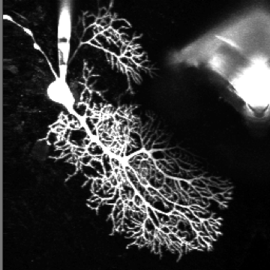
Modern neuronal modeling: electrophysiology
(jump out to neuron)

Slide 20
Modern neuronal modeling: molecular dynamics
membrane diffusion in Virtual Cell
Notes:
A time sequence illustrating membrane diffusion of a molecular species (D=10μm2/s) on a 3-D cellular membrane after “bleaching” in a prototypical FRAP experiment. Each frame is labeled with time in seconds from beginning of experiment. Time 0.0 shows an evenly distributed concentration of a diffusible molecule (in red, high concentration) followed by a “bleach” event at time 2.0 creating a localized concentration deficit (in blue, low concentration) and subsequent diffusion at times 2.5–4.0 from un-bleached membrane to bleached area causing a concentration gradient (green, yellow) to form. In addition to illustrating the results of the VCell lateral diffusion algorithm, this also exemplifies the data display and export features.

Slide 21
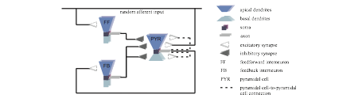
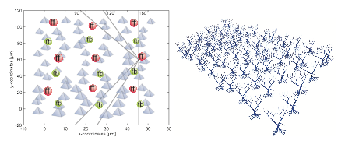
Modern neuronal modeling: networks
Notes:
A time sequence illustrating membrane diffusion of a molecular species (D=10μm2/s) on a 3-D cellular membrane after “bleaching” in a prototypical FRAP experiment. Each frame is labeled with time in seconds from beginning of experiment. Time 0.0 shows an evenly distributed concentration of a diffusible molecule (in red, high concentration) followed by a “bleach” event at time 2.0 creating a localized concentration deficit (in blue, low concentration) and subsequent diffusion at times 2.5–4.0 from un-bleached membrane to bleached area causing a concentration gradient (green, yellow) to form. In addition to illustrating the results of the VCell lateral diffusion algorithm, this also exemplifies the data display and export features.

Slide 22
Neurocardiac circuitry
Shivkumar group, UCLA
Ardell et al 2016 J Physiol

Slide 23
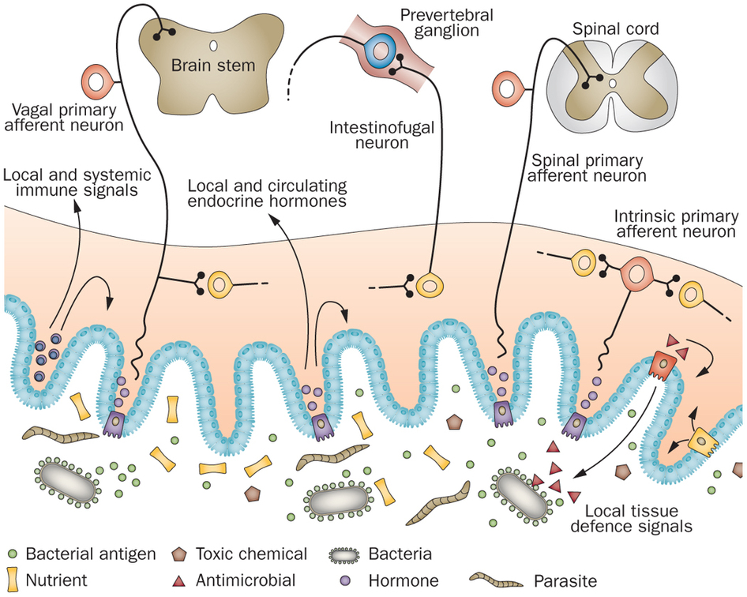
Intestinal neural circuitry
Gastric neural circuitry
Furness et al. Nat Rev Gastroenterology & Hepatology 2013
Powley group, Purdue

Slide 24
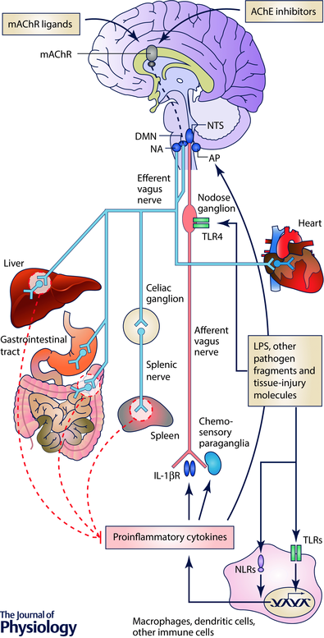
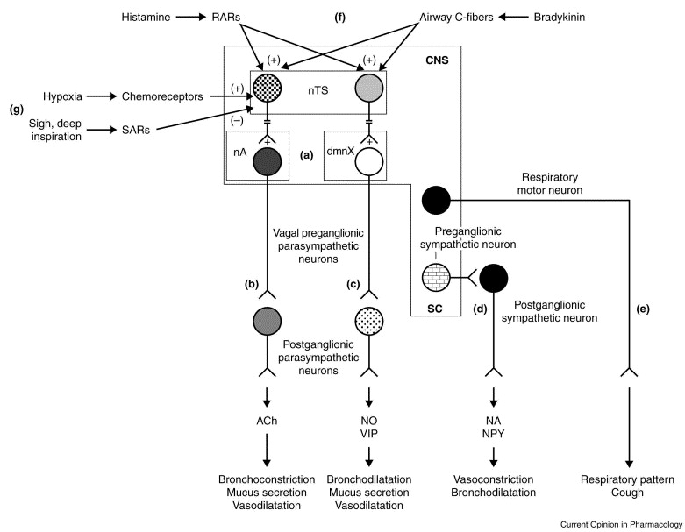
Neuroimmune/neuroinflammatory circuitry
Respiratory neural circuitry
Bonaz et al J Physiol 2016
Mazzone & Canning Curr Opin Pharmacol 2002
Notes:
What are the interesting kinds of questions that drive investigation here?

Slide 25
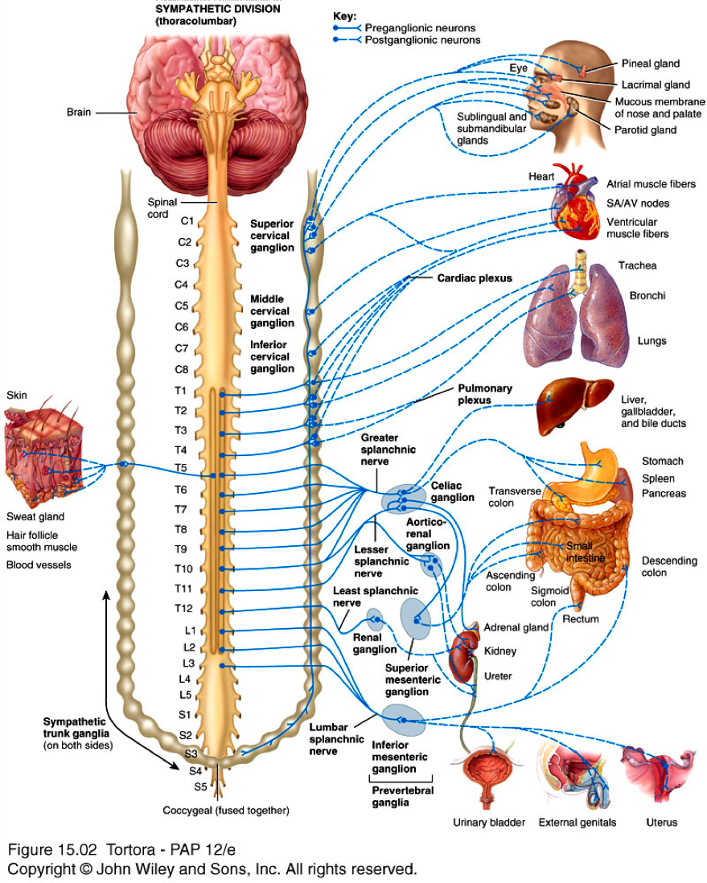
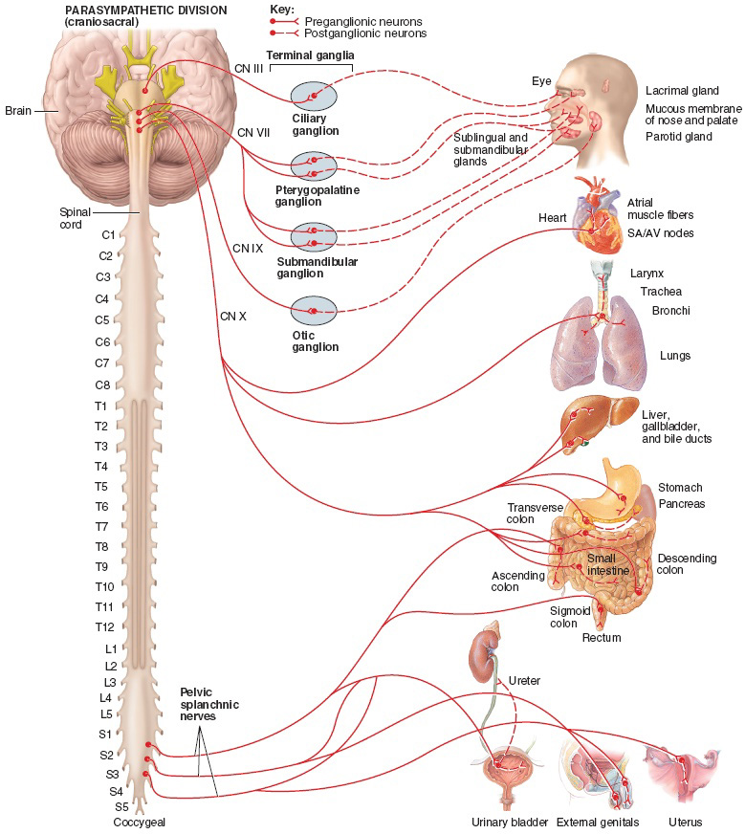
Sympathetic
Parasympathetic

Slide 26
NIH SPARC: Synergistic Opportunities in the PNS
Gene Civillico, Ph.D.
SPARC Program Manager
NIH/OD/DPCPSI/OSC
BRAIN Investigators Meeting
Bethesda, MD
14 December 2016
Furness 2006
Notes:
Transverse section throung a canine vagus nerve. Only myelin sheaths (plus some lipid associated wth epineurium and perineurium) are stained. Notice the rage in size of myelinated fibers. Within a fascicle, the white gaps between myelinated fibers are occupied by non-myelinated fibers.
overview of the program, the new OT authority, the first round of R18 awards (which included many topics/systems that fall within the NIDDK mission), and your vision/plans for its future?

Slide 27
SPARC: Open and Upcoming Funding Opportunities
SPARC-1: Anatomical and Functional Mapping
RFA-RM-15-003: Comprehensive Anatomical and Functional Mapping of Organ Neurobiology OT1
Bimonthly receipt dates throughout FY17
SPARC-2: New Tools
No current announcement but we will have needs in this space!
SPARC-4: Data and Resource Center
NOIP NOT-RM-16-032 – Announcement coming very soon with estimated due date in spring 2017
Modeling, Mapping, and Data Coordination Cores
NOTE: Rapidly developing SPARC OT opportunities need not appear in the NIH GUIDE, so watch these spaces:
NIH-SPARC-Info@list.nih.gov
https://commonfund.nih.gov/sparc/grants
@NIH_CommonFund
@gcivillicoNIH
#NIH_SPARC

Slide 28
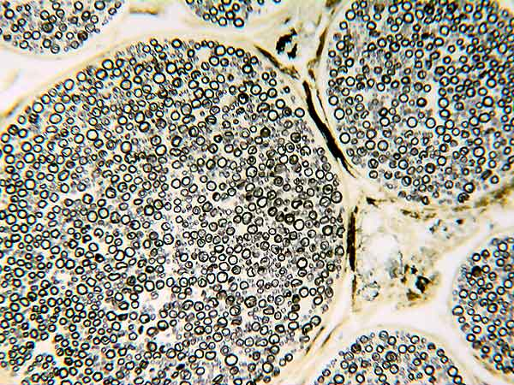
Stimulating Peripheral Activity to Relieve Conditions (SPARC): An NIH Common Fund Program
Gene Civillico, Ph.D.
SPARC Program Manager
NIH/OD/DPCPSI/OSC
IMAG/MSM Consortium Meeting
Bethesda, MD
23 March 2017
http://vanat.cvm.umn.edu/neurLab1/nerves.html
Notes:
Transverse section throung a canine vagus nerve. Only myelin sheaths (plus some lipid associated wth epineurium and perineurium) are stained. Notice the rage in size of myelinated fibers. Within a fascicle, the white gaps between myelinated fibers are occupied by non-myelinated fibers.
overview of the program, the new OT authority, the first round of R18 awards (which included many topics/systems that fall within the NIDDK mission), and your vision/plans for its future?
Register today for the Interagency Modeling and Analysis Group (IMAG) 10th Anniversary Multiscale Modeling (MSM) Consortium Meeting.
March 22-24, 2017
NIH Natcher Conference Center
NIH Main Campus
Bethesda, MD
Keynote Address: Dr. Subra Suresh, President, Carnegie Mellon
Welcome: Dr. Roderic Pettigrew, NIBIB; Dr. Patti Brennan, NLM
Themes
Theme 1: Where have we been and where are we going?
Theme 2: Translating models for policy change
Theme 3: MSM for medical devices
Theme 4: Stakeholder perspectives - scientists, clinicians, industry
Highlights
100 multiscale modeling projects
Latest MSM methodologies from other IMAG communities
Review of model credibility plans
MSM Consortium working groups
Government initiatives and agency policies for modeling
See agenda at https://www.imagwiki.nibib.nih.gov/imag-events/imag-celebrating-10th-anniversary-multiscale-modeling-consortium
Register at https://www.eventbrite.com/e/imag-10th-anniversary-multiscale-modeling-consortium-meeting-tickets-29818641359

Slide 29
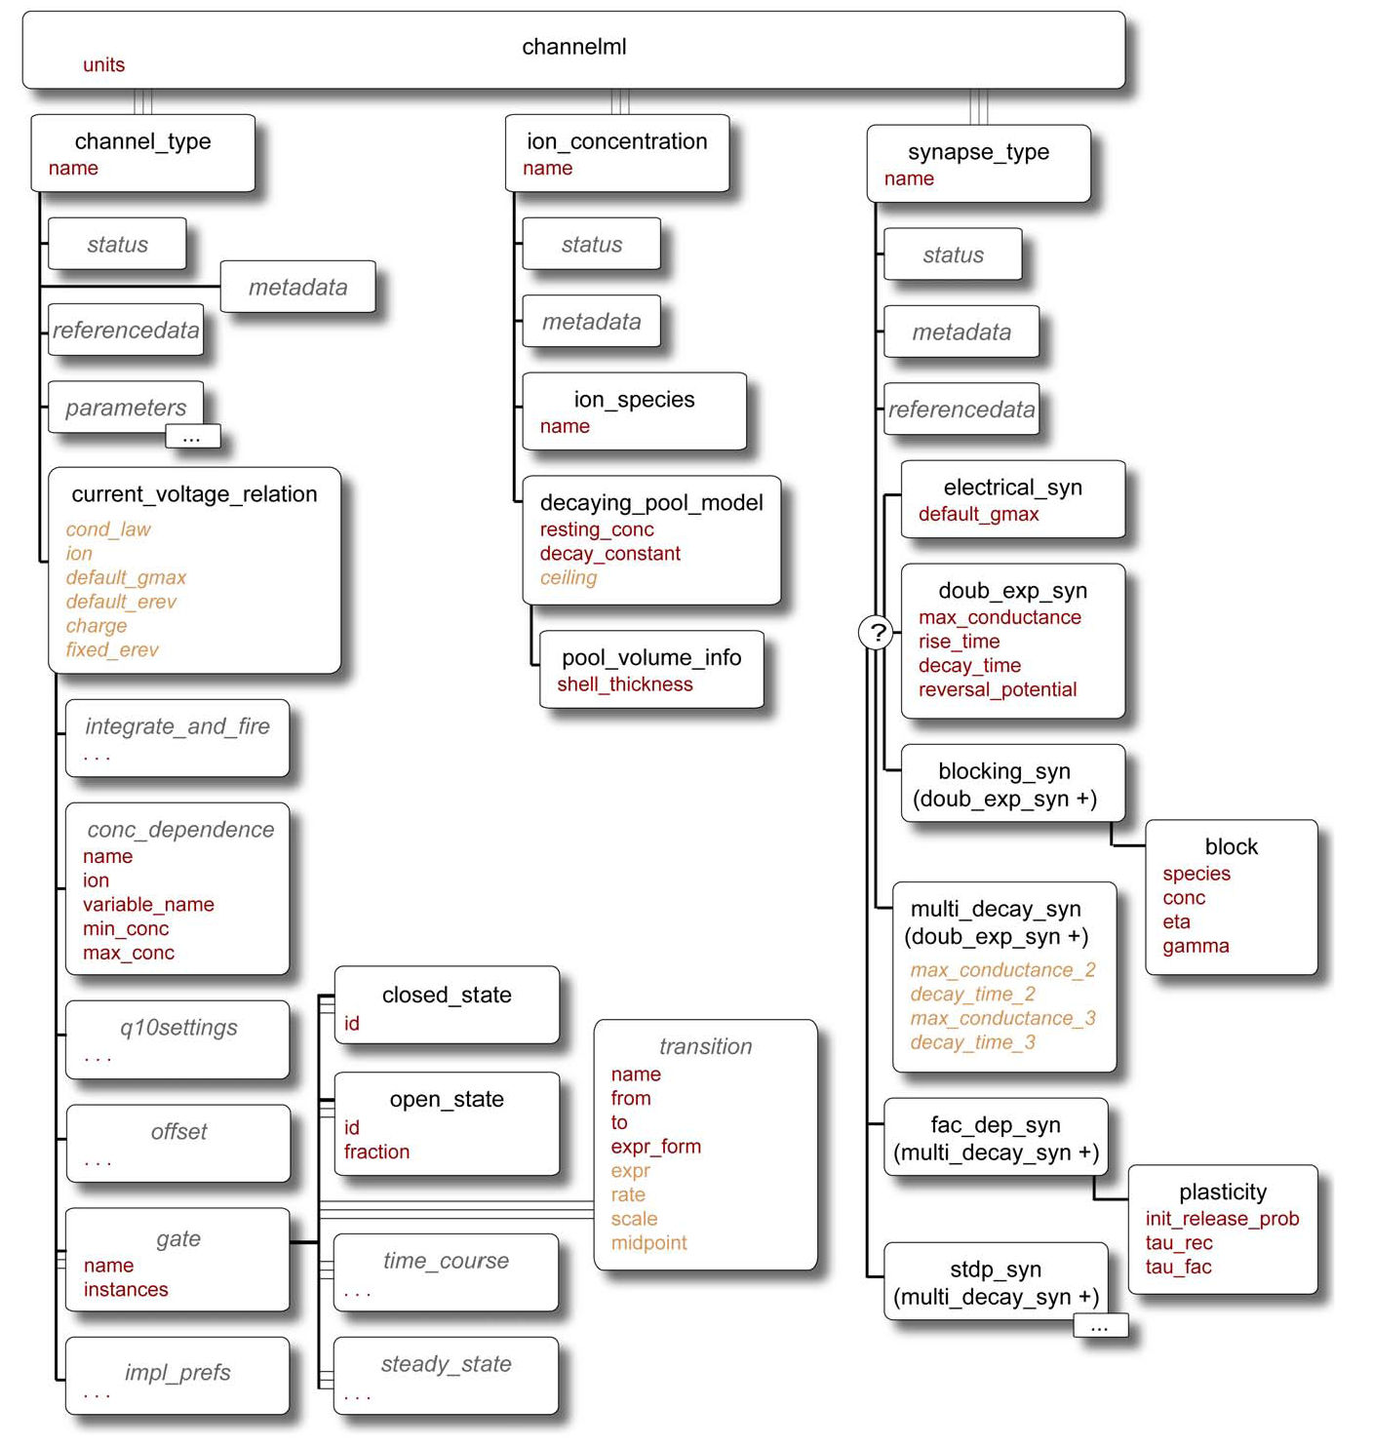
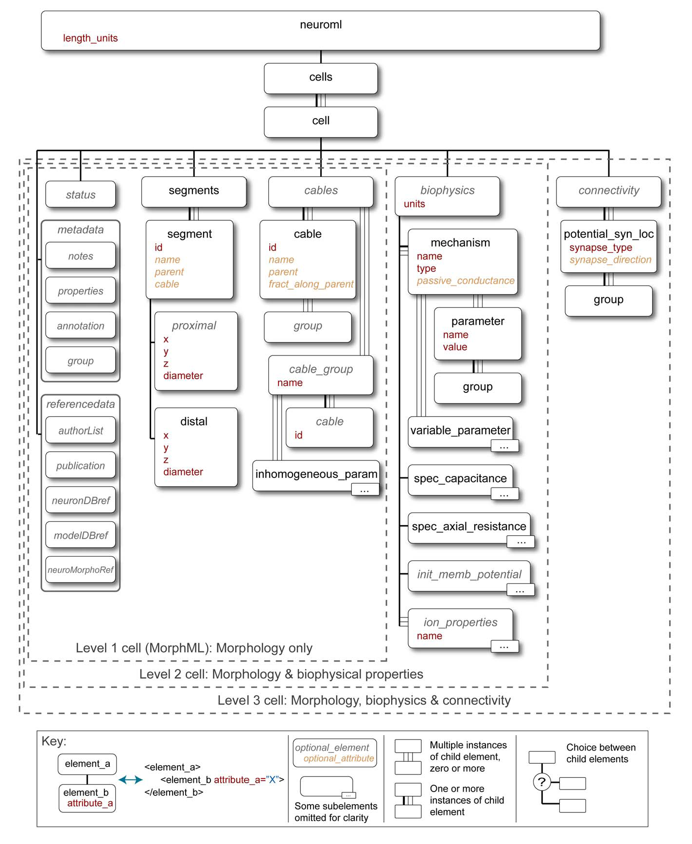
PLoS Comput Biol. 2010 Jun 17;6(6):e1000815. doi: 10.1371/journal.pcbi.1000815.

Slide 30
Notable features of PNS neurostimulation research
http://vanat.cvm.umn.edu/neurLab1/nerves.html
Furness 2006
Notes:
Different biophysical challenges
Rapid innovation in device therapeutic approaches
Possibility of minimally surgical or even nonsurgical access to nerves
Postsynaptic cells are often not other neurons
How to measure functional strength of a nerve-organ connection
Diversity of therapeutic targets – means diversity of funding targets!
New methods challenging even very basic classifications
transcriptomic and developmental analysis

Slide 31
SPARC Other Transactions: Dynamism and innovation at every award stage
Funding Announcements
No template
Rapid dissemination
Reach nontraditional applicants
Review
Custom review process:
New reviewer voices
Interactive discussion with Program staff
Outcome-driven selection criteria
Selection of pieces of a proposal
Award Management
Awarded activity can be rapidly expanded, modified, partnered, or discontinued based on program needs, emerging methods, technologies, or approaches
Notes:
Currently, SPARC, PMI and NCATS are using NIH’s OT Authority – this enables respective program staff to build upon one another’s efforts to increase flexibility of how NIH funds and manages OT awards
1. Easier to include individuals in addition to large businesses, SBIR/startups and first time applicants
2. SPARC uses a 2-stage process involving pre-applications (OT1s or LOIs) and a subsequent full application (OT2 or OT3), not required to use existing FOA templates or require DUNS/SAM for OT1 applicants, may publish FAs on the SPARC website and receive applications via email, or can use existing systems like Grants.gov
3. This is not Peer Review! Allows for mixed Federal and non-Federal review panels that are instructed to avoid reaching a consensus and discuss “gems” (components or subcomponents) within proposed projects, Gene provides a customized review summary rather than releasing reviewer summary statements, and may guide applicants pre- and post-application to so proposed projects align with SPARC goals
4. Adjustable funding periods, which Kate will discuss in more detail, that facilitate project modifications and terminations
5. Enhanced oversight and direct involvement by SPARC staff (e.g., pair projects/project components, incorporate field experts, create partnerships/collaborations, and change scientific focus of funded projects)
SPARC is now being encouraged to fully leverage the benefits of OTA to develop a more creative and flexible management approach for our OT awards. Grants management wants to see us using OT awards
Some of this evolved from decisions made by the other OT programs regarding (e.g., individuals, DUNS/SAM, and funding periods)
Continue to work with OPERA, OER and NCATS regarding SPARC policy, IP and data sharing, and award management
This potential award will be made under the Other Transactions Authority meaning it is not a grant, contract or cooperative agreement.
Per the email sent on August 19, the AOR and PIs for this potential award should read and be familiar with the Other Transactions Policy Guide relevant to this program.
There are similarities between Other Transactions awards and grants as in the fact that all federal regulations applicable for federal financial assistance apply to Other Transactions (for example – Fly America Act, Salary Cap, Human Subjects Regulations, etc.). However it is important to note that there are some differences particularly in the areas such as intellectual property, data sharing, and appeal rights.
Other Transactions allows SPARC the flexibility to alter the course of projects in real-time to meet the overarching programmatic goal. This means that awarded activity could be expanded, modified, partnered, not supported, or later discontinued based on program needs, emerging methods, technologies, or approaches, and availability of funds.
This Other Transactions program focuses on collaborative team science with involvement of public, private, non-profit and government sectors.
This program will involve multiple awards made to various organizations that will be expected to cooperate and collaborate with one another as well as SPARC staff and other designated consultants.
There will be significant ongoing involvement from SPARC staff.
For each award, there will be an assigned an Agreement Officer (similar to a Grants Management Officer) and a Project Manager (similar to a Program Official). The AO will be responsible for the administrative and financial management of the award. The Project Manager will be responsible for the scientific oversight and collaboration.
Award negotiations will be conducted via various forms of communication. Written documentation should include AOR concurrence. Written documentation submitted will be used to form the final milestones included in a Notice of Award.
All potential award milestones will be negotiated independently however once all awards are made, parties are revealed and collaboration begins, alterations may be required.

Slide 32
SPARC High-Level Plans
MAPS
Maps 1.0
Maps 2.0
New Tools (exploratory)
TOOLS
New tools (specific, need-driven)
Powered by “Other Transactions”
Build public-private partnerships
TRANSLATION
Leverage public-private partnerships for human functional mapping
DATA
“Next-gen sharing”
2015
2016
2017
2018
2019
2020
2021
3
22
42
47
46
42
38

