Slide 1
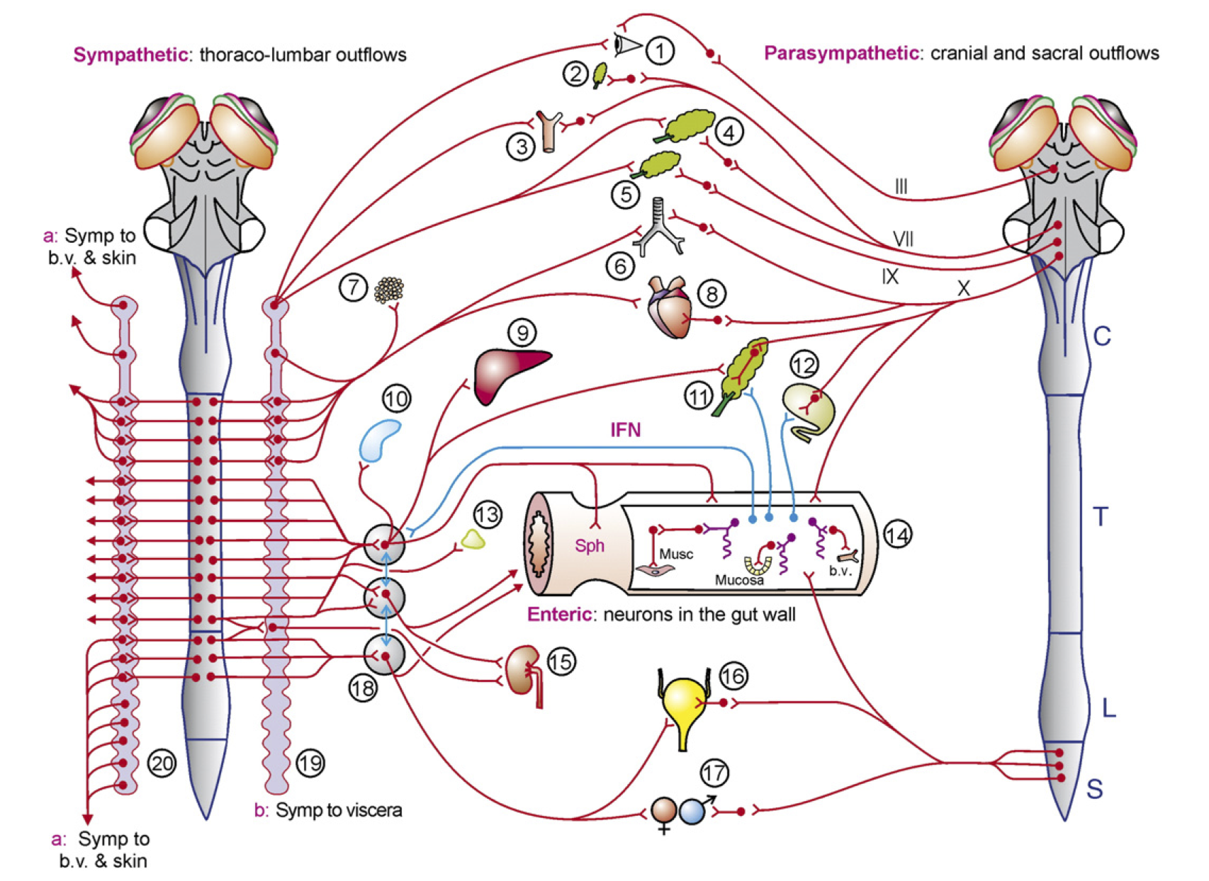
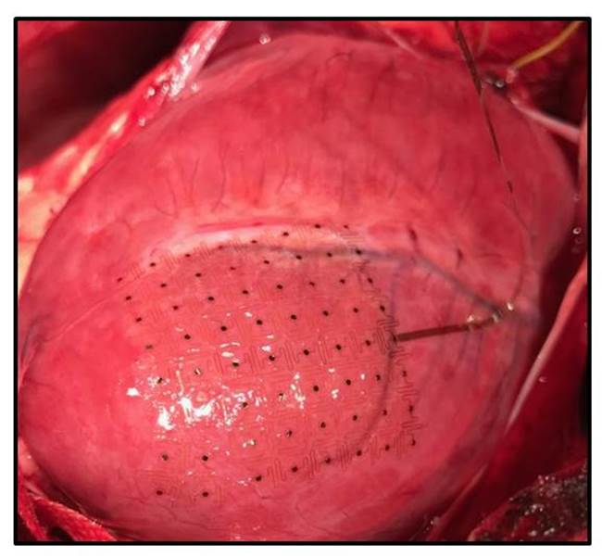
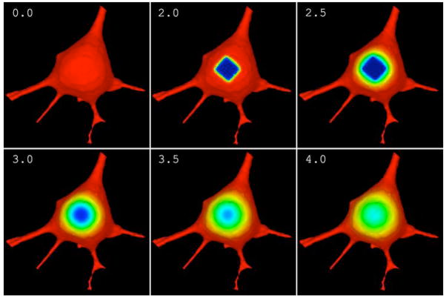
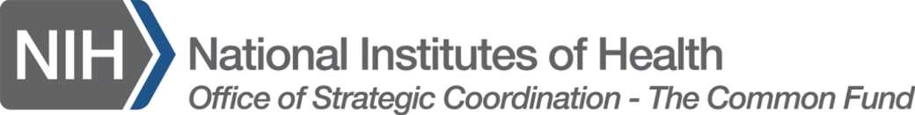
MSM in SPARC: Plans and Stretch Goals
Bower
Ardell UCLA
Virtual Cell
Furness 2006
Rogers Illinois
Gene Civillico, Ph.D.
SPARC Program Manager
NIH/OD/DPCPSI/OSC
Notes:
Register today for the Interagency Modeling and Analysis Group (IMAG) 10th Anniversary Multiscale Modeling (MSM) Consortium Meeting.
March 22-24, 2017
NIH Natcher Conference Center
NIH Main Campus
Bethesda, MD
Keynote Address: Dr. Subra Suresh, President, Carnegie Mellon
Welcome: Dr. Roderic Pettigrew, NIBIB; Dr. Patti Brennan, NLM
Themes
Theme 1: Where have we been and where are we going?
Theme 2: Translating models for policy change
Theme 3: MSM for medical devices
Theme 4: Stakeholder perspectives - scientists, clinicians, industry
Highlights
100 multiscale modeling projects
Latest MSM methodologies from other IMAG communities
Review of model credibility plans
MSM Consortium working groups
Government initiatives and agency policies for modeling
See agenda at https://www.imagwiki.nibib.nih.gov/imag-events/imag-celebrating-10th-anniversary-multiscale-modeling-consortium
Register at https://www.eventbrite.com/e/imag-10th-anniversary-multiscale-modeling-consortium-meeting-tickets-29818641359

Slide 2
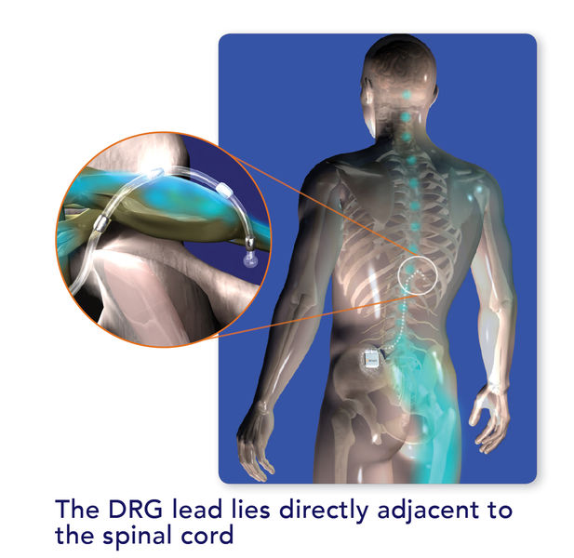
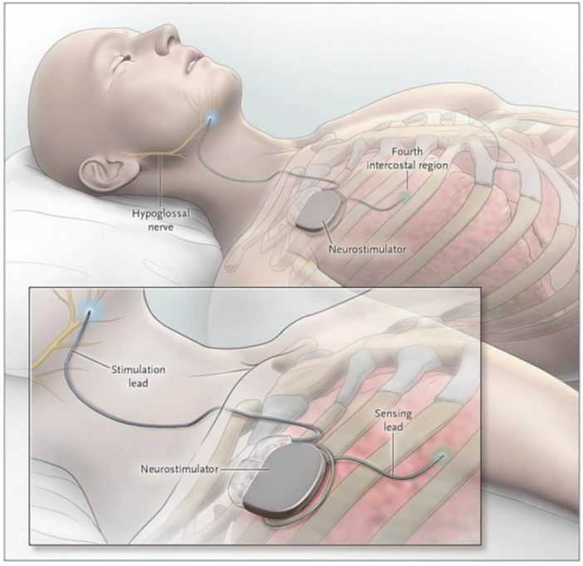
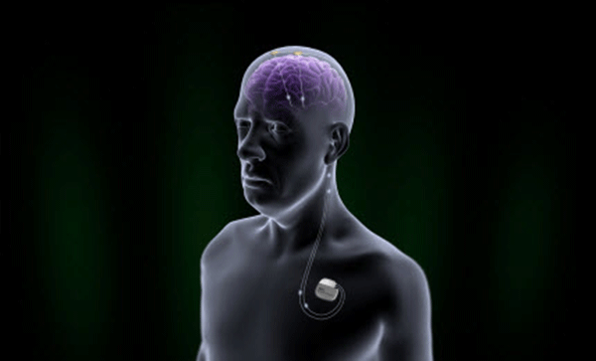
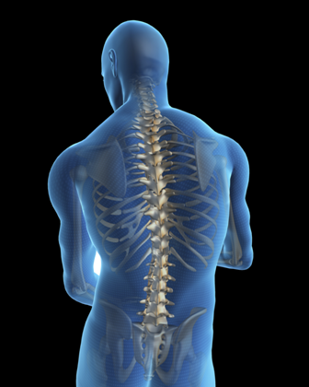
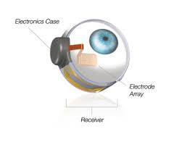
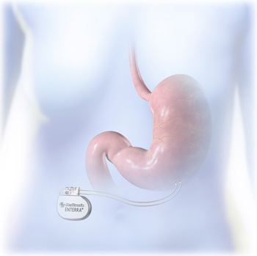
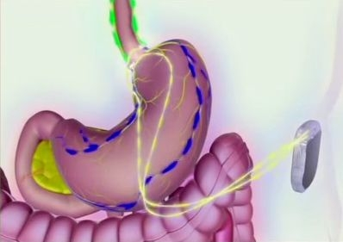
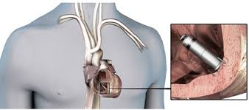
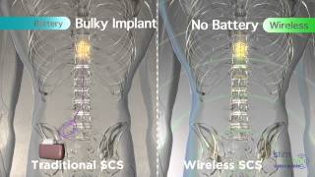
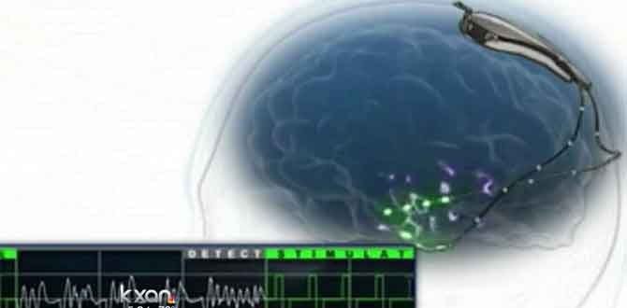
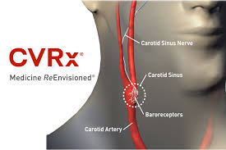
Neuromodulation: Recent FDA Market Approvals
StimWave 510(k)
Medtronic Micra PMA
Second Sight Argus II HDE
Inspire, PMA
St. Jude Brio PMA
Enteromedics Maestro, PMA
Medtronic Enterra II HDE
Nevro Sensa PMA
NeuroPace, PMA
CVRx® Rheos HDE
St. Jude Axium PMA
Notes:
Talking about PMAs
Inspire – great example of approval. Got CE mark – closed loop, stimulates hypoglossal nerve 4 muscles. Clinical trials have failed because of targeting.
DAGRID. Implant everybody, turn everybody on for 6 months – identify responders, then do blinded offs. Better than going two-thirds on, blinded 1/3 off.
Enteromedics maestro. Block. Got CE mark, did trial in US. 24% weight loss in on arm, 16% in off arm. Common theme – huge placebo effects that get you CE mark.
Neuropace. 37% reduction in monthly seizures, 17% sham moanthly reduction in seizures. 6-7% had serious event associated with the surgery
St Jude Brio PMA
Constant current stim
Spinal cord stims aren’t being sham=controlled, because stim is perceptible so you can’t try.
They’re allowed to evaluate them based on non-inferiority
Nevro Sensa 10 kHz stim for pain
Reduction in paresthesia
St Jude Axium
Both showed about 80% reduction on pain scale (happy face)
All this stuff is same IPG as cardiac pacemaker with different interface, based
Except MDT Micra PMA which is wireless and snaked in with a catheter. Starts to get to a profile that’s injectable
HDEs
Second sight Argus II HDE
64 channels
CVRx Rheos Missed primary endpoint but controlled hypertensions (in 42% in on arm, 24% in off arm), so have to let people keep it.
HDE to do battery replacements and apply for reimbursement
MDT Enterra II HDE
Nausea and gastroparesis
510(k)
StimWave (what is name of product?)
Wireless transfer of power (is this because the power supply is on the outside?)
There’s a lot more things that got CE marks that were not approved. Here come some of those…

Slide 3
Many randomized controlled trials miss their prespecified primary efficacy endpoints
Boston Scientific NECTAR Trial (Vagal Nerve Stimulation, Heart Failure)
BioControls INOVATE Trial (Vagal Nerve Stimulation, Heart Failure)
Medtronic SYMPLICITY (Renal Denervation, Hypertension)
CVRx® Rheos (Baroreflex Activation Therapy)
Apnex (Hypoglossal Nerve Stimulation, Sleep Apnea)
St. Jude BROADEN Trial (DBS Area 25, Depression)
Medtronic RECLAIM Trial (DBS Ventral Capsule/Ventral Striatum, Depression)
Medtronic SANTE Trial (DBS ANT, Epilepsy)
Common Themes:
  followed successful open label studies
  large sham arm effect
  remarkable response in some patients
SCS/Vagal Nerve = No RCT Trial (Approved by FDA in 1989 and1997)!
Notes:
Biocontrols – closed loop system, syncs with the heart rate
Renal denervation - ablate renal nerves with RF catheter
All the above – sham arm had a large effect
Endpoints of the above are ultrasound investigation of heart structure (cardiac remodelling, surrogate for pressure at the ventricle that would create backflow, creates pulmonary edema)
Rheos
Primary endpoint was 10 mm drop. Half of patients in OFF arm had 10 mm drop.
Apnex, hypoglossal nerve stim, sleep apnea
Tried to do same trial design as inspire and got shot down. Note that inspire prescreened for suitable anatomy
Broaden, reclaim, CE mark, good open label, failed primary endpoint. Very subjective metrics.
Biomarkers are subjective, not automated
SANTE – data looks like neuropace’s, got shot down. (7-5 panel decision)
Neuropace (12-0)
SCS/vagal – new products aren’t asked for sham-controlled study, only asked for 10% noninferiority to existing , because of earlier approval in a different environment
YOU NEED THE MAP AND THE BIOMARKER

Slide 4
Why is treatment response so inconsistent?
In many (most? all?) cases, we don’t know:
  Desired cellular target
  What the target is actually “seeing”
  Minimum activation volume to create effect
  Optimal temporal pattern to create effect
  Variance in anatomy from subject to subject
  Variance in pathology from subject to subject
  Effect of drug interactions
  Long-term adaptation (systemic, neural interface)
  Translatability of animal study results…
Spatial scale
Orientation of fibers
Myelination
Notes:
The target model that unconsciously underlies an incredible amount of biomedical research is derived from drug orthodoxy. And there are good reasons for this. Potassium channels are the same size in mice and humans. Vascular perfusion works essentially the same way in mice and humans.
Patients are on lots of drugs that impact the pathways you’re looking at
Differences in orientation/size/degree of myelination of nerve fibers and distance to electrode matter
Electrode size, cathode/anode spacing and insulation matter
END OF THIS SLIDE: so – we need your help!
We don’t know these things because the study of autonomic circuits has been neglected…

Slide 5
SPARC Ultimate Goal:
Build predictive functional maps of the human PNS in relation to selected organ targets

Slide 6
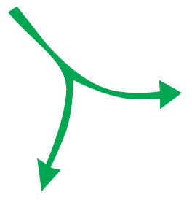
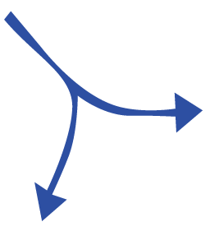
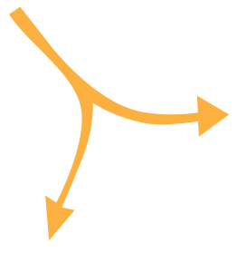
SPARC Component Structure
ANATOMICAL & FUNCTIONAL MAPPING
TRANSLATIONAL PARTNERSHIPS
NIDDK
DATA & RESOURCE CENTER
NCATS/NINDS
Program Manager and Staff in OSC (“Common Fund”) set overall vision and make adjustments
NIBIB
TECHNOLOGY DEVELOPMENT
NIBIB/NINDS
Notes:
new markets: real talk.

Slide 7
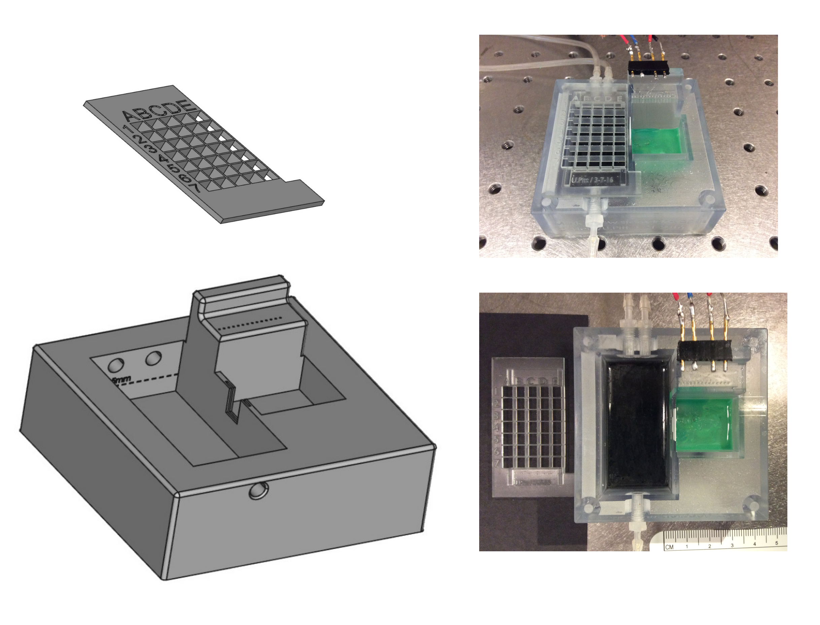
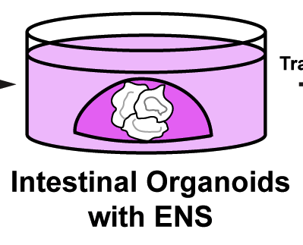
SPARC Consortium Snapshot, March 2017
Comprehensive (Shivkumar/UCLA)
Auricular branch of vagus (Napadow/MGH)
Comprehensive (Powley/Purdue)
Mapping
Comprehensive (Howard/Toledo)
Transcriptome (Southard-Smith/Vanderbilt)
Comprehensive (Bolser/U FL)
Pulmonary neuroepithelial cells (Sun/UCSD)
SCG Physiological Atlas (Lewis/Case Western)
Adipose tissue (Columbia, Pennington )
Pancreas (Campbell-Thompson/U FL)
Bladder (Keast/Melbourne)
Translation
Canning (Hopkins)/Nuviant
Synapse VNS for asthma
Chen (Hopkins)/Boston Sci
SCS for gastric motility
Yin (Transtimulation)/CVRx
VNS for diabetes
(Ardell/UCLA)
Cardioneural mapping electrodes
(Strohl/Case)
Rabbit OSA model
(Howard/Toledo)
Mouse lines for ENS study
(Okusa/UVA)
Ultrasound modulation
(Davis/Pitt)
Viral bladder tools
Tools
(Bruns/Pitt)
Spinal root interface
(Farajidavar/NYIT)
Implantable gastric platform
(Wells/Cinncinnati)
Human GI organoids
(Vulchanova/UMN)
Viral tools
(Durand/Case)
Intrafascicular nanowire
(Horn/Pitt)
Vagal-gastric communication
(Gereau/WashU)
Conformal bladder electronics
Data
TBD TBD TBD TBD – APPLY!
Notes:
Tomorrow at 1:30
Afferent Stimulation and Modulation of the Autonomic Nervous System Forum 2, 3, and 4 Moderators: Jeffrey L. Ardell, PhD; Robert Foreman, PhD
Tomorrow at 3:30
Autonomic Efferent Targets for Therapeutic Control of Visceral Function Forum 2, 3, and 4 Moderators: Lawrence P. Schramm, PhD; Jiande Chen, PhD
Jiande Chen
Saturday at 3:30
Non-pain indications session
Kingman Strohl
NIC IV session
Dominique Durand

Slide 8

Powley et al JCN 2016
Why is that happening?
What is there?
“Organ readout”
How can we access it reliably?
How can we measure the result?
How should we modulate it?

Slide 9
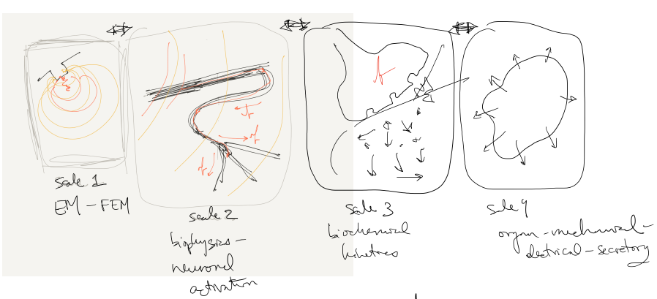
container
SPARC4
connectors
SPARC1/SPARC2
Notes:
Who builds the single-physics pieces?
SPARC1 and 2? Are they doing this already? If not we need to add to awards.
Where is the handoff between 1-2 and 4? Who is responsible for bringing a piece “up to code”?
Modeling core:
Gets the pieces online
Builds the connections between them
Builds the container that lets you interact with the resulting multiscale model
Identifies model components that are driving variability in combined model output. Recommends experiments.

Slide 10
SPARC4: Data and Resource Center Cores
Just released!
Mandatory (minimal!) LOI due April 7th by email
https://go.usa.gov/xXBkA
DAT-CORE
MAP-CORE
SIM-CORE
Store, organize, manage and track access to data and resources generated by SPARC.
Build interactive, modular, continually updated visualizations of nerve-organ anatomy and function
Host and connect simulations to create predictive multiscale, multiphysics models of neuromodulation of organ function
Notes:
OT3 Multi-component Research Project
5 years, $10M, budget able to increase or decrease as needed

Slide 11
SIM-CORE
Help us make something new!
Host component simulations
Build links between simulations to create composite multiscale, multiphysics models
Build an interface to the composite model that does not require access to the underlying models. Users should be able to run composite models in either direction.
Build uncertainty quantification into composite model outputs by propagating uncertainties from all component model parameters. Quantify and make available to users the contributions to overall output uncertainty from component parameter and input uncertainties.
Notes:
Either direction: by specifying a neuromodulation pattern and receiving a predicted organ readout, or specifying a desired organ readout and an intervention point and receiving a neuromodulation pattern.

Slide 12
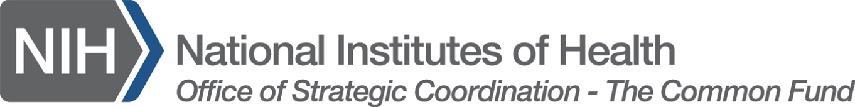
SPARC Contacts & Resources
Office of the NIH Director Team
Dr. Gene Civillico, Program Manager gene.civillico@nih.gov (301) 351 4180
Dr. Felicia Qashu, Program Officer, OT Project Manager felicia.qashu@nih.gov (301) 451 7222
Kristina Faulk, Communications Lead, OT Policy/Program Analyst kfaulk@mail.nih.gov (301) 402 9185
Kate Nicholson, Budget Analyst, kate.nicholson@nih.gov
Institute/Center Project Team Leaders
Biology – Dr. Jill Carrington: carringj@niddk.nih.gov (301) 402 0671
Technology – Dr. Mike Wolfson: michael.wolfson@nih.gov (301) 451 4778
Translation – Dr. Danilo Tagle: danilo.tagle@nih.gov (301) 594 8064
Dr. Siavash Vaziri: siavash.vaziri@nih.gov (301) 594 8921
Data – Dr. Vinay Pai: paiv@mail.nih.gov (301) 451 4781
Other Contributing ICs
NHLBI
NIDCD
NCCIH
NICHD
NIAID
NIDA
CSR
NCI
NIDCR
NIH-SPARC-Info@list.nih.gov
https://commonfund.nih.gov/sparc/grants
@NIH_CommonFund
@gcivillicoNIH
#NIH_SPARC

Slide 14
DEVICE PROPERTIES
applied current/voltage
heat
EM fields
ultrasound
light
“the line”
gene expression
cytosolic 2nd messengers
extracellular potentials
cell secretions
transmembrane currents
metabolite/byproduct concentrations
CELLULAR PROPERTIES

Slide 15
SAFETY IS NOT JUST THE ABSENCE OF CELL DEATH
“This stimulation pattern is safe because it doesn’t kill neurons.”
“This .exe is safe because it doesn’t fry my CPU.”
Notes:
the CNS and PNS can run malware on perfectly functioning hardware

Slide 16
SPARC4: Data and Resource Center Cores
Help us make something new!
Just released!
Mandatory (minimal!) LOI due April 7th by email
https://go.usa.gov/xXBkA
DAT-CORE
MAP-CORE
SIM-CORE
Store, organize, manage and track access to data and resources generated by SPARC.
Build interactive, modular, continually updated visualizations of nerve-organ anatomy and function
Host and connect simulations to create predictive multiscale, multiphysics models of neuromodulation of organ function
Notes:
OT3 Multi-component Research Project
5 years, $10M, budget able to increase or decrease as needed

