Slide 1
A Twin Study of Adolescent Alcohol and Drug Use Development: Leveraging Intensive Longitudinal Assessments
Scott I. Vrieze^{1,2}, Naomi P. Friedman²
¹ University of Minnesota
¹ University of Colorado Boulder
NIH U01 DA046413

Slide 2
Behavioral problem: Substance use
Goal: Develop a fine-grained model of developmental change in key risk domains and their relations to substance use, including moderation by environmental context.
Theoretical Framework: Dual systems model of adolescent risk behavior. The combination of high sensation seeking (bottom-up influences) and low levels of executive function (top-down control) puts adolescents at risk to use and misuse alcohol and other drugs. While this is clearly a developmental theory, no study to date has conducted intensive longitudinal assessments to characterize these developmental trends, their interrelationships, or their modulation by environmental circumstances, particularly in the young adult transition.

Slide 3
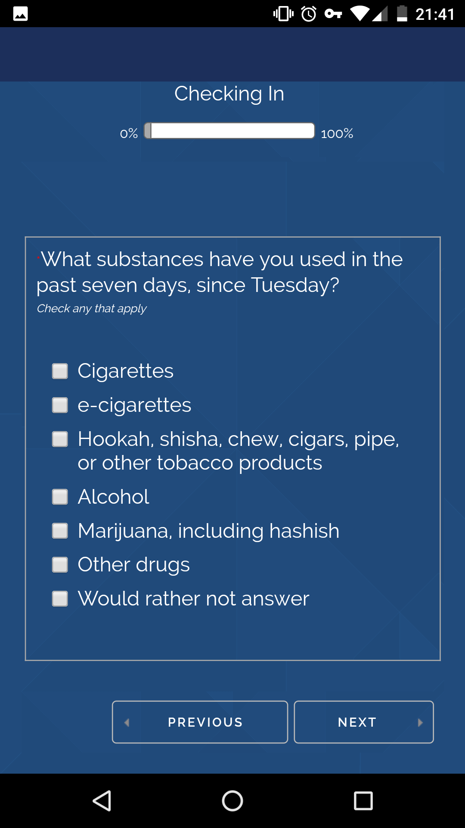
Design
1,000 individual adolescent twins
Baseline in-person assessment
Substance use, executive functions, personality, psychopathology, peer and family context
2-year remote follow-up with CoTwins app
~Weekly substance use and mood, monthly peer substance use, life events, parental monitoring, yearly personality, executive function
GPS, audio sampling, photos of environment
Notes:
Photos and audio recordings will be automatically processed for relevant features: social context, valence, presence of substances in environment.

Slide 4
Modeling
Modeling:
Substance use data: growth curve models, classical twin genetic and environmental decomposition, and co-twin control models
GPS and smartphone data: derivation of instrument variables (e.g., moving out of parental home; starting new job); twin similarity in environment
Challenges:
Missing data
Highly multivariate analysis with a relatively small sample size
Impact:
Fine-grained characterization of development of substance use behaviors informed by genetic and environmental context

