Slide 1


Credibility in multiscale modeling of bone environment response to metastatic cancer
David Basanta and Conor Lynch

Slide 2
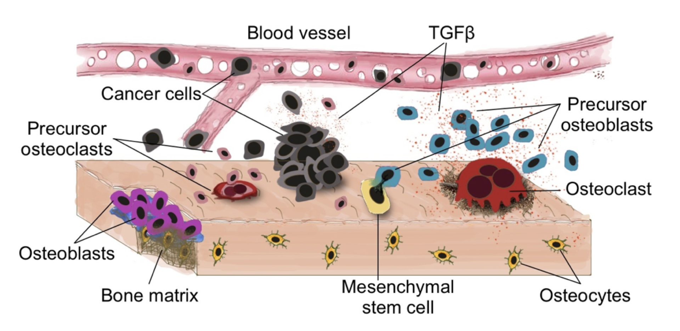
The problem
A
Monocyte Recruitment
Pro-inflammatory
Polarization
Monocyte Macrophages
Anti-inflammatory
Polarization
Inflammatory Macrophages
Bone Macrophages
Anti-Inflammatory Macrophages
Osteoclastogenesis
Differentiation
Maturation
Osteoclast
MSC and OB Precursors
BMP
BMP
MMP
MMP
Osteoblast
Injury
MMP
Osteogenesis
Osteolysis

Slide 3
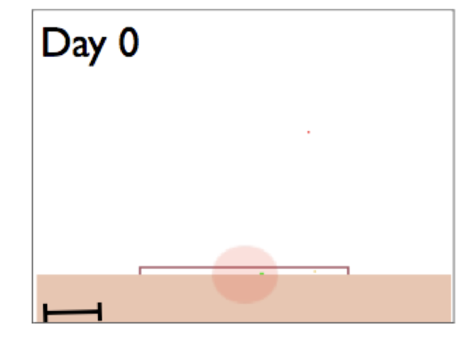
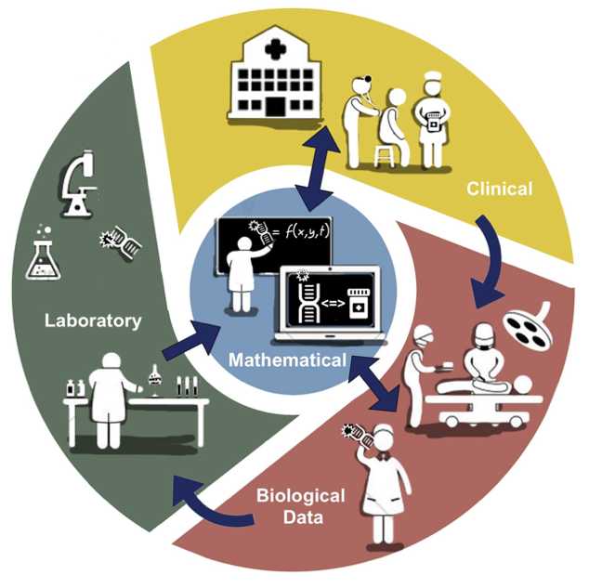
3 levels of credibility

