Slide 1
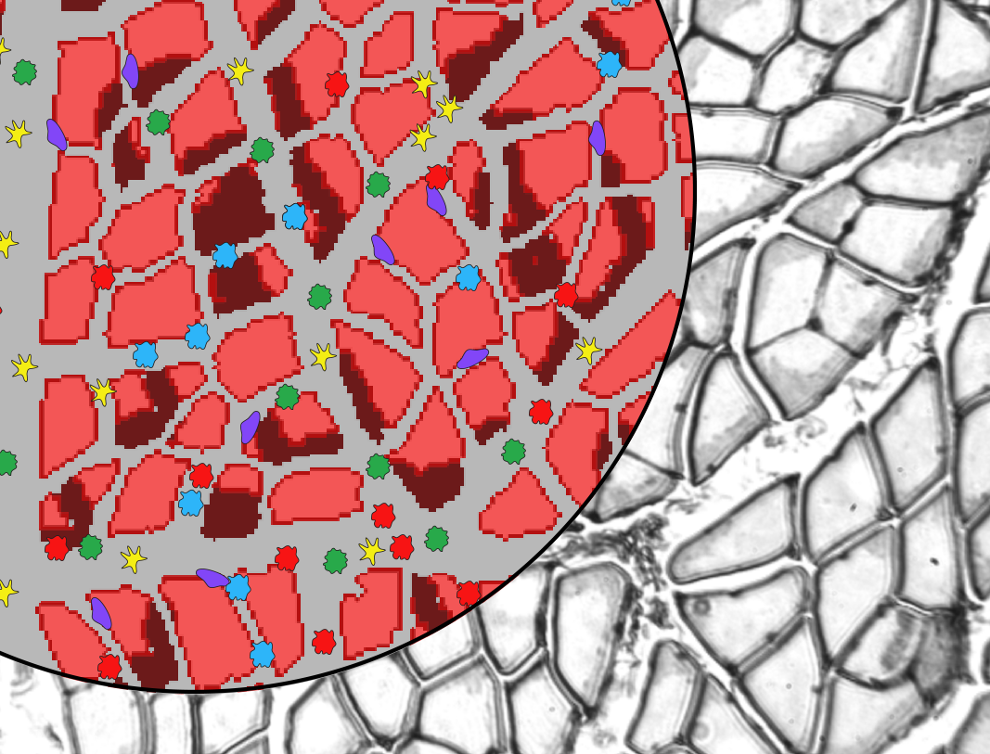

Multi-scale modeling for treatment discovery in
Duchenne muscular dystrophy
Silvia Salinas Blemker and Shayn Peirce-Cottler
Biomedical Engineering
University of Virginia

Slide 2
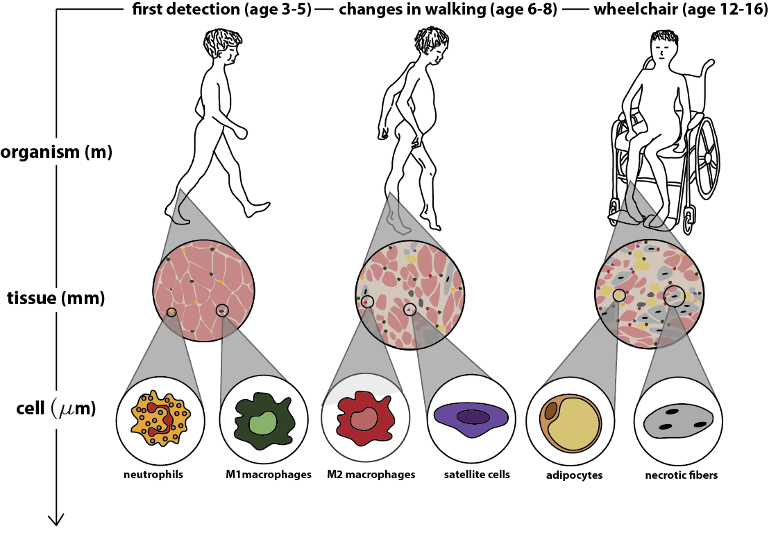
This U01 grant aims to model disease progression and potential treatments for Duchenne muscular dystrophy
RULE 1
Notes:
Duchenne muscular dystrophy is a devastating neuromuscular disease, affecting 1 in 3500 boys, resulting in severe muscle pathology across multiple spatial and temporal scales.
The disease is typically first detected around age 3-5 with boys have difficulty rising from the floor. High susceptibility to contraction induced damaged caused by the missing protein leads to constant cycles of degeneration and regeneration of muscle and chronic inflammation. As the muscle continues to degenerate, contractile muscle tissue is replaced by fibrosis and fatty infiltration, and boys lose their ability to walk in their early teens and die due to cardiac or respiratory complications in their 20’s.
And although we know that the disease is caused by dystrophin deficiency there is still no effective treatment for DMD, despite extensive experimental research.

Slide 3
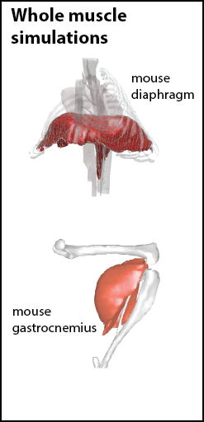
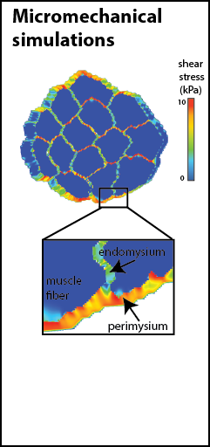
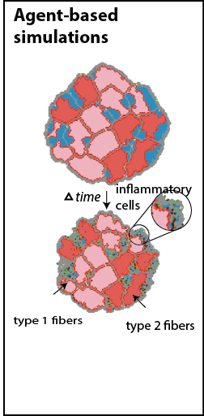
Multi-scale muscle modeling framework
macro-scale strains
micro-scale strains
updated tissue properties
updated micro-structure

Slide 4
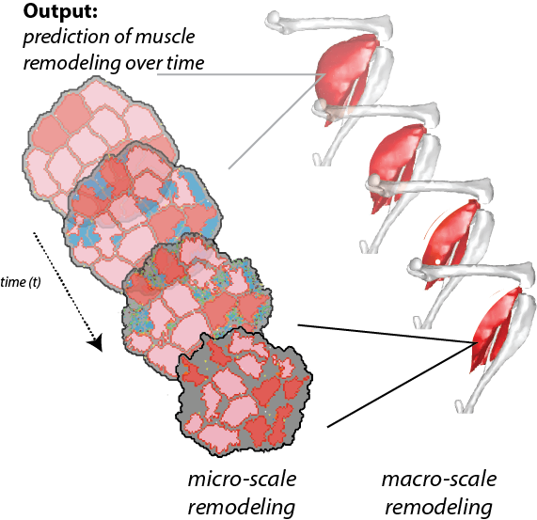
Predict macro- and micro-scale remodeling

Slide 5
Key components of model credibility plan
Verification
Validation
Sensitivity analysis
Documentation of model limitations
Evaluation of clinical credibility

Slide 6
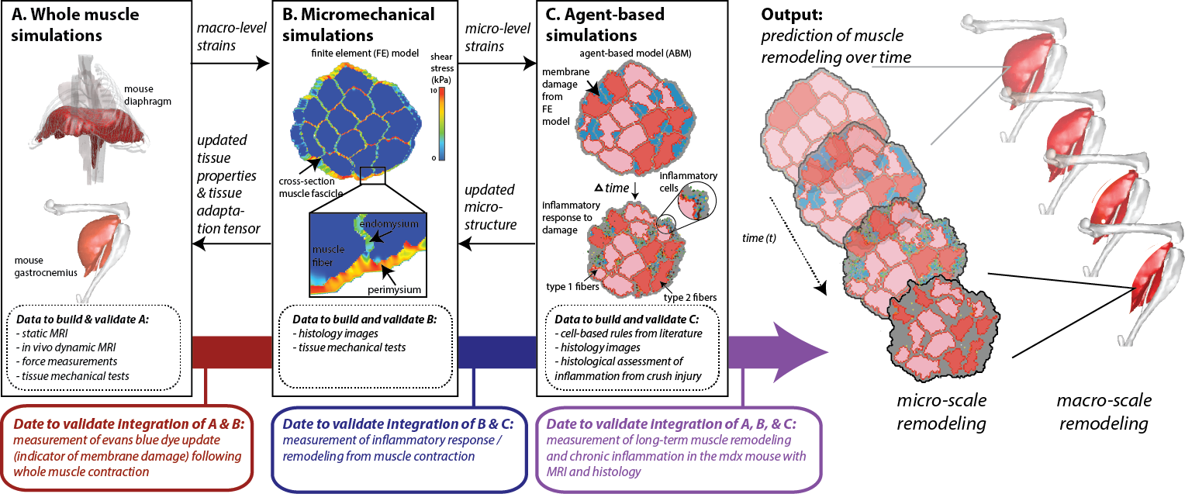

Validation
RULES 2 & 3

Slide 7
Timeline
RULES 5, 6, 7, 8

Slide 8
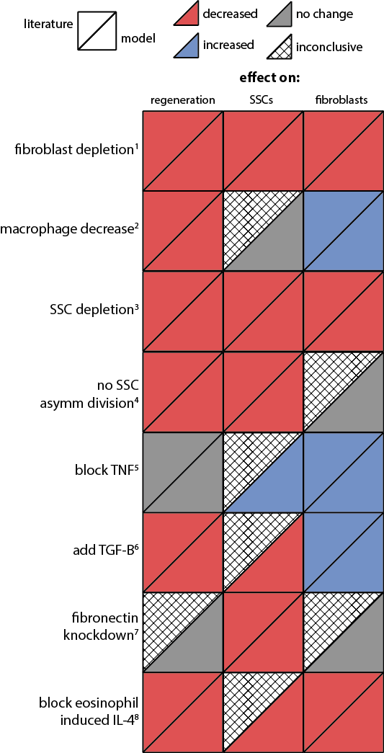
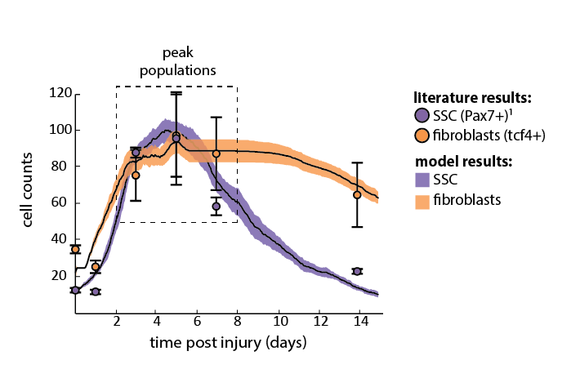
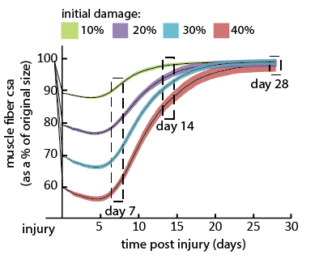
Year 1 progress of model credibility
Validation & sensitivity analysis
RULES 2 & 3

Slide 9
Challenges and opportunities
Complexity of our multi-scale model presents a challenge for robust uncertainty quantification and sensitivity analysis.
Combination of deterministic and stochastic behaviors that require different validation approaches.
Numerical validation may not be equivalent to clinical validation … what is most important?
RULE 4

Slide 10

Third-party evaluator
Dr. Scharf (co-I) will provide clinical evaluation
Looking for two MSM evaluators:
  Biomechanical modeling expert
  Agent-based modeling expert

Slide 11

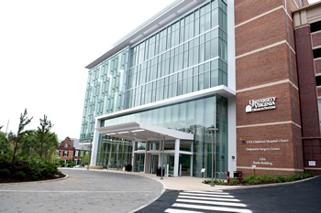
We are also looking for a post-doc!
email: ssblemker@virginia.edu if you are interested!

