Slide 1
MICRO-TEMPORAL PROCESSES UNDERLYING HEALTH BEHAVIOR ADOPTION AND MAINTENANCE (microT Study)
Genevieve Dunton, Stephen Intille, Alex Rothman,
Don Hedeker, Adam Leventhal, Susan Redline

Slide 2
Behavioral Problems: Physical Inactivity, Sitting, Poor Sleep
Goal: Assess differences in the micro-temporal processes underlying the adoption versus maintenance of behaviors
Measurement: Prospective within-subject case-crossover observational design collecting Intensive Longitudinal Data (ILD) across 12-months in ethnically-diverse emerging adults (ages 18-24)
Theoretical Framework: Dual-Process Model of Decision-making and Behavior
Deliberative/reflective processes will be activated to a greater extent when attempting to adopt behavior
Automatic/reactive processes will be activated to a greater extent when attempting to maintain behavior

Slide 3
Data Collection
Smartphone
Reflective Factors
Control
Demands
Deliberation
Stress/coping/affect
Self-efficacy
Self-report:
Random EMA
Context-sensitive EMA
Passive sensing
Reactive Factors
Location
Proximity to types of people
Phone/app use
Text/voice communication
Transportation mode
Noise/light/weather
Smartwatch
Self-report: Random µEMA
Context-sensitive µEMA Passive sensing
Health Behaviors
Physical Activity
Sedentary Behavior
Sleep

Slide 4
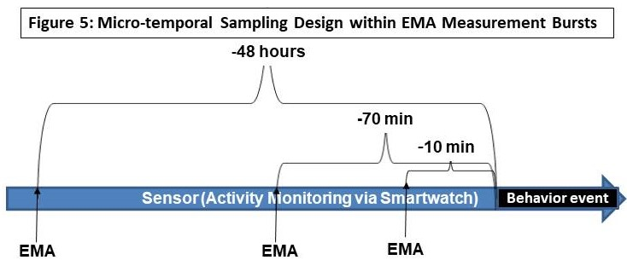
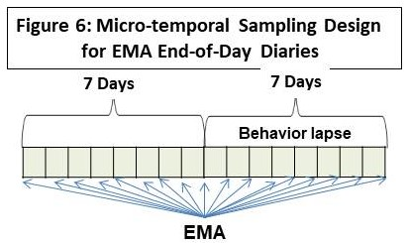
Modeling, Challenges and Impact
Modeling: Two-pronged approach: Use machine learning (ML) to identify person-specific combinations of factors predicting behavior episodes and lapses. Use multilevel regression to identify time-varying and time-invariant moderators
Challenges: Building ML models that can detect and predict of individual-level behaviors with limited training data without overfitting; using models conducive to explanation (e.g., variants on decision trees); seeding algorithms with appropriate features
Impact: Insights into the temporal-, situational-, behavioral-, and individual-specificity of time-varying explanatory factors to build more predictive models of health behavior and personalized interventions

