Slide 1
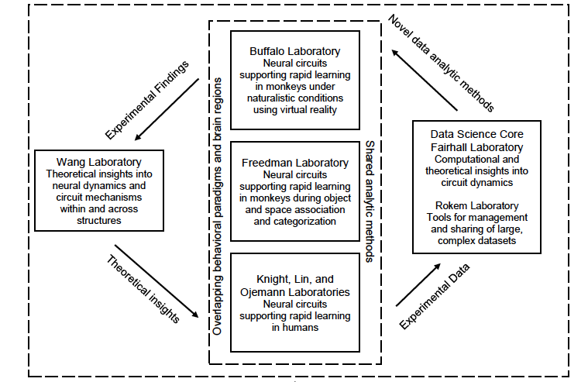
Fairhall_Buffalo
Computational and circuit mechanisms underlying rapid learning
Collaborators
Beth Buffalo, UW
David Freedman, U. Chicago
Bob Knight, Berkeley
Jack Lin, UC Irvine
Jeff Ojemann, UW
XJ Wang, NYU
Adrienne Fairhall, UW
Ariel Rokem, UW
Goal
to characterize the multi-area network interactions and dynamics that underlie the formation of schema, ie a conceptual structure of a task that allows for rapid learning. Simultaneous NHP and human recordings in cortex and hippocampus along with multi-area network modeling

