Slide 1
Modeling and Simulation at U.S. FDA
Tina Morrison, Ph.D.
Chair, Modeling and Simulation Working Group
Office of the Chief Scientist
Deputy Director, Division of Applied Mechanics
Office of Science and Engineering Laboratories
U.S. Food and Drug Administration
Tina.Morrison@fda.hhs.gov

Slide 2
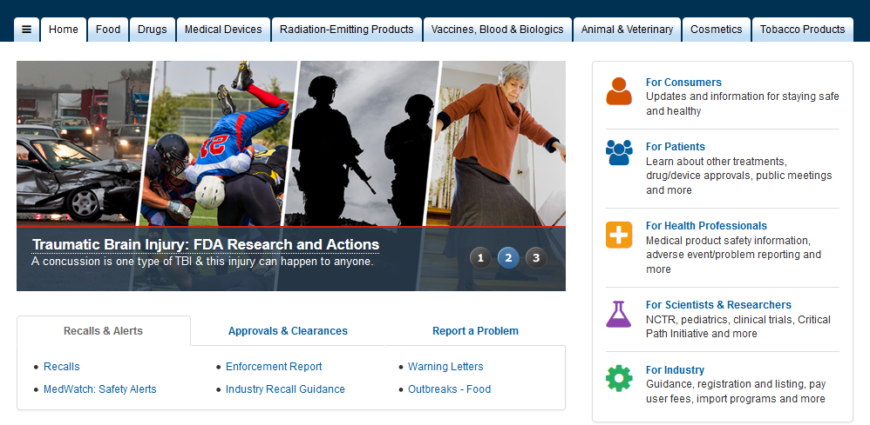
FDA protects and promotes PuBLIc health

Slide 3
What does FDA Do?
Assures the safety, effectiveness and security of
human and veterinary drugs,
vaccines and other biological products,
medical devices,
the food supply,
cosmetics and radiation-emitting devices
Regulate tobacco products

Slide 4
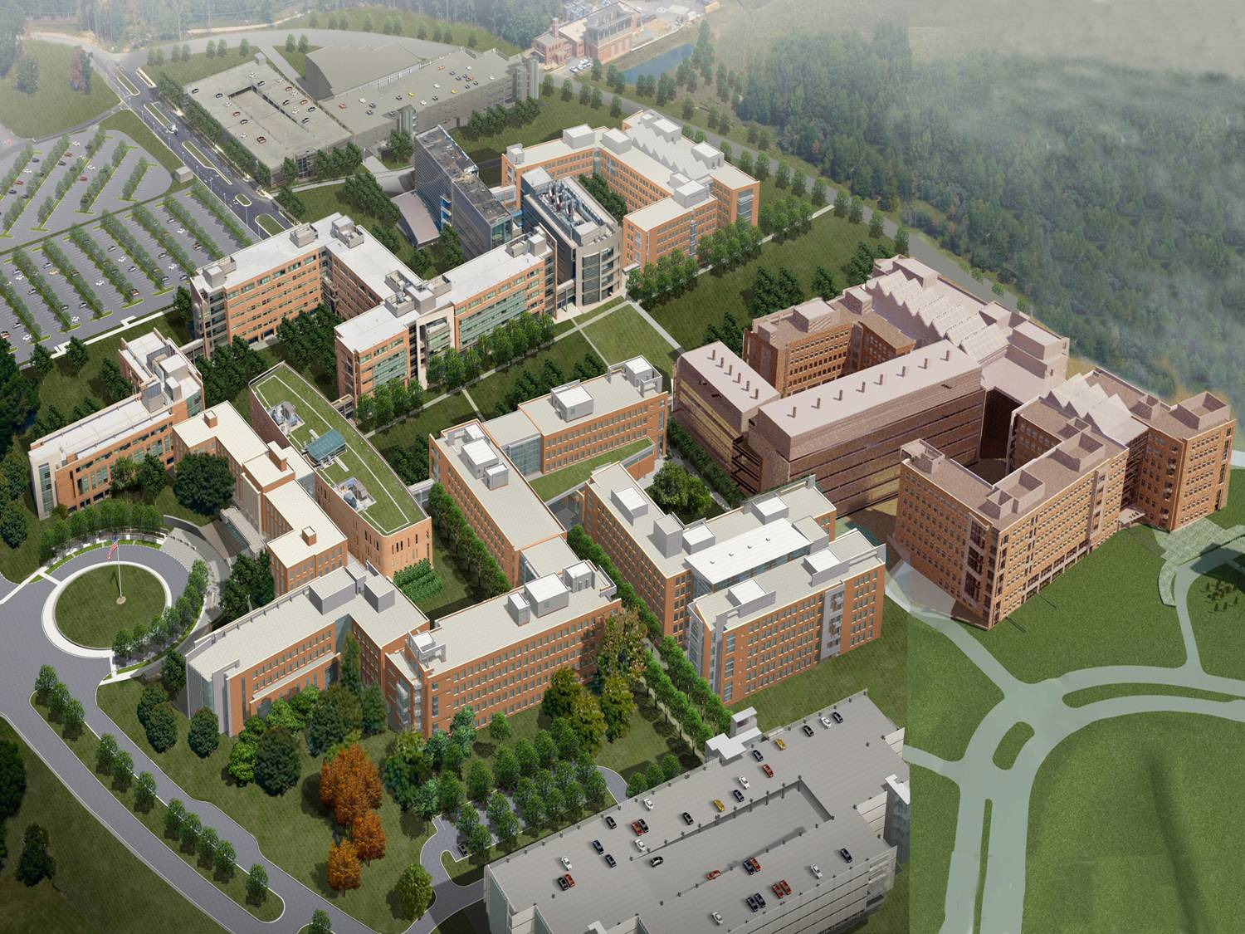
CDRH:
Center for Devices and Radiological Health
CDER:
Center for Drug Evaluation and Research
Food and Drug Administration
Office of the Commissioner
Office of
Regulatory Affairs
CBER:
Center for Biologics Evaluation and Research
CFSAN:
Center for Food Safety and Applied Nutrition
NCTR:
National Center for Toxicological Research
CTP:
Center for Tobacco Products
CVM:
Center for Veterinary Medicine

Slide 5
Ways FDA Accomplishes its Mission
New product review and pre-market approval/clearance
Monitor
Safe manufacturing
Safe handling
New risks
Enforcement and Compliance
Research
Guiding working principle is that we make sound science-based decision making

Slide 6
FDA also Advances Public Health
Help speed innovations that make products safer, more effective, and more affordable
Help the public get accurate, science based information about the products we regulate
The key for FDA is regulatory science:
The science of developing new tools, standards, and approaches to assess the safety, efficacy, quality, and performance of FDA-regulated products.
Safer,
Faster,
Cheaper
Notes:
Try to create policy to stay ahead of the curve

Slide 7
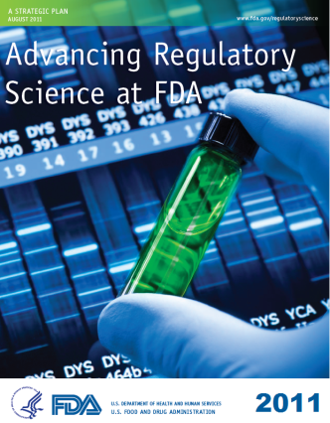
FDA’s Strategic Plan for Regulatory Science
FDA has identified an important role for
modeling and simulation (in silico methods) in its strategic priorities.
Of the 8 science priority areas, 4 have a specific call for M&S
Modernize Toxicology to Enhance Safety
Stimulate Innovation in Clinical Evaluations and Personalized Medicine to Improve Product Development and Patient Outcomes
Ensure FDA Readiness to Evaluate Innovative Emerging Technologies
Harness Diverse Data through Information Sciences to Improve Health Outcomes
Notes:
9 Strategic Priorities
FDA’s strategic plan is designed to enable the Agency to meet today’s public health needs and to be fully prepared for the challenges and opportunities of tomorrow.
Investment in these areas are essential to mission success and public health and safety.
Chemical Quantitative structure activity relationship models

Slide 8
FDA’s Strategic Plan for Regulatory Science
FDA has identified an important role for
modeling and simulation (in silico methods) in its strategic priorities.
Proposed Methods/Approaches
(Q)SAR models to predict human risk
Computer models of cells, organs, and systems to better predict product safety and efficacy
Virtual physiologic patients for testing medical products
Clinical trial simulations that reveal interactions between therapeutic effects, patient characteristics, and disease variables
Knowledge building tools:
data mining, visualization, knowledge bases,
high throughput methods
Mechanism for sharing and reuse of data/models/algorithms
Virtual Population – IT’IS Foundation
high-end virtual models, digital phantoms, for in silico biomedical applications

Slide 9
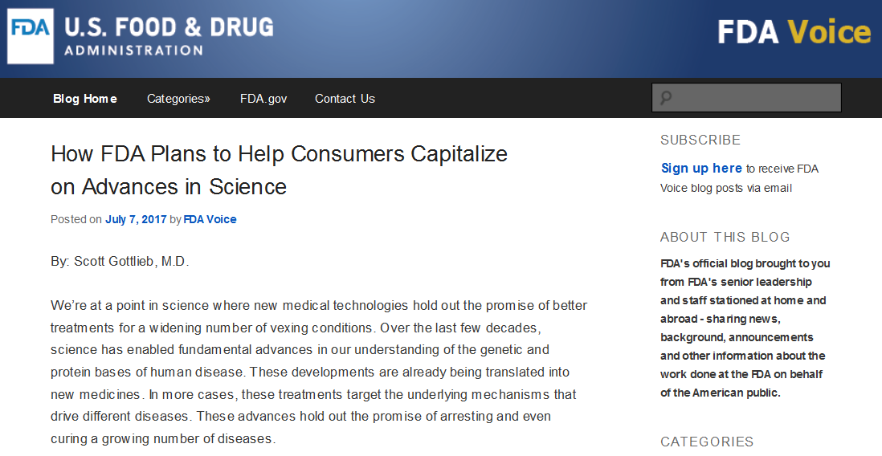
Recent blog post by Commissioner https://blogs.fda.gov/FDAvoice/index.php
“In silico clinical trials use computer models and simulations to develop and evaluate devices and drugs. M&S play a critical role in organizing diverse data sets and exploring alternate study designs. This enables safe and effective new therapeutics to advance more efficiently through the different stages of clinical trials. FDA’s efforts in M&S are enabled through multiple collaborations with external parties that provide additional expertise and infrastructure to advance the development of these state-of-the-art technologies.”

Slide 10
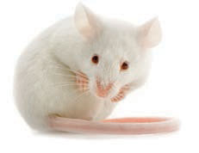
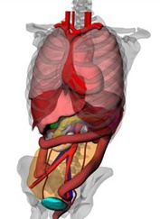
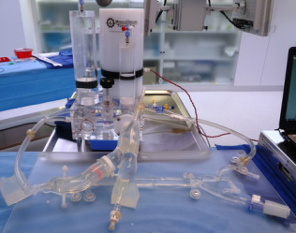
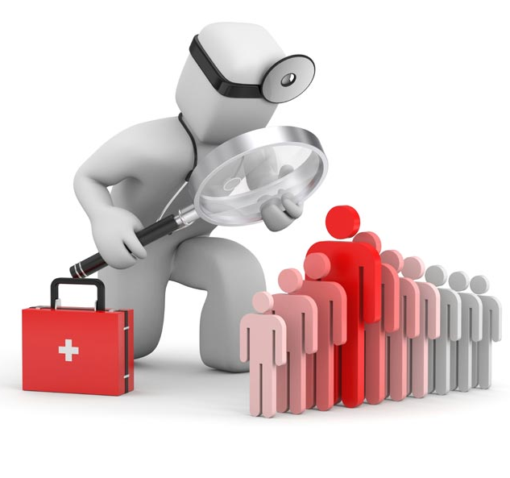
What is a Model?
Model: a representation of a system, entity, phenomena, or process.
In vivo
(animals/humans)
In vitro
(laboratory)
In silico
(computer)
http://medicalimplanttestinglab.com/news.html
www.wakehealth.edu
Notes:
A model is representation of a system, entity, phenomena, or process, which could be a laboratory bench test, animal model (e.g., mouse) or computational model (e.g., of a human organ system). And we use all of these models, including the clinical trial, to evaluate medical products

Slide 11
Sources of Scientific Evidence
Computer
Human
Computer
Laboratory
Human
Animal
Animal
Laboratory
Today
Future
Notes:
Build on:
FDA Document: Guidance for the Use of Bayesian Statistics in Medical Device Clinical Trials
Integrate the virtual patient in clinical design
Augment using Bayesian methods
Maintain clinical endpoints with reduced sample size

Slide 12
Modeling and Simulation at FDA
Chemical
(Q)SAR
Quality by Design
Mechanistic
PBPK
PK/PD
Big Data
Statistical
Knowledge bases
Data Visualization
Physics
Acoustics
Fluid dynamics
Heat Transfer
Solid Mechanics
Electromagnetics
In vivo In vitro correlation
PK
Chemoinformatics
“-omics”
Next gen sequencing
Lumped parameters
Bayesian
Adaptive designs
Stochastic
Tipping point
Data mining
Optics
Systems Modeling
Data driven models
Risk assessment

Slide 13
M&S is a key source of scientific evidence
Launched FDA-wide Survey – February 2016
~ 2.6% of FDA’s workforce responded to the survey
Key Roles for M&S
1. Review and assess M&S submitted by external stakeholders in regulatory submissions
2. Develop M&S for regulatory decision making by internal stakeholders
3. Use M&S for regulatory decision making developed by others

Slide 14
Fda-wide working group
Modeling and Simulation

Slide 15
Who are we?
An FDA-wide working group on Modeling and Simulation sponsored by the Office of the Chief Scientist
Two (2) representatives from each product Center form the leadership circle
CBER | Ryan Ortega | Mark Walderhaug
CDER | Liang Zhao | Paul Schuette
CDRH | Tina Morrison | Pras Pathmanathan
CFSAN | Jane Van Doren | Patra Volarath
CTP | Antonio Paredes | Kausar Riaz Ahmed
CVM | Marilyn Martinez | Bipin Mistry
NCTR | Roger Perkins | Huixiao Hong

Slide 16
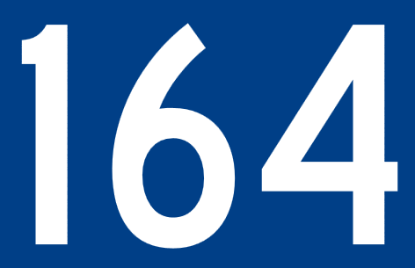
As of July 12, 2017 membership is:
Center Breakdown
Interest Groups

Slide 17
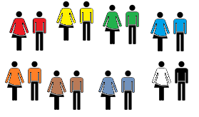
FDA Modeling and Simulation Working Group Sponsored by the Office of the Chief Scientist Fall 2016
Key Objectives:
Raise awareness of the successes, challenges and opportunities for modeling and simulation to advance regulatory science at the FDA;
Create an environment for enhanced communication and coordination on cross-cutting modeling and simulation efforts at FDA;
Establish credibility principles for modeling and simulation used for research and regulatory decision-making; and
Liaise with national and international organizations pursuing similar activities.
Leadership
Interest Groups
Implementation Teams
Knowledge/
Big Data
Risk
Assessment
Communication Plan
FDA White Paper
Successes, Challenges and Opportunities in M&S
Credibility Principles
Chemical
Mechanistic
Physics
Statistical

Slide 18
Timeline of Activities
Launched survey – February 2016
Presentation to Senior Science Council – May 2016
Charter signed – September 2016
Hosted Breakout Sessions at Scientific Computing Days – September 2016
Nominations for members of the leadership circle – Winter 2016
Inaugural Meeting for Leadership Circle – February 7, 2017

Slide 19
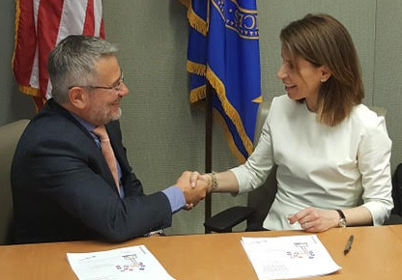
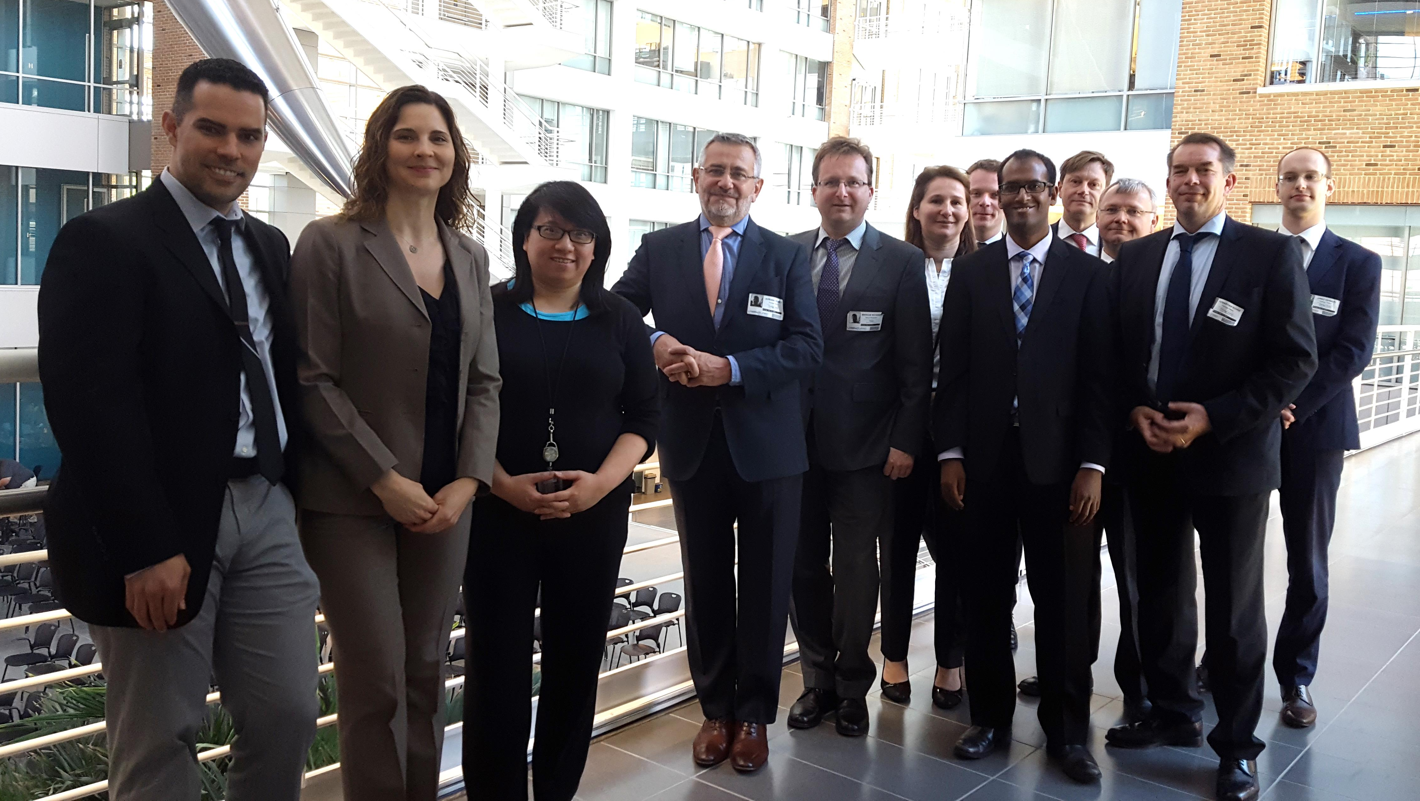
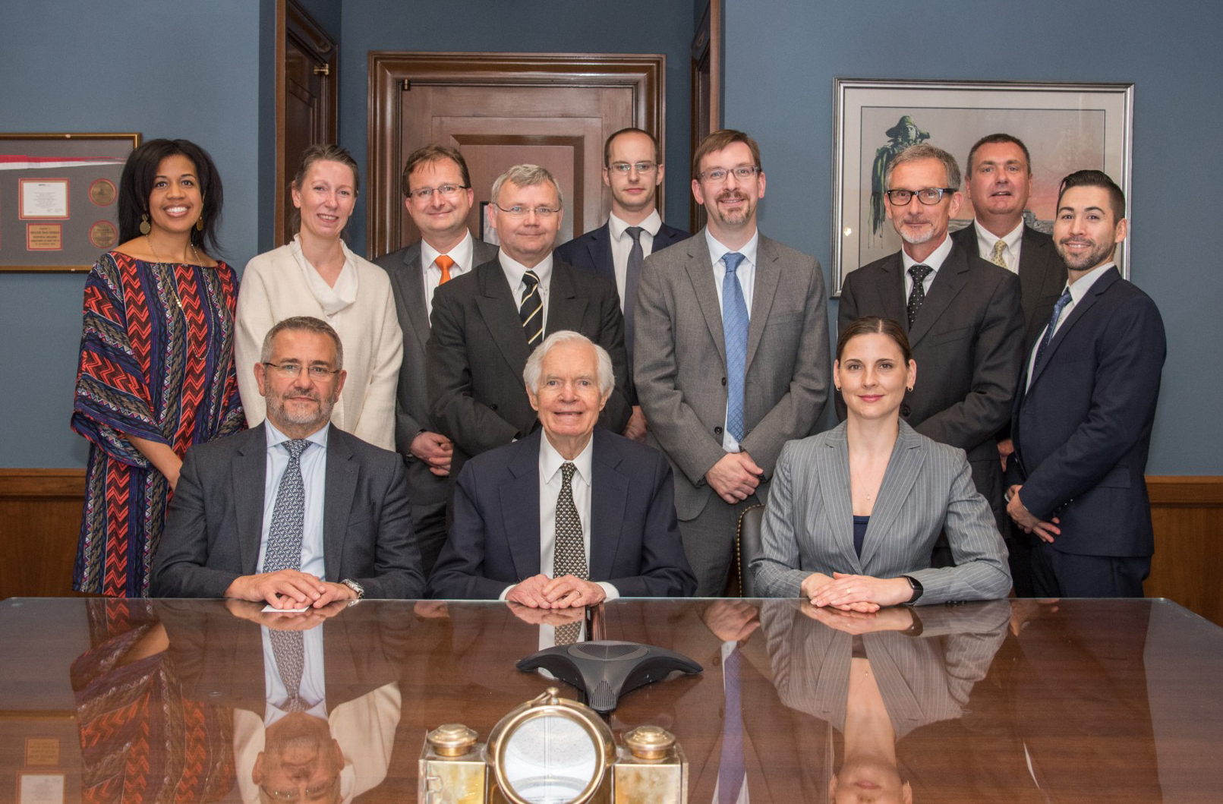
Timeline of Activities – cont’d
Hosted Avicenna Alliance – May 15, 2017
Signed an MOU with Dr. Borio
Meeting with Senator Cochran and Staff – May 17, 2017
FDA Science Forum M&S Session – June 1, 2017
Inaugural Meeting for the working group – TODAY!
Scientific Computing Days – September 2017

Slide 20
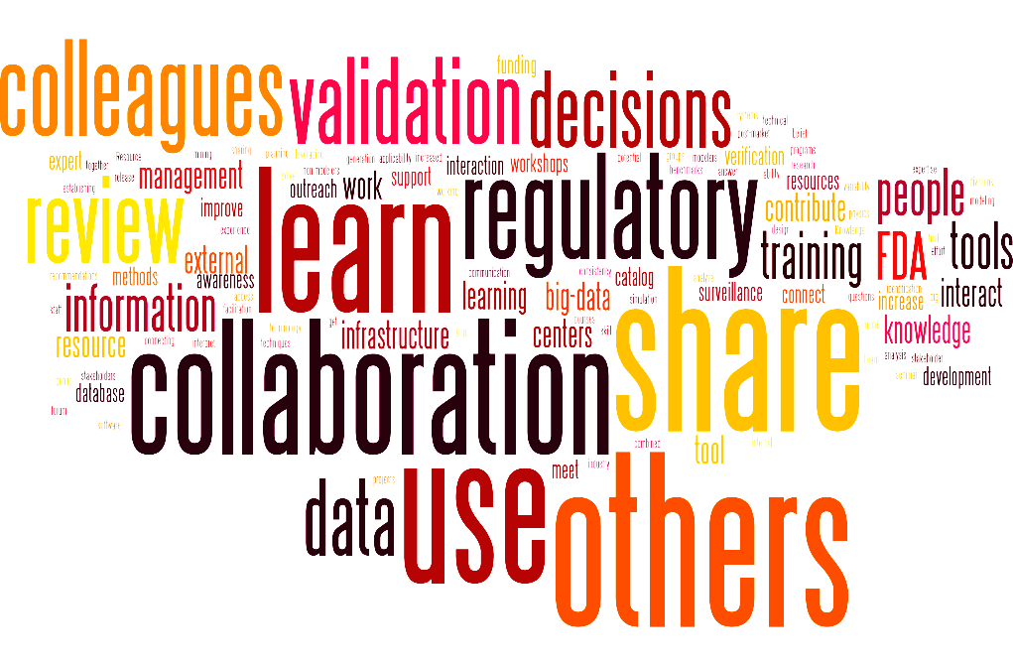
http://sharepoint.fda.gov/orgs/OC-OCS/ORSI/ModSimWG

Slide 22
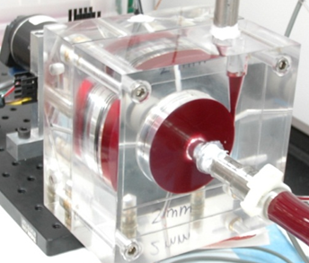
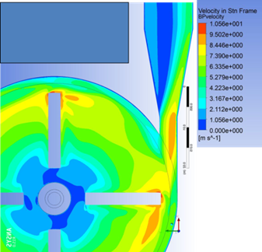
Each model has its strengths and limitations for predicting clinical outcomes, or other aspects of performance¹.
Model’s ability to represent aspects of device performance
Good
Fair
Poor
Animal
Bench
Clinical Trial
Computer
Predict clinical outcomes relevant to patients
Predict in vivo performance of the device
Predict in vivo safety of the device
Predict performance beyond IFU
Represent disease state
Adaptable for patient specificity
Predict performance with few assumptions
Maintain experimental control
Ability to vary parameters
Cost
Time
[1] Morrison et al., J Med Devices 2017

